Slide 1
Architecture
On-premise Cluster
Container
Repository
A
Submit Jobs and
transfer data (put)
Client
qsub
Compute Node
Cloud
Object
Storage
Download
Agent
Put data
Shared Storage
Container
Repository
B
Bucket & Object Layout
(per user)
Fetch Jobs and Data (get)
job_bucket
Job0/
Job2/
Agent
qsub
Download
Compute Node
Software
Repository
A
Job1/
data_bucket
Put data
Shared Storage
Any data used by jobs
Cloud, Supercomputer

Slide 2
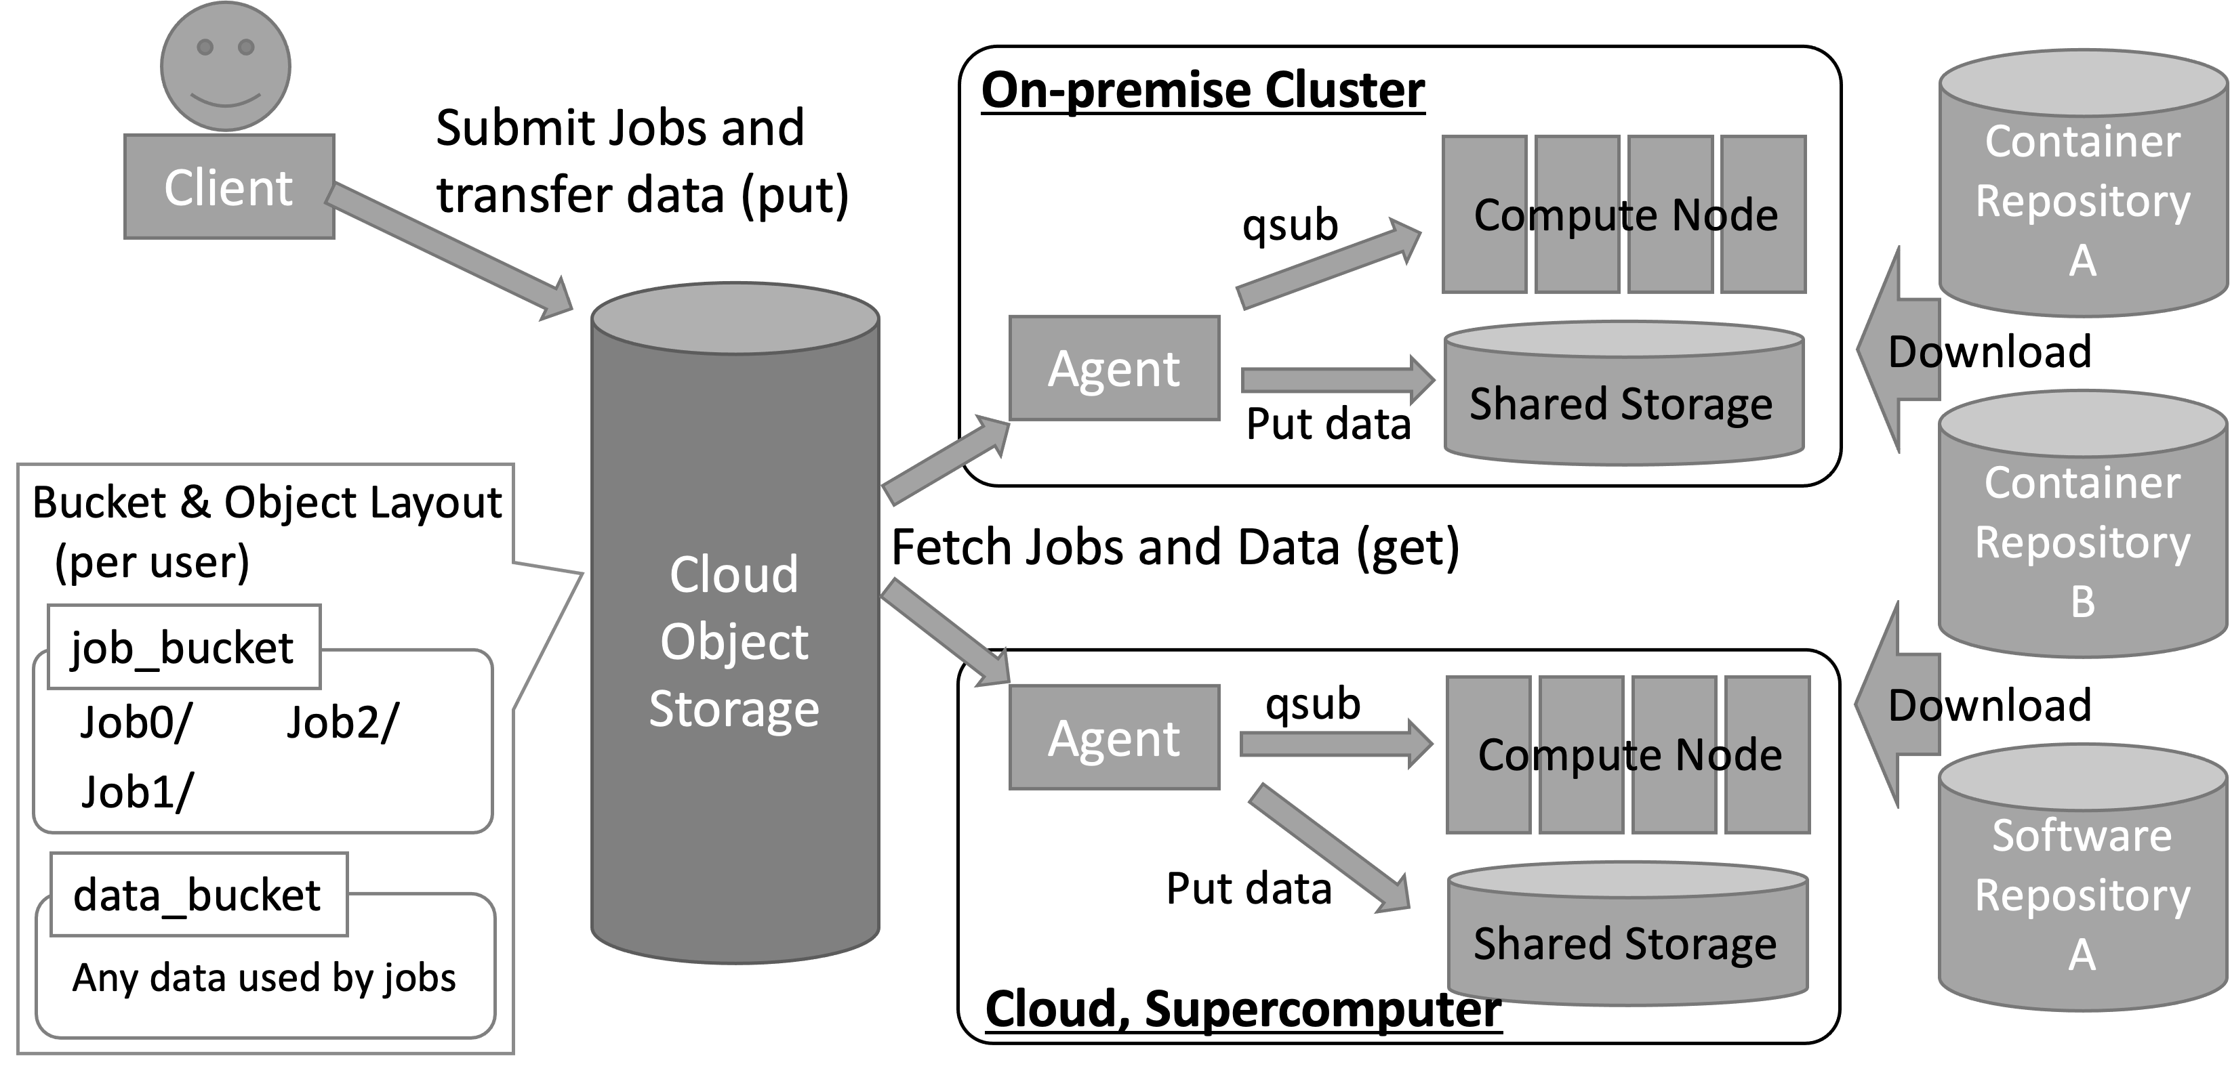
Setup on ABCI
Your PC
ABCI Cloud Storage
ABCI

Slide 3
Setup on AWS
Your PC
AWS S3
AWS

Slide 4
Setup on ABCI & AWS
Your PC
ABCI Cloud Storage
ABCI
AWS

