Slide 1
Jquery
Basics

Slide 2
Enevnts
Onclick
On hover

Slide 3
JQuery methods
html()
css()
attr()
apend()
prepend()
hide()
remove()

Slide 4
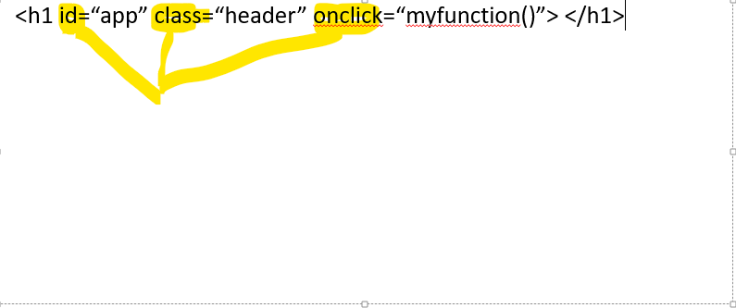
Attrebute
<h1 id=“app” class=“header” onclick=“myfunction()”> </h1>

Slide 5
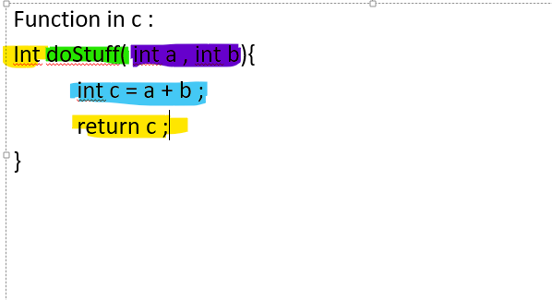
Function
Function in c :
Int doStuff( int a , int b){
int c = a + b ;
return c ;
}

Slide 6
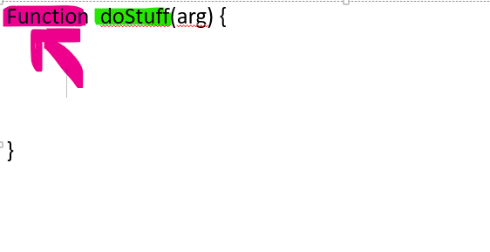
Function in JS / JQuery
Function doStuff(arg) {
}

Slide 7
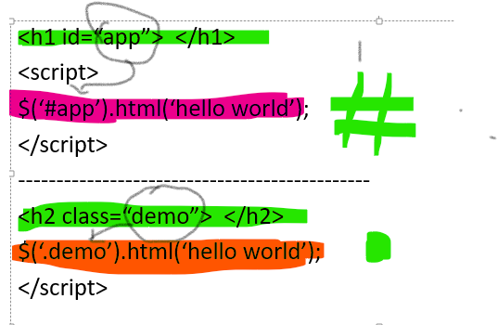
Selector
<h1 id=“app”> </h1>
<script>
$(‘#app’).html(‘hello world’);
</script>
----------------------------------------------
<h2 class=“demo”> </h2>
$(‘.demo’).html(‘hello world’);
</script>

