Slide 1
Notes On Throughput
Mike Goodrich, Eric Mercer
TJ Gledhill, Robert Ivie, Jared Moore
Brigham Young University

Slide 2
Simulator
Simulator
Process Transitions
Go to next Time Step
Actor 1
Actor 2
Actor 3

Slide 3
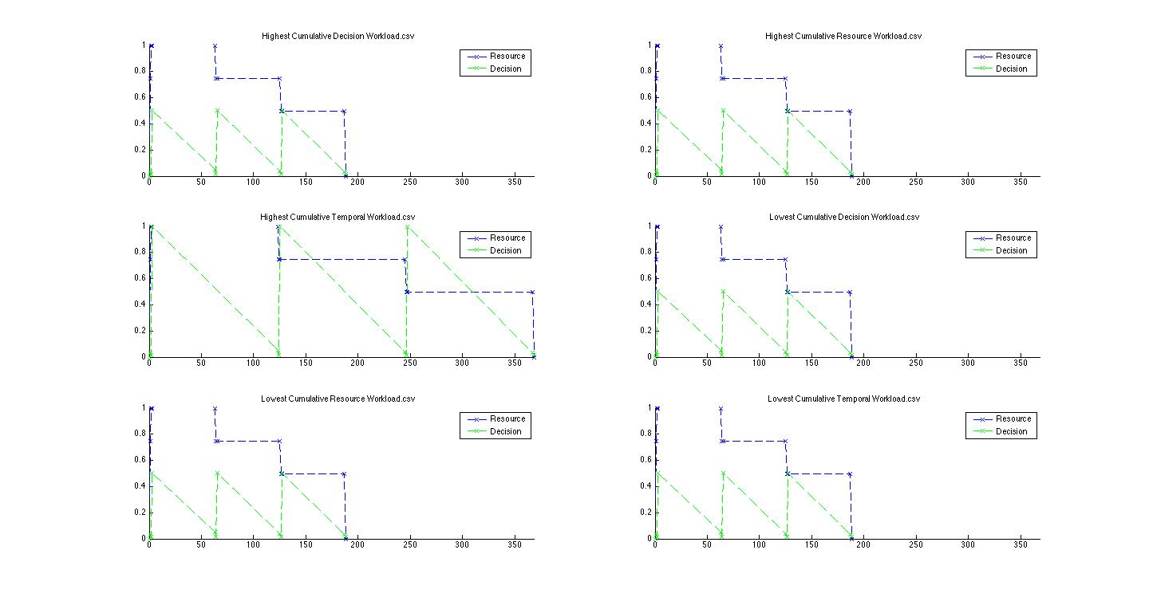
Results

Slide 4
Interactive Plotting

Slide 5
Interactive Plotting

Slide 6
Interactive Plotting

Slide 7
Understanding Anomalies

