Slide 1
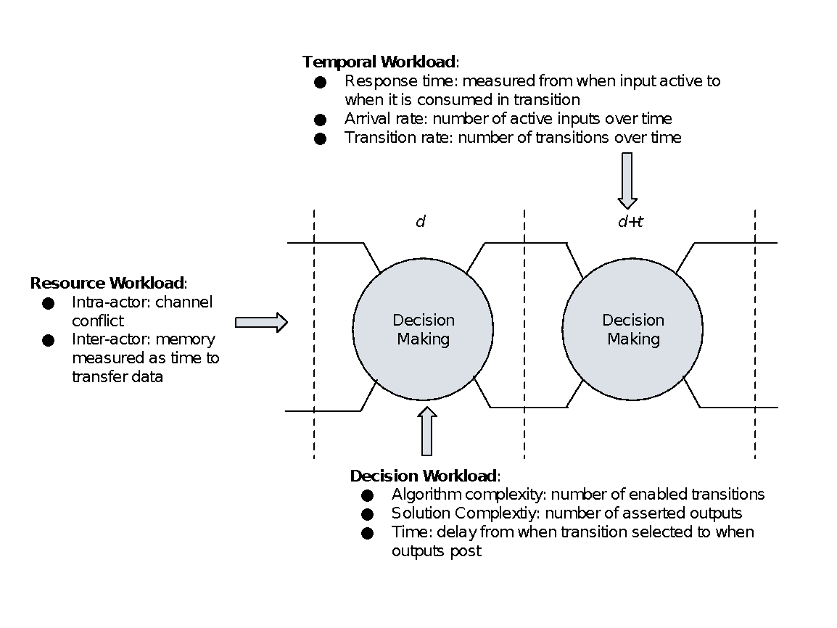
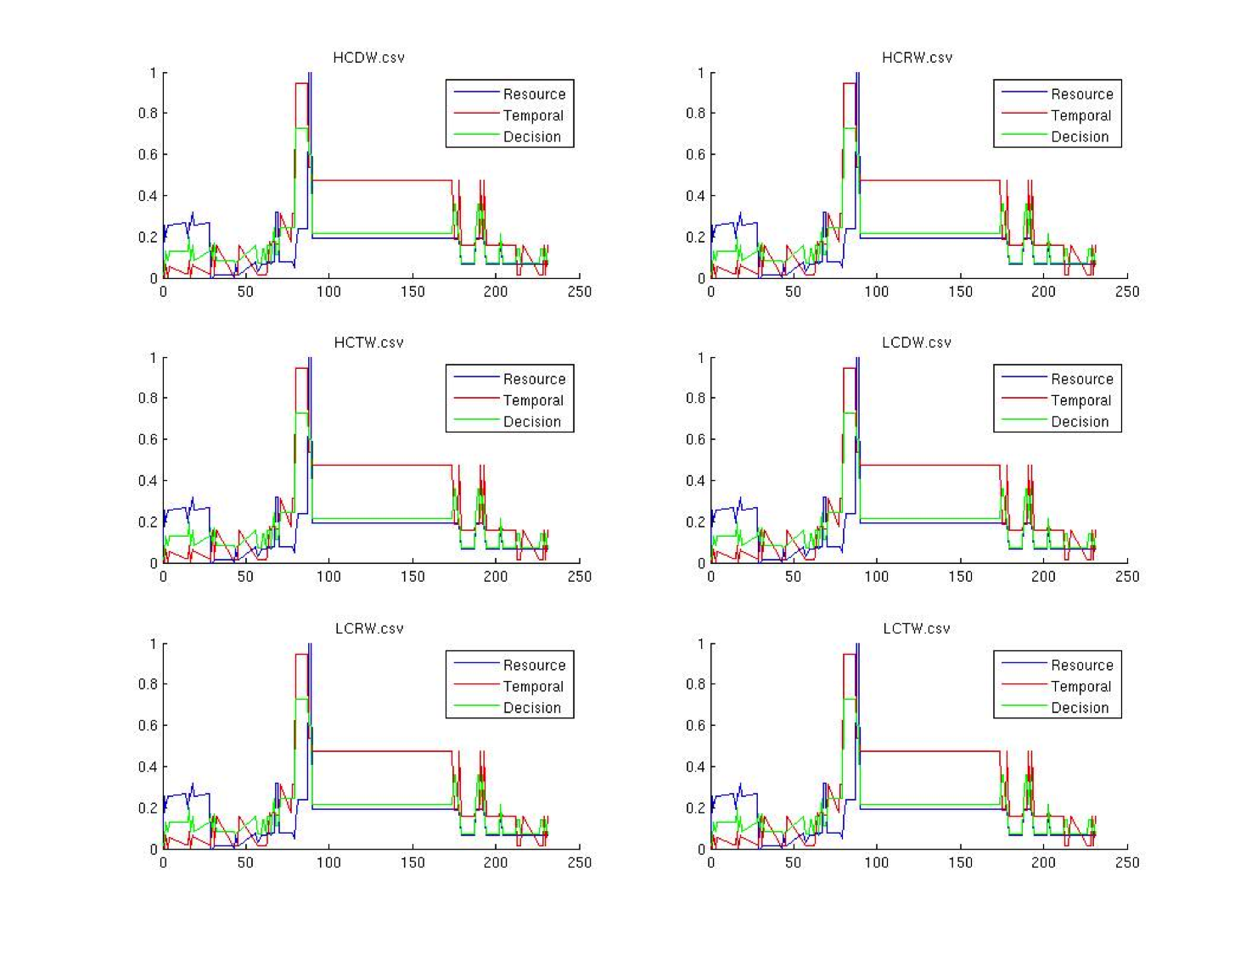
Modeling Workload
Metrics
Models
Simulator
Temporal Workload
Many Models
Resource Workload
Java Pathfinder
Decision Workload
Non-Deterministic Model
Swim Lanes
Results

