Slide 1
UAS Role Fusion
Mike Goodrich, Eric Mercer
TJ Gledhill, Robert Ivie, Jared Moore
Brigham Young University

Slide 2
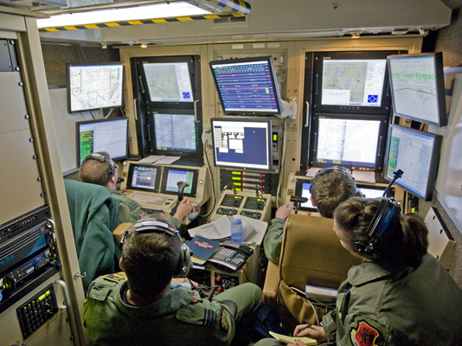

Slide 3
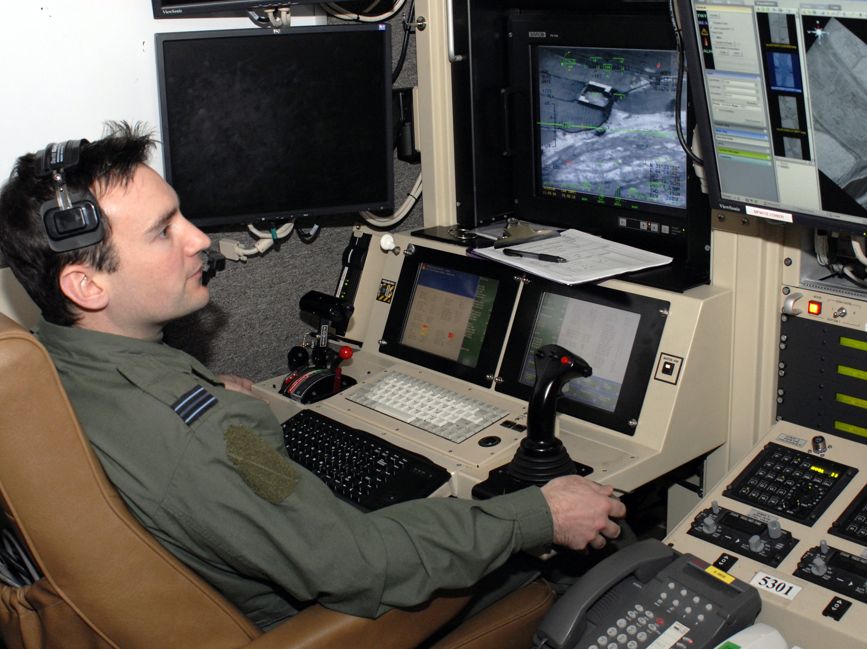

Slide 4
Role Fusion
How can we reduce the number of operators within an unmanned aerial system such that the new system is equally effective?
Through forming and measuring models of prospective systems we can find an effective system with fewer operators.

Slide 5
Directed Team Graph
Visual
Bob
Audio
Alice
Visual
Audio
Notes:
Everything schedules on the event simulator.

Slide 6
Discrete Event Simulator
Visual
Bob
Audio
Alice
Visual
Audio
Events
Update on Event
Events
Discrete Event
Simulator
Notes:
Everything schedules on the event simulator.

Slide 7
Directed Role Graph
Memory
DESIRE = 10
Vo
Bob
Ao
c1
Vi
IDLE
WAVE
Ai
c2
c4
c3
SPEAK
Notes:
Everything schedules on the event simulator.

Slide 8
Tabular Form
PS | INPUT | MEM | NS | OUTPUT | MEM | Pr | Delay | Pb
IDLE |  | DESIRE>5 | WAVE | Vo=WAVE |  |  | [2-5] | 95%
IDLE |  | DESIRE<=5 | IDLE |  | DESIRE++ |  | [5-10]
WAVE | Vi=WAVE |  | SPEAK | Ao=HELLO | DESIRE++ | 1 | [2-5]
WAVE |  |  | IDLE | Vo=SAD | DESIRE-- | 2 | [5-10]
SPEAK | Ai=HELLO |  | IDLE |  | DESIRE-- |  | [2-5]
PS | INPUT | MEM | NS | OUTPUT | MEM | Pr | Delay | Pb
IDLE | Vi=WAVE | APATHY<5 | WAVE | Vo=WAVE |  |  | [2-5] | 70%
IDLE | Vi=WAVE | APATHY>=5 | IDLE |  | APATHY-- |  | [2-5]
WAVE | Ai=HELLO |  | IDLE | Ao=HELLO | APATHY++ | 1 | [2-5]
Notes:
Add non-determinism in the enabled events in each actor so they have a choice. That models decisions workload.
All enabled transitions are sent to the simulator. It resolves the choice on priority first, and the coin-flip if tie (or order of appearance in the table)’
If you post the same transition, then the simulator sticks with it. If you post a new transition, then the simulator replaces your scheduled transition with the new transition.
You can create models which loop infinitely without firing any transition (zeno or shrondingers cat problem)

Slide 9
DESIRE = 5
APATHY = 5
PS
Bob
V_{o}
A_{o}
PS
Alice
V_{o}
A_{o}
PS | INPUT | MEM | NS | OUTPUT | MEM | Pr | Delay | Pb
IDLE |  | DESIRE>5 | WAVE | Vo=WAVE |  |  | [2-5] | 95%
IDLE |  | DESIRE<=5 | IDLE |  | DESIRE++ |  | [5-10]

Slide 10
DESIRE = 5
APATHY = 5
PS
IDLE
Bob
V_{o}
A_{o}
PS
Alice
V_{o}
A_{o}
PS | INPUT | MEM | NS | OUTPUT | MEM | Pr | Delay | Pb
IDLE |  | DESIRE<=5 | IDLE |  | DESIRE++ |  | [5-10]

Slide 11
DESIRE = 6
APATHY = 5
PS
IDLE
Bob
V_{o}
A_{o}
PS
IDLE
Alice
V_{o}
A_{o}

Slide 12
DESIRE = 6
APATHY = 5
PS
IDLE
Bob
V_{o}
A_{o}
PS
IDLE
Alice
V_{o}
A_{o}
PS | INPUT | MEM | NS | OUTPUT | MEM | Pr | Delay | Pb
IDLE |  | DESIRE>5 | WAVE | Vo=WAVE |  |  | [2-5] | 95%
IDLE |  | DESIRE<=5 | IDLE |  | DESIRE++ |  | [5-10]

Slide 13
DESIRE = 6
APATHY = 5
PS
IDLE
Bob
V_{o}
A_{o}
PS
IDLE
Alice
V_{o}
A_{o}
PS | INPUT | MEM | NS | OUTPUT | MEM | Pr | Delay | Pb
IDLE |  | DESIRE>5 | WAVE | Vo=WAVE |  |  | [2-5] | 95%

Slide 14
DESIRE = 6
APATHY = 5
PS
IDLE
Bob
V_{o}
A_{o}
PS
IDLE
Alice
V_{o}
A_{o}

Slide 15
DESIRE = 6
APATHY= 5
PS
IDLE
WAVE
Bob
V_{o}
WAVE
A_{o}
PS
IDLE
Alice
V_{o}
A_{o}
PS | INPUT | MEM | NS | OUTPUT | MEM | Pr | Delay | Pb
WAVE | Vi=WAVE |  | SPEAK | Ao=HELLO | DESIRE++ | 1 | [2-5]
WAVE |  |  | IDLE | Vo=SAD | DESIRE-- | 2 | [5-10]

Slide 16
DESIRE = 6
APATHY= 5
PS
IDLE
WAVE
Bob
V_{o}
WAVE
A_{o}
PS
IDLE
Alice
V_{o}
A_{o}
PS | INPUT | MEM | NS | OUTPUT | MEM | Pr | Delay | Pb
IDLE | Vi=WAVE | APATHY<5 | WAVE | Vo=WAVE |  |  | [2-5] | 70%
IDLE | Vi=WAVE | APATHY>=5 | IDLE |  | APATHY-- |  | [2-5]

Slide 17
DESIRE = 6
APATHY= 4
PS
IDLE
WAVE
Bob
V_{o}
WAVE
A_{o}
PS
IDLE
Alice
V_{o}
A_{o}

Slide 18
DESIRE = 6
APATHY= 4
PS
IDLE
WAVE
Bob
V_{o}
WAVE
A_{o}
PS
IDLE
Alice
V_{o}
A_{o}
PS | INPUT | MEM | NS | OUTPUT | MEM | Pr | Delay | Pb
WAVE | Vi=WAVE |  | SPEAK | Ao=HELLO | DESIRE++ | 1 | [2-5]
WAVE |  |  | IDLE | Vo=SAD | DESIRE-- | 2 | [5-10]

Slide 19
DESIRE = 6
APATHY= 4
PS
IDLE
WAVE
Bob
V_{o}
WAVE
A_{o}
PS
IDLE
Alice
V_{o}
A_{o}
PS | INPUT | MEM | NS | OUTPUT | MEM | Pr | Delay | Pb
IDLE | Vi=WAVE | APATHY<5 | WAVE | Vo=WAVE |  |  | [2-5] | 70%
IDLE | Vi=WAVE | APATHY>=5 | IDLE |  | APATHY-- |  | [2-5]

Slide 20
DESIRE = 6
APATHY= 4
PS
IDLE
WAVE
Bob
V_{o}
WAVE
A_{o}
PS
IDLE
Alice
V_{o}
A_{o}
PS | INPUT | MEM | NS | OUTPUT | MEM | Pr | Delay | Pb
IDLE | Vi=WAVE | APATHY<5 | WAVE | Vo=WAVE |  |  | [2-5] | 70%
IDLE | Vi=WAVE | APATHY>=5 | IDLE |  | APATHY-- |  | [2-5]

Slide 21
DESIRE = 6
APATHY= 4
PS
IDLE
WAVE
Bob
V_{o}
WAVE
A_{o}
PS
IDLE
Alice
V_{o}
A_{o}

Slide 22
DESIRE = 6
APATHY= 4
PS
IDLE
WAVE
Bob
V_{o}
WAVE
A_{o}
PS
IDLE
Alice
V_{o}
A_{o}
PS | INPUT | MEM | NS | OUTPUT | MEM | Pr | Delay | Pb
WAVE | Vi=WAVE |  | SPEAK | Ao=HELLO | DESIRE++ | 1 | [2-5]
WAVE |  |  | IDLE | Vo=SAD | DESIRE-- | 2 | [5-10]

Slide 23
DESIRE = 6
APATHY= 4
PS
IDLE
WAVE
Bob
V_{o}
WAVE
A_{o}
PS
IDLE
Alice
V_{o}
A_{o}
PS | INPUT | MEM | NS | OUTPUT | MEM | Pr | Delay | Pb
WAVE | Vi=WAVE |  | SPEAK | Ao=HELLO | DESIRE++ | 1 | [2-5]
WAVE |  |  | IDLE | Vo=SAD | DESIRE-- | 2 | [5-10]

Slide 24
DESIRE = 6
APATHY= 4
PS
IDLE
WAVE
Bob
V_{o}
WAVE
A_{o}
PS
IDLE
Alice
V_{o}
A_{o}
PS | INPUT | MEM | NS | OUTPUT | MEM | Pr | Delay | Pb
WAVE | Ai=HELLO |  | IDLE | Ao=HELLO | APATHY++ | 1 | [2-5]

Slide 25
DESIRE = 6
APATHY= 4
PS
IDLE
WAVE
Bob
V_{o}
WAVE
A_{o}
PS
IDLE
WA
Alice
V_{o}
WA
A_{o}

Slide 26
DESIRE = 5
APATHY= 4
PS
IDLE
WAVE
SPEAK
Bob
V_{o}
WAVE
A_{o}
HELLO
PS
IDLE
WAVE
IDLE
Alice
V_{o}
WAVE
A_{o}
HELLO
PS | INPUT | MEM | NS | OUTPUT | MEM | Pr | Delay | Pb
IDLE | Vi=WAVE | APATHY<5 | WAVE | Vo=WAVE |  |  | [2-5] | 70%
IDLE | Vi=WAVE | APATHY>=5 | IDLE |  | APATHY-- |  | [2-5]

Slide 27
DESIRE = 5
APATHY= 4
PS
IDLE
WAVE
SPEAK
Bob
V_{o}
WAVE
A_{o}
HELLO
PS
IDLE
WAVE
IDLE
Alice
V_{o}
WAVE
A_{o}
HELLO

Slide 28
Tabular Form
(IDLE,[],[BOB_HI_ALICE=TRUE],2,10,1.0)
x(TELL_ALICE,[V=BOB_REQUEST_ALICE],[])
(TELL_ALICE,[],[],2,10,1.0)
x(IDLE,[A=BOB_HI_ALICE],[BOB_HI_ALICE=FALSE])
<Alice.jtr>
(IDLE,[V=BOB_REQUEST_ALICE],[],2,10,1.0)
x(RECEIVE_BOB,[V=ALICE_ACKNOWLEGE_BOB],[])
(RECEIVE_BOB,[A=BOB_HI_ALICE],[],2,10,1.0)
x(IDLE,[],[BOB_HI_ALICE=TRUE])
Notes:
Add non-determinism in the enabled events in each actor so they have a choice. That models decisions workload.

Slide 29
Model Language and Semantics
<Bob.jtr>
(IDLE,[],[BOB_HI_ALICE=TRUE],2,10,1.0)
x(TELL_ALICE,[V=BOB_REQUEST_ALICE],[])
(TELL_ALICE,[],[],2,10,1.0)
x(IDLE,[A=BOB_HI_ALICE],[BOB_HI_ALICE=FALSE])
<Alice.jtr>
(IDLE,[V=BOB_REQUEST_ALICE],[],2,10,1.0)
x(RECEIVE_BOB,[V=ALICE_ACKNOWLEGE_BOB],[])
(RECEIVE_BOB,[A=BOB_HI_ALICE],[],2,10,1.0)
x(IDLE,[],[BOB_HI_ALICE=TRUE])
State

Slide 30
Model Language and Semantics
<Bob.jtr>
(IDLE,[],[BOB_HI_ALICE=TRUE],2,10,1.0)
x(TELL_ALICE,[V=BOB_REQUEST_ALICE],[])
(TELL_ALICE,[],[],2,10,1.0)
x(IDLE,[A=BOB_HI_ALICE],[BOB_HI_ALICE=FALSE])
<Alice.jtr>
(IDLE,[V=BOB_REQUEST_ALICE],[],2,10,1.0)
x(RECEIVE_BOB,[V=ALICE_ACKNOWLEGE_BOB],[])
(RECEIVE_BOB,[A=BOB_HI_ALICE],[],2,10,1.0)
x(IDLE,[],[BOB_HI_ALICE=TRUE])
Output
Memory
Input

Slide 31
Model Language and Semantics
<Bob.jtr>
(IDLE,[],[BOB_HI_ALICE=TRUE],2,10,1.0)
x(TELL_ALICE,[V=BOB_REQUEST_ALICE],[])
(TELL_ALICE,[],[],2,10,1.0)
x(IDLE,[A=BOB_HI_ALICE],[BOB_HI_ALICE=FALSE])
<Alice.jtr>
(IDLE,[V=BOB_REQUEST_ALICE],[],2,10,1.0)
x(RECEIVE_BOB,[V=ALICE_ACKNOWLEGE_BOB],[])
(RECEIVE_BOB,[A=BOB_HI_ALICE],[],2,10,1.0)
x(IDLE,[],[BOB_HI_ALICE=TRUE])
Probability
Priority
Duration

Slide 32
Simulation (0 Seconds)
<Bob.jtr>
(IDLE,[],[BOB_HI_ALICE=TRUE],2,10,1.0)
x(TELL_ALICE,[V=BOB_REQUEST_ALICE],[])
(TELL_ALICE,[],[],2,10,1.0)
x(IDLE,[A=BOB_HI_ALICE],[BOB_HI_ALICE=FALSE])
<Alice.jtr>
(IDLE,[V=BOB_REQUEST_ALICE],[],2,10,1.0)
x(RECEIVE_BOB,[V=ALICE_ACKNOWLEGE_BOB],[])
(RECEIVE_BOB,[A=BOB_HI_ALICE],[],2,10,1.0)
x(IDLE,[],[BOB_HI_ALICE=TRUE])
Hi.

Slide 33
Simulation (10 Seconds)
<Bob.jtr>
(IDLE,[],[BOB_HI_ALICE=TRUE],2,10,1.0)
x(TELL_ALICE,[V=BOB_REQUEST_ALICE],[])
(TELL_ALICE,[],[],2,10,1.0)
x(IDLE,[A=BOB_HI_ALICE],[BOB_HI_ALICE=FALSE])
<Alice.jtr>
(IDLE,[V=BOB_REQUEST_ALICE],[],2,10,1.0)
x(RECEIVE_BOB,[V=ALICE_ACKNOWLEGE_BOB],[])
(RECEIVE_BOB,[A=BOB_HI_ALICE],[],2,10,1.0)
x(IDLE,[],[BOB_HI_ALICE=TRUE])

Slide 34
Simulation (20 Seconds)
<Bob.jtr>
(IDLE,[],[BOB_HI_ALICE=TRUE],2,10,1.0)
x(TELL_ALICE,[V=BOB_REQUEST_ALICE],[])
(TELL_ALICE,[],[],2,10,1.0)
x(IDLE,[A=BOB_HI_ALICE],[BOB_HI_ALICE=FALSE])
<Alice.jtr>
(IDLE,[V=BOB_REQUEST_ALICE],[],2,10,1.0)
x(RECEIVE_BOB,[V=ALICE_ACKNOWLEGE_BOB],[])
(RECEIVE_BOB,[A=BOB_HI_ALICE],[],2,10,1.0)
x(IDLE,[],[BOB_HI_ALICE=TRUE])

Slide 35
Simulation (30 Seconds)
<Bob.jtr>
(IDLE,[],[BOB_HI_ALICE=TRUE],2,10,1.0)
x(TELL_ALICE,[V=BOB_REQUEST_ALICE],[])
(TELL_ALICE,[],[],2,10,1.0)
x(IDLE,[A=BOB_HI_ALICE],[BOB_HI_ALICE=FALSE])
<Alice.jtr>
(IDLE,[V=BOB_REQUEST_ALICE],[],2,10,1.0)
x(RECEIVE_BOB,[V=ALICE_ACKNOWLEGE_BOB],[])
(RECEIVE_BOB,[A=BOB_HI_ALICE],[],2,10,1.0)
x(IDLE,[],[BOB_HI_ALICE=TRUE])
Hi.

Slide 36
Simulation (40 Seconds)
<Bob.jtr>
(IDLE,[],[BOB_HI_ALICE=TRUE],2,10,1.0)
x(TELL_ALICE,[V=BOB_REQUEST_ALICE],[])
(TELL_ALICE,[],[],2,10,1.0)
x(IDLE,[A=BOB_HI_ALICE],[BOB_HI_ALICE=FALSE])
<Alice.jtr>
(IDLE,[V=BOB_REQUEST_ALICE],[],2,10,1.0)
x(RECEIVE_BOB,[V=ALICE_ACKNOWLEGE_BOB],[])
(RECEIVE_BOB,[A=BOB_HI_ALICE],[],2,10,1.0)
x(IDLE,[],[BOB_HI_ALICE=TRUE])
Hi.

Slide 37
Workload Related Measurements

Slide 38
UAS Team Diagram
4
4
4
4
Parent Search
Mission Manager
Payload Operator
Payload
GUI
UAV
4
4
4
4
4
4
4
4
4
UAV Operator
UAV
GUI
4
4
4
Notes:
Add visual and input connection on MM to Payload GUI. All of the actors is A and V only. Add DATA channel between Payload GUI and UAV Gui.
Add visual channel to UAV operator and UAV. Add data channels between GUIs and UAV.

Slide 39
Operator Actor
(IDLE,[A=MM_POKE_OP],[],3,NEXT,1.0)
X(RX_MM,[A=OP_ACK_MM],[])
(IDLE,[A=VO_POKE_OP],[],2,NEXT,1.0)
X(RX_VO,[A=OP_ACK_VO],[])
(IDLE,[A=VO_POKE_OP,A=MM_POKE_OP],[],4,NEXT,1.0)
X(RX_MM,[A=OP_ACK_MM,A=OP_BUSY_VO],[])
(IDLE,[V!=UAV_LANDED_OP],[],1,NEXT,1.0)
X(OBSERVING_OGUI,[],[])
(IDLE,[V=UAV_LANDED_OP],[],1,NEXT,1.0)
X(POST_FLIGHT,[D=OP_POST_FLIGHT_UAV],[])
…
Notes:
Actors vary by system size, Currently our actor contains nearly 200 transitions.

Slide 40
Model Statistics
Actor Name | Number of States | Number of Transitions
Parent Search | 5 | 19
Mission Manager | 16 | 56
Payload Operator | 13 | 45
UAV Operator | 13 | 80
Payload GUI | 2 | 35
UAV GUI | 2 | 27
UAV | 6 | 42

Slide 41
Workload Related Measurements
Simple Scenario

Slide 42
Robustness and Non-Determinism
Many Models
Java Pathfinder
Non-Deterministic Model

