Slide 1
UAS Role Fusion
Mike Goodrich, Eric Mercer
TJ Gledhill, Robert Ivie, Jared Moore
Brigham Young University

Slide 2
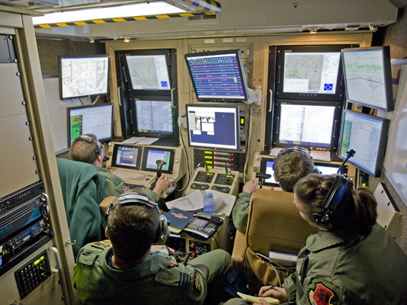

Slide 3
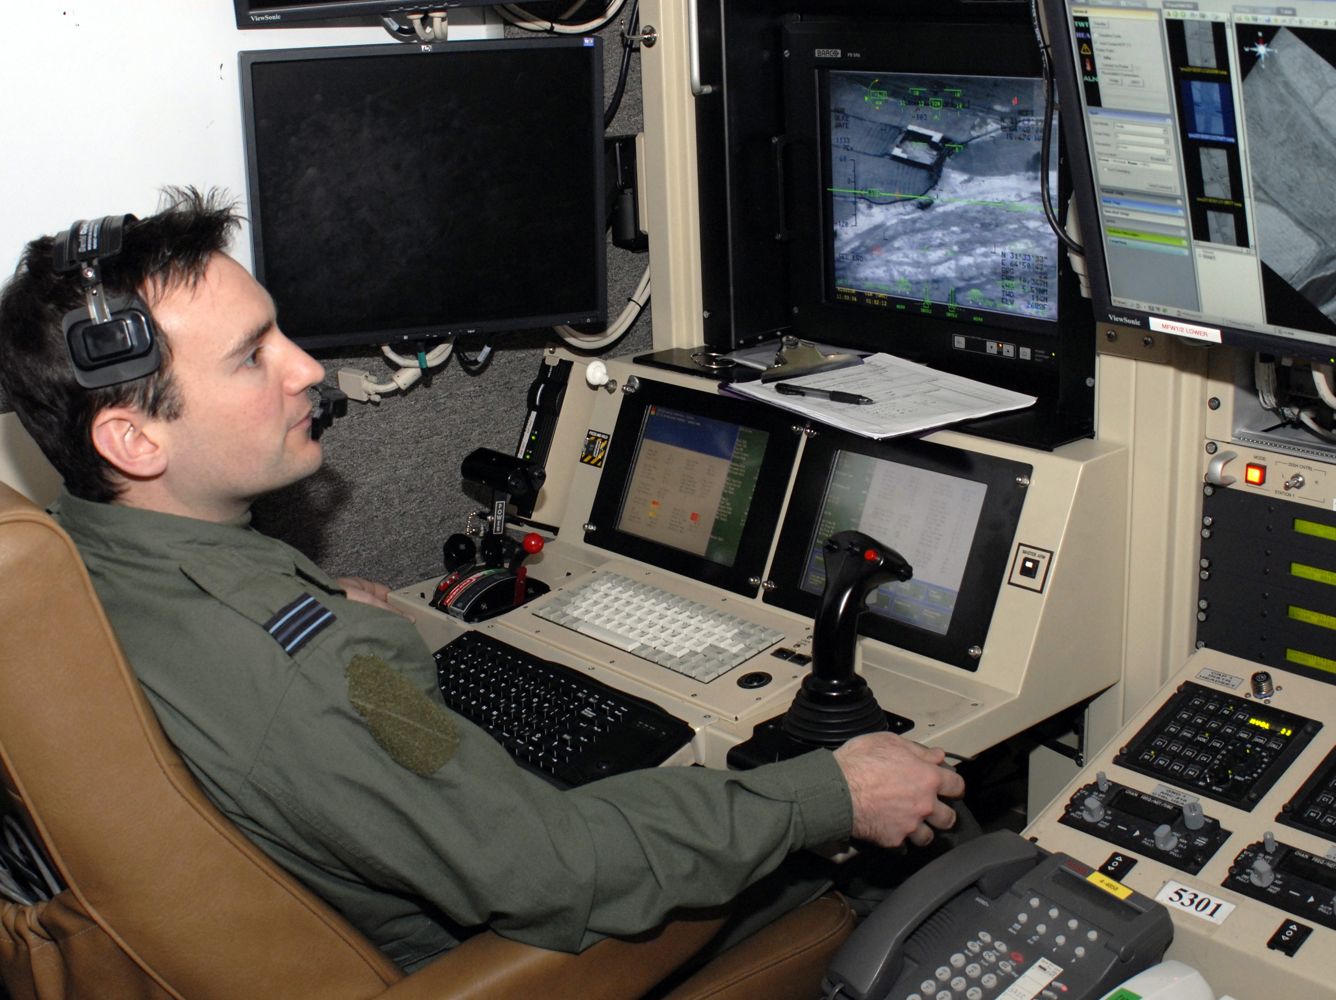

Slide 4
Role Fusion
How can we reduce the number of operators within an unmanned aerial system such that the new system is equally effective?
Through forming and measuring models of prospective systems we can find an effective system with fewer operators.

Slide 5
Team Diagram
Audio
Audio
Bob
Simulator
Alice
Visual
Visual
Haptic
Haptic
Data
Data
Audio
Audio
Visual
Visual
Haptic
Haptic
Data
Data

Slide 6
Reduced Team Diagram
Bob
4
Alice
4

Slide 7
Actor Objects
<Bob.jtr>
(IDLE,[],[BOB_HI_ALICE=TRUE],2,10,1.0)
x(TELL_ALICE,[V=BOB_REQUEST_ALICE],[])
(TELL_ALICE,[],[],2,10,1.0)
x(IDLE,[A=BOB_HI_ALICE],[BOB_HI_ALICE=FALSE])
<Alice.jtr>
(IDLE,[V=BOB_REQUEST_ALICE],[],2,10,1.0)
x(RECEIVE_BOB,[V=ALICE_ACKNOWLEGE_BOB],[])
(RECEIVE_BOB,[A=BOB_HI_ALICE],[],2,10,1.0)
x(IDLE,[],[BOB_HI_ALICE=TRUE])

Slide 8
Model Language and Semantics
<Bob.jtr>
(IDLE,[],[BOB_HI_ALICE=TRUE],2,10,1.0)
x(TELL_ALICE,[V=BOB_REQUEST_ALICE],[])
(TELL_ALICE,[],[],2,10,1.0)
x(IDLE,[A=BOB_HI_ALICE],[BOB_HI_ALICE=FALSE])
<Alice.jtr>
(IDLE,[V=BOB_REQUEST_ALICE],[],2,10,1.0)
x(RECEIVE_BOB,[V=ALICE_ACKNOWLEGE_BOB],[])
(RECEIVE_BOB,[A=BOB_HI_ALICE],[],2,10,1.0)
x(IDLE,[],[BOB_HI_ALICE=TRUE])
State

Slide 9
Model Language and Semantics
<Bob.jtr>
(IDLE,[],[BOB_HI_ALICE=TRUE],2,10,1.0)
x(TELL_ALICE,[V=BOB_REQUEST_ALICE],[])
(TELL_ALICE,[],[],2,10,1.0)
x(IDLE,[A=BOB_HI_ALICE],[BOB_HI_ALICE=FALSE])
<Alice.jtr>
(IDLE,[V=BOB_REQUEST_ALICE],[],2,10,1.0)
x(RECEIVE_BOB,[V=ALICE_ACKNOWLEGE_BOB],[])
(RECEIVE_BOB,[A=BOB_HI_ALICE],[],2,10,1.0)
x(IDLE,[],[BOB_HI_ALICE=TRUE])
Output
Memory
Input

Slide 10
Model Language and Semantics
<Bob.jtr>
(IDLE,[],[BOB_HI_ALICE=TRUE],2,10,1.0)
x(TELL_ALICE,[V=BOB_REQUEST_ALICE],[])
(TELL_ALICE,[],[],2,10,1.0)
x(IDLE,[A=BOB_HI_ALICE],[BOB_HI_ALICE=FALSE])
<Alice.jtr>
(IDLE,[V=BOB_REQUEST_ALICE],[],2,10,1.0)
x(RECEIVE_BOB,[V=ALICE_ACKNOWLEGE_BOB],[])
(RECEIVE_BOB,[A=BOB_HI_ALICE],[],2,10,1.0)
x(IDLE,[],[BOB_HI_ALICE=TRUE])
Probability
Priority
Duration

Slide 11
Simulation (0 Seconds)
<Bob.jtr>
(IDLE,[],[BOB_HI_ALICE=TRUE],2,10,1.0)
x(TELL_ALICE,[V=BOB_REQUEST_ALICE],[])
(TELL_ALICE,[],[],2,10,1.0)
x(IDLE,[A=BOB_HI_ALICE],[BOB_HI_ALICE=FALSE])
<Alice.jtr>
(IDLE,[V=BOB_REQUEST_ALICE],[],2,10,1.0)
x(RECEIVE_BOB,[V=ALICE_ACKNOWLEGE_BOB],[])
(RECEIVE_BOB,[A=BOB_HI_ALICE],[],2,10,1.0)
x(IDLE,[],[BOB_HI_ALICE=TRUE])
Hi.

Slide 12
Simulation (10 Seconds)
<Bob.jtr>
(IDLE,[],[BOB_HI_ALICE=TRUE],2,10,1.0)
x(TELL_ALICE,[V=BOB_REQUEST_ALICE],[])
(TELL_ALICE,[],[],2,10,1.0)
x(IDLE,[A=BOB_HI_ALICE],[BOB_HI_ALICE=FALSE])
<Alice.jtr>
(IDLE,[V=BOB_REQUEST_ALICE],[],2,10,1.0)
x(RECEIVE_BOB,[V=ALICE_ACKNOWLEGE_BOB],[])
(RECEIVE_BOB,[A=BOB_HI_ALICE],[],2,10,1.0)
x(IDLE,[],[BOB_HI_ALICE=TRUE])

Slide 13
Simulation (20 Seconds)
<Bob.jtr>
(IDLE,[],[BOB_HI_ALICE=TRUE],2,10,1.0)
x(TELL_ALICE,[V=BOB_REQUEST_ALICE],[])
(TELL_ALICE,[],[],2,10,1.0)
x(IDLE,[A=BOB_HI_ALICE],[BOB_HI_ALICE=FALSE])
<Alice.jtr>
(IDLE,[V=BOB_REQUEST_ALICE],[],2,10,1.0)
x(RECEIVE_BOB,[V=ALICE_ACKNOWLEGE_BOB],[])
(RECEIVE_BOB,[A=BOB_HI_ALICE],[],2,10,1.0)
x(IDLE,[],[BOB_HI_ALICE=TRUE])

Slide 14
Simulation (30 Seconds)
<Bob.jtr>
(IDLE,[],[BOB_HI_ALICE=TRUE],2,10,1.0)
x(TELL_ALICE,[V=BOB_REQUEST_ALICE],[])
(TELL_ALICE,[],[],2,10,1.0)
x(IDLE,[A=BOB_HI_ALICE],[BOB_HI_ALICE=FALSE])
<Alice.jtr>
(IDLE,[V=BOB_REQUEST_ALICE],[],2,10,1.0)
x(RECEIVE_BOB,[V=ALICE_ACKNOWLEGE_BOB],[])
(RECEIVE_BOB,[A=BOB_HI_ALICE],[],2,10,1.0)
x(IDLE,[],[BOB_HI_ALICE=TRUE])
Hi.

Slide 15
Simulation (40 Seconds)
<Bob.jtr>
(IDLE,[],[BOB_HI_ALICE=TRUE],2,10,1.0)
x(TELL_ALICE,[V=BOB_REQUEST_ALICE],[])
(TELL_ALICE,[],[],2,10,1.0)
x(IDLE,[A=BOB_HI_ALICE],[BOB_HI_ALICE=FALSE])
<Alice.jtr>
(IDLE,[V=BOB_REQUEST_ALICE],[],2,10,1.0)
x(RECEIVE_BOB,[V=ALICE_ACKNOWLEGE_BOB],[])
(RECEIVE_BOB,[A=BOB_HI_ALICE],[],2,10,1.0)
x(IDLE,[],[BOB_HI_ALICE=TRUE])
Hi.

Slide 16
Workload Related Measurements

Slide 17
UAS Team Diagram
4
4
4
4
Parent Search
Mission Manager
Payload Operator
Payload
GUI
UAV
4
4
4
4
4
4
4
4
4
4
4
UAV Operator
UAV
GUI
4
4
4

Slide 18
Operator Actor
(IDLE,[A=MM_POKE_OP],[],3,NEXT,1.0)
X(RX_MM,[A=OP_ACK_MM],[])
(IDLE,[A=VO_POKE_OP],[],2,NEXT,1.0)
X(RX_VO,[A=OP_ACK_VO],[])
(IDLE,[A=VO_POKE_OP,A=MM_POKE_OP],[],4,NEXT,1.0)
X(RX_MM,[A=OP_ACK_MM,A=OP_BUSY_VO],[])
(IDLE,[V!=UAV_LANDED_OP],[],1,NEXT,1.0)
X(OBSERVING_OGUI,[],[])
(IDLE,[V=UAV_LANDED_OP],[],1,NEXT,1.0)
X(POST_FLIGHT,[D=OP_POST_FLIGHT_UAV],[])
…
Notes:
Actors vary by system size, Currently our actor contains nearly 200 transitions.

Slide 19
Model Statistics
Actor Name | Number of States | Number of Transitions
Parent Search | 5 | 19
Mission Manager | 16 | 56
Payload Operator | 13 | 45
UAV Operator | 13 | 80
Payload GUI | 2 | 35
UAV GUI | 2 | 27
UAV | 6 | 42

Slide 20
Workload Related Measurements
Simple Scenario

Slide 21
Robustness and Non-Determinism
Many Models
Java Pathfinder
Non-Deterministic Model

