Slide 1
Modeling Workload
Mike Goodrich, Eric Mercer
TJ Gledhill, Robert Ivie, Jared Moore
Brigham Young University
Notes:
Today I’m going to talk about Modeling Workload.

Slide 2
Simulator
Simulator
Process Transitions
Go to next Time Step
Actor 1
Actor 2
Actor 3
Notes:
The first step to measuring workload is to create a simulator that is capable of processing an arbitrary number of actors in parallel. We then extract specific data from that actors that correspond to our workload metrics. Finally we run the simulator through a modeling program that finds us the maximum and minimum workloads and outputs it to a plot.

Slide 3
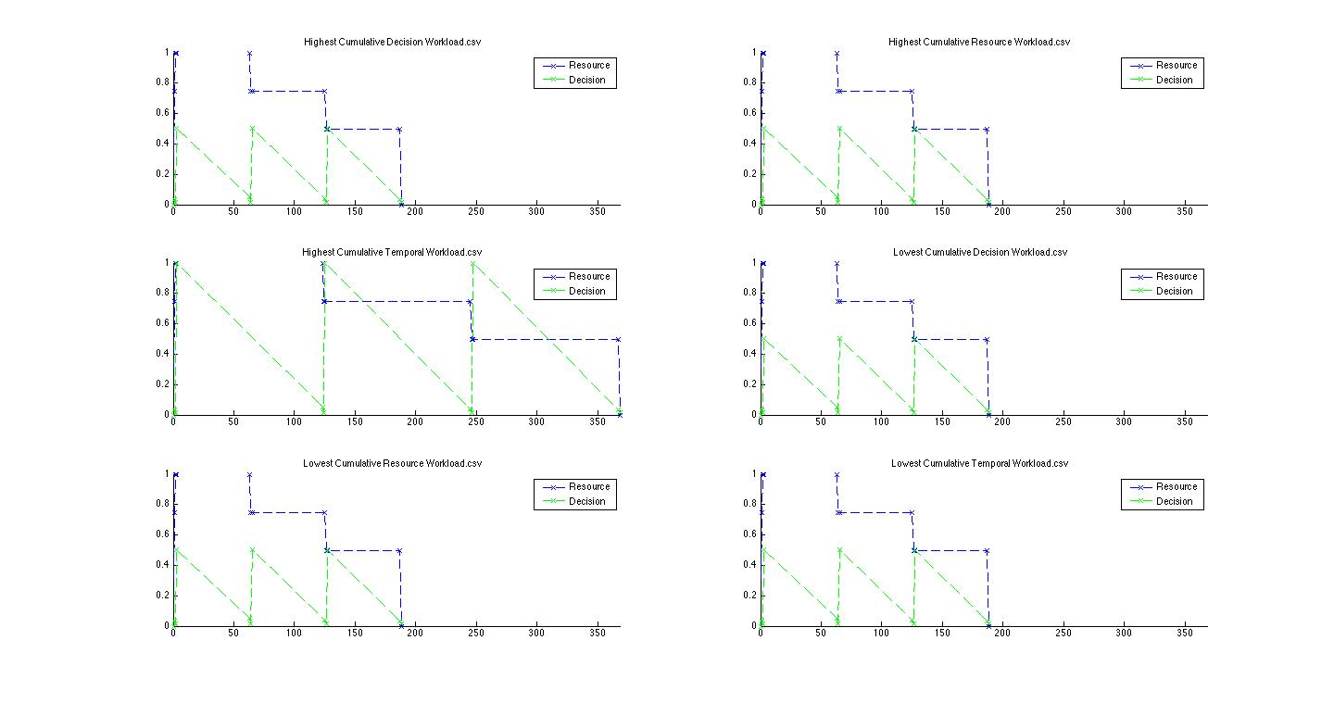
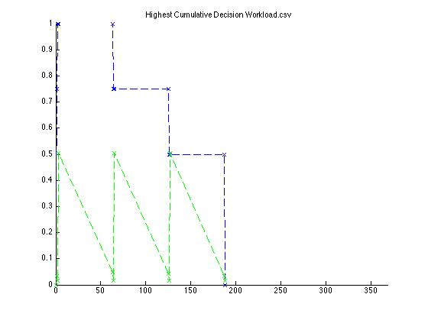
Results
Highest Cumulative Resource Workload
Resource Workload
Decision Workload
Notes:
Here you can see we’ve created a simple scenario where 3 actors have a piece of information they wish to share with the fourth actor. This plot shows the path taken to get our highest cumulative resource workload.

Slide 4
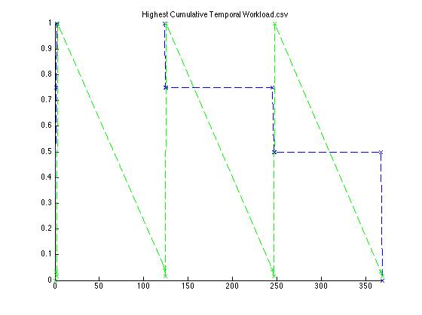
Results
Highest Cumulative Decision Workload
Resource Workload
Decision Workload
Notes:
Whereas this plot shows us the path of our highest decision workload. However in order to get all the information we need from these plots we need an interactive system that lets us see what is going on in each of the actors to give us the data we’re looking at.

Slide 5
Interactive Plotting
Highest Cumulative Decision Workload
Decision Workload
Resource Workload
Notes:
So we created a system that lets us click on any point in the plot and see a list of the tasks in progress by each of the actors. Here you can see that three of the actors have determined they have information they wish to transmit while the fourth actor has chosen to listen to one of them.

Slide 6
Interactive Plotting
Highest Cumulative Decision Workload
Resource Workload
Decision Workload
Notes:
And so we see that each dropped plane in the resource workload is evidence by the completion of one of the communications.

Slide 7
Interactive Plotting
Highest Cumulative Decision Workload
Decision Workload
Resource Workload
Notes:
The reason knowing the cause of the workload is so critical to our research is because we are attempting to devise a system that is able to handle complex tasks while avoiding exessive strain on the people involved. In order to do this we need to create protocols that maintain an optimum level of workload. As you can see there are two sharp drops in workload just between communications.

Slide 8
Understanding Anomalies
Highest Cumulative Decision Workload
Decision Workload
Resource Workload
Notes:
By clicking on that specific point we’re able to see that a communication appears in the process of ending. The Operator has finished sharing data, but the listener hasn’t yet acknoledged the process is over. We can verify this by looking at a previous section.

Slide 9
Understanding Anomalies
Highest Cumulative Decision Workload
Decision Workload
Resource Workload
Notes:
With this system of data analysis we have the tools necessary to look at any system and examine the workload each member is experiencing and deterimine if the system is safe and what protocols need to be adjusted to increase reliable behaviour.

