Slide 1
UAS Role Fusion
Mike Goodrich, Eric Mercer
TJ Gledhill, Robert Ivie, Jared Moore
Brigham Young University

Slide 2
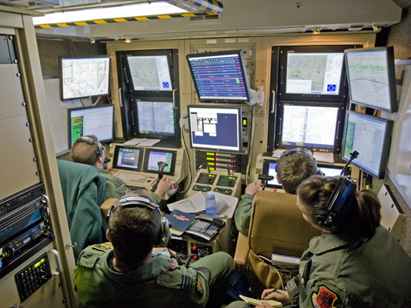

Slide 3
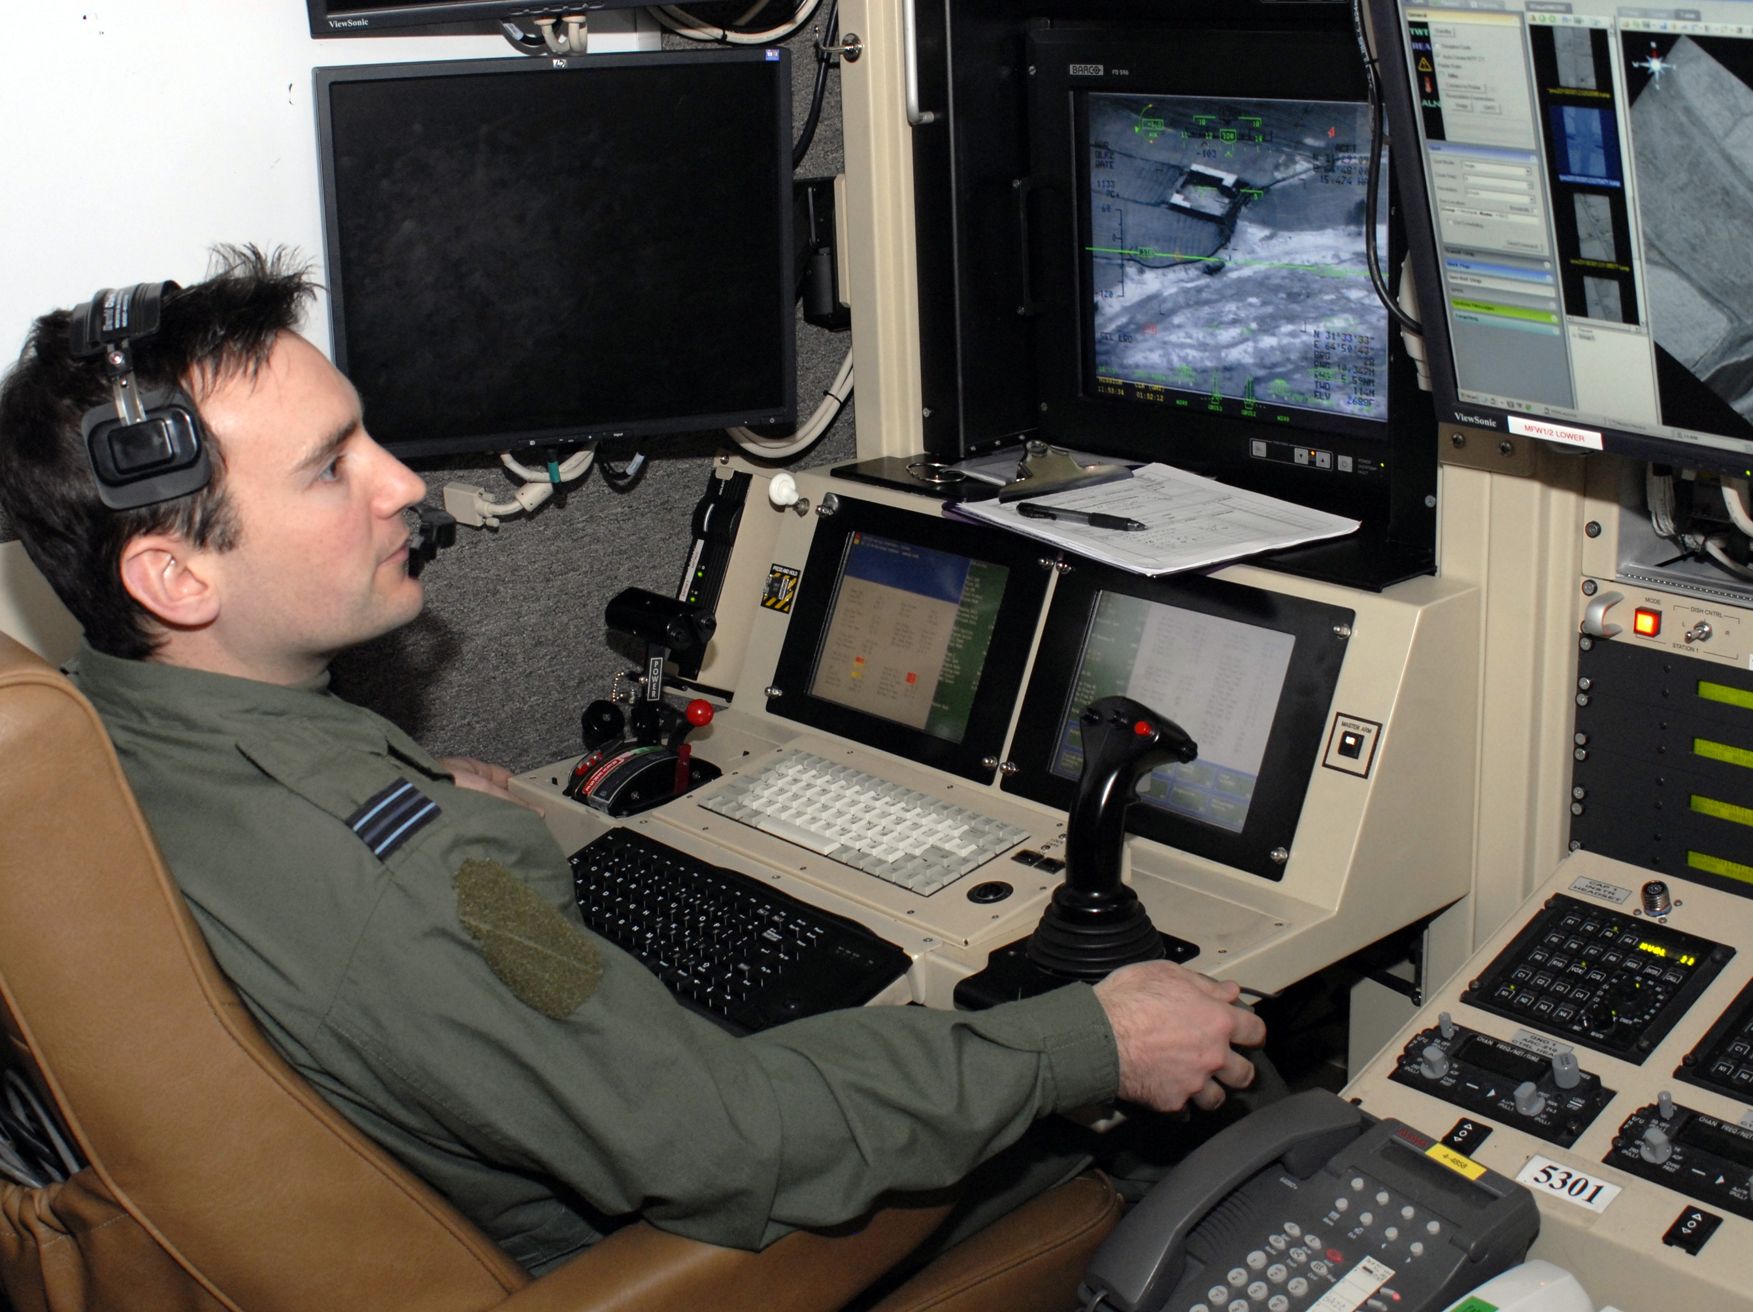

Slide 4
How can we reduce the number of operators and manage workload through better interfaces and increased autonomy?

Slide 5
Directed Team Graph
Visual
Bob
Audio
Alice
Visual
Audio
Notes:
Everything schedules on the event simulator.

Slide 6
Discrete Event Simulator
Visual
Bob
Audio
Alice
Visual
Audio
Events
Update on Event
Events
Discrete Event
Simulator
Notes:
Everything schedules on the event simulator.

Slide 7
Directed Role Graph
Memory
DESIRE = 10
Vo
Bob
Ao
c1
Vi
IDLE
WAVE
Ai
c2
c4
c3
SPEAK
Notes:
Everything schedules on the event simulator.

Slide 8
Tabular Form
PS | INPUT | MEM | NS | OUTPUT | MEM | Pr | Delay | Pb
IDLE |  | DESIRE>5 | WAVE | Vo=WAVE |  |  | [2-5] | 95%
IDLE |  | DESIRE<=5 | IDLE |  | DESIRE++ |  | [5-10]
WAVE | Vi=WAVE |  | SPEAK | Ao=HELLO | DESIRE++ | 1 | [2-5]
WAVE |  |  | IDLE | Vo=SAD | DESIRE-- | 2 | [5-10]
SPEAK | Ai=HELLO |  | IDLE |  | DESIRE-- |  | [2-5]
PS | INPUT | MEM | NS | OUTPUT | MEM | Pr | Delay | Pb
IDLE | Vi=WAVE | APATHY<5 | WAVE | Vo=WAVE |  |  | [2-5] | 70%
IDLE | Vi=WAVE | APATHY>=5 | IDLE |  | APATHY-- |  | [2-5]
WAVE | Ai=HELLO |  | IDLE | Ao=HELLO | APATHY++ | 1 | [2-5]
Notes:
Add non-determinism in the enabled events in each actor so they have a choice. That models decisions workload.
All enabled transitions are sent to the simulator. It resolves the choice on priority first, and the coin-flip if tie (or order of appearance in the table)’
If you post the same transition, then the simulator sticks with it. If you post a new transition, then the simulator replaces your scheduled transition with the new transition.
You can create models which loop infinitely without firing any transition (zeno or shrondingers cat problem)

Slide 9
DESIRE = 5
APATHY = 5
PS
IDLE
Bob
V_{o}
A_{o}
PS
IDLE
Alice
V_{o}
A_{o}
PS | INPUT | MEM | NS | OUTPUT | MEM | Pr | Delay | Pb
IDLE |  | DESIRE>5 | WAVE | Vo=WAVE |  |  | [2-5] | 95%
IDLE |  | DESIRE<=5 | IDLE |  | DESIRE++ |  | [5-10]

Slide 10
DESIRE = 5
APATHY = 5
PS
IDLE
IDLE
Bob
V_{o}
A_{o}
PS
IDLE
Alice
V_{o}
A_{o}
PS | INPUT | MEM | NS | OUTPUT | MEM | Pr | Delay | Pb
IDLE |  | DESIRE<=5 | IDLE |  | DESIRE++ |  | [5-10]

Slide 11
DESIRE = 5
APATHY = 5
PS
IDLE
IDLE
Bob
V_{o}
A_{o}
PS
IDLE
Alice
V_{o}
A_{o}
PS | INPUT | MEM | NS | OUTPUT | MEM | Pr | Delay | Pb
IDLE | Vi=WAVE | APATHY<5 | WAVE | Vo=WAVE |  |  | [2-5] | 70%
IDLE | Vi=WAVE | APATHY>=5 | IDLE |  | APATHY-- |  | [2-5]

Slide 12
DESIRE = 6
APATHY = 5
PS
IDLE
IDLE
Bob
V_{o}
A_{o}
PS
IDLE
Alice
V_{o}
A_{o}

Slide 13
DESIRE = 6
APATHY = 5
PS
IDLE
IDLE
Bob
V_{o}
A_{o}
PS
IDLE
Alice
V_{o}
A_{o}
PS | INPUT | MEM | NS | OUTPUT | MEM | Pr | Delay | Pb
IDLE |  | DESIRE>5 | WAVE | Vo=WAVE |  |  | [2-5] | 95%
IDLE |  | DESIRE<=5 | IDLE |  | DESIRE++ |  | [5-10]

Slide 14
DESIRE = 6
APATHY = 5
PS
IDLE
WAVE
Bob
V_{o}
WAVE
A_{o}
PS
IDLE
Alice
V_{o}
A_{o}
PS | INPUT | MEM | NS | OUTPUT | MEM | Pr | Delay | Pb
IDLE |  | DESIRE>5 | WAVE | Vo=WAVE |  |  | [2-5] | 95%

Slide 15
DESIRE = 6
APATHY = 5
PS
IDLE
WAVE
Bob
V_{o}
WAVE
A_{o}
PS
IDLE
Alice
V_{o}
A_{o}
PS | INPUT | MEM | NS | OUTPUT | MEM | Pr | Delay | Pb
IDLE | Vi=WAVE | APATHY<5 | WAVE | Vo=WAVE |  |  | [2-5] | 70%
IDLE | Vi=WAVE | APATHY>=5 | IDLE |  | APATHY-- |  | [2-5]

Slide 16
DESIRE = 6
APATHY = 5
PS
IDLE
WAVE
Bob
V_{o}
WAVE
A_{o}
PS
IDLE
Alice
V_{o}
A_{o}

Slide 17
DESIRE = 6
APATHY = 5
PS
IDLE
WAVE
Bob
V_{o}
WAVE
A_{o}
PS
IDLE
Alice
V_{o}
A_{o}
PS | INPUT | MEM | NS | OUTPUT | MEM | Pr | Delay | Pb
WAVE | Vi=WAVE |  | SPEAK | Ao=HELLO | DESIRE++ | 1 | [2-5]
WAVE |  |  | IDLE | Vo=SAD | DESIRE-- | 2 | [5-10]

Slide 18
DESIRE = 6
APATHY = 5
PS
IDLE
WAVE
IDLE
Bob
V_{o}
WAVE
SAD
A_{o}
PS
IDLE
Alice
V_{o}
A_{o}
PS | INPUT | MEM | NS | OUTPUT | MEM | Pr | Delay | Pb
WAVE | Vi=WAVE |  | SPEAK | Ao=HELLO | DESIRE++ | 1 | [2-5]
WAVE |  |  | IDLE | Vo=SAD | DESIRE-- | 2 | [5-10]

Slide 19
DESIRE = 6
APATHY = 5
PS
IDLE
WAVE
IDLE
Bob
V_{o}
WAVE
SAD
A_{o}
PS
IDLE
Alice
V_{o}
A_{o}
PS | INPUT | MEM | NS | OUTPUT | MEM | Pr | Delay | Pb
IDLE | Vi=WAVE | APATHY<5 | WAVE | Vo=WAVE |  |  | [2-5] | 70%
IDLE | Vi=WAVE | APATHY>=5 | IDLE |  | APATHY-- |  | [2-5]

Slide 20
DESIRE = 6
APATHY = 5
PS
IDLE
WAVE
IDLE
Bob
V_{o}
WAVE
SAD
A_{o}
PS
IDLE
IDLE
Alice
V_{o}
A_{o}
PS | INPUT | MEM | NS | OUTPUT | MEM | Pr | Delay | Pb
IDLE | Vi=WAVE | APATHY<5 | WAVE | Vo=WAVE |  |  | [2-5] | 70%
IDLE | Vi=WAVE | APATHY>=5 | IDLE |  | APATHY-- |  | [2-5]

Slide 21
DESIRE = 6
APATHY = 4
PS
IDLE
WAVE
IDLE
Bob
V_{o}
WAVE
SAD
A_{o}
PS
IDLE
IDLE
Alice
V_{o}
A_{o}

Slide 22
DESIRE = 6
APATHY = 4
PS
IDLE
WAVE
IDLE
Bob
V_{o}
WAVE
SAD
A_{o}
PS
IDLE
IDLE
Alice
V_{o}
A_{o}
PS | INPUT | MEM | NS | OUTPUT | MEM | Pr | Delay | Pb
WAVE | Vi=WAVE |  | SPEAK | Ao=HELLO | DESIRE++ | 1 | [2-5]
WAVE |  |  | IDLE | Vo=SAD | DESIRE-- | 2 | [5-10]

Slide 23
DESIRE = 6
APATHY = 4
PS
IDLE
WAVE
IDLE
Bob
V_{o}
WAVE
SAD
A_{o}
PS
IDLE
IDLE
Alice
V_{o}
A_{o}
PS | INPUT | MEM | NS | OUTPUT | MEM | Pr | Delay | Pb
IDLE | Vi=WAVE | APATHY<5 | WAVE | Vo=WAVE |  |  | [2-5] | 70%
IDLE | Vi=WAVE | APATHY>=5 | IDLE |  | APATHY-- |  | [2-5]

Slide 24
DESIRE = 6
APATHY = 4
PS
IDLE
WAVE
IDLE
Bob
V_{o}
WAVE
SAD
A_{o}
PS
IDLE
WAVE
Alice
V_{o}
WAVE
A_{o}
PS | INPUT | MEM | NS | OUTPUT | MEM | Pr | Delay | Pb
IDLE | Vi=WAVE | APATHY<5 | WAVE | Vo=WAVE |  |  | [2-5] | 70%
IDLE | Vi=WAVE | APATHY>=5 | IDLE |  | APATHY-- |  | [2-5]

Slide 25
DESIRE = 6
APATHY = 4
PS
IDLE
WAVE
IDLE
Bob
V_{o}
WAVE
SAD
A_{o}
PS
IDLE
WAVE
Alice
V_{o}
WAVE
A_{o}

Slide 26
DESIRE = 6
APATHY = 4
PS
IDLE
WAVE
IDLE
Bob
V_{o}
WAVE
SAD
A_{o}
PS
IDLE
WAVE
Alice
V_{o}
WAVE
A_{o}
PS | INPUT | MEM | NS | OUTPUT | MEM | Pr | Delay | Pb
WAVE | Vi=WAVE |  | SPEAK | Ao=HELLO | DESIRE++ | 1 | [2-5]
WAVE |  |  | IDLE | Vo=SAD | DESIRE-- | 2 | [5-10]

Slide 27
DESIRE = 6
APATHY = 4
PS
IDLE
WAVE
SPEAK
Bob
V_{o}
WAVE
A_{o}
HELLO
PS
IDLE
WAVE
Alice
V_{o}
WAVE
A_{o}
PS | INPUT | MEM | NS | OUTPUT | MEM | Pr | Delay | Pb
WAVE | Vi=WAVE |  | SPEAK | Ao=HELLO | DESIRE++ | 1 | [2-5]
WAVE |  |  | IDLE | Vo=SAD | DESIRE-- | 2 | [5-10]

Slide 28
DESIRE = 6
APATHY = 4
PS
IDLE
WAVE
SPEAK
Bob
V_{o}
WAVE
A_{o}
HELLO
PS
IDLE
WAVE
Alice
V_{o}
WAVE
A_{o}
PS | INPUT | MEM | NS | OUTPUT | MEM | Pr | Delay | Pb
WAVE | Ai=HELLO |  | IDLE | Ao=HELLO | APATHY++ | 1 | [2-5]

Slide 29
DESIRE = 6
APATHY = 4
PS
IDLE
WAVE
SPEAK
Bob
V_{o}
WAVE
A_{o}
HELLO
PS
IDLE
WA
Alice
V_{o}
WA
A_{o}

Slide 30
DESIRE = 6
APATHY = 4
PS
IDLE
WAVE
SPEAK
Bob
V_{o}
WAVE
A_{o}
HELLO
PS
IDLE
WA
Alice
V_{o}
WA
A_{o}
PS | INPUT | MEM | NS | OUTPUT | MEM | Pr | Delay | Pb
SPEAK | Ai=HELLO |  | IDLE |  | DESIRE-- |  | [2-5]

Slide 31
DESIRE = 6
APATHY = 4
PS
IDLE
WAVE
SPEAK
Bob
V_{o}
WAVE
A_{o}
HELLO
PS
IDLE
WA
Alice
V_{o}
WA
A_{o}
PS | INPUT | MEM | NS | OUTPUT | MEM | Pr | Delay | Pb
WAVE | Ai=HELLO |  | IDLE | Ao=HELLO | APATHY++ | 1 | [2-5]

Slide 32
DESIRE = 6
APATHY = 4
PS
IDLE
WAVE
SPEAK
Bob
V_{o}
WAVE
A_{o}
HELLO
PS
IDLE
WAVE
IDLE
Alice
V_{o}
WAVE
A_{o}
HELLO
PS | INPUT | MEM | NS | OUTPUT | MEM | Pr | Delay | Pb
WAVE | Ai=HELLO |  | IDLE | Ao=HELLO | APATHY++ | 1 | [2-5]

Slide 33
DESIRE = 6
APATHY = 5
PS
IDLE
WAVE
SPEAK
Bob
V_{o}
WAVE
A_{o}
HELLO
PS
IDLE
WAVE
IDLE
Alice
V_{o}
WAVE
A_{o}
HELLO

Slide 34
DESIRE = 6
APATHY = 5
PS
IDLE
WAVE
SPEAK
Bob
V_{o}
WAVE
A_{o}
HELLO
PS
IDLE
WAVE
IDLE
Alice
V_{o}
WAVE
A_{o}
HELLO
PS | INPUT | MEM | NS | OUTPUT | MEM | Pr | Delay | Pb
SPEAK | Ai=HELLO |  | IDLE |  | DESIRE-- |  | [2-5]

Slide 35
DESIRE = 6
APATHY = 5
PS
IDLE
WAVE
SPEAK
IDLE
Bob
V_{o}
WAVE
A_{o}
HELLO
PS
IDLE
WAVE
IDLE
Alice
V_{o}
WAVE
A_{o}
HELLO
PS | INPUT | MEM | NS | OUTPUT | MEM | Pr | Delay | Pb
SPEAK | Ai=HELLO |  | IDLE |  | DESIRE-- |  | [2-5]

Slide 36
DESIRE = 6
APATHY = 5
PS
IDLE
WAVE
SPEAK
IDLE
Bob
V_{o}
WAVE
A_{o}
HELLO
PS
IDLE
WAVE
IDLE
Alice
V_{o}
WAVE
A_{o}
HELLO
PS | INPUT | MEM | NS | OUTPUT | MEM | Pr | Delay | Pb
IDLE | Vi=WAVE | APATHY<5 | WAVE | Vo=WAVE |  |  | [2-5] | 70%
IDLE | Vi=WAVE | APATHY>=5 | IDLE |  | APATHY-- |  | [2-5]

Slide 37
DESIRE = 5
APATHY = 5
PS
IDLE
WAVE
SPEAK
IDLE
Bob
V_{o}
WAVE
A_{o}
HELLO
PS
IDLE
WAVE
IDLE
Alice
V_{o}
WAVE
A_{o}
HELLO

Slide 38
Workload
Temporal
Algorithmic
Cognitive

Slide 39
Workload
Temporal
Algorithmic
Cognitive
Notes:
Metaphor: job shop
Constraints: order, which comes first, deadlines
Operation Tempo: pacing and completion of tasks over time
Fan-out: task neglect and required interaction time

Slide 40
Temporal Workload in Model
PS
IDLE
WAVE
SPEAK
Bob
V_{o}
WAVE
A_{o}
HELLO
PS
IDLE
WAVE
IDLE
Alice
V_{o}
WAVE
A_{o}
HELLO
6 fired transitions
Notes:
Largely a measure of operation tempo: Sliding window that counts transitions

Slide 41
Temporal Workload in Model
PS
IDLE
WAVE
SPEAK
Bob
V_{o}
WAVE
A_{o}
HELLO
PS
IDLE
WAVE
IDLE
Alice
V_{o}
WAVE
A_{o}
HELLO
4 fired transitions
Notes:
Largely a measure of operation tempo: Sliding window that counts transitions

Slide 42
Temporal Workload in Model
PS
IDLE
WAVE
SPEAK
Bob
V_{o}
WAVE
A_{o}
HELLO
PS
IDLE
WAVE
IDLE
Alice
V_{o}
WAVE
A_{o}
HELLO
4 fired transitions
Notes:
Largely a measure of operation tempo: Sliding window that counts transitions

Slide 43
Temporal Workload in Model
PS
IDLE
WAVE
SPEAK
Bob
V_{o}
WAVE
A_{o}
HELLO
PS
IDLE
WAVE
IDLE
Alice
V_{o}
WAVE
A_{o}
HELLO
6 fired transitions
Notes:
Largely a measure of operation tempo: Sliding window that counts transitions

Slide 44
Temporal Workload in Model
PS
IDLE
WAVE
SPEAK
Bob
V_{o}
WAVE
A_{o}
HELLO
PS
IDLE
WAVE
IDLE
Alice
V_{o}
WAVE
A_{o}
HELLO
6 fired transitions
Notes:
Largely a measure of operation tempo: Sliding window that counts transitions

Slide 45
Temporal Workload in Model
PS
IDLE
WAVE
SPEAK
Bob
V_{o}
WAVE
A_{o}
HELLO
PS
IDLE
WAVE
IDLE
Alice
V_{o}
WAVE
A_{o}
HELLO
6 fired transitions
Notes:
Largely a measure of operation tempo: Sliding window that counts transitions

Slide 46
Temporal Workload in Model
PS
IDLE
WAVE
SPEAK
Bob
V_{o}
WAVE
A_{o}
HELLO
PS
IDLE
WAVE
IDLE
Alice
V_{o}
WAVE
A_{o}
HELLO
8 fired transitions
Notes:
Largely a measure of operation tempo: Sliding window that counts transitions

Slide 47
Workload
Temporal
Algorithmic
Cognitive
Notes:
Metaphore: computer hardware
Parallel: Using multiple channels simultaneously such as visual and audio. Or visual, audio, and haptic.
Sequential: Doing one thing at a time in series.
Multi-threaded: Channel conflict—two audio sources both active

Slide 48
Cognitive Workload in Model
PS
IDLE
WAVE
SPEAK
Bob
V_{o}
WAVE
A_{o}
HELLO
PS
IDLE
WAVE
IDLE
Alice
V_{o}
WAVE
A_{o}
HELLO
0 Active Inputs
Notes:
Count the number of active inputs at each point in time (every output is an input somewhere). Only count at the interface of certain actors.

Slide 49
Cognitive Workload in Model
PS
IDLE
WAVE
SPEAK
Bob
V_{o}
WAVE
A_{o}
HELLO
PS
IDLE
WAVE
IDLE
Alice
V_{o}
WAVE
A_{o}
HELLO
1 Active Inputs

Slide 50
Cognitive Workload in Model
PS
IDLE
WAVE
SPEAK
Bob
V_{o}
WAVE
A_{o}
HELLO
PS
IDLE
WAVE
IDLE
Alice
V_{o}
WAVE
A_{o}
HELLO
1 Active Inputs

Slide 51
Cognitive Workload in Model
PS
IDLE
WAVE
SPEAK
Bob
V_{o}
WAVE
A_{o}
HELLO
PS
IDLE
WAVE
IDLE
Alice
V_{o}
WAVE
A_{o}
HELLO
1 Active Inputs

Slide 52
Cognitive Workload in Model
PS
IDLE
WAVE
SPEAK
Bob
V_{o}
WAVE
A_{o}
HELLO
PS
IDLE
WAVE
IDLE
Alice
V_{o}
WAVE
A_{o}
HELLO
1 Active Inputs

Slide 53
Cognitive Workload in Model
PS
IDLE
WAVE
SPEAK
Bob
V_{o}
WAVE
A_{o}
HELLO
PS
IDLE
WAVE
IDLE
Alice
V_{o}
WAVE
A_{o}
HELLO
1 Active Inputs

Slide 54
Cognitive Workload in Model
PS
IDLE
WAVE
SPEAK
Bob
V_{o}
WAVE
A_{o}
HELLO
PS
IDLE
WAVE
IDLE
Alice
V_{o}
WAVE
A_{o}
HELLO
2 Active Inputs

Slide 55
Cognitive Workload in Model
PS
IDLE
WAVE
SPEAK
Bob
V_{o}
WAVE
A_{o}
HELLO
PS
IDLE
WAVE
IDLE
Alice
V_{o}
WAVE
A_{o}
HELLO
2 Active Inputs

Slide 56
Workload
Temporal
Algorithmic
Cognitive
Notes:
Metaphor: artificial intelligence
Perceive, think, act: finding the solution is often harder than executing the solution (perceive and think matter)
Algorithmic Complexity: Executing the solution may take time.

Slide 57
Algorithmic Workload in Model
PS
IDLE
WAVE
SPEAK
IDLE
Bob
V_{o}
WAVE
A_{o}
HELLO
PS
IDLE
WAVE
IDLE
Alice
V_{o}
WAVE
A_{o}
HELLO
PS | INPUT | MEM | NS | OUTPUT | MEM | Pr | Delay | Pb
IDLE | Ai=HELLO |  | SPEAK | Vo=WAVE |  |  | [2-5] | 70%
IDLE | Ai=HELLO |  | IDLE |  | APATHY-- |  | [2-5]
2 Enabled Transitions
Notes:
Abstracts Perceive. There are two choices. A little strange all the same though since the simulator makes the final selection (randomly) when it is not resolved by priority.

Slide 58
Algorithmic Workload in Model
PS
IDLE
IDLE
Bob
V_{o}
A_{o}
PS
IDLE
Alice
V_{o}
A_{o}
Working over 5 time units
Nothing Fired
Notes:
Crude abstraction of algorithmic complexity. It took some amount of time to be ready to fire a transition.
Increment a counter in each time bucket if an actor is working. Otherwise leave it alone.
Must measure per-actor back from fired transition over the duration.

Slide 59
Algorithmic Workload in Model
PS
IDLE
WAVE
Bob
V_{o}
WAVE
A_{o}
PS
IDLE
Alice
V_{o}
A_{o}
Working over 3 time units
Nothing Fired
Notes:
Crude abstraction of algorithmic complexity. It took some amount of time to be ready to fire a transition.

Slide 60
Algorithmic Workload in Model
PS
IDLE
WAVE
IDLE
Bob
V_{o}
WAVE
SAD
A_{o}
PS
IDLE
IDLE
Alice
V_{o}
A_{o}
Nothing Fired
Working over 3 time units
Notes:
It is a causal relationship.

Slide 61
Algorithmic Workload in Model
PS
IDLE
WAVE
IDLE
Bob
V_{o}
WAVE
SAD
A_{o}
PS
IDLE
WAVE
Alice
V_{o}
WAVE
A_{o}
Nothing Fired
Working over 2 time units
Notes:
Once a transition fires, it looks back and marks where it was working.

Slide 62
Resolving Non-determinism
Many Executions
Java Pathfinder
Non-Deterministic Model

Slide 63
Finding Workload Extremes
Workload
Cumulative Workload
Time
Find Paths that Max/Min Cumulative Workload

Slide 64
Workload Related Measurements

Slide 65
UAS Team Diagram
4
4
4
4
Parent Search
Mission Manager
Payload Operator
Payload
GUI
UAV
4
4
4
4
4
4
4
4
4
UAV Operator
UAV
GUI
4
4
4
Notes:
Add visual and input connection on MM to Payload GUI. All of the actors is A and V only. Add DATA channel between Payload GUI and UAV Gui.
Add visual channel to UAV operator and UAV. Add data channels between GUIs and UAV.

Slide 66
Operator Actor
(IDLE,[A=MM_POKE_OP],[],3,NEXT,1.0)
X(RX_MM,[A=OP_ACK_MM],[])
(IDLE,[A=VO_POKE_OP],[],2,NEXT,1.0)
X(RX_VO,[A=OP_ACK_VO],[])
(IDLE,[A=VO_POKE_OP,A=MM_POKE_OP],[],4,NEXT,1.0)
X(RX_MM,[A=OP_ACK_MM,A=OP_BUSY_VO],[])
(IDLE,[V!=UAV_LANDED_OP],[],1,NEXT,1.0)
X(OBSERVING_OGUI,[],[])
(IDLE,[V=UAV_LANDED_OP],[],1,NEXT,1.0)
X(POST_FLIGHT,[D=OP_POST_FLIGHT_UAV],[])
…
Notes:
Actors vary by system size, Currently our actor contains nearly 200 transitions.

Slide 67
Model Statistics
Actor Name | Number of States | Number of Transitions
Parent Search | 5 | 19
Mission Manager | 16 | 56
Payload Operator | 13 | 45
UAV Operator | 13 | 80
Payload GUI | 2 | 35
UAV GUI | 2 | 27
UAV | 6 | 42

Slide 68
Workload Related Measurements
Simple Scenario

Slide 69
Robustness and Non-Determinism
Many Models
Java Pathfinder
Non-Deterministic Model

