Slide 1
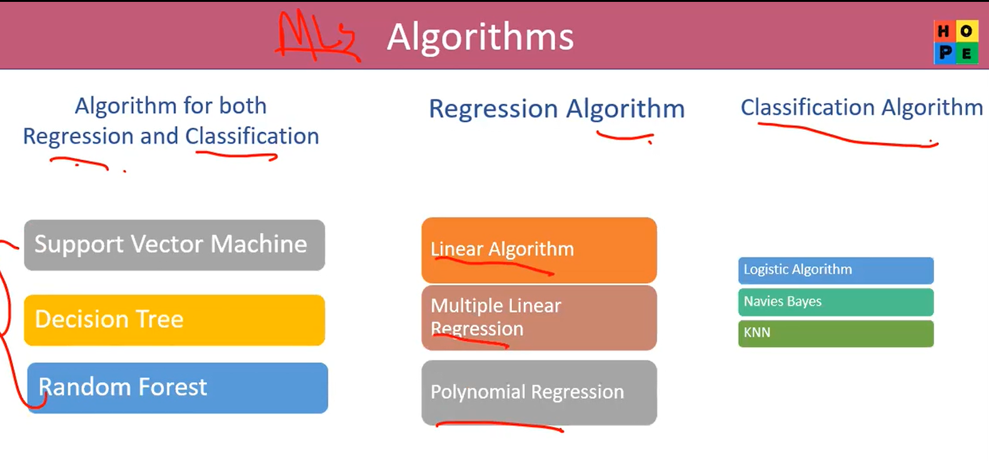
Artificial Intelligence (Ai)
Perdiction
4 Main Domain
Machine Learning
Deep Learning
Natural Language Processing
Time Serious Analysis
Number(Data)
Definition: A subset of AI where algorithms learn patterns from data to make predictions.
Data Size: Small → Medium datasets.
Focus: General predictive models.
Feature Extraction: Humans need to manually select important features
Examples:
1. Predicting employee resignations
2. Spam email classification
3. loan approval prediction
Image, Speech, Number (Data), Big data, complex data
Definition: A subset of ML using neural networks with multiple hidden layers.
Data Size: Requires large datasets.
Focus: Works well with images, speech, text, and complex data.
Feature Extraction: : Automatically extracts features from raw data.
Examples:
1.image recognition (face detection in employees).
2. Speech-to-text assistants
3. Medical image diagnostics
Text
Definition: A field of AI (often powered by ML/DL) that helps computers understand, interpret, and generate human language.
Data Type: Text & Speech.
Focus: Language understanding and generation.
Feature Extraction: Tokenization, embeddings
Examples:
1.Chatbots for employee queries
2.Sentiment analysis of resignation letters
3. Machine translation (English → French)
Perdition Based on Data Type
Date
Definition: A method in ML/statistics for analyzing sequential data over time.
Data Type: Time-based data (chronological).
Focus: Trend, seasonality, forecasting.
Feature Extraction: Lags, seasonality, ARIMA
Examples:
1.Predicting stock prices
2.Sales forecasting
3. Employee resignation prediction based on monthly trends
4. Weather prediction
Learning Selection
1. Supervised Learning
2. Semi-Supervised Learning
3. Unsupervised Learning
1. Supervised Learning
2. Semi-Supervised Learning
3. Unsupervised Learning (Rare)
1. Supervised Learning
2. Semi-Supervised Learning
3. Unsupervised Learning (Rare)
1. Supervised Learning
Learning
Supervised Learning
Definition: Model is trained on labeled data (input + correct output).
Goal: Learn a mapping from input → output.
Examples:
1.Predict if employee will resign (Yes/No).
2.Predict house price based on size, location, 3.Email classification: Spam / Not Spam.
Algorithms:
Regression: Linear Algorithm, Multiple Linear Regression, Polynomial Regression
Classification: Logistic Algorithms, Navies Bayes, KNN
Both Reg & Clasi: support vector Machine SVM, Decision Trees, Random Forests.
Semi-Supervised Learning
Definition: Uses a small amount of labeled data + a large amount of unlabeled data.
Goal: Improve accuracy when labeling is expensive/difficult.
Examples:
1.Group employees into clusters (happy, stressed, at-risk).
2.Market segmentation: Group customers by buying behavior.
3.Anomaly detection: Detect unusual employee activity.
Techniques: Self-training, Co-training, Graph-based models
Unsupervised Learning
Definition: Model is trained on unlabeled data (only input, no output)..
(Cluster)
Goal: Find hidden patterns or groupings
Algorithms: K-Means Clustering, Hierarchical Clustering, PCA (Dimensionality Reduction), Autoencoders.
Examples:
1.Group employees into clusters (happy, stressed, at-risk).
2.Market segmentation: Group customers by buying behavior.
3.Anomaly detection: Detect unusual employee activity.
Ai
Two Phase
Model Creation/Learning
Deployment/Production/Implement
Data Collection
Load the Best Saved Model
Data Preprocessing
Split: Input and Output
Get inputs
Split: Train and test set
Predicts
Train Set
Train Set
Call to Action
Model Creation
Evaluation Metrics
Save the best Model

