Slide 1

HACK AI 2018
Possible Topics & Data Sources

Slide 2

1. Dallas mavericks dataset

Slide 3
Mavericks Data
Data contains live game action at 24 intervals per second.
Think of it like moving frames from a game.
Position of the ball (x, y, z) and coordinates of 5 players from home team and away team are given.

Slide 4
Data Description
Three datasets:
Frames Dataset – time frame data with ball and player locations.
Simple-Markings Dataset – details about key events, such as field goals, rebound, turnover, etc., with their timestamps

Slide 5
Data Description
Three datasets:
Meta: information about games, teams, and players.
Please look at the documentation for details of each field.

Slide 6
Hints and Suggestions
Datasets are quite large, so it would be wise to start with a smaller sample.
Try aggregating time frames. Work at 1 second intervals rather than 24x per second.
Develop a prototype on smaller dataset, and then scale up.

Slide 7
Hints and Suggestions
Various interesting analyses can be done
Try to explore the simple-markings dataset as it contains information about key events, such as field goal, rebound, turnover, etc

Slide 8
Hints and Suggestions
Use cloud based services such as AWS, Google Cloud, Google Colab.
They will give you high performance, without blocking up your local resources.

Slide 9
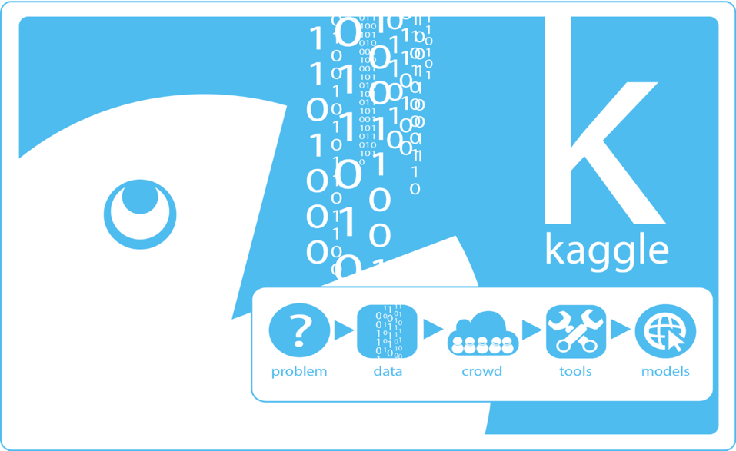
2. Kaggle competitions

Slide 10
Kaggle Competitions
Kaggle is the leading data science competition website.
It hosts a large number of competitions, some of them have prizes associated.
Look at the competitions section: https://www.kaggle.com/competitions

Slide 11
Kaggle Competitions
Look at the various types of competitions available: https://www.kaggle.com/docs/competitions

Slide 12
Hints and Suggestions
Try to work on projects that are in your area of interest e.g. image processing, text processing, stock market analysis, etc.
Look carefully at the data documentation and rules before starting.

Slide 13
Hints and Suggestions
Start with a simple prototype on a smaller sized sample.
Add complexity and scale up as you progress.
Look at models like XGBoost, which have been known to win many competitions.

Slide 14
Hints and Suggestions
For image or large scale text data, consider deep learning methods, such as Convolution Neural Network (CNN) and Recurrent Neural Network (RNN).
You can use Keras for faster processing: https://keras.io/layers/convolutional/

Slide 15
Hints and Suggestions
Consider cloud based technologies, such as Google Collab
It gives you access to a powerful server, which can be configured to be GPU powered.

Slide 16
Hints and Suggestions
XGBoost links
https://www.import.io/post/how-to-win-a-kaggle-competition/
https://www.kdnuggets.com/2017/10/xgboost-top-machine-learning-method-kaggle-explained.html
https://no2147483647.wordpress.com/2014/09/17/winning-solution-of-kaggle-higgs-competition-what-a-single-model-can-do/
https://www.slideshare.net/JaroslawSzymczak1/xgboost-the-algorithm-that-wins-every-competition

