Slide 1
Securing CNN Model and Biometric Template using Blockchain
Aiswarya Vijayan
TVE18MCA003

Slide 2
Contents
Introduction
Motivation
Existing Methods
Proposed System

Slide 3
Introduction
Blockchain has emerged as a leading technology that ensures security in a distributed framework.
It develop a secure system which uses the amalgamation of biometrics and blockchain technology.
We have developed a self-correcting template and parameter tamper-proof blockchain architecture for biometrics recognition.
The proposed deep learning model is able to protect different stages of the biometrics recognition pipeline, specifically feature extraction, matching, and template storage

Slide 4
Motivation
The integration of the advantages and characteristics of private blockchains in biometric systems is a very recent area of research with a high potential and interest.
The block chain technology could provide biometric systems with some desirable characteristics such as immutability, accountability, availability or universal access.
Proposed approach provides security to both deep learning model and the biometric template.

Slide 5
Existing Method
Storing all the collected data on a central server is reasonable in the sense that it requires the involvement of minimum people and hence chances of an external attack such as template tampering are minimum.
Distributed systems ensure minimum loss in case of system failure but are hard to trust because of the number of entities involved in the process (mutual distrust between entities is a common problem in a distributed framework).
One of the key limitations of the existing model is computation time because cryptographic computations, especially symmetric key encryption, and decryption are very demanding operation

Slide 6
Proposed System
We model a trained biometric recognition system in an architecture which leverages the blockchain technology to provide fault tolerant access in a distributed environment
We secure an encrypted fingerprint template by a symmetric peer-to-peer network and symmetric encryption. The fingerprint is encrypted by the symmetric key algorithm: Advanced Encryption Standard (AES) algorithm and then is uploaded to a symmetrically distributed storage system, the Inter Planetary File system (IPFS).
The hash of the template is stored in a decentralized blockchain.

Slide 7
Proposed System
The main operations are
Creation:
Receives the User ID, template data metadata, and adds a new Biometric Template structure to the blockchain.
Modiﬁcation:
Modiﬁes the template of an existing user. For a hash table storage scheme, this is equivalent to an addition operation.
Deletion:
Removes the link between a speciﬁc template and user ID.
Retrieval and matching:
Retrieves the Biometric Template structure for a user. This function is a call, not a transaction as the rest of functions eg: authentication while downloading a file etc

Slide 8
Modules
FEATURE EXTRACTOR
MERKLE TREE GENERATION
BLOCK LEVEL ENCRYPTION
TEMPLATE MATCHING

Slide 9
Data Flow Diagram

Slide 10
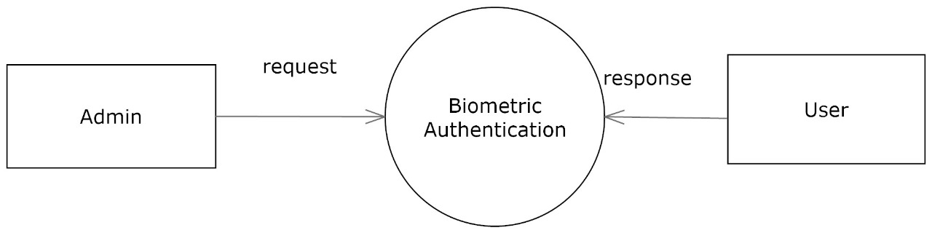
Level 0 Context diagram

Slide 11
Level 1
.

Slide 12
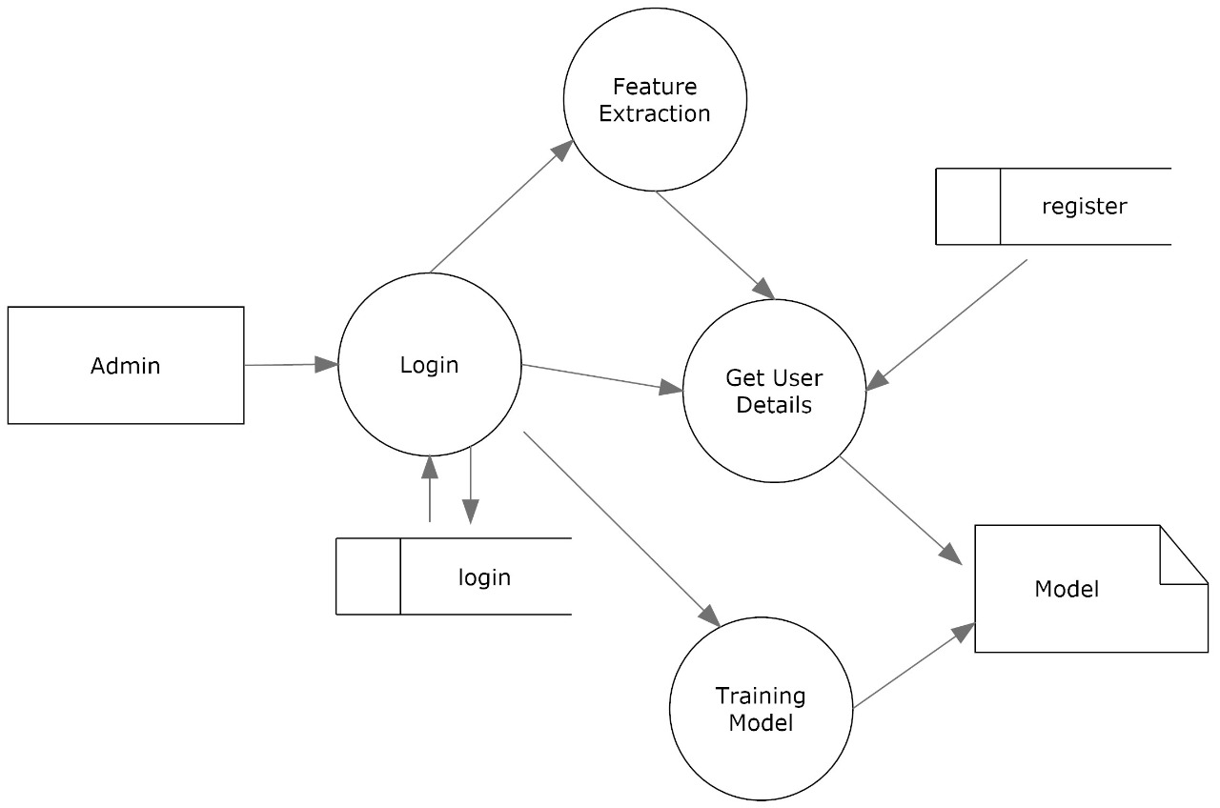
Level 2 Admin

Slide 13
Level 2 User
.

Slide 14
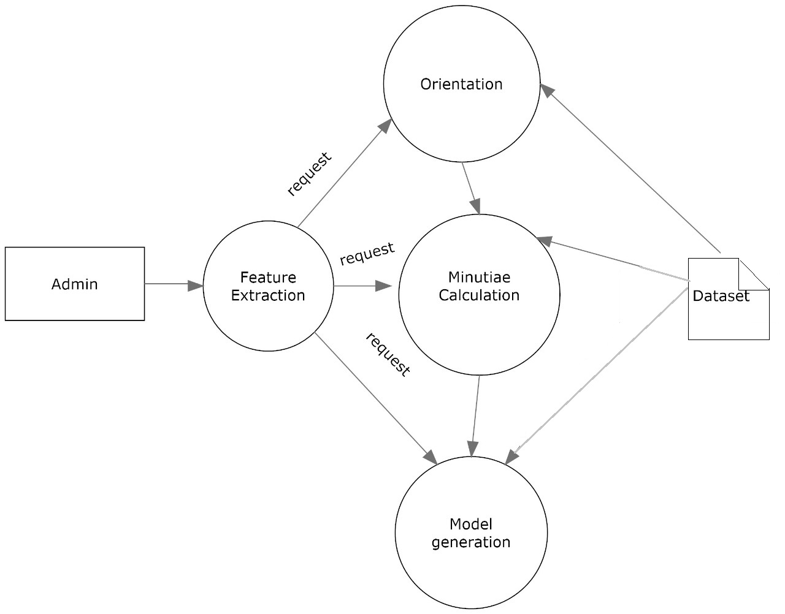
Level 3 Feature Extraction

Slide 15
filedata table
Login table
Field name | category | Description
user_id | Varchar(10) | Id of user
user_name | Varchar(10) | User name
password | Varchar(10) | password
Field name | category | Description
file_id | Varchar(10) | Id of file
user_id | Varchar(10) | User ID
file_name | Varchar(10) | File name
file_details | Varchar(10) | File details

Slide 16
fingerdata table
Field name | category | Description
fing_id | Varchar(10) | Id of finger
user_id | Varchar(10) | User ID
rigid_point | int | value
mins_point | int | value
angular_value | int | value

Slide 17
Referrences
Akhil Goel∗, Akshay Agarwal∗, Mayank Vatsa∗, Richa Singh∗, and Nalini Ratha+ ∗IIIT Delhi and +IBM Research, NY, USA c , “Securing CNN Model and Biometric Template using Blockchain” (2019)
X. Zhou, Y. Hafedh, Y. Wang, and V. Jesus. “A simple auditable ﬁngerprint authentication scheme using smart-contracts”. In International Conference on Smart Blockchain, pages 86–92. Springer, 2018.

Slide 18
Thank you

