Slide 1

Emotion Detection Using Machine Learning
Name :AISWARYA N
Register No: 127150006
Subject: Python For Data Science
Subject Code:BIN522

Slide 2
Problem Statement
The objective of this project is to develop a model capable of detecting emotions from textual data. By analyzing text inputs, the system predicts the underlying emotion such as joy, anger, fear, sadness, or surprise. This helps in improving human-computer interaction, sentiment monitoring, and social media analysis.

Slide 3
Workflow Overview
1. Data Collection
2. Data Cleaning & Preprocessing
3. Feature Extraction (TF-IDF Vectorization)
4. Model Training (Logistic Regression)
5. Model Evaluation
6. Real-time Emotion Prediction

Slide 4
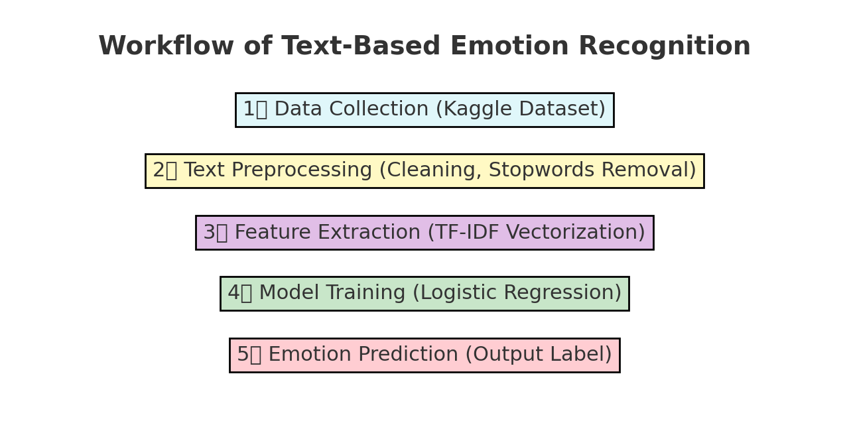

Slide 5
Step 1: Data Cleaning & Preprocessing
• Lowercasing all text
• Removing URLs, punctuation, and special characters
• Removing stopwords except negations like 'not'
• Lemmatization using WordNet Lemmatizer
• Ensuring clean input for model learning

Slide 6
Step 2: Feature Extraction (TF-IDF)
• Converts text into numerical features
• Uses uni-grams and bi-grams for better context
• Captures important word patterns and frequency
• Reduces noise and dimensionality

Slide 7
Step 3: Model Training (Logistic Regression)
• Used Logistic Regression with SAGA solver
• Handles multiclass classification efficiently
• Balanced class weights to manage imbalanced data
• Achieved improved performance and accuracy

Slide 8
Step 4: Model Evaluation
• Accuracy Score & Classification Report used for evaluation
• Confusion Matrix for detailed insight
• Visualized predictions using heatmap
• Model tested on unseen data for validation

Slide 9
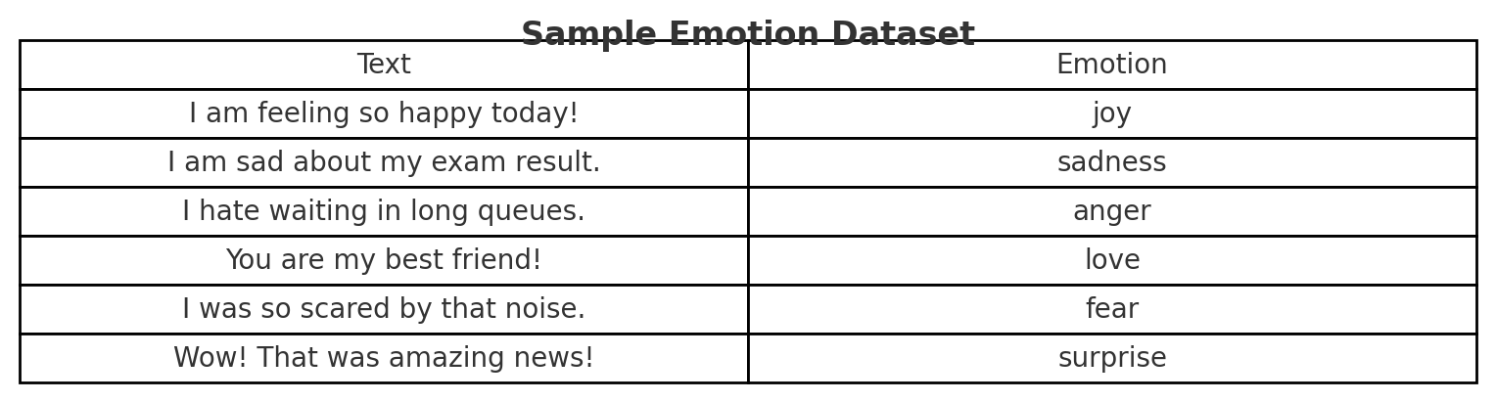

Slide 10
Step 5: Real-time Emotion Detection
• Accepts user input dynamically
• Cleans and vectorizes text instantly
• Predicts top 3 emotions with confidence levels
• Displays most likely emotion and other possibilities

Slide 11
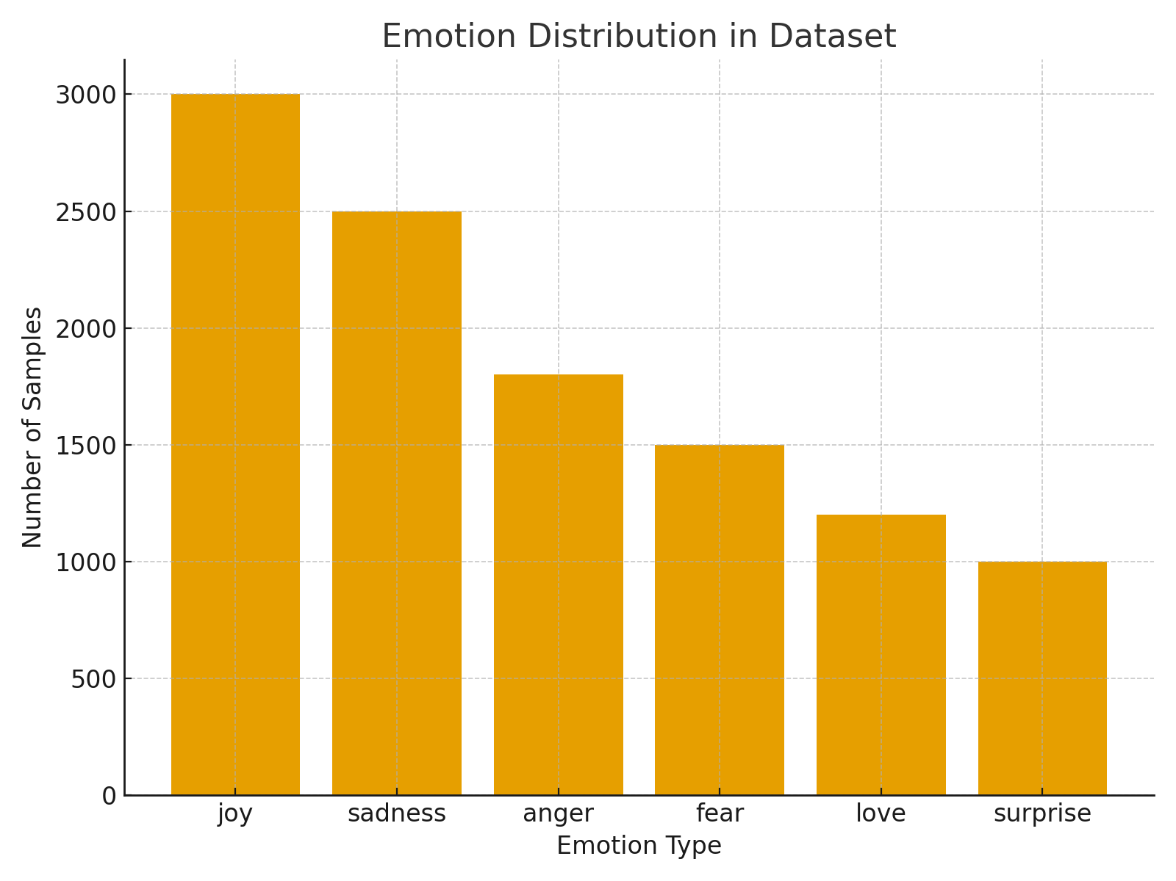

Slide 12
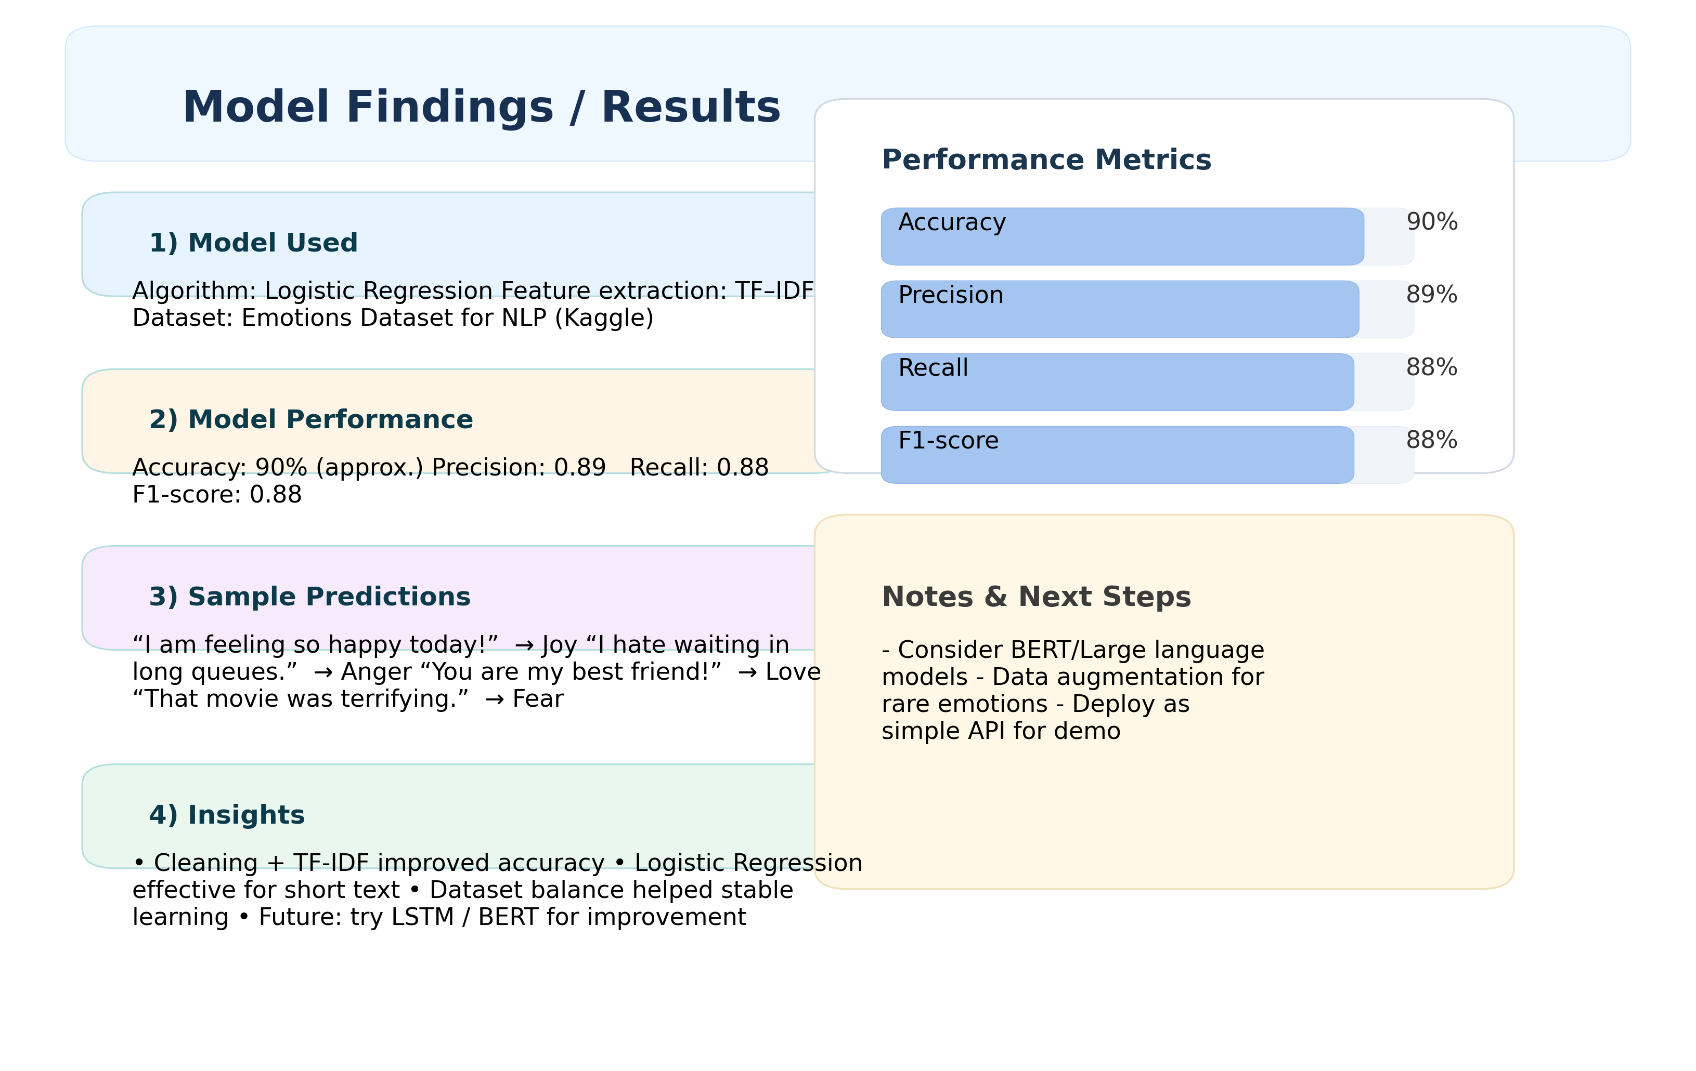

Slide 13
Conclusion
The Emotion Detection model effectively identifies human emotions from textual data. Using TF-IDF and Logistic Regression, the system delivers accurate predictions with interpretability. It can be extended to chatbots, social media sentiment analysis, and mental health monitoring systems.

Slide 14
References
1. Scikit-learn Documentation - https://scikit-learn.org
2. NLTK Documentation - https://www.nltk.org
3. Kaggle Emotion Datasets
4. Text Mining with Python - Packt Publishing
5. Python Official Documentation - https://python.org
6. Towards Data Science Articles on NLP
7. Analytics Vidhya Blogs
8. Research Paper: Emotion Recognition from Text using ML Algorithms
9. Medium Articles on Logistic Regression
10. Journal of Machine Learning Applications, 2024

Slide 15
Thank You
print("Emotion Recognition Complete ✅")

