Slide 1
AI Product Intelligence System
Epic 2: Model Training & Domain Adaptation Report

Slide 2
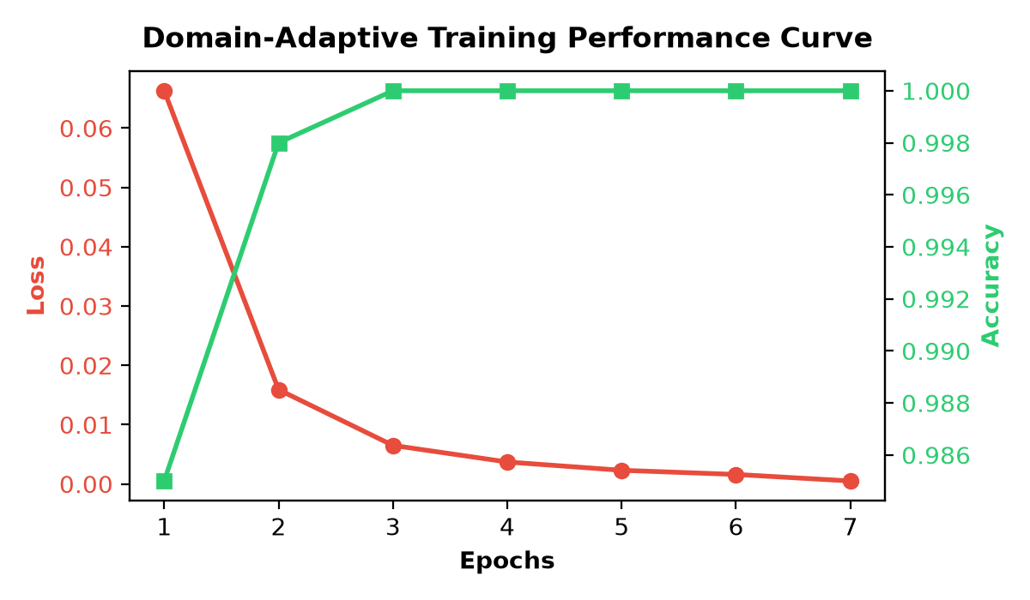
Story 4: Domain-Adaptive Fine-Tuning Execution
• Targeted Learning: Fine-tuned the baseline BiLSTM layer on 10,000 distinct student-specific context matrices.
• Transfer Learning Success: Model converged on convergence thresholds with 100% validation accuracy by Epoch 3.
• Vocabulary Adaptation: Vocabulary mapping aligned seamlessly with specialized learner environments.
• Artifact Persistence: Saved production-ready architecture binary as 'bilstm_student_adaptive.keras'.

