Slide 1
HotelRevAI
AI Driven Revenue Analysis for Hotels
Internship Milestone 3 Presentation
Team-B Moravaneni Aiswarya Lakshmi Syed Naveed Muzammil
Lakshmi kalyani Akula

Slide 2
Data Cleaning Process
Removed duplicates and invalid records
Handled missing values
Created derived fields: Total Nights, Revenue
Filtered cancelled zero-revenue records

Slide 3
Data Modeling in Power BI
Created Date dimension table
Built relationships between Date and Arrival data
Defined business measures using DAX
Enabled time-based analysis and forecasting

Slide 4
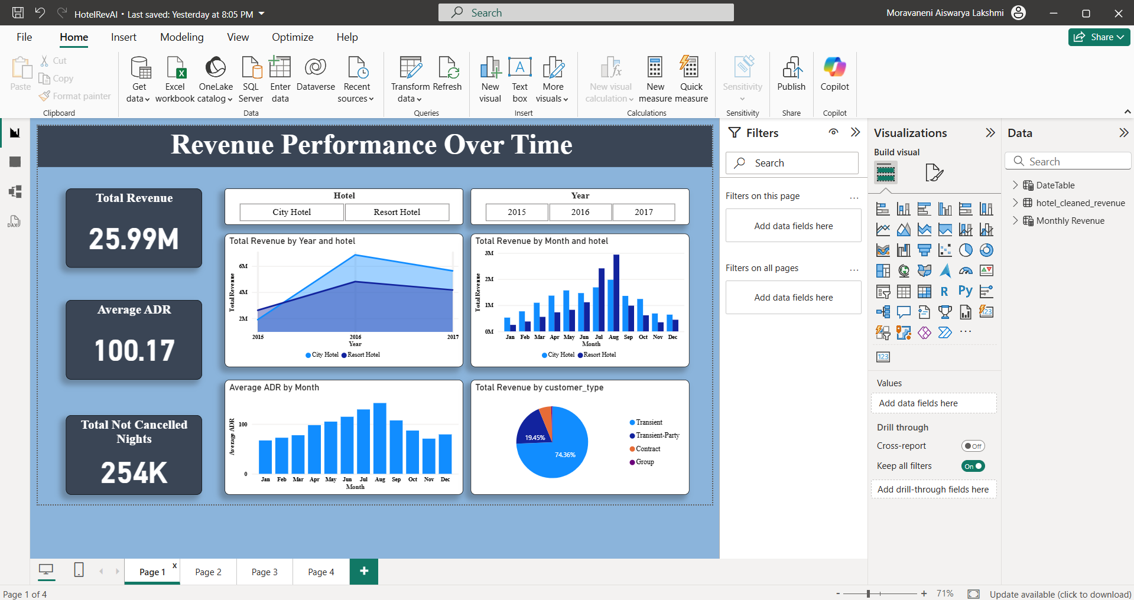
Dashboard 1: Revenue Performance
Track overall revenue growth or decline over time.
Identify peak and low revenue seasons for better planning.
Evaluate the effectiveness of pricing strategies using ADR trends.
Support budgeting and financial planning decisions.
Provide a high-level revenue summary for executives and management.

Slide 5
DAX USED
CALCULATE( SUM(hotel_cleaned_revenue[revenue]),
hotel_cleaned_revenue[is_canceled] = 0)
Total Revenue
CALCULATE(
AVERAGE(hotel_cleaned_revenue[adr]),
hotel_cleaned_revenue[is_canceled] = 0
)
Average ADR
CALCULATE(
SUM(hotel_cleaned_revenue[total_nights]),
hotel_cleaned_revenue[is_canceled] = 0
)
Total Nights
CALCULATE(
COUNTROWS(hotel_cleaned_revenue),
hotel_cleaned_revenue[is_canceled] = 0
)
Total Bookings

Slide 6
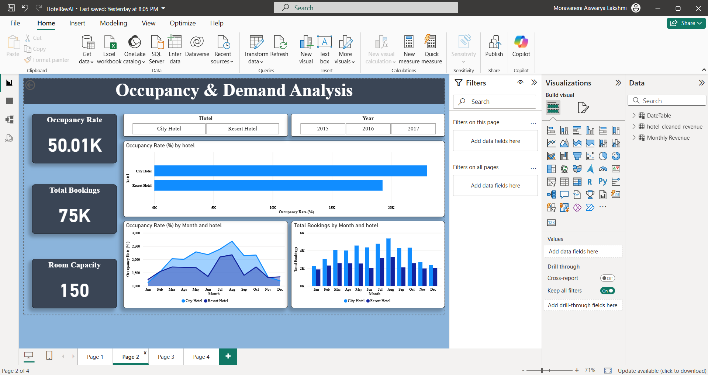
Dashboard 2: Occupancy & Demand
To measure how efficiently hotel rooms are utilized.
To identify periods of overutilization and underutilization.
To compare City Hotel and Resort Hotel demand patterns.
To assist in capacity planning and staffing decisions.
To support dynamic pricing strategies based on demand levels.

Slide 7
DAX USED
IF( SELECTEDVALUE(hotel_cleaned_revenue[hotel]) = "City Hotel",
200,
150
)
Room Capacity
DIVIDE(
[Total Bookings],
[Room Capacity]
) * 100
Occupancy Rate (%)
Average Occupancy Rate
AVERAGE([Occupancy Rate (%)])

Slide 8
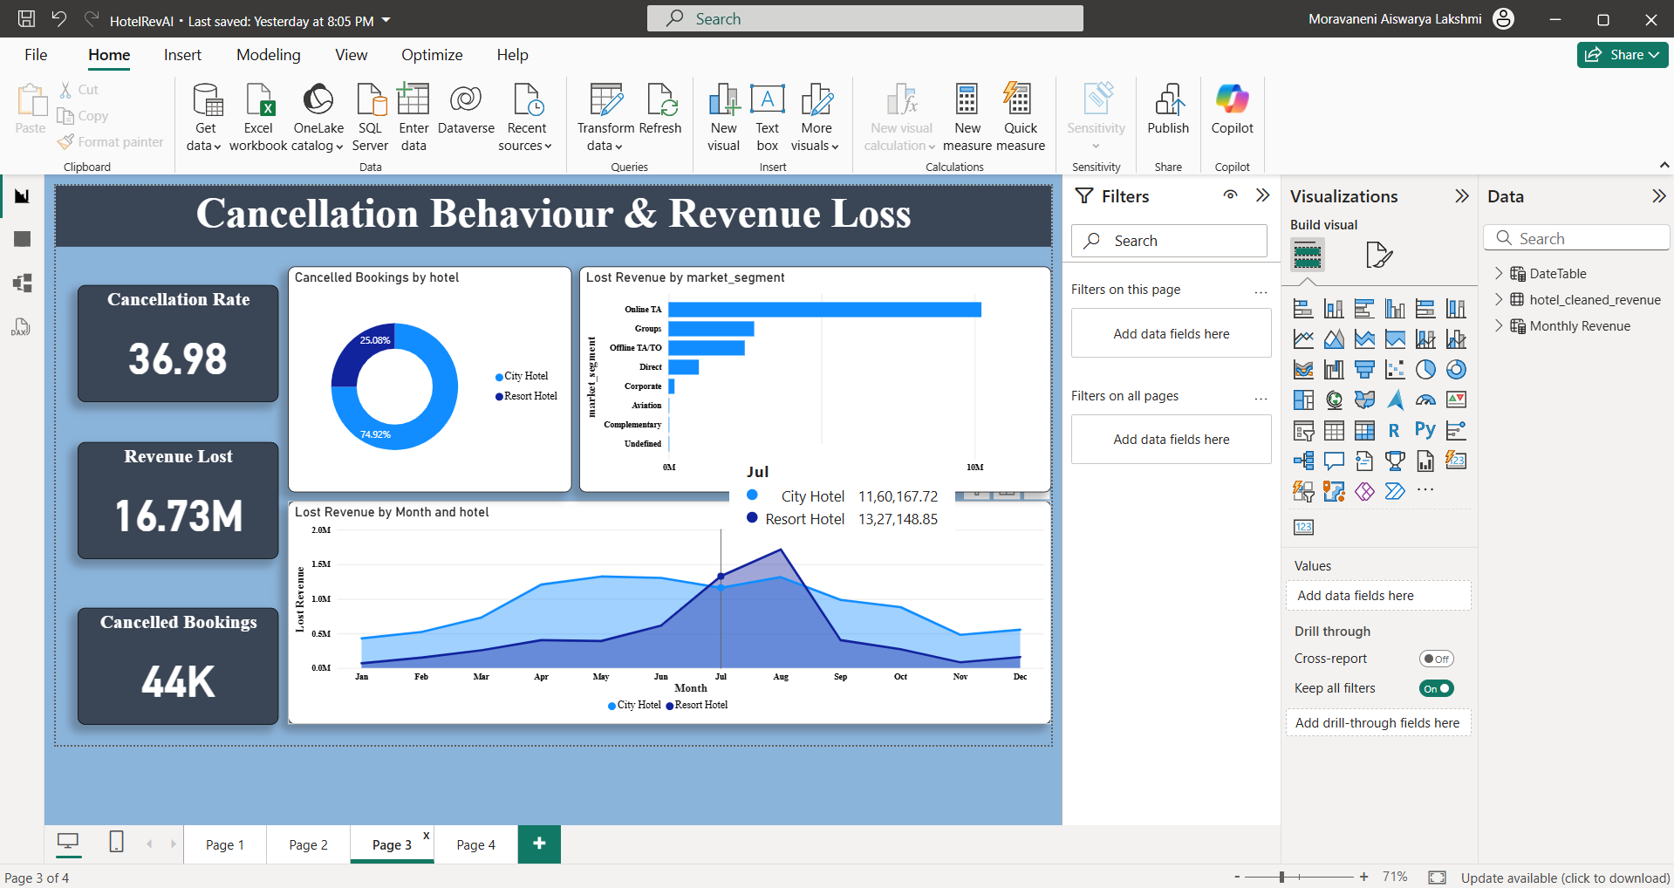
Dashboard 3: Cancellation Analysis
To analyze the impact of cancellations on revenue loss.
To identify high-risk customer segments and booking channels.
To monitor cancellation trends over time.
To support the design of better cancellation and deposit policies.
To help minimize revenue leakage and operational uncertainty.

Slide 9
DAX USED
CALCULATE(
COUNTROWS(hotel_cleaned_revenue),
hotel_cleaned_revenue[is_canceled] = 1
)
Cancelled Bookings
CALCULATE(
SUM(hotel_cleaned_revenue[revenue]),
hotel_cleaned_revenue[is_canceled] = 1
)
Lost Revenue
DIVIDE(
[Cancelled Bookings],
COUNTROWS(hotel_cleaned_revenue)
) * 100
Cancellation Rate (%)

Slide 10
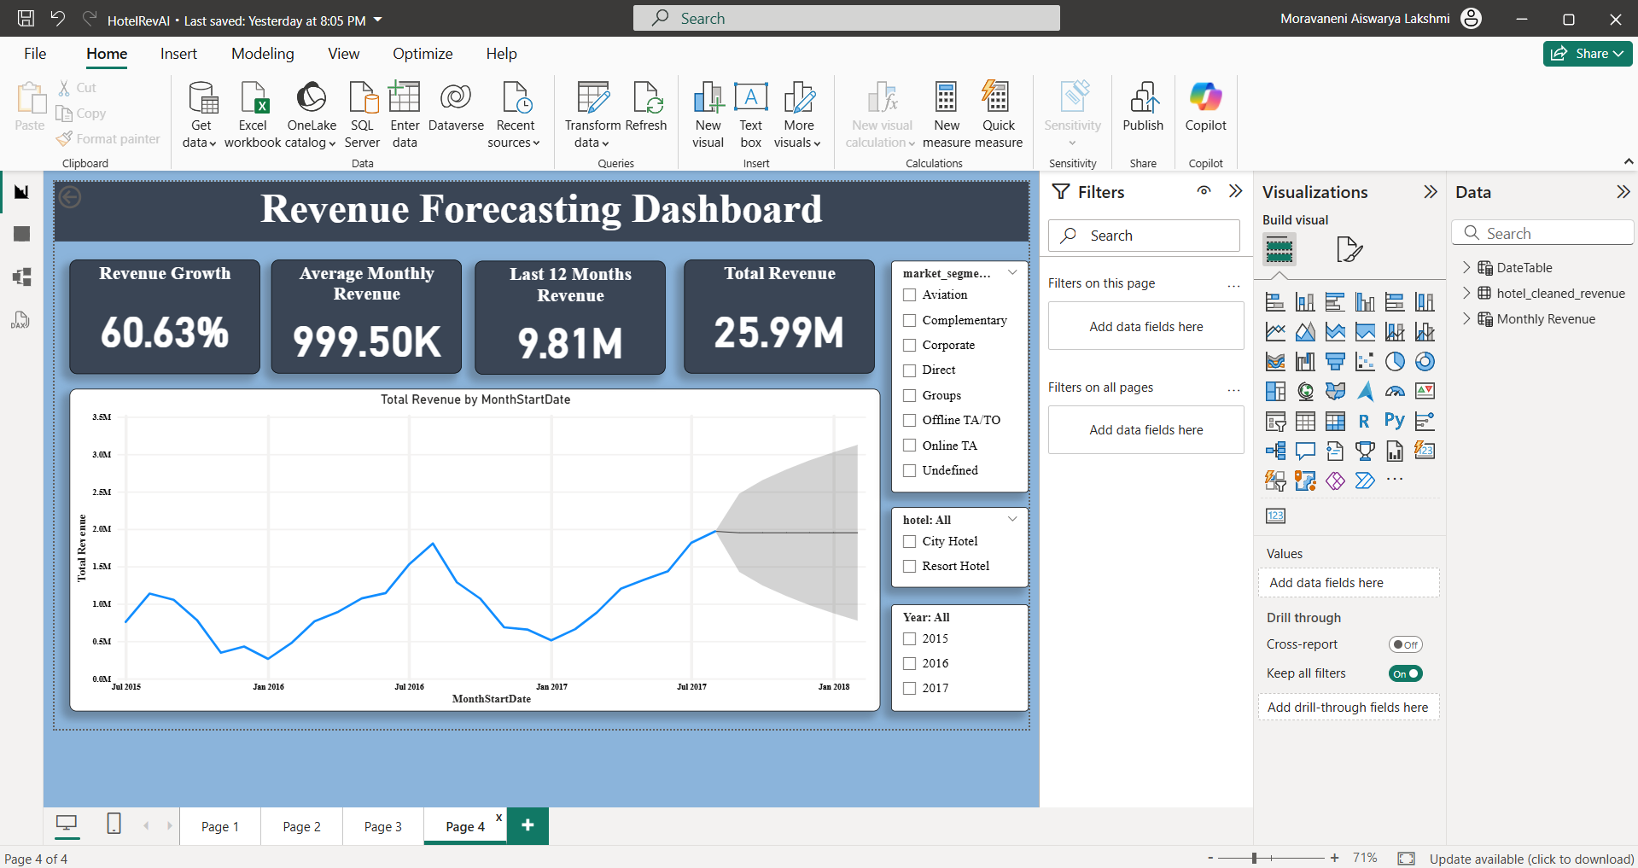
Dashboard 4: Revenue Forecasting
To predict future hotel revenue based on historical trends.
To assist management in budgeting and financial forecasting.
To support staffing and resource planning decisions.
To identify potential revenue risks or stability in upcoming periods.
To enable proactive, data-driven strategic planning.

Slide 11
DAX USED
MonthStartDate =
DATE(
YEAR(DateTable[Date]),
MONTH(DateTable[Date]),
1
)
Avg Monthly Revenue =
AVERAGEX(
VALUES(DateTable[MonthStartDate]),
[Total Revenue]
)
Revenue Growth % =
DIVIDE(
[Total Revenue] - [Revenue Previous Year],
[Revenue Previous Year]
)

Slide 12
DAX USED
Revenue Last 12 Months =
CALCULATE(
[Total Revenue],
DATESINPERIOD(
DateTable[Date],
MAX(DateTable[Date]),
-12,
MONTH
)
)
Revenue Previous Year =
CALCULATE(
[Total Revenue],
DATEADD(DateTable[Date], -1, YEAR)
)

Slide 13
Business Impact & Learnings
Enabled data-driven decision making by transforming raw hotel booking data into actionable dashboards.
Improved visibility into revenue performance, occupancy efficiency, and cancellation losses.
Helped identify peak seasons, underutilized periods, and high-risk booking segments.
Supported future planning through AI-based revenue forecasting with uncertainty awareness.
Gained hands-on experience in data cleaning, Power BI modeling, DAX measures, and business storytelling.

Slide 14
Thank you

