Slide 1

Team Members 1. Moravaneni Aiswarya Lakshmi 2. Syed Naveed Muzammil 3. Lakshmi kalyani Akula

Slide 2
Introduction
The hospitality industry generates large volumes of booking data from customers across multiple platforms such as online travel agencies, direct bookings, and corporate reservations.
Analyzing this data helps hotels understand customer behavior, optimize pricing strategies, and improve occupancy rates.
In this project, we analyze hotel booking data using Power BI to build interactive dashboards and derive insights that support better decision-making.

Slide 3
Problem Statement
• Identify peak booking seasons • Understand customer segments • Reduce booking cancellations • Optimize pricing strategies This project aims to solve these challenges through data analysis and visualization.
Hotels often face challenges in understanding booking patterns, customer behavior, and revenue trends.

Slide 4
Project Objectives
The main objectives of this project are:
• Analyze hotel booking data to understand revenue trends • Identify key performance indicators for hotel performance • Create interactive dashboards using Power BI • Analyze occupancy patterns and booking behavior • Evaluate cancellation patterns and revenue loss • Use forecasting techniques to predict future revenue

Slide 5
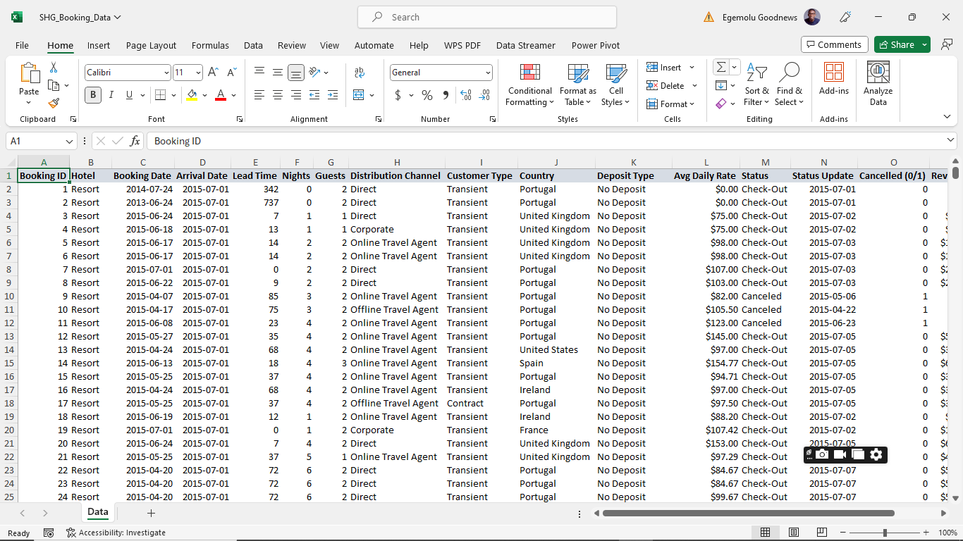
Dataset Overview The dataset used for this project is the Hotel Booking Dataset from Kaggle.
Dataset Information:
• Time Period: 2015 – 2017 • Total Records: ~120,000 bookings • Hotel Types: City Hotel and Resort Hotel
Key attributes include:
• Customer type • Market segment • Room category • Average daily rate (ADR) • Stay duration • Booking cancellations • Country of origin

Slide 6
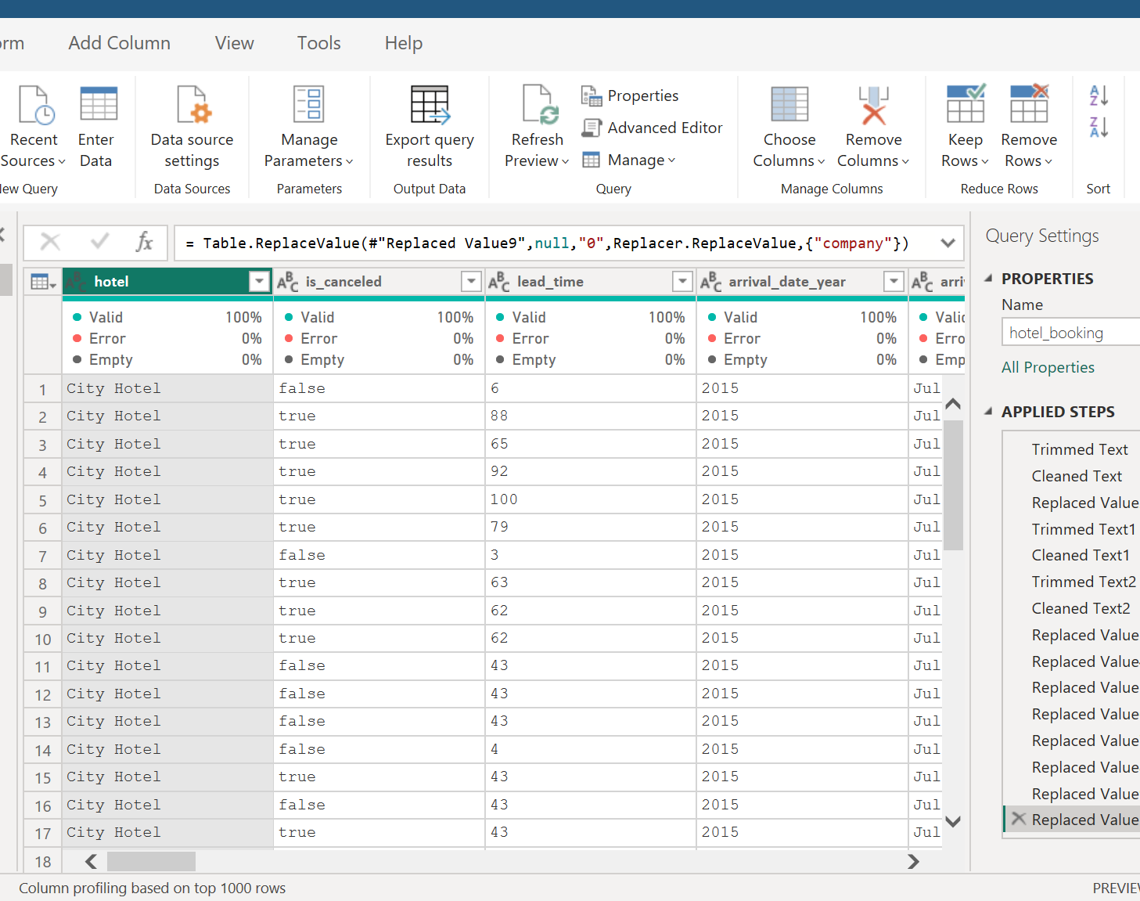
Data Preprocessing
Before analysis, the dataset was cleaned and prepared. Data preprocessing steps included:
• Handling missing values • Removing duplicate records • Correcting inconsistent data entries • Converting date fields to proper format • Creating calculated columns for analysis
These steps ensured that the dataset was accurate and ready for visualization.

Slide 7
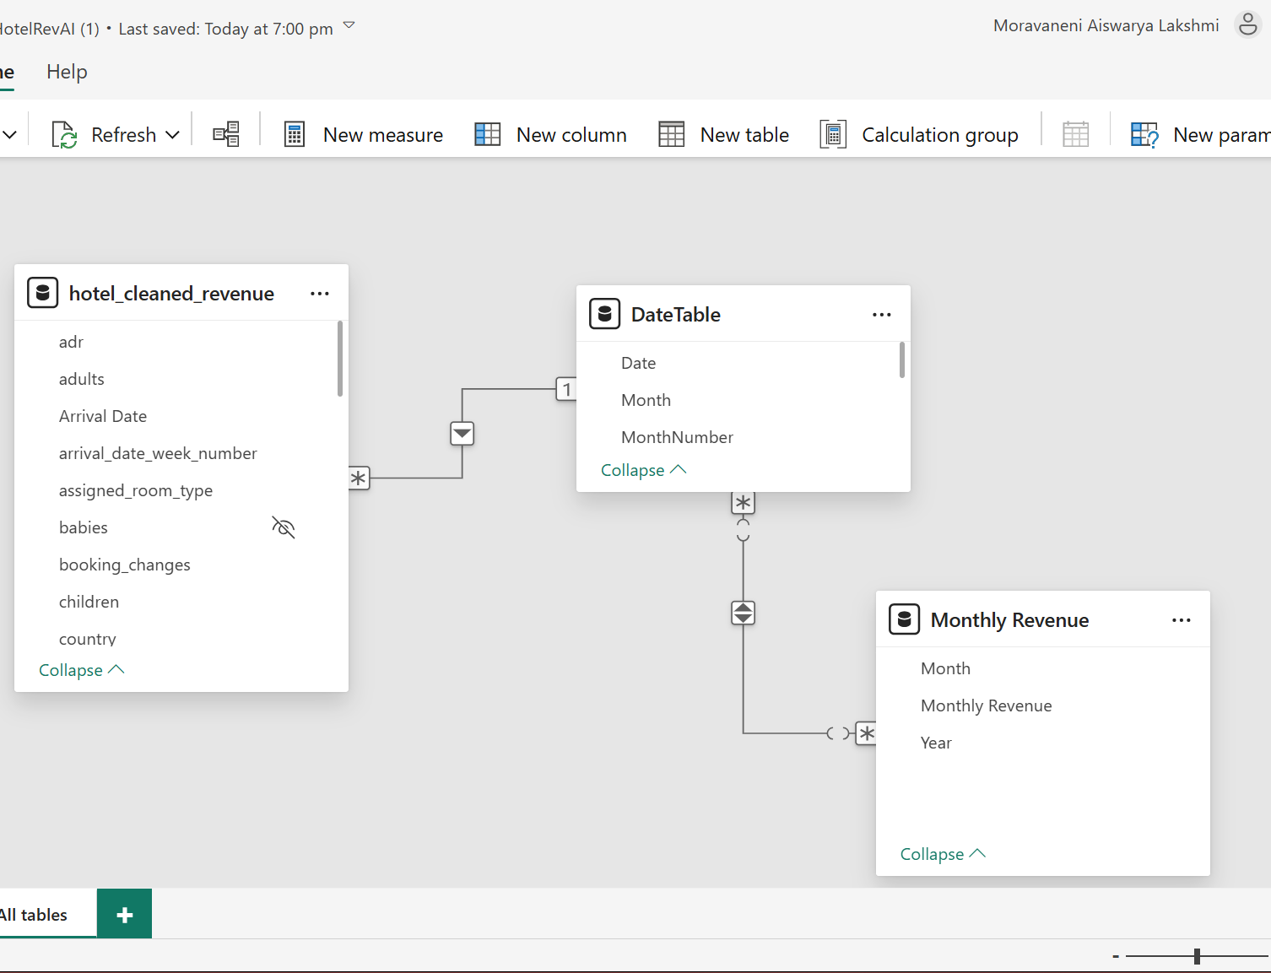
Data Modeling
Data modeling was performed in Power BI to organize the dataset for efficient analysis.
Key modeling steps:
• Establishing relationships between tables • Creating calculated measures using DAX • Designing a structured data model for analysis • Defining key performance indicators
This step helped improve query performance and enabled interactive dashboards.

Slide 8
Key Performance Indicators
To measure hotel performance, the following KPIs were used:
• Total Revenue – Revenue generated from bookings • Total Bookings – Number of confirmed bookings • Average Daily Rate (ADR) – Average price per room • Occupancy Rate – Percentage of rooms booked • Cancellation Rate – Percentage of cancelled bookings • Revenue Loss – Revenue lost due to cancellations
These KPIs help evaluate the financial performance of hotels.

Slide 9
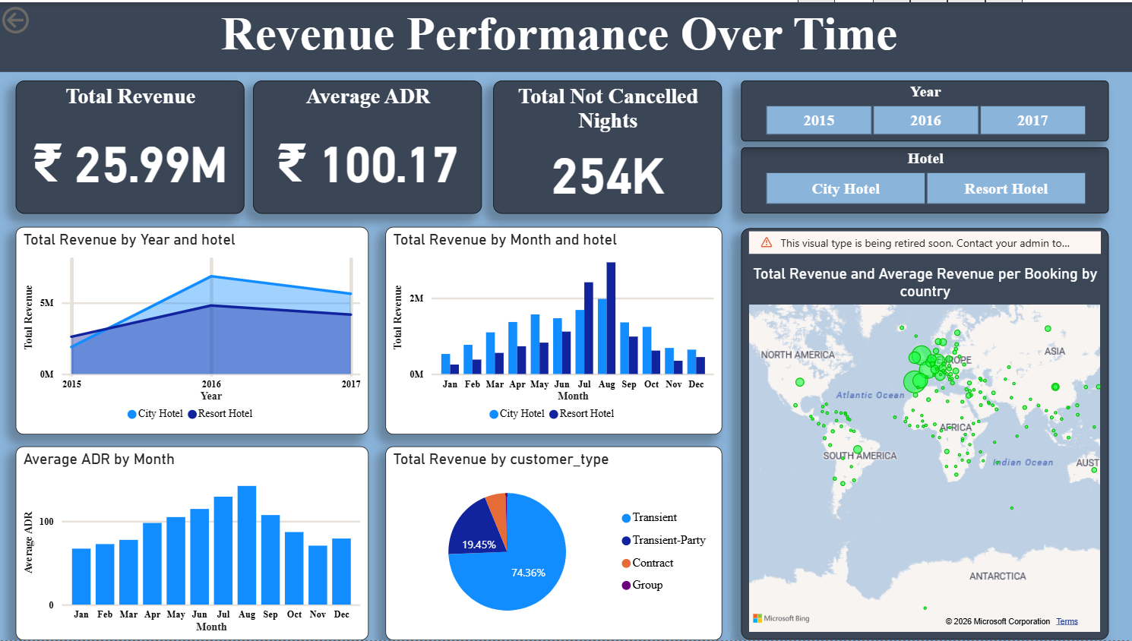
Revenue Performance Dashboard
This dashboard provides an overview of the hotel revenue performance over time and compares the performance of City Hotels and Resort Hotels.
Key Metrics Displayed
• Total Revenue: ₹25.99M generated from hotel bookings • Average ADR: ₹100.17 average room price per night • Total Not Cancelled Nights: 254K nights stayed
Key Visual Insights
• Monthly revenue trends help identify seasonal demand patterns • City hotels generally generate higher revenue compared to resort hotels • ADR trends show pricing variations across different months • Revenue by customer type shows which guest segments contribute most to revenue • Geographic map visualizes revenue distribution by country
This dashboard helps hotel managers understand revenue trends, pricing performance, and customer contribution to revenue growth.

Slide 10
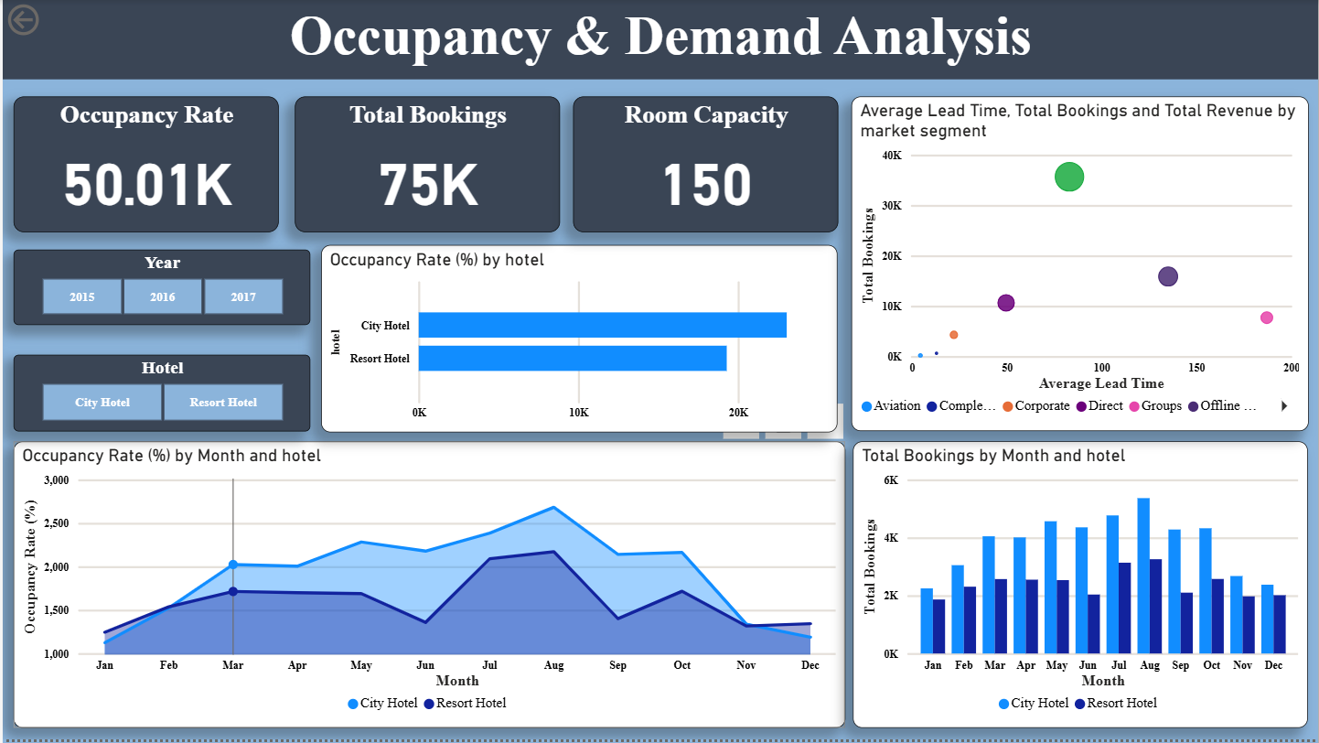
Occupancy & Demand Analysis
This dashboard analyzes hotel booking demand and occupancy patterns across different time periods.
Key Metrics:
Occupancy Rate
Total Bookings
Room Capacity
Key Insights:
City hotels show higher occupancy rates compared to resort hotels
Booking demand varies across months indicating seasonal trends
Peak demand occurs during mid-year months
Market segments influence booking patterns

Slide 11
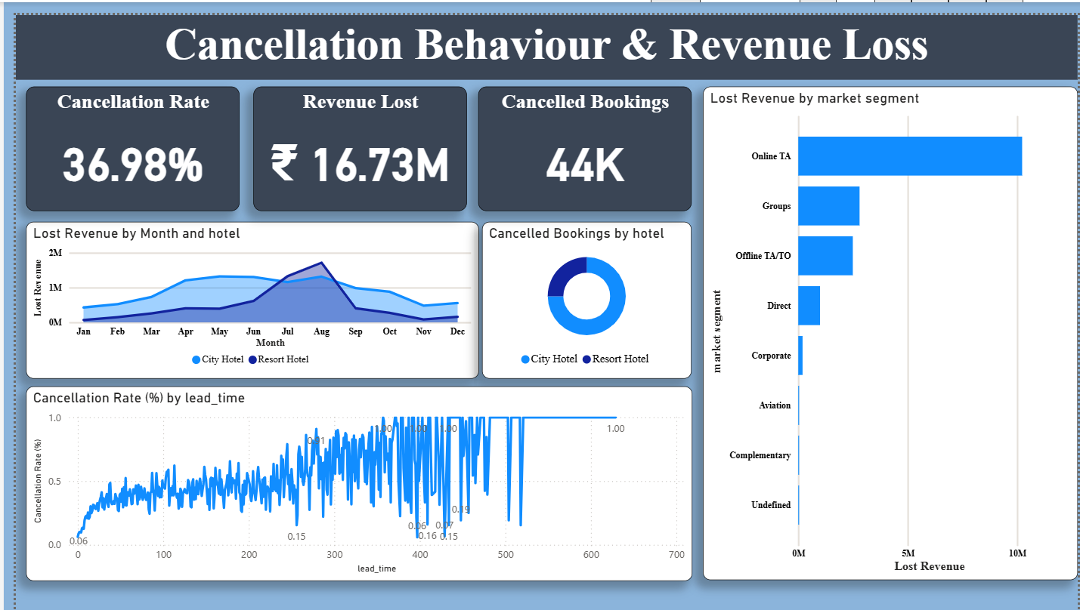
Cancellation Behaviour & Revenue Loss
This dashboard focuses on analyzing booking cancellations and the financial impact of lost revenue.
Key Metrics
• Cancellation Rate: 36.98% • Revenue Lost: ₹16.73M • Cancelled Bookings: 44K
Key Insights
• Online travel agencies contribute to the highest revenue loss due to cancellations • Cancellation rates increase with longer lead times • Both hotel types experience cancellations, but the pattern varies across months • Market segment analysis helps identify high-risk booking channels
Understanding cancellation behavior allows hotels to implement strategies such as flexible pricing, deposit policies, and improved booking management.

Slide 12
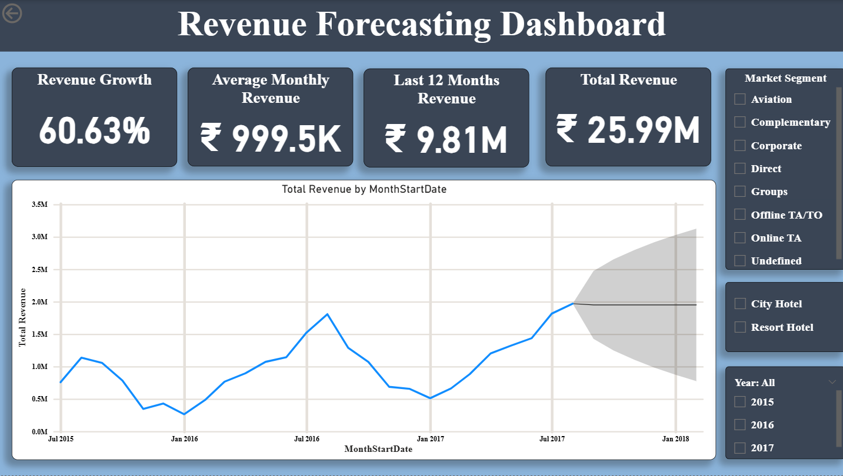
Revenue Forecasting Dashboard
This dashboard uses Power BI forecasting capabilities to predict future revenue trends based on historical booking data.
Key Metrics
• Revenue Growth: 60.63% • Average Monthly Revenue: ₹999.5K • Last 12 Months Revenue: ₹9.81M • Total Revenue: ₹25.99M
Key Insights
• Revenue trends show consistent growth over time • Forecasting predicts future revenue fluctuations based on historical patterns • Market segment filters help analyze revenue contributions from different booking channels • Year and hotel filters allow deeper analysis of revenue trends
Forecasting enables hotel managers to anticipate demand, optimize pricing strategies, and improve long-term revenue planning.

Slide 13
Key Insights and Business Impact
Key Insights
City hotels generate higher revenue
Peak demand occurs during mid-year months
Online travel agencies dominate bookings
High cancellations lead to revenue loss
Business Impact
The insights derived from the dashboards help hotel managers:
• Optimize pricing strategies based on demand trends
• Improve occupancy planning and room allocation
• Reduce revenue loss caused by booking cancellations
• Improve demand forecasting and revenue planning

Slide 14
Thank You
Conclusion
This project demonstrates how Power BI dashboards can transform hotel booking data into meaningful business insights.
Through revenue analysis, occupancy trends, cancellation behavior, and forecasting models, hotel managers can better understand booking patterns and optimize revenue strategies.
Interactive dashboards allow stakeholders to monitor performance and make data-driven decisions.

