Slide 1

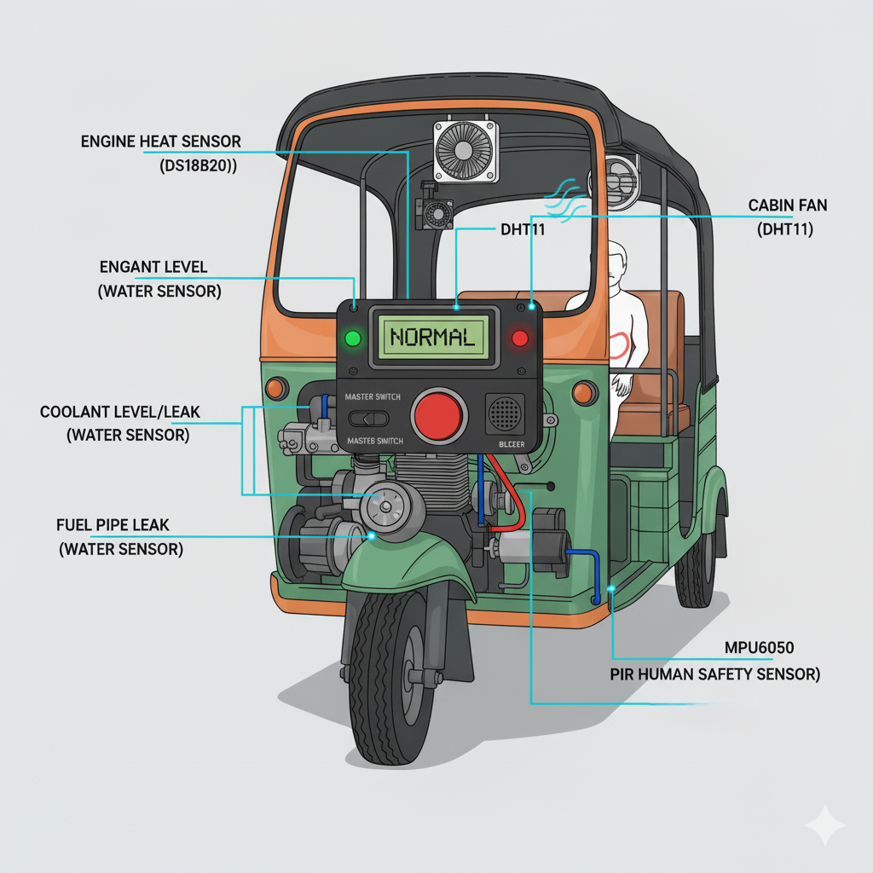
Vehicle Health Monitoring System
Advanced STM32F405RGT6 embedded implementation for small electric vehicles, delivering comprehensive safety monitoring at 75% cost reduction compared to commercial solutions.

Slide 2
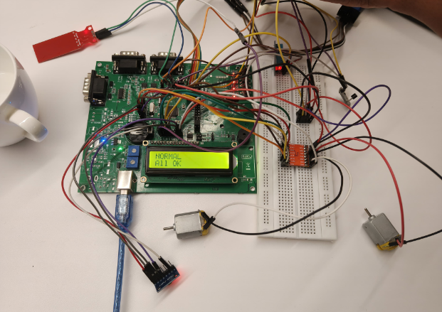
The Challenge
Extreme Operating Conditions
Critical Failure Modes
34% thermal incidents, 28% mechanical failures, 23% passenger safety events, 15% coolant system failures
12-16 hour daily utilization, 8°C to 47°C temperature range, 650kg to 1000kg load variations
Cost Constraints
Premium safety systems unaffordable for cost-sensitive operators serving urban transportation markets

Slide 3
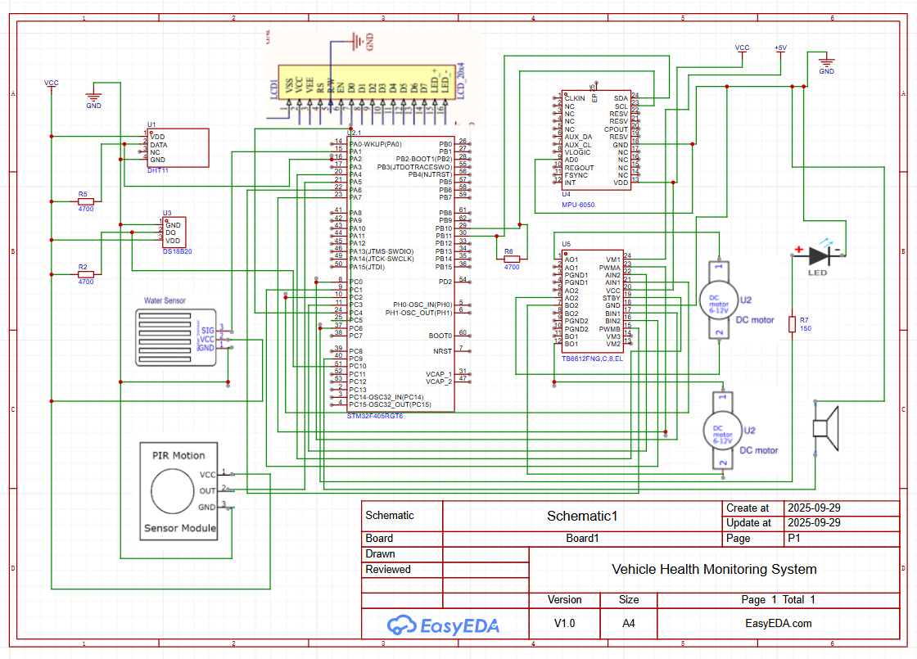



Our Solution Architecture
Thermal Management
DS18B20 sensors with ambient-compensated trip points. Adaptive protection prevents shutdowns while maintaining motor safety.
Vibration Monitoring
MPU6050 frequency-domain analysis optimized for three-wheeler dynamics. Predicts failures 5-15 days in advance.
Human Safety
PIR sensors with dual-confirmation logic and thermal masking prevent passenger contact with moving parts.

Slide 4
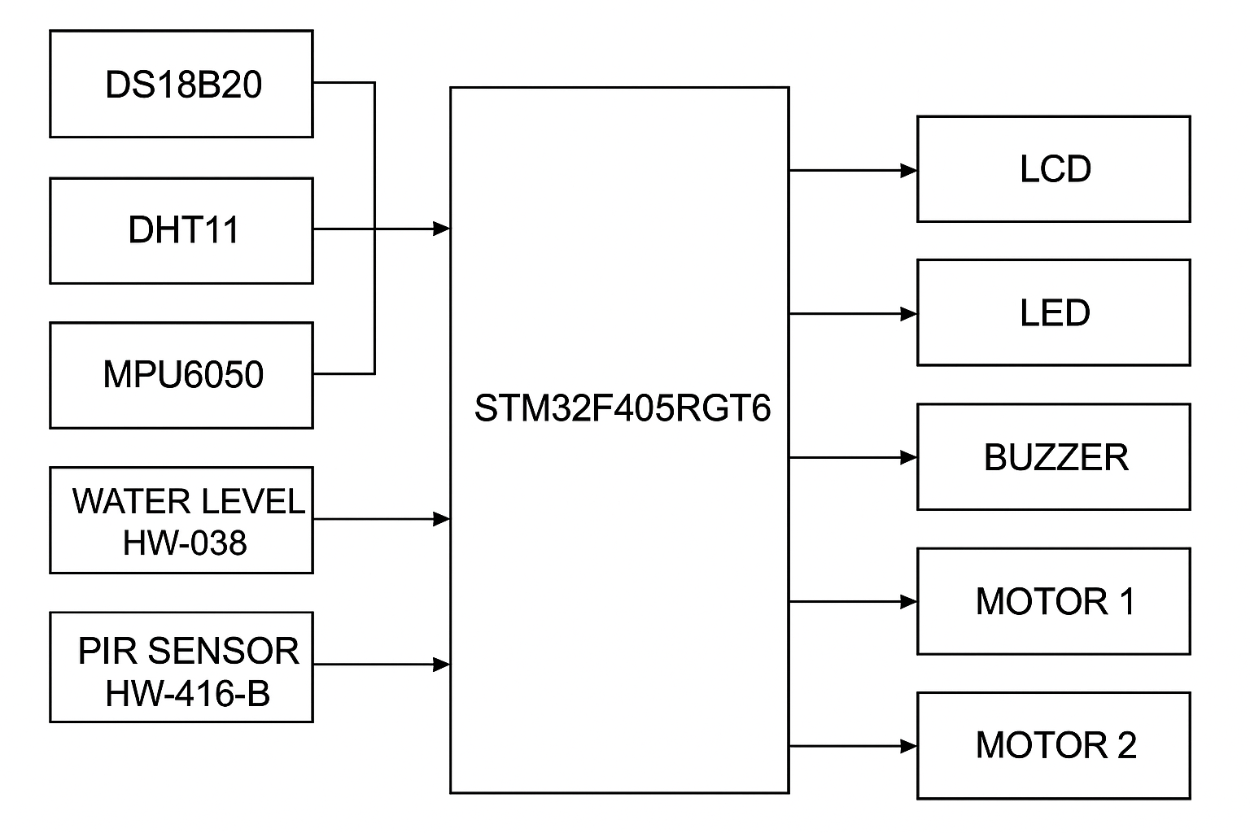
System Performance
98.7%
67%
100%
System Uptime
Thermal Failure Reduction
Safety Incident Elimination
Exceptional reliability in harsh operating conditions
Dramatic improvement in motor protection
Complete prevention of human safety events
23
Days to ROI
Rapid payback period with sustained benefits

Slide 5
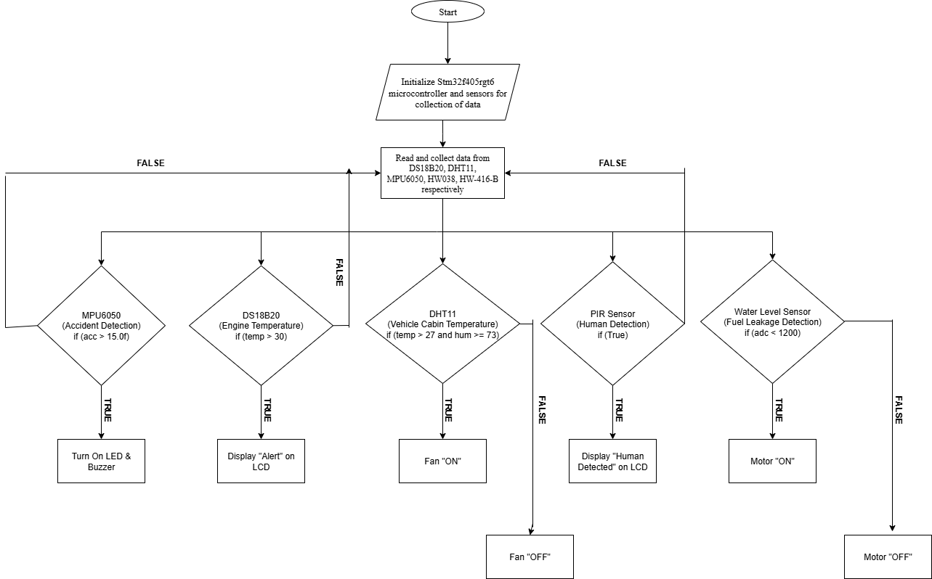
Advanced Sensor Integration
01
Multi-Modal Sensing
DS18B20 temperature, DHT11 environmental, MPU6050 vibration, PIR motion, and water leak sensors
02
Real-Time Processing
STM32F405RGT6 Cortex-M4F with FreeRTOS task architecture ensuring deterministic response
03
Intelligent Analysis
Frequency-domain vibration analysis, adaptive thermal protection, and dual-confirmation safety logic
04
Fail-Safe Control
Relay-based actuator control with emergency shutdown and comprehensive alert systems

Slide 6



State Machine Design
INIT State
System initialization with comprehensive self-diagnostics, sensor verification, and baseline calibration
WARNING State
Threshold exceeded with hysteresis protection, enhanced cooling activation, operator notification
TRIP State
Critical condition detected, fail-safe shutdown, emergency protocols activated

Slide 7
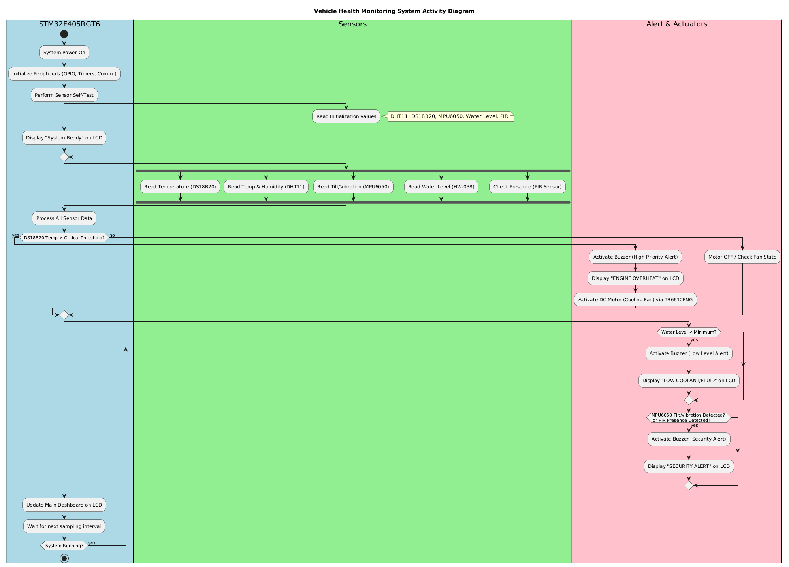

Slide 8
FreeRTOS Task Performance
57%
41%
2%
LCD Task
Engine Temperature
System Overhead
Display management and user interface
Thermal monitoring and protection
Significant computational headroom available
Efficient resource allocation with CPU utilization below 15% under full operational load, ensuring deterministic real-time response.

Slide 9

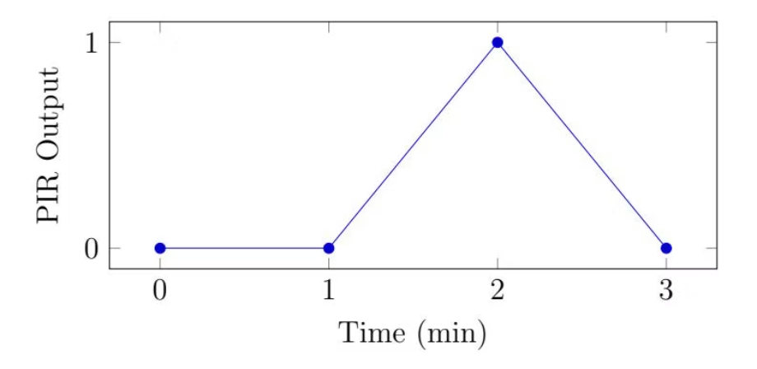
Comprehensive Testing Results
Test Scenarios Validated
PIR human detection with dual-confirmation
MPU6050 accident detection thresholds
All test scenarios achieved PASS status with stable operation, accurate threshold detection, and robust noise immunity.
DHT11 temperature/humidity monitoring
DS18B20 engine overheat protection
Water level detection with noise filtering
24-hour stress test validation

Slide 10
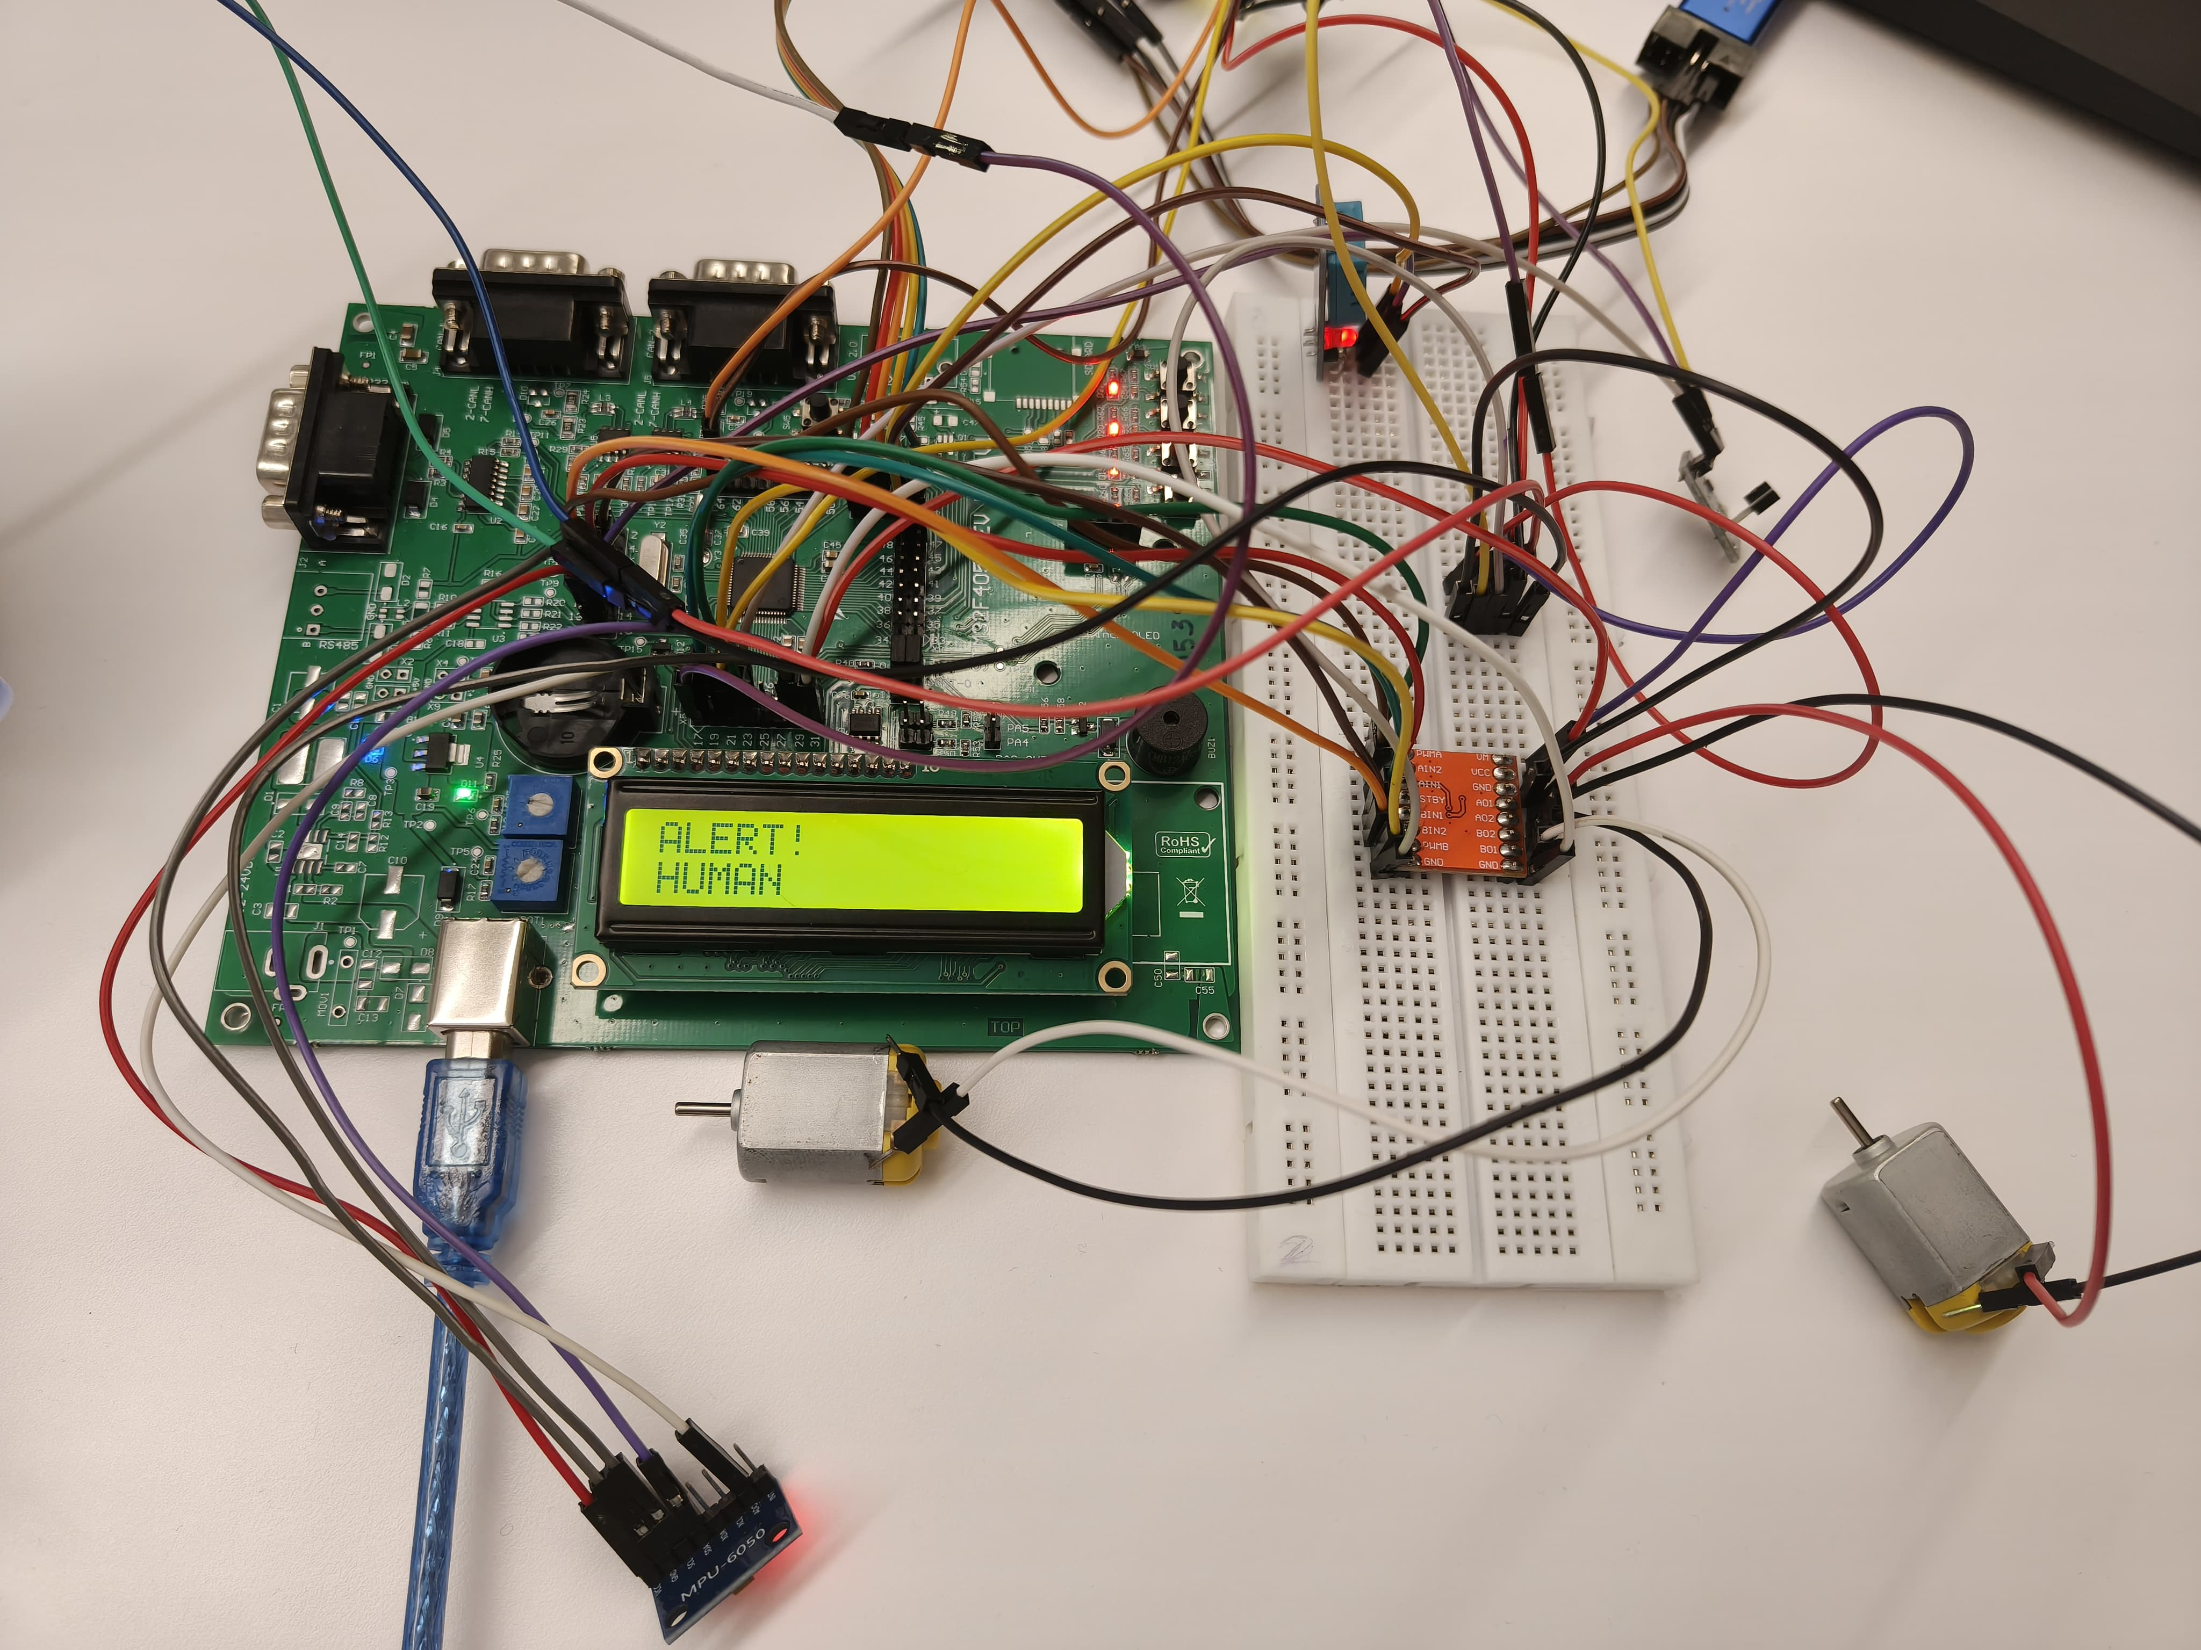
Future Vision
1
Short-term (6-12 months)
GSM/4G connectivity, advanced algorithms, battery backup, enhanced interface
2
Long-term (1-3 years)
Machine learning integration, OEM partnerships, regulatory certification, fleet management
This comprehensive vehicle health monitoring system establishes a solid foundation for widespread deployment across the small electric vehicle market, delivering exceptional safety and economic benefits.

