Slide 1
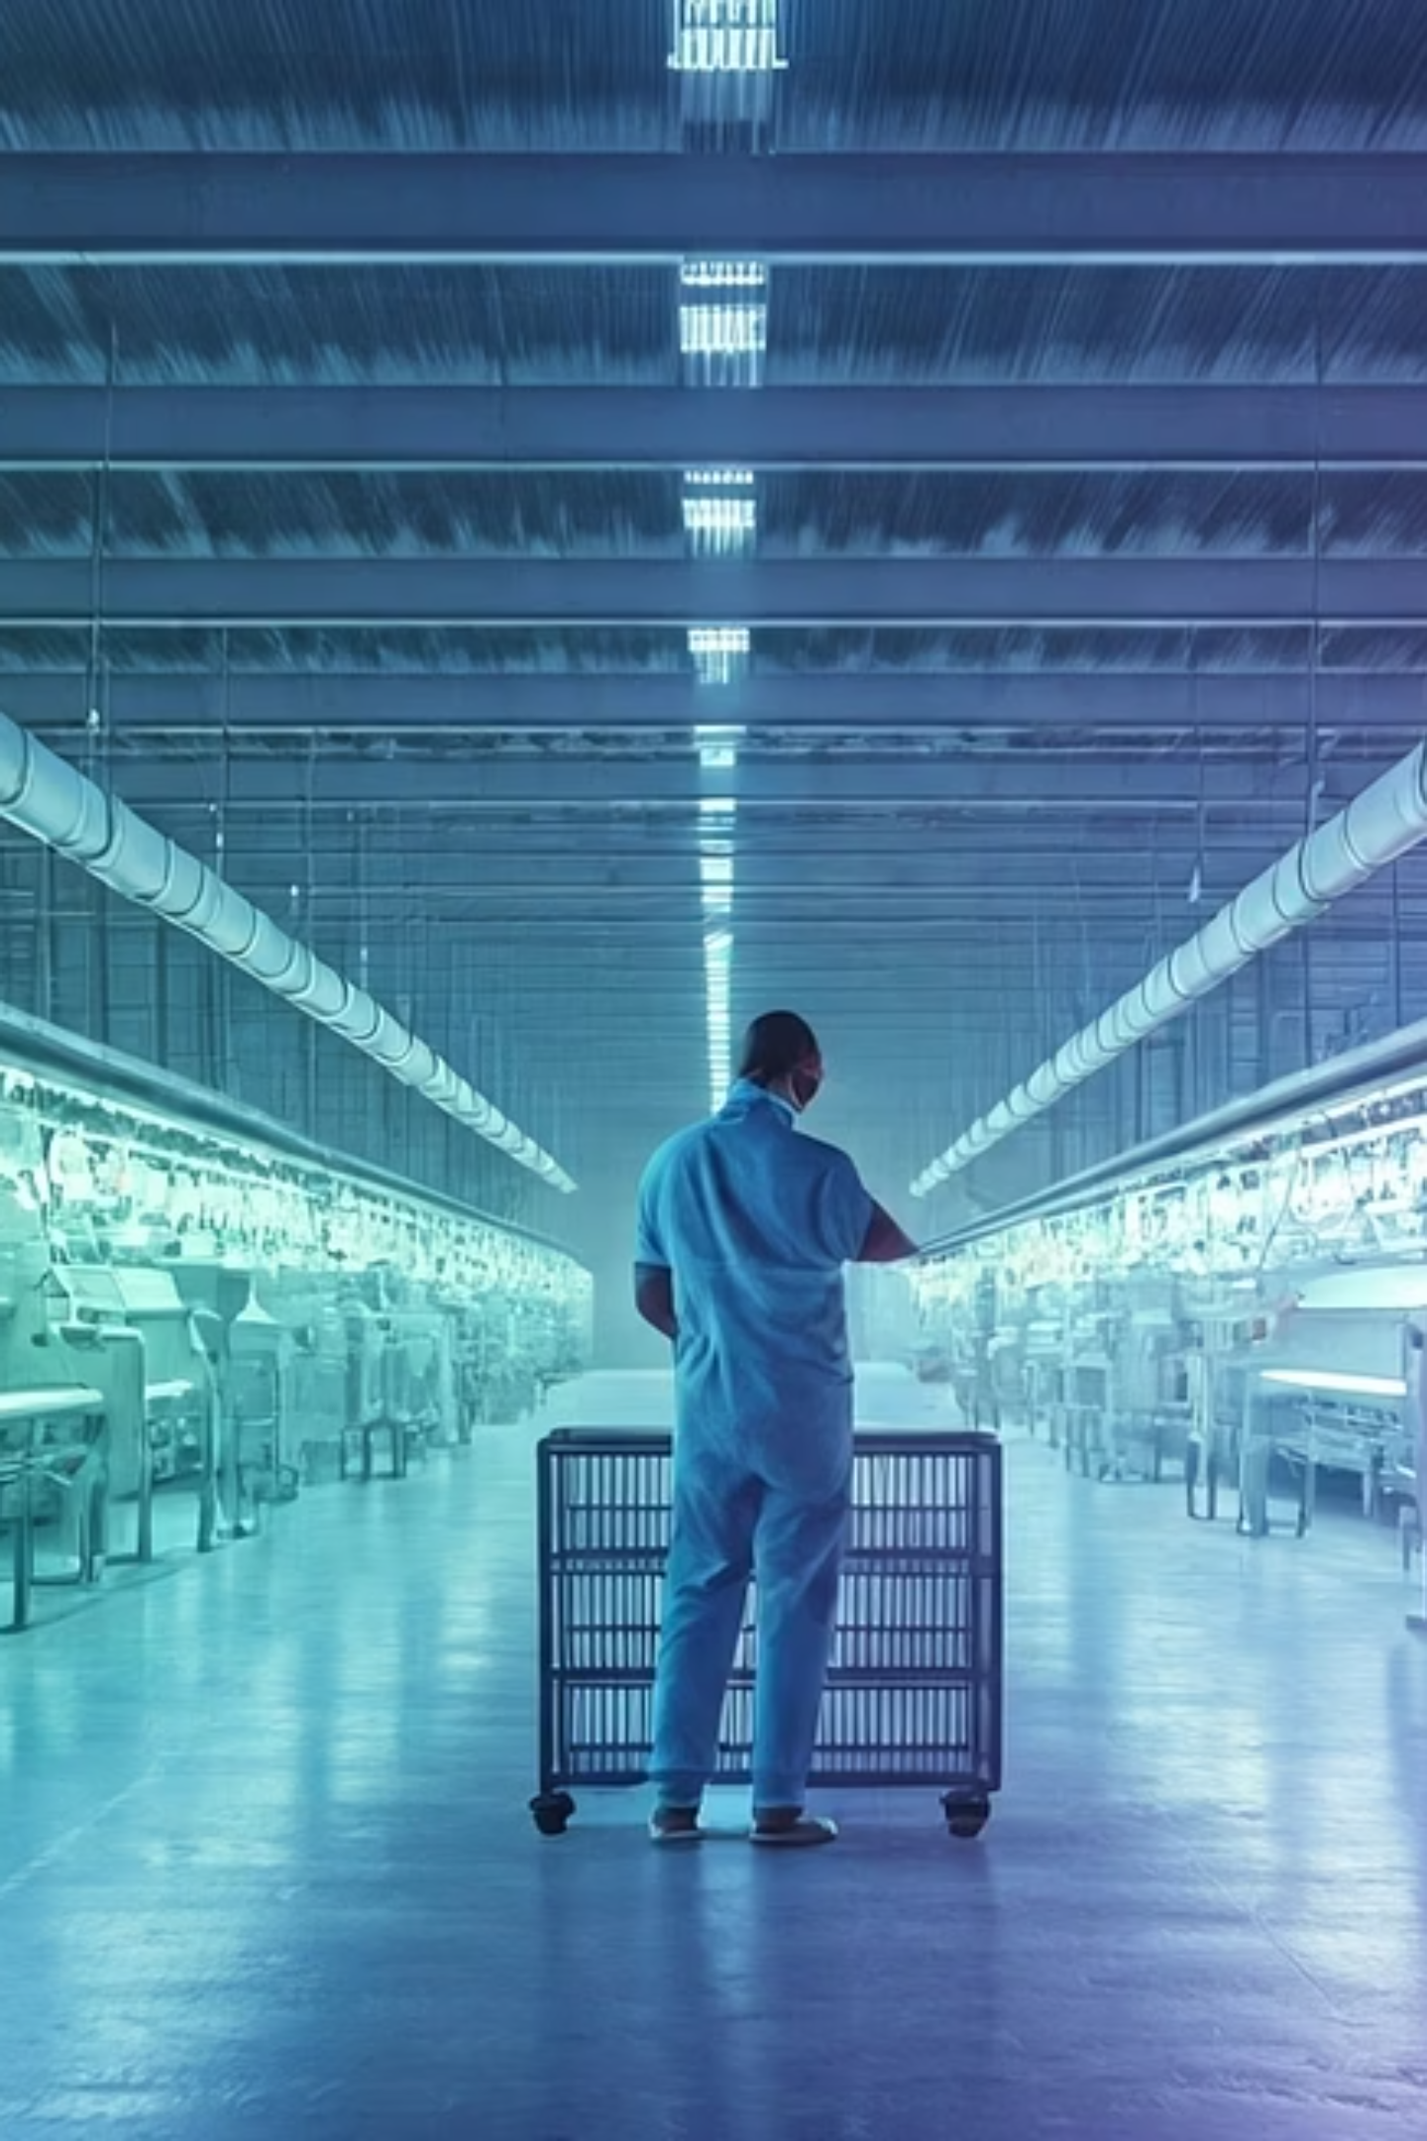

Textile Industry Safety Monitoring Project
SILICON SQUAD | Final Review Presentation | 15th July 2025

Slide 2
Team & Acknowledgments
The success of this project is a testament to the dedication and collaboration of the SILICON SQUAD.
Aiswarya P
Team Member
Jayanth Kolisetty
Team Member
Karishma
Team Member
Sri Kamesh Guru
Team Manager
Rahul Sharma
Team Lead

Slide 3
Presentation Agenda
Requirement Analysis & Literature Review
1
System Design
2
Implementation
3
Testing & Results
4
References & Q&A
5

Slide 4
Project Execution: SDLC Overview
Our project adhered to a structured Software Development Life Cycle (SDLC) to ensure systematic progress and quality.
Phase 2: System Design
Phase 1: Requirement Analysis & Research
Architecting the system's components and interactions.
Defining system needs and reviewing existing solutions.
Phase 4: Testing & Results
Phase 3: Implementation
Validating system performance and effectiveness.
Developing the hardware and software modules.

Slide 5
Phase 1: Problem Statement
Manual monitoring in textile industries is inconsistent and unreliable, leading to significant risks.
Environmental Hazards
Hazardous Zone Entry
Machinery Malfunction
High temperatures and humidity cause severe heat stress and discomfort for workers.
Workers inadvertently entering dangerous machinery areas, leading to potential injuries.
Undetected vibrations and anomalies cause significant damage to critical equipment, leading to costly downtime.

Slide 6



Project Objectives
Our system aims to address these challenges through automated, real-time safety measures.
Real-time Monitoring
Continuously monitor environmental parameters and machine vibrations.
Automated Risk Mitigation
Implement automatic detection and mitigation of identified safety risks.
Threshold-based Actions
Automatically stop machinery motors and trigger immediate alerts when danger thresholds are exceeded.

Slide 7
Literature Review Findings
Our system design aligns with established research on textile industry safety standards.
Worker Safety Standards
Automated Safety Systems
Kavin et al. (2019) recommend maintaining temperature below 27°C and humidity below 73% for optimal worker safety and comfort.
Sharma et al. (2021) demonstrated that automated safety systems significantly reduce injury rates in industrial settings.
System Alignment
Real-time Monitoring Importance
Our project's design incorporates these key findings to create a robust and compliant safety solution.
Ramachandran et al. (2020) emphasize the critical role of real-time monitoring systems in preventing industrial accidents.

Slide 8
Key Takeaways & Next Steps
Key Takeaways
Next Steps
Proactive safety measures mitigate risks.
Pilot deployment in a live textile facility.
Real-time data is crucial for prevention.
Gather user feedback for iterative improvements.
Automated systems enhance workplace safety.
Explore integration with existing factory management systems.
Thank you for your time and attention. We are now open for questions.

Slide 9



Phase 2: System Design
Solution Overview
Our system is engineered to create a safer textile manufacturing environment. By integrating a network of sensors with a central microcontroller and various actuators, we've developed a robust solution for continuous safety monitoring.
Sensors
Microcontroller
Actuators
Continuous data acquisition from environmental and operational parameters.
Real-time processing of sensor data against predefined safety thresholds.
Automated responses, including machinery shutdown and immediate alerts.

Slide 10

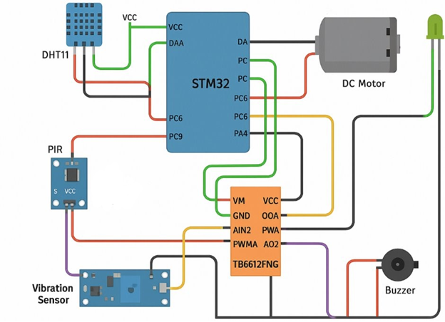
System Block Diagram
The system block diagram illustrates the flow of information and control within our safety monitoring solution. Input from various sensors feeds into the STM32 microcontroller, which then processes this data to control machinery motors and activate critical alerts.

Slide 11
Key System Components
We've carefully selected a suite of reliable components to ensure the accuracy and effectiveness of our safety monitoring system. Each component plays a vital role in data collection, processing, and response.
Component
Purpose
DHT11
Monitors ambient temperature and humidity levels.
PIR & HC-SR501
Detects human presence and motion in restricted areas.
HW-072
Measures vibration for machinery fault detection.
TB6612FNG
Drives and controls the machinery motors.
Buzzer & LEDs
Provides audible and visual alerts for safety incidents.
STM32 MCU
Central processing unit for data analysis and control logic.

Slide 12
Pin Mapping Details
Precise pin mapping is crucial for seamless communication between the STM32 microcontroller and all connected components. The following table outlines the specific pin assignments for each hardware element.
Component
Pin
MCU Pin
LCD D0–D7 Data
Data Lines
PC4…PB15
DHT11
Data
PA2
PIR
Data
PA4
Vibration
DO
PA5
Motor Driver
AIN1, AIN2, PWMA, STBY
PC0, PC1, PA6, PA3
Buzzer
Signal
PC9
LED
Signal
PC6

Slide 13
Software Architecture
Our software architecture is designed for modularity, robustness, and responsiveness. It leverages a threshold-based logic system to ensure immediate and appropriate reactions to potential safety hazards.
Modular Design
Threshold-Based Logic
Sensor Drivers: Dedicated modules for accurate data acquisition from each sensor type.
Temperature: Motor stop & alert if Temp ≥27°C.
Humidity: Alert only if Humidity ≥73%.
Decision Logic: Core processing unit that interprets sensor data against safety parameters.
Proximity & Motion: Motor stop & alert for Motion, Vibration, Presence detection.
Actuator Control: Manages machinery shutdown and activates alert systems.

Slide 14
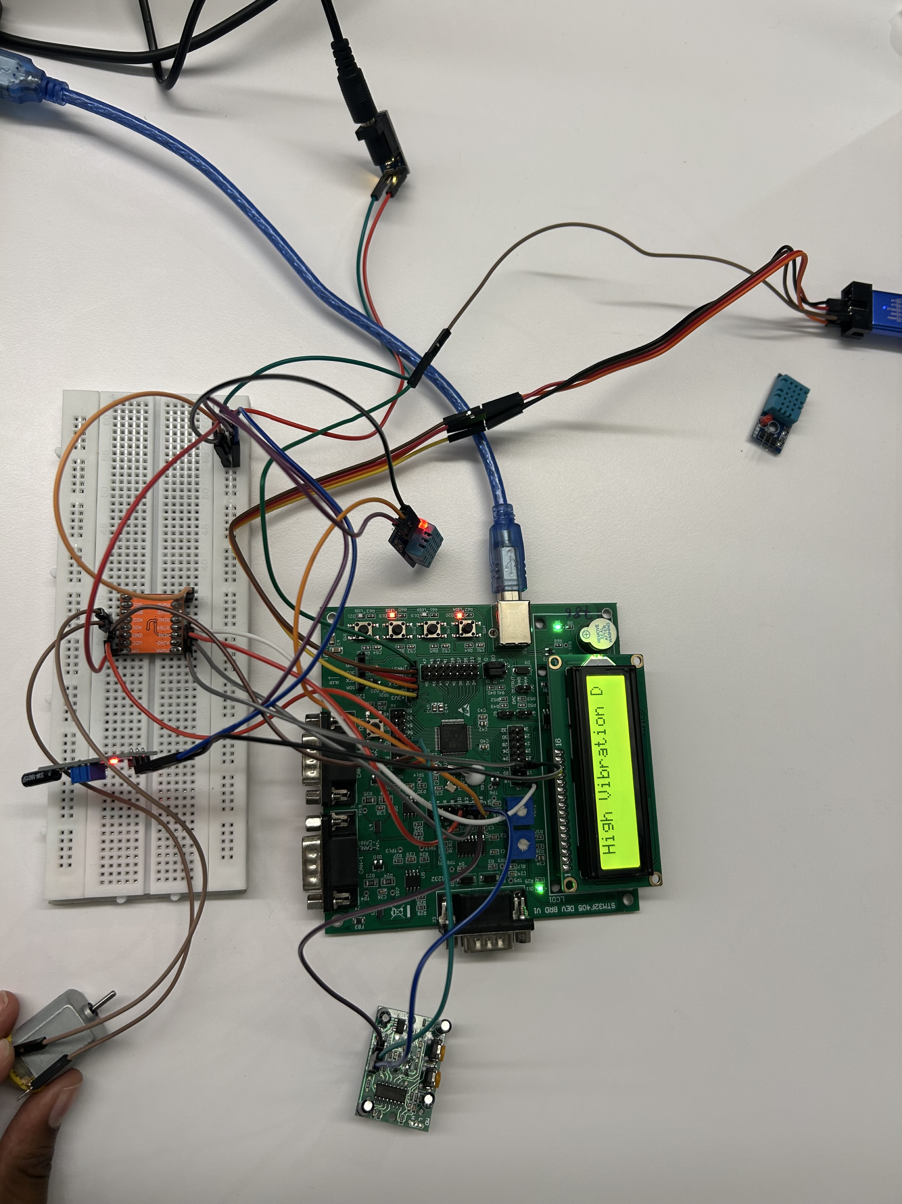
Hardware Schematic
The circuit schematic provides a comprehensive visual representation of all component interconnections. This detailed diagram ensures proper wiring and serves as a blueprint for hardware assembly and troubleshooting.

Slide 15
Phase 3: Implementation
Hardware Assembly & Software Development
The implementation phase focused on bringing the design to life, from assembling the physical components to writing the embedded code that powers the system's intelligence.
Hardware Assembly
Software Development
Components were meticulously wired on a breadboard, ensuring secure connections. Power rails and all inter-component wiring were rigorously verified for stability.
The system's core logic was developed in embedded C, following a structured "Read → Compare → Actuate" paradigm for efficient and reliable operation.

Slide 16
System Integration
The integration phase was critical for combining individual components into a cohesive, functional prototype. This involved rigorous testing of the interconnected system to ensure all parts worked in harmony.
Functional Prototype
Interoperability Checks
The complete system was assembled and validated, resulting in a fully operational prototype ready for comprehensive testing.
Component Testing
Verification of seamless communication and data exchange between all integrated hardware modules.
Individual sensors, the controller, and actuators were tested independently to confirm their functionality.

Slide 17
Phase 4: Testing & Results
Comprehensive Testing and Successful Outcomes
Our rigorous testing strategy validated the system's reliability and effectiveness in detecting and responding to safety thresholds.
Testing Strategy
Key Results
Unit Testing: Individual sensors and modules were validated for accuracy and performance.
DHT11: Temperature ≥27°C successfully triggered motor stop and alerts.
Integration Testing: All components were tested as a complete system to ensure seamless operation.
Humidity: Levels ≥73% reliably activated alerts.
Motion/Vibration/Presence: All detections promptly stopped motors and triggered alerts.
Condition Simulation: Real-world scenarios were simulated to trigger system responses under controlled conditions.
Reliability: The system consistently functioned without failure across all test cases.

Slide 18



Enhancing Workplace Safety
Enhanced Worker Safety & Comfort
Reduced Risk of Machine Failure
Compliance with Industry & OSHA Guidelines
Ensuring optimal environmental conditions minimizes health risks and improves overall well-being on the factory floor.
Proactive monitoring prevents costly breakdowns and extends the lifespan of critical machinery.
Adherence to strict regulatory standards ensures a safe and legal operating environment.

Slide 19
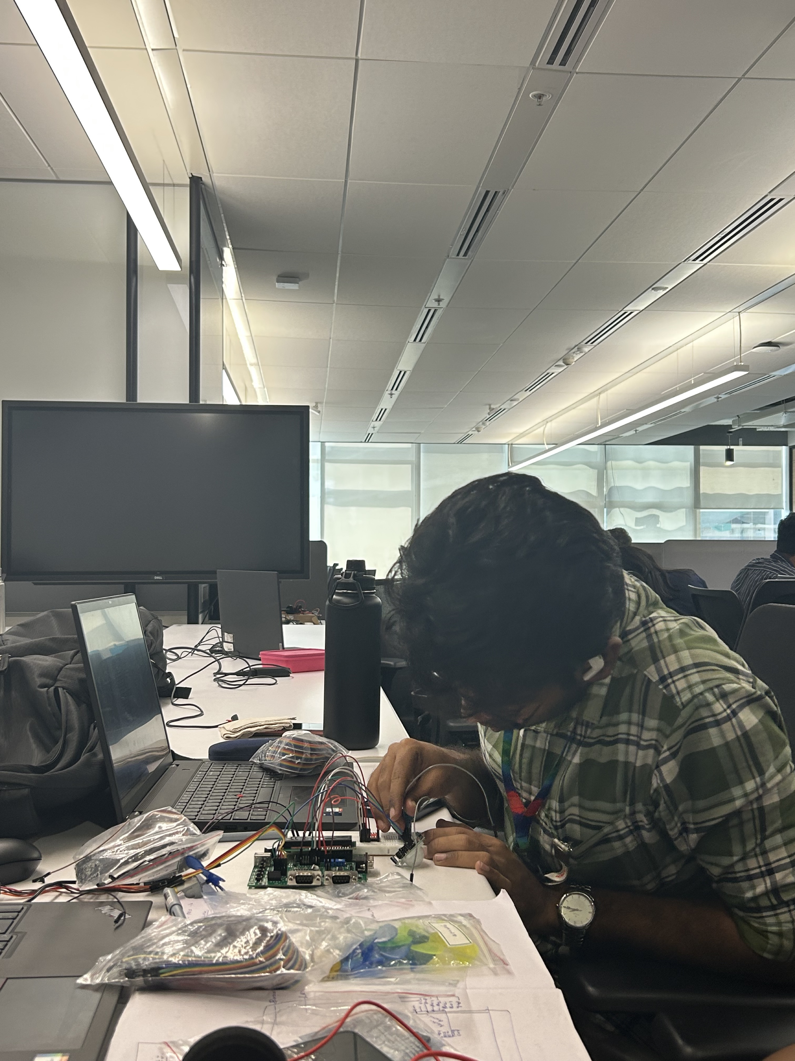
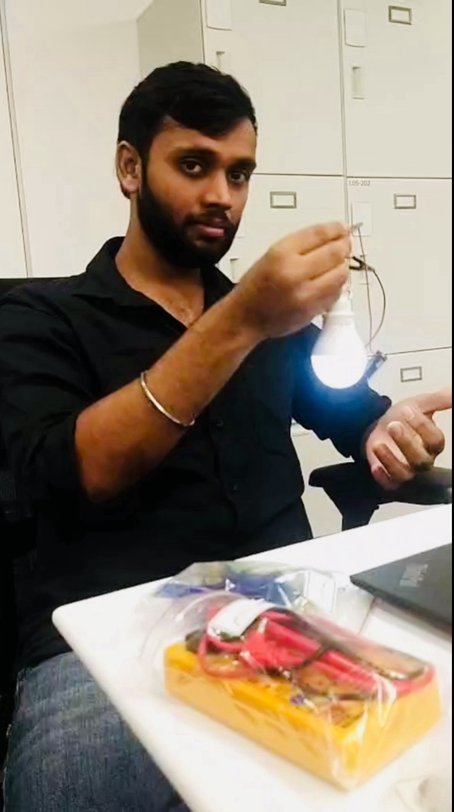
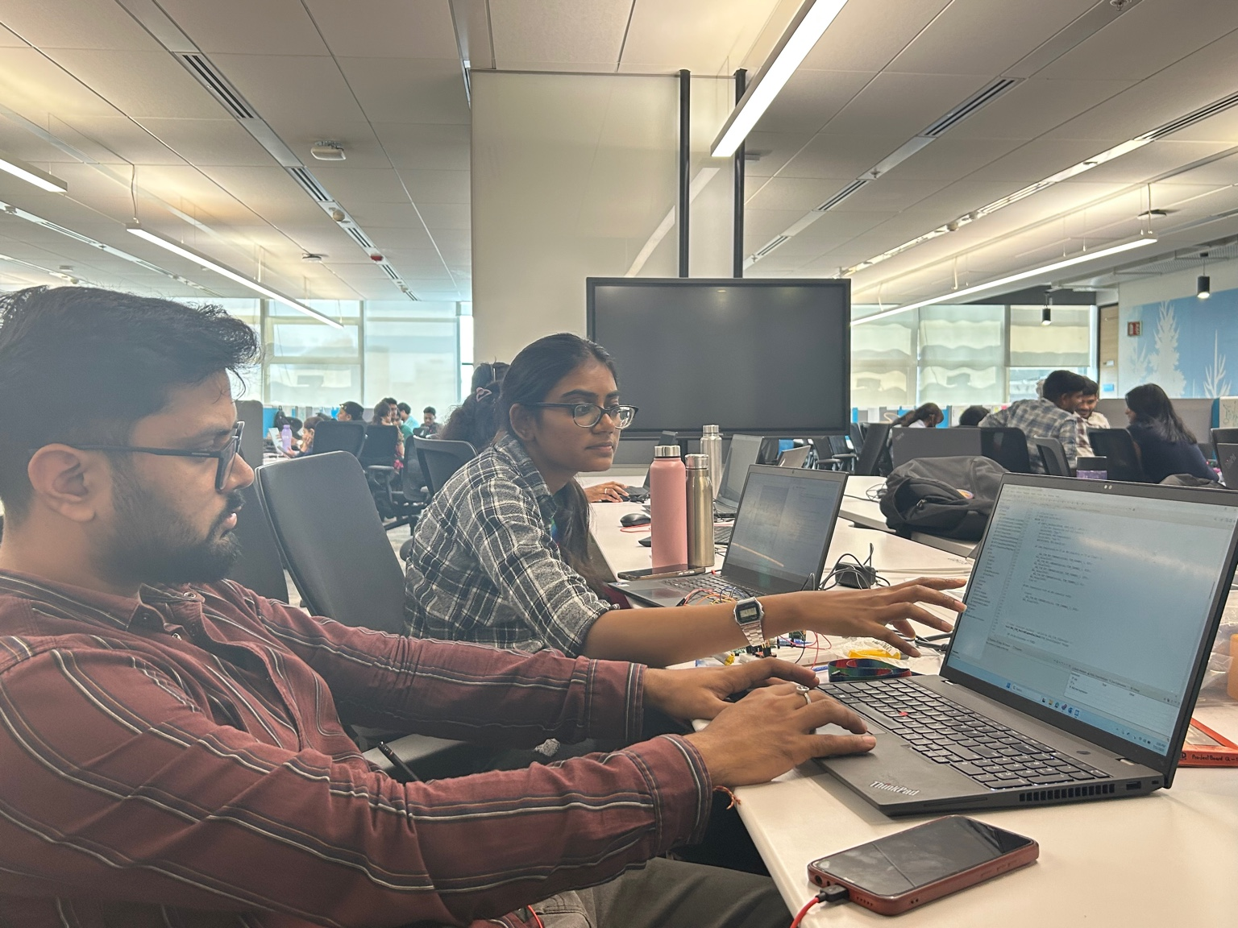
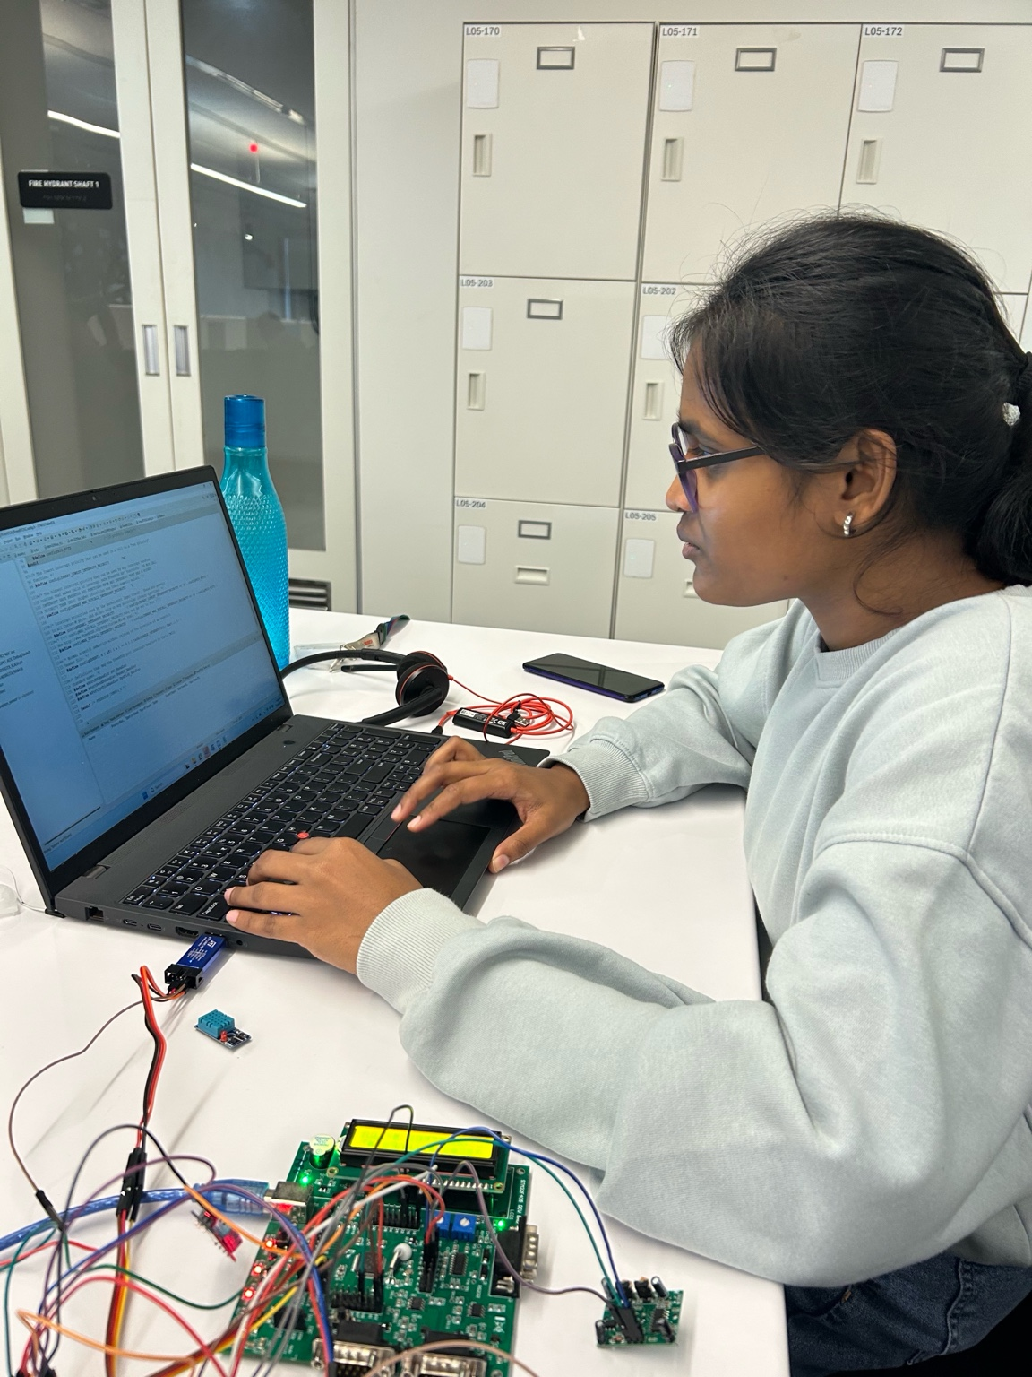
Operational Advantages
Our automated system provides significant operational benefits, streamlining processes and improving responsiveness.
Real-time monitoring: Continuous data streams provide immediate insights into environmental conditions.
Immediate action on unsafe conditions: Automated alerts and responses mitigate risks without delay.
Low-cost & scalable solution: Designed for affordability and easy expansion across various industrial settings.

Slide 20
Lessons Learned from Implementation
Effective Teamwork Boosts Project Efficiency
Shielded Connections Improve Stability
Careful Calibration is Key
Collaborative efforts among engineers and stakeholders were vital for smooth integration and rapid problem-solving.
Precise sensor calibration ensures accurate data and reliable system performance in varied conditions.
Implementing shielded wiring prevents electromagnetic interference and enhances data integrity in noisy industrial environments.

Slide 21
Key Research & Guidelines
Automatic Humidity and Temperature Controller
Real-Time Environmental Monitoring
Ramachandran, P. et al., _“Real-Time Environmental Monitoring in Textile Mills,”_ IJERT, 2020.
Kavin, V. et al., _“Automatic Humidity and Temperature Controller for Textile Mills,”_ IJIRSET, 2019.
View Research
Automated Safety Systems in Industrial Environments
OSHA Guidelines for Textile Worker Safety
OSHA Guidelines for Textile Worker Safety, 2018.
Sharma, R. et al., _“Automated Safety Systems in Industrial Environments,”_ IJSER, 2021.

Slide 22
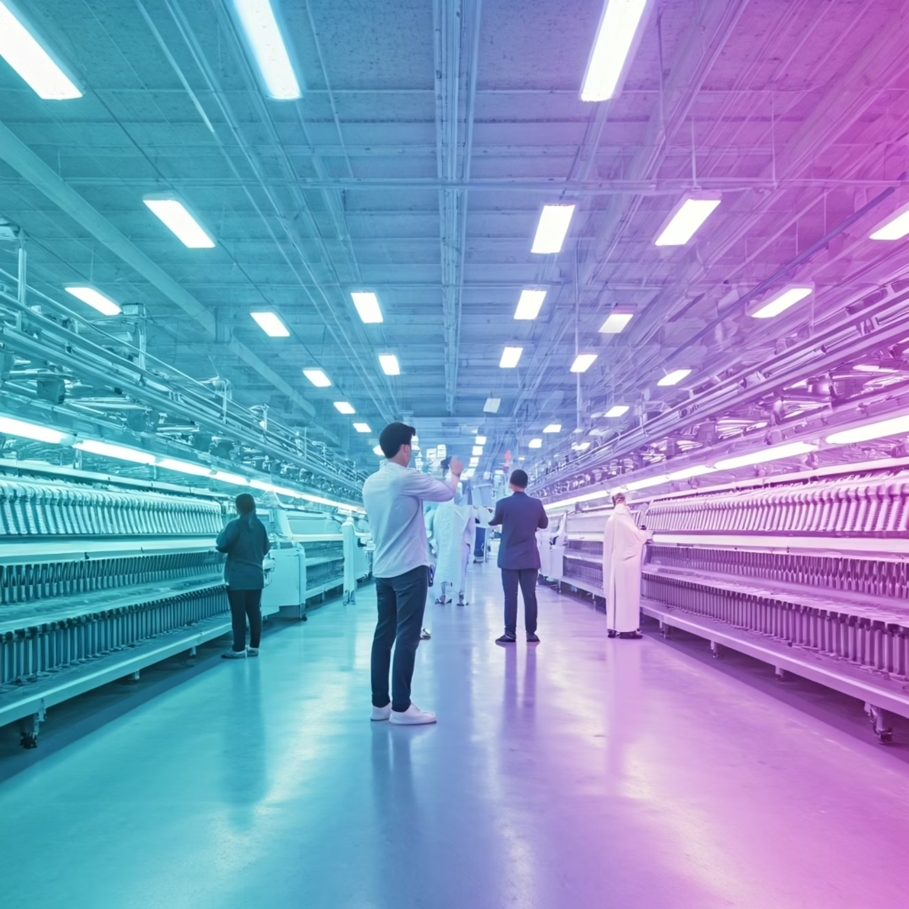
Future Outlook: Innovation and Expansion
We are continuously exploring advancements in sensor technology and AI-driven analytics to further enhance system capabilities. Our vision includes:
Integration with predictive maintenance platforms.
Expansion to other manufacturing sectors.
Enhanced data visualization and reporting.

Slide 23

Thank You!
🙏 We appreciate your time & feedback!
Questions?

