Slide 1

Smart Traffic Management System
Revolutionizing urban mobility through intelligent, sensor-driven traffic control.

Slide 2
The Problem
Traffic Congestion: A Global Challenge
Current urban traffic management largely relies on two outdated methods: manual police intervention and fixed timer-based signals. Both approaches are inherently inefficient and contribute significantly to widespread urban issues.
These inefficiencies manifest in critical problems:
Severe Congestion: Increased travel times and productivity loss.
Wasted Resources: Excessive fuel consumption and increased vehicle wear.
Manual Control: Inconsistent, resource-intensive, and prone to human error.
Environmental Pollution: Higher emissions from idling vehicles.
Fixed Timers: Unable to adapt to real-time traffic flow, leading to unnecessary delays and inefficient light cycles.
Economic Impact: Billions lost annually due to traffic delays.
We need an adaptive, sensor-based automated control system to alleviate these pressing issues.

Slide 3




Our Solution
Dynamic Traffic Optimization
Our objective is to design and implement a smart traffic management system that addresses the core limitations of existing solutions. This system will leverage advanced sensing and embedded processing to create a truly responsive and efficient traffic network.
Real-time Vehicle Detection
Dynamic Traffic Light Control
Robust Embedded Control
Utilize ultrasonic sensors to precisely detect vehicle presence and density in each lane, providing accurate, instantaneous data.
Employ the STM32F405RGT6 microcontroller as the central processing unit, ensuring reliable and high-performance system operation.
Algorithmically adjust traffic light timings based on live sensor data, optimizing flow and minimizing idle times.

Slide 4
Background & Innovation
Beyond Conventional Approaches
Our research involved an in-depth analysis of existing smart traffic solutions and academic literature. While the field is evolving, a critical gap remains that our system aims to address.
Current Trends in Smart Traffic
The Cost Barrier
IoT-based Traffic Systems (Ref: IEEE Xplore, 2023)
While effective, camera and AI-based systems often come with a prohibitive cost due to high-resolution cameras, powerful processing units, and complex AI model training. This limits their widespread adoption, especially in resource-constrained environments.
AI-driven Adaptive Traffic Management (Springer, 2022)
Sensor-based Signal Manipulation (MDPI, 2024)
Many cutting-edge solutions predominantly rely on camera and AI technologies for vehicle detection and analysis.
Our proposed system provides a low-cost ultrasonic sensor alternative, offering a scalable and economically viable solution without compromising on adaptive control capabilities.

Slide 5
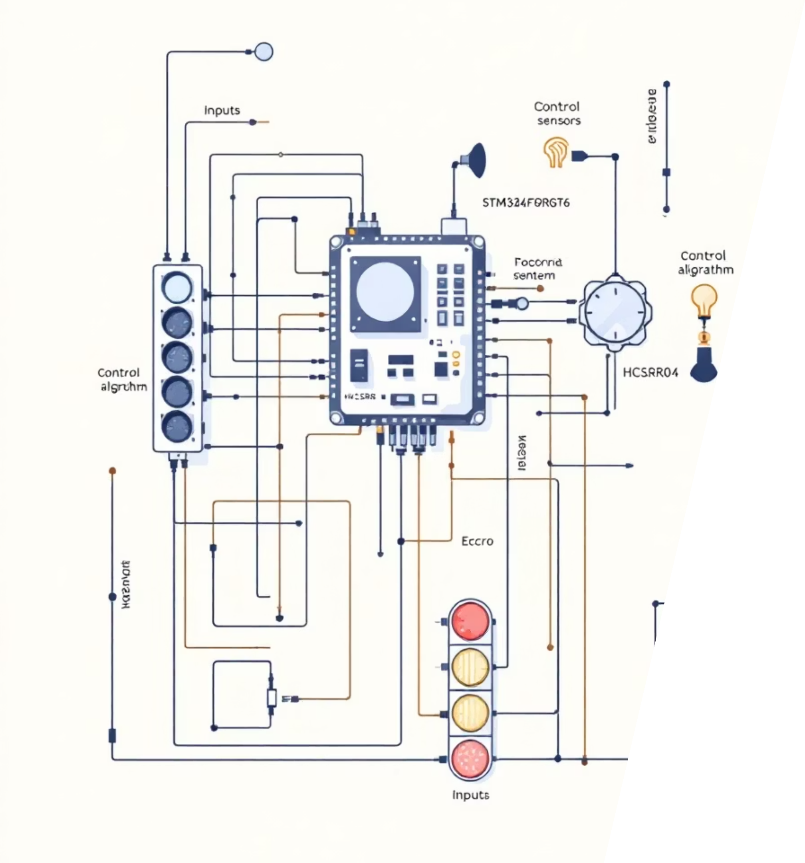
System Architecture Overview
Integrated Hardware & Software
Inputs
Ultrasonic Sensors (HCSR04) strategically placed on each lane for accurate presence detection.
Processor
STM32F405RGT6 microcontroller, the brain of the system, responsible for real-time data processing and decision-making.
Outputs
Standard LED Traffic Lights (Red, Yellow, Green) for visual signaling to drivers.
Control & Timing
Custom Dynamic Priority Assignment algorithm and RCC/TIM2 for precise timing and reliable operation.

Slide 6
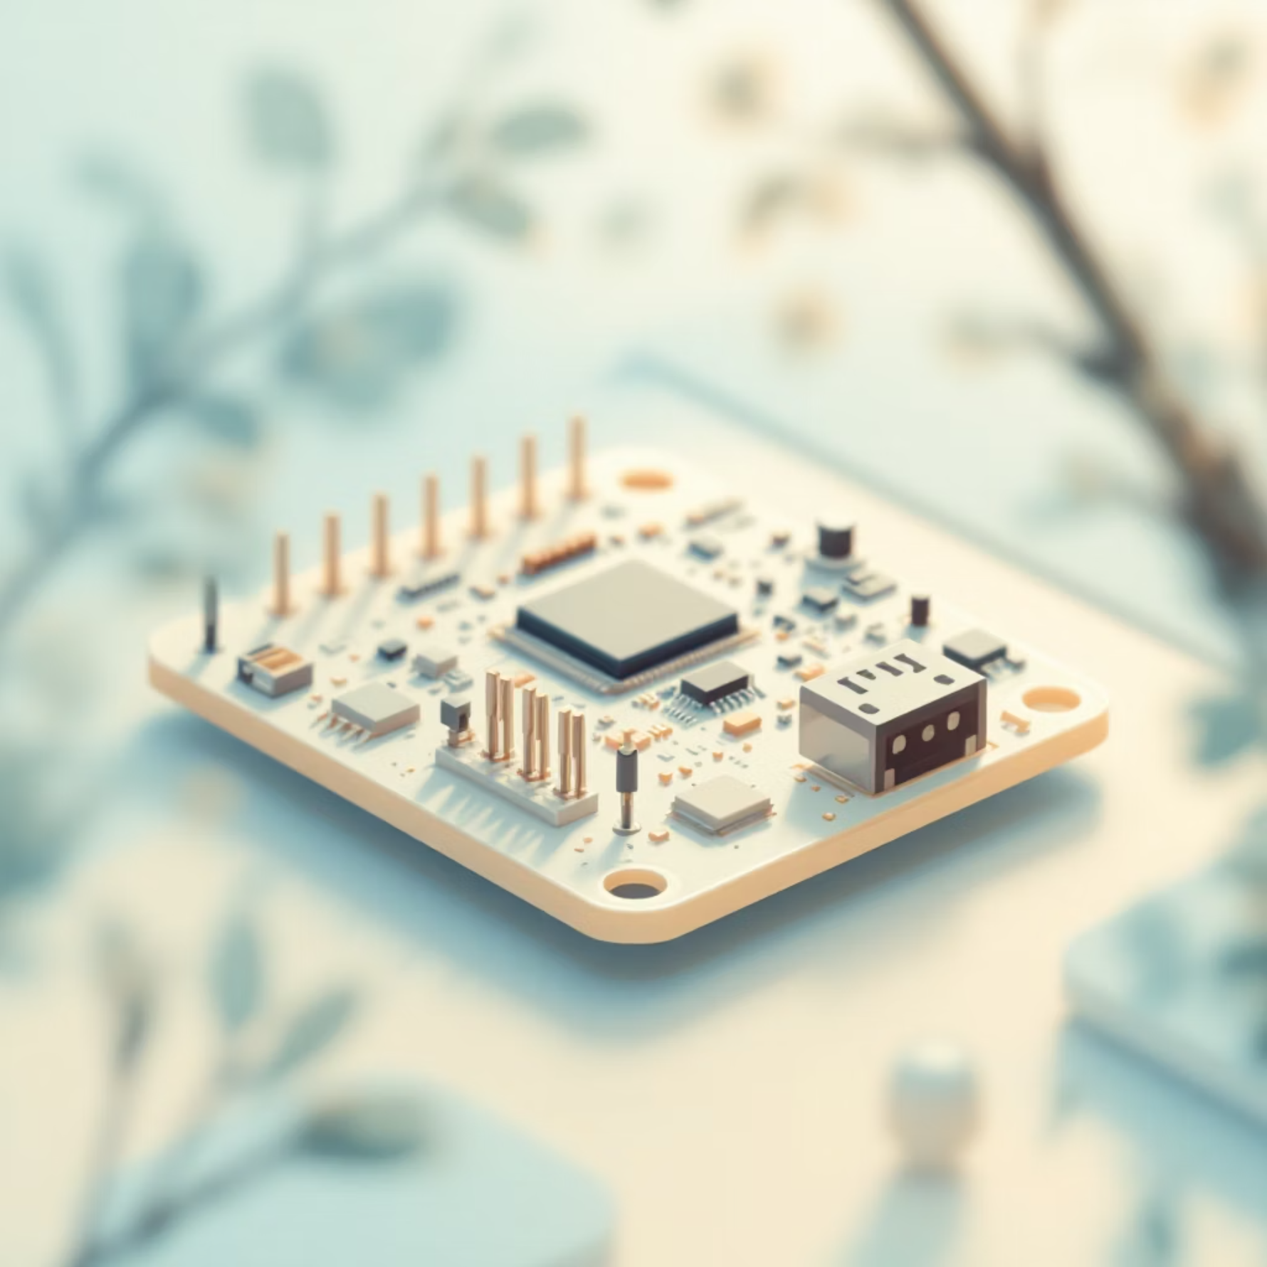

Core Hardware Components
Robust and Efficient Selection
The selection of hardware components is critical for the system's performance, reliability, and cost-effectiveness. We've chosen industry- and education-standard components known for their capabilities and ease of integration.
STM32F405RGT6 Microcontroller
Ultrasonic Sensors (HCSR04)
Processor: ARM Cortex-M4 @ 168 MHz
Range: 2cm to 400cm
Memory: 1MB Flash, 192+4KB SRAM
Accuracy: Up to 3mm
Peripherals: Rich set of GPIOs, Timers, ADCs, etc.
Operation: Emits ultrasound, measures echo arrival time.
Role: Central processing unit for sensor data, algorithm execution, and traffic light control.
Role: Non-contact detection of vehicle presence and approximate distance in each lane.
Additional Components: Traffic Signal LEDs (Red, Yellow, Green), 5V/3.3V Power Regulation.
Future Integration (Optional): TB6612FNG Motor Driver for more complex signaling or barrier control.

Slide 7




Software Development
Baremetal Efficiency & Modularity
Our software is engineered for maximum efficiency and control, developed using baremetal C code for direct hardware interaction. This approach ensures minimal overhead and optimal performance, critical for real-time applications.
Baremetal C Code
Key Driver Development
Direct register access for low-level control, eliminating OS overhead.
GPIO: Configures pins for input (sensors) and output (LEDs).
Timer (TIM2): Provides precise delays and measures ultrasonic echo duration.
Ultrasonic: Handles trigger pulse generation and distance calculation.
Traffic Light State Machine
Agile Lifecycle
Manages the sequence and timing of traffic light changes based on the control algorithm.
Iterative development for rapid prototyping, testing, and continuous improvement.

Slide 8
Flow of Control
Real-time Decision Making Process
The system operates on a continuous feedback loop, adapting to traffic conditions in real-time. This sequential flow ensures dynamic and efficient traffic management.
01
02
03
Trigger Ultrasonic Sensors
Measure Echo Pulse
Calculate & Compare Distance
The microcontroller initiates a trigger pulse from each sensor to emit ultrasound waves.
The time taken for the ultrasound wave to return (echo) is precisely measured by the microcontroller's timer.
The echo duration is converted into distance. This distance is then compared against a predefined threshold to determine vehicle presence.
04
05
Assign Traffic Light Priority
Update Light States
Based on vehicle detection across all lanes, the system's algorithm dynamically assigns priority to the busiest lane(s).
Traffic lights are updated according to the assigned priorities, optimizing flow and reducing wait times.

Slide 9
Code Logic Summary
Algorithmic Core of STM32
Initialization Sequence
Traffic Control Algorithm
RCC Clock Enabled: System clock configured for optimal performance.
Vehicle Detection: If the calculated distance is less than a predefined threshold, vehicles are considered present in that lane.
GPIOs & TIM2 Configured: All necessary pins and timer peripherals initialized.
Dynamic Priority: Lanes with detected vehicles are given priority, overriding the default cyclic sequence.
Default State: All traffic lights are initially set to red, ensuring a safe startup.
Green Time Management: A prioritized lane receives a maximum green time before transitioning to yellow and then red.
Ultrasonic Measurement Logic
Next Lane Selection: After a lane's cycle, the algorithm evaluates other lanes for priority or proceeds in a default order if no priority is needed.
Trigger Pulse: A short pulse is sent to the sensor's trigger pin.
Echo Duration: The microcontroller listens for the echo pulse on the sensor's echo pin, measuring its duration using TIM2.
Continuous Operation Loop
Distance Calculation: Distance is computed using the formula: Distance = Pulse width / 58 (for cm).
Sensors continuously update distance measurements.
The traffic control algorithm re-evaluates and updates the light cycle dynamically based on the latest data.

Slide 10
Prototype Implementation
Bringing the Concept to Life
Our functional prototype demonstrates the viability and effectiveness of the Smart Traffic Management System. This hands-on implementation phase allowed us to rigorously test and validate our design.
Physical Layout
Breadboard connections facilitating easy assembly and modification.
Microcontroller Integration
STM32F405RGT6 seamlessly connected to all sensors and output LEDs.
Sensor Configuration
Four ultrasonic sensors strategically positioned to simulate traffic lanes.
Traffic Signal Representation
LEDs clearly represent red, yellow, and green traffic lights.
Power Supply
Reliable power provided via USB or a regulated external source.
Testing Environment
Real-time testing conducted using toy vehicles to simulate varying traffic conditions and observe dynamic responses.

Slide 11
Code Implementation
Core Logic Snippets
GPIO & TIM2 Setup
Ultrasonic Measurement
// GPIO for HC-SR04 Trigger & EchoHAL_GPIO_Init(...);// TIM2 for microsecond delaysTIM_HandleTypeDef htim2;htim2.Instance = TIM2;HAL_TIM_Base_Init(&htim2);HAL_TIM_Base_Start(&htim2);
float getDistance_cm() { // Trigger pulse HAL_GPIO_WritePin(TRIG_GPIO_Port, TRIG_Pin, GPIO_PIN_SET); delay_us(10); HAL_GPIO_WritePin(TRIG_GPIO_Port, TRIG_Pin, GPIO_PIN_RESET); // Measure echo pulse duration while(HAL_GPIO_ReadPin(ECHO_GPIO_Port, ECHO_Pin) == GPIO_PIN_RESET); uint32_t start_time = __HAL_TIM_GET_COUNTER(&htim2); while(HAL_GPIO_ReadPin(ECHO_GPIO_Port, ECHO_Pin) == GPIO_PIN_SET); uint32_t end_time = __HAL_TIM_GET_COUNTER(&htim2); return (end_time - start_time) * 0.034 / 2; // Speed of sound in cm/µs}
Traffic Cycle Logic
The system prioritizes traffic flow based on real-time vehicle detection. When a vehicle is detected, the corresponding lane's green light duration is extended. In the absence of traffic, a default cycle maintains flow, preventing unnecessary delays.

Slide 12
Project Management
Agile Development Lifecycle
01
02
03
Requirement Gathering
Sprint Planning
Incremental Prototyping
Defined core functionalities: real-time detection, adaptive timing, and basic traffic states.
Structured development into two-week sprints, focusing on hardware integration, sensor logic, and traffic control algorithms.
Developed modular code for GPIO, timers, and sensor readings, integrating and testing in stages.
04
05
Testing & Feedback
Deployment
Conducted bench testing and simulated traffic scenarios to refine sensor accuracy and timing logic.
Finalized prototype for demonstration, showcasing adaptive behavior in varied traffic conditions.
Our agile approach facilitated rapid iteration and allowed us to adapt to unforeseen technical challenges efficiently, leading to a robust and functional prototype.

Slide 13

Prototype Evaluation
Key Advantages & Benefits
1
2
3
Reduced Congestion
Fuel & Time Savings
Pollution Control
Dynamic adjustment of signal timings based on real-time traffic flow minimizes unnecessary waits.
Optimized traffic flow leads to less idling, conserving fuel and reducing commute times for drivers.
Less idling directly translates to lower vehicular emissions and improved urban air quality.
4
5
Low-Cost Implementation
Scalable
Utilizes readily available and economical components like STM32 microcontrollers and ultrasonic sensors.
The modular design allows for integration into larger smart city infrastructure, potentially with AI/IoT capabilities.

Slide 14

Prototype Evaluation
Challenges & Limitations
Sensor accuracy can be affected by adverse weather conditions such as heavy rain or dense fog, leading to inconsistent readings.
The HC-SR04 ultrasonic sensor has a limited effective detection range of approximately 400 cm, restricting its application in wide intersections.
Scaling the system to manage traffic in large, complex urban environments would necessitate a robust IoT backbone for centralized data processing and control.
The current prototype requires continuous power and would need backup power solutions (e.g., UPS) to maintain operation during electrical blackouts.

Slide 15



Future Outlook
Beyond the Prototype
IoT Cloud Integration
AI-Based Prediction
Solar Power
Connecting units to cloud platforms for centralized data analytics, remote monitoring, and firmware updates.
Implementing machine learning algorithms to predict traffic density based on historical data and real-time inputs.
Integrating solar panels and battery storage to create self-sufficient, environmentally friendly traffic units.
Conclusion
The STM32-based adaptive traffic control system offers a feasible, cost-effective, and efficient solution for modern urban traffic management, reducing congestion and human intervention. Further enhancements can leverage IoT and AI for even smarter cities.
References: IEEE Xplore: Smart Traffic Systems (2023) | MDPI Sensors: Adaptive Signal Control (2024) | Springer: AI in Transportation (2022) | STM32F405RGT6 & HCSR04 Datasheets

