Slide 1
Student Information System Using Cloud Computing
Team Members:
1.AISWARYA.M
2.ANJANA MANOJ
3.DEEPTHI.K.T
Industrial Guide:
Mr. GOKUL.S
Faculty Guide:
Mrs. KAMALA.V
Department of CSE, KGiSL Institute of Technology, Coimbatore

Slide 2
Abstract
Cloud computing has emerged as a new compelling paradigm for the deployment of Applications and services .It represents an evolution of cloud programming models, abstractions, platforms and is a testament to the maturity and wide adoption of Cloud technologies.
Create web application that enables users to request rides without servers. The application will present users with an HTML based user interface for indicating the location where they would like to be picked up and will interface on the backend with a RESTful web service to submit the request and dispatch a nearby unicorn. A Static Website to be hosted with User Management and a cloud based backend is created. JavaScript executed in the browser sends and receives data from a public backend API built using Lambda and API Gateway.
Department of CSE, KGiSL Institute of Technology, Coimbatore

Slide 3
Existing system
In the existing computing system server based computing is used.
Server-based computing (SBC) is an over-arching term referring to the technology by which applications are implemented, controlled, supported and functioned on the server . Upgrading hardware, application deployment, backing up of data and technical support are simplified in a server-based environment. We need the sever room to handle the systems and to store the data. In the existing student information systems basically they will establish the student data and they will be run in the normal physical server.
Department of CSE, KGiSL Institute of Technology, Coimbatore

Slide 4
Proposed System
Student information system using cloud computing is the web application which helps the students to gather the information about the extracurricular activities that are going to happened in different institutions like workshops ,paper presentation, seminars etc… Also the students can register through this website and they can publish the details of the events that they are aware of including the venue date etc... We are using cloud as the backend to store and retrieve the data ..some of the aws services like lambda,cognito,s3,dynamodb, Restful API are used. Our proposed system is highly scalable and cost effective.
Department of CSE, KGiSL Institute of Technology, Coimbatore

Slide 5
Advantages over existing methods
The biggest advantage of cloud computing is that there is no more provisioning or managing of physical servers. It is not that servers are troublesome.
There is no need for the physical setup so that the implementation cost will be very less.
Data will be stored in very secured way.
Disaster recovery is the other very important benefit of cloud computing .
Future Enhancements
More security can be ensured by providing security devices.
Encryption technologies can be used.
Include students academic details also

Slide 6
Literature Review
Drawbacks of existing methods
The existing system needs the physical servers so that the cost for implementing this will be very high.
It will consumes more space for the physical setup including all other networking devices.
The data will not be secured and data can’t be recover after any disaster.
References: www.nevon.com
www.aws.amazon.com
Department of CSE, KGiSL Institute of Technology, Coimbatore

Slide 7
Architectural Design DFD and/ or ER diagram
Student
Management
Cloud Admin
Faculty
Application layer
View Events
Register Events
Publish Events
Middle layer
Cloud Storage
Data base layer

Slide 8
Dataflow Diagram Level 0
User
Find events
Register
Publish
Data store

Slide 9
Data Flow Diagram Level 1
Publish
User
Signup
Login
Find events
Register
generate details in the form of excel or pdf
Publish events
Data store

Slide 10
Module Splitup
Module 1:
Static Web Hosting
Module 2:
User Management
Module 3:
Serverless Backend
Module 4:
RESTful API’s
Module 5:
Resource Termination And Next Step
Department of CSE, KGiSL Institute of Technology, Coimbatore

Slide 11
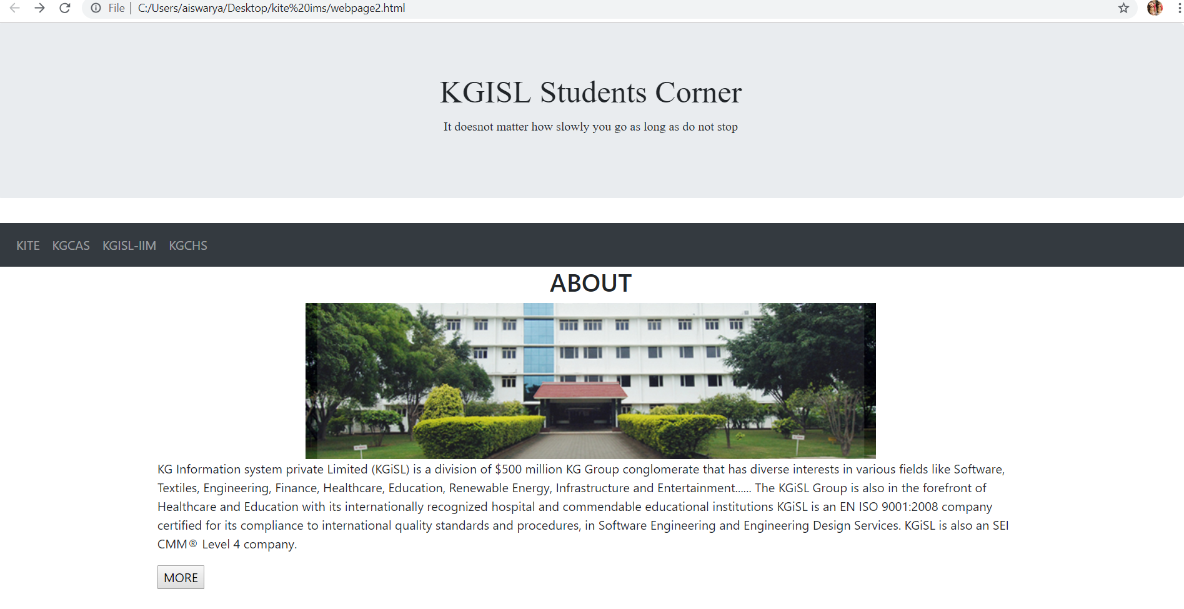
snapshots

Slide 12
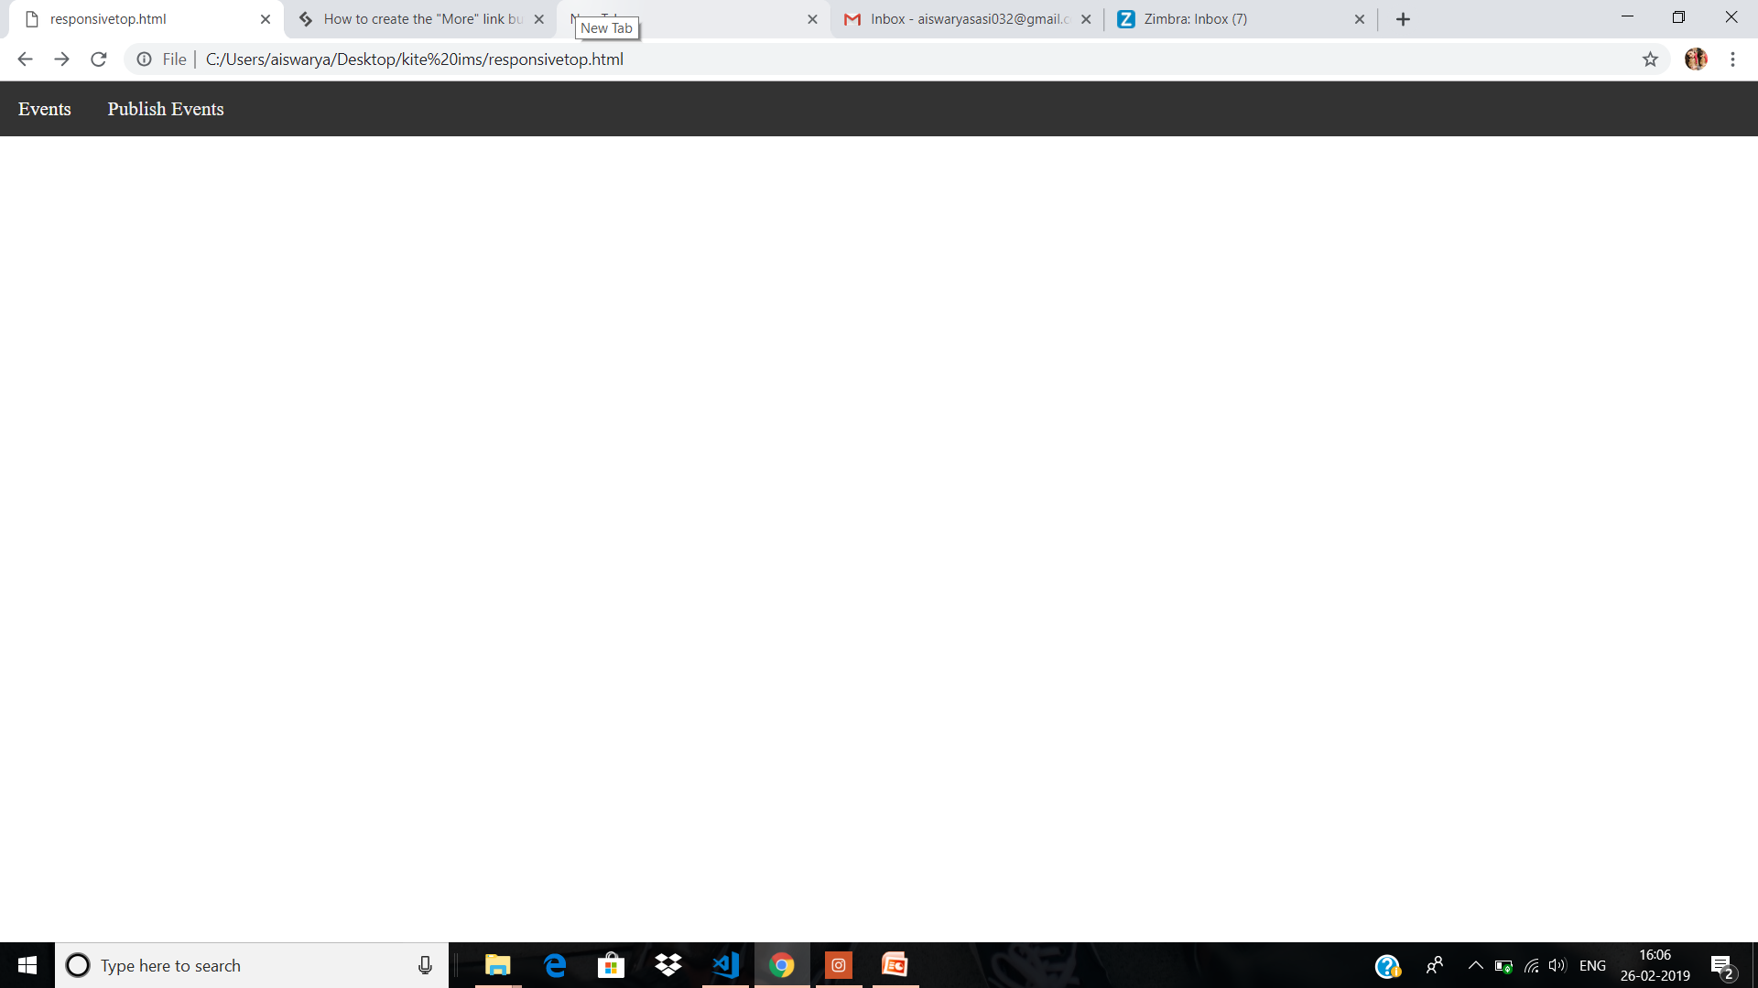

Slide 13
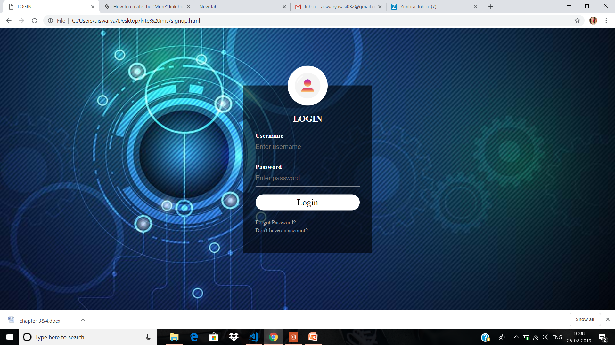

Slide 14
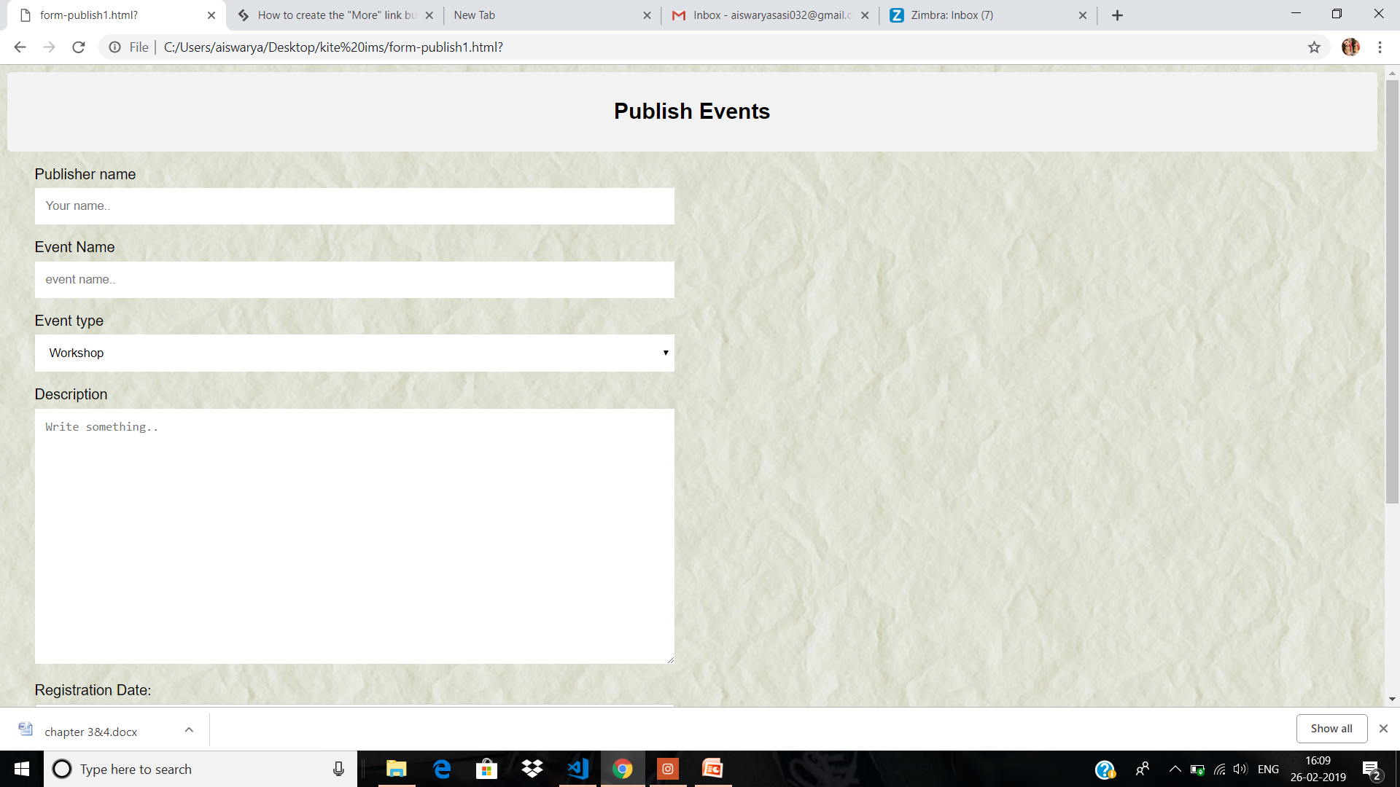

Slide 15
THANK YOU

