Slide 1
Student Performance
Prediction & Early Intervention
Identifying At-Risk Students Using Machine Learning
Team Members:
Aiswarya S
Arun P.S
Sanika J.R

Slide 2
Problem Statement & Motivation
Problem Statement
🎯 Early Identification
Spot weak students before final exams
Predict whether students will pass or fail using academic and demographic data, and identify at-risk students early for timely intervention.
📊 Academic Planning
Support data-driven curriculum decisions
Dataset: UCI Student Performance Dataset
🏆 Improve Success Rates
Increase overall pass rates institution-wide

Slide 3
Dataset Description
395
30+
2
Student Records
Features
Target Classes
Key Features
Social & Family Features
G1 — First period grade
G2 — Second period grade
Study time (1–4 scale)
Number of past failures
Number of absences
Mother's education level
Father's education level
Internet access at home
Family relationship quality
Free time after school
Target Variable: ✅ Pass (1) → Final grade ≥ 10 ❌ Fail (0) → Final grade < 10

Slide 4
Methodology
01
02
03
04
05
Data Preprocessing
EDA
Feature Engineering
Model Building
Evaluation & XAI
Handled missing values
Encoded categoricals
Created Pass/Fail target
Grade distributions
Study time vs performance
Failure patterns analysis
Removed irrelevant features
Label encoding
Feature selection
Logistic Regression
Decision Tree
Gradient Boosting
Accuracy & F1 score
LIME explanations
Model interpretability

Slide 5
Exploratory Data Analysis
Key EDA Insights
📈 Higher G1 & G2 scores strongly correlate with passing final grades
⏱️ Students with more study time (3-4 hrs) have significantly better outcomes
❌ Past failures are the strongest single predictor of failing again
📅 High absenteeism (>15 absences) is linked to higher failure rates

Slide 6
Model Evaluation & Results
🏆 Best Model
Logistic Regression
Accuracy: 92.4%
Model | Accuracy | Status
Logistic Regression | 92.4% | ✅ Selected
Decision Tree | 88.6% | —
Gradient Boosting | 86.0% | —

Slide 7
Model Explainability — LIME
🔍 LIME (Local Interpretable Model-Agnostic Explanations) explains WHY the model made each individual prediction
📊 G1 & G2 Grades
High Positive
⚠️ Past Failures
High Negative
Low grades in G1/G2 are the strongest indicators of final failure risk
Each additional past failure significantly increases fail probability
📚 Study Time
Moderate Positive
📅 Absences
Moderate Negative
Higher study time reduces failure risk, especially combined with good grades
Frequent absences correlate with lower performance and fail risk

Slide 8
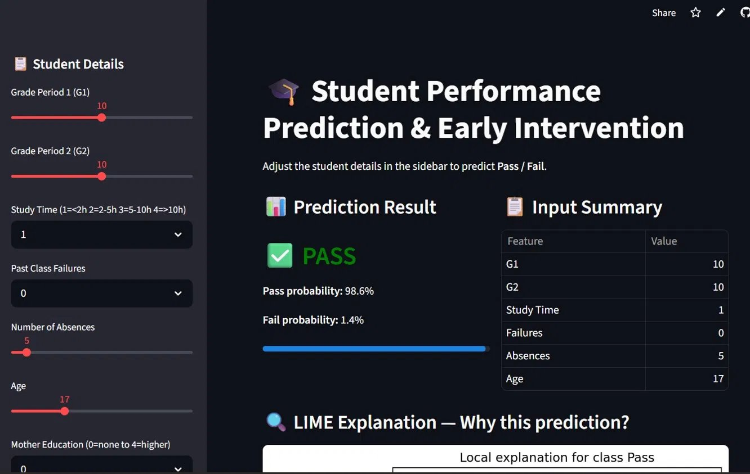
Deployment — Streamlit Web App
🎓 Prediction Result
Instantly predicts Pass or Fail with percentage probability for each student
📋 Input Summary
Displays all 6 input features — G1, G2, Study Time, Failures, Absences, Age
🔍 LIME Explanation
Explains WHY the prediction was made using local feature importance
🎚️ Interactive Controls
Sliders & dropdowns for Grade, Age, Study Time, Absences and more
🔗 Live App: https://project2studentperformancepredictionandearlyintervention-veita.streamlit.app/

Slide 9
Conclusion & Future Scope
✅ Logistic Regression achieved 92.4% accuracy on UCI dataset
✅ LIME explanations provide transparent, actionable insights
✅ Live Streamlit app deployed for real-time student assessment
✅ G1, G2 grades and failures are the most critical predictors
Thank You!
Questions & Discussion
🔭 Future Scope
Real-time data collection via student portal integration
Deep learning models for improved accuracy
Multi-class prediction (grade bands, not just Pass/Fail)

