Slide 1
HOMESTAY BOOKING SYSTEM (HomeLodge)
by:
Aisyah Umairah binti Azmir
Supervisor:
Dr. Zalmiyah binti Zakaria
17 July 2021
PSM 1

Slide 2
Presentation Outlines
Introduction
Problem Background
Project Aim
Literature Reviews
Methodology
Software/Hardware Requirement
Initial Finding
PSM2 Planning
Conclusion
PSM 1

Slide 3
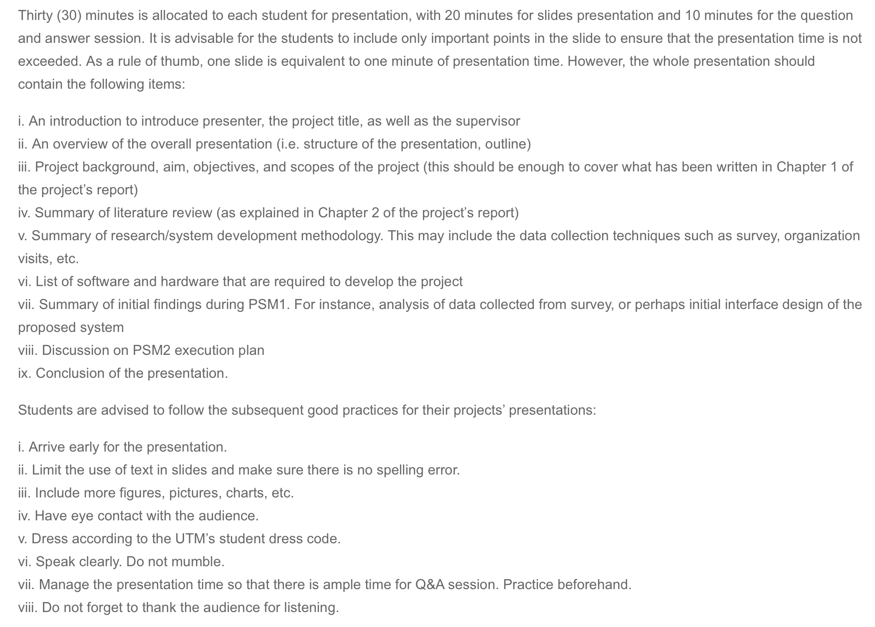
Notes:
https://engineering.utm.my/computing/psm/psm-1/

Slide 4
(1) Introduction
(1) Introduction
Text
PSM 1

Slide 5
(1) Introduction
(2) Problem Background
Text
PSM 1

Slide 6
(1) Introduction
(3) Project Aim
Text
PSM 1

Slide 7
(1) Introduction
(3) Project Objectives:
Text
Text
Text
PSM 1

Slide 8
(1) Introduction
(3) Project Scopes:
Text
Text
Text
PSM 1

Slide 9
(1) Introduction
(4) Literature Review
(a) System 1
Text
PSM 1

Slide 10
(1) Introduction
(4) Literature Review
Continue from previous slide
If not use this, just hide or delete this slide
PSM 1

Slide 11
(1) Introduction
(4) Literature Review
(b) System 2
Text
PSM 1

Slide 12
(1) Introduction
(4) Literature Review
Continue from previous slide
If not use this, just hide or delete this slide
PSM 1

Slide 13
(1) Introduction
(4) Literature Review
(c) System 3
Text
PSM 1

Slide 14
(1) Introduction
(4) Literature Review
Continue from previous slide
If not use this, just hide or delete this slide
PSM 1

Slide 15
(1) Introduction
(4) Literature Review
Table: System comparison
Item | System 1 | System 2 | System 3 | Yours
PSM 1

Slide 16
(1) Introduction
(4) Literature Review
Technologies:
Text

Slide 17
(1) Introduction
(4) Literature Review
Text
Figure: Use this label for each figure
PSM 1

Slide 18
(1) Introduction
(4) Literature Review
You may copy paste this slide for extended information
Figure: The technology
PSM 1

Slide 19
(1) Introduction
(5) Methodology
Text
PSM 1

Slide 20
(1) Introduction
(6) Software/Hardware Requirement
Table: Software requirement
Item | Description
PSM 1

Slide 21
(1) Introduction
(6) Software/Hardware Requirement
Table: Hardware requirement
Item | Description
PSM 1

Slide 22
(1) Introduction
(7) Initial Finding
Text
PSM 1

Slide 23
(1) Introduction
(7) Initial Finding
System Design:
Text
PSM 1

Slide 24
(1) Introduction
(7) Initial Finding
Figure: System design
PSM 1

Slide 25
(1) Introduction
(7) Initial Finding
Figure: Use case diagram (main)
PSM 1

Slide 26
(1) Introduction
(7) Initial Finding
Figure: Sequence diagram
PSM 1

Slide 27
(1) Introduction
(7) Initial Finding
System Interfaces:
Text
PSM 1

Slide 28
(1) Introduction
(7) Initial Finding
Figure: Interface 1
PSM 1

Slide 29
(1) Introduction
(8) PSM2 Planning
Text
PSM 1

Slide 30
(1) Introduction
(9) Conclusion
Text
PSM 1

Slide 31
(1) Introduction
Thank You
(Question & Answer)
PSM 1

