Slide 1

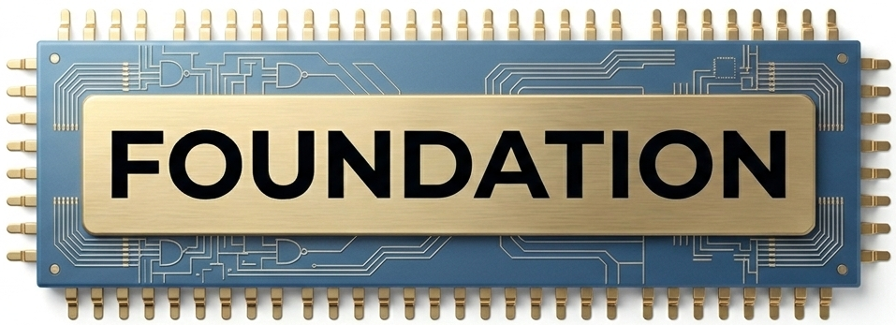
AI & Compute

Slide 2
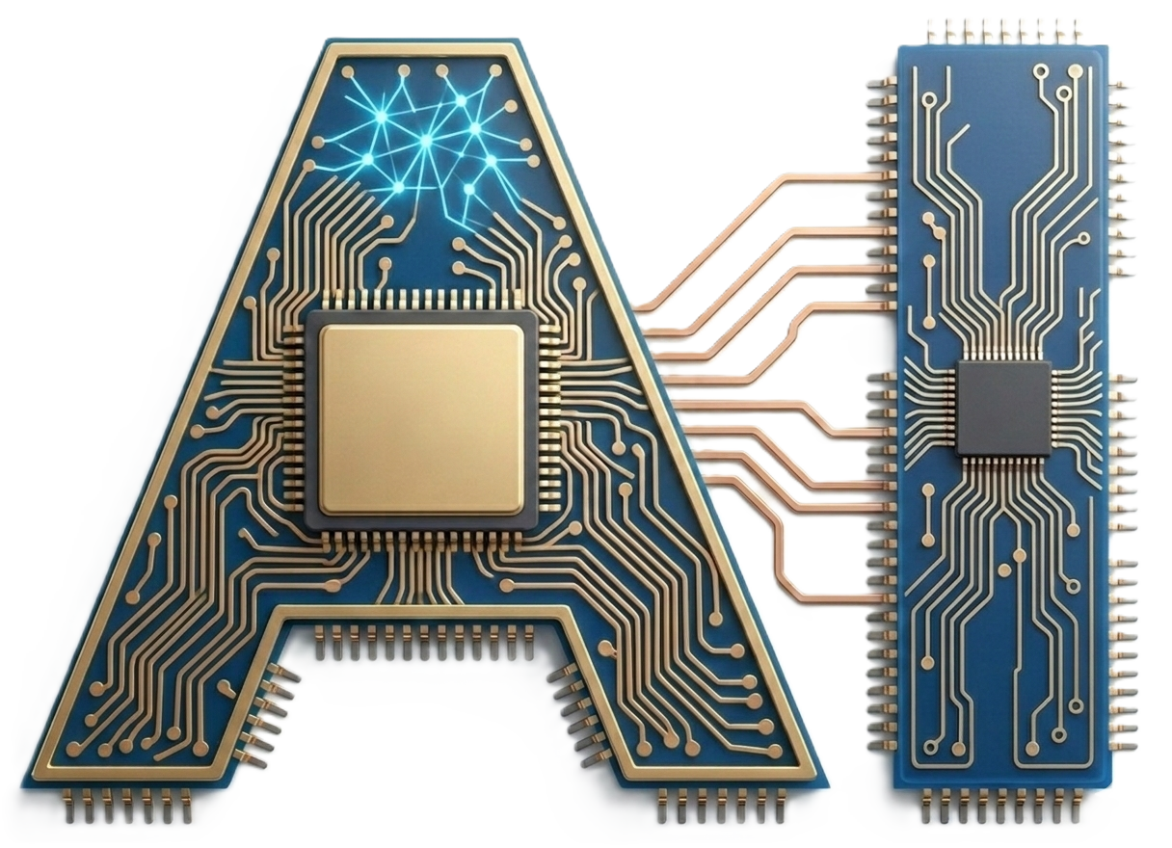
& Compute
FOUNDATION

