Slide 1
Bodyshop Profit & Loss
By: Darryl Mittlestaedt, Linh Nguyen,
Aaron Trierweiler, and Michael Weaver

Slide 2
Motivation
We got our idea for this project from a business owner of an automobile body shop company in La Grange, IL
Client would like an updated application to track their company's profits and loss for the various parts of the business
Big Picture: similar companies can utilize this application as well and project is reasonable with the scope of our coding experience
Notes:
What is the business problem your application is trying to solve?
Darryl came up with an idea to resolve a problem for a local body shop company.
The company was using an outdated way of tracking their information.

Slide 3
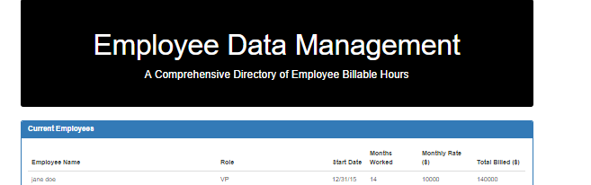
Design
Previous class exercises
Timesheet
We contacted the client and scheduled a meeting to review their needs
Client wanted app to be on one page to resemble a Microsoft Excel document

Slide 4
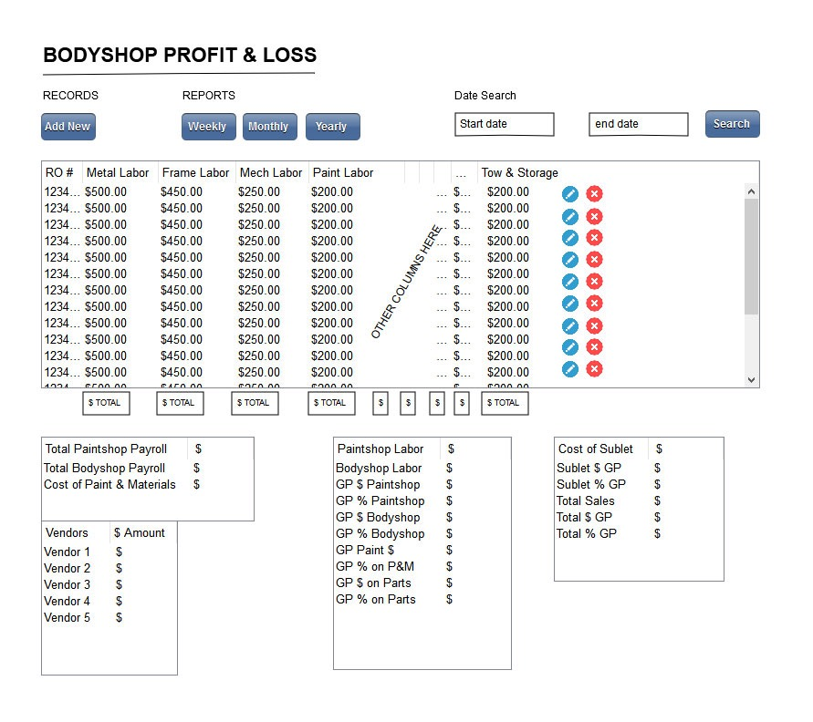
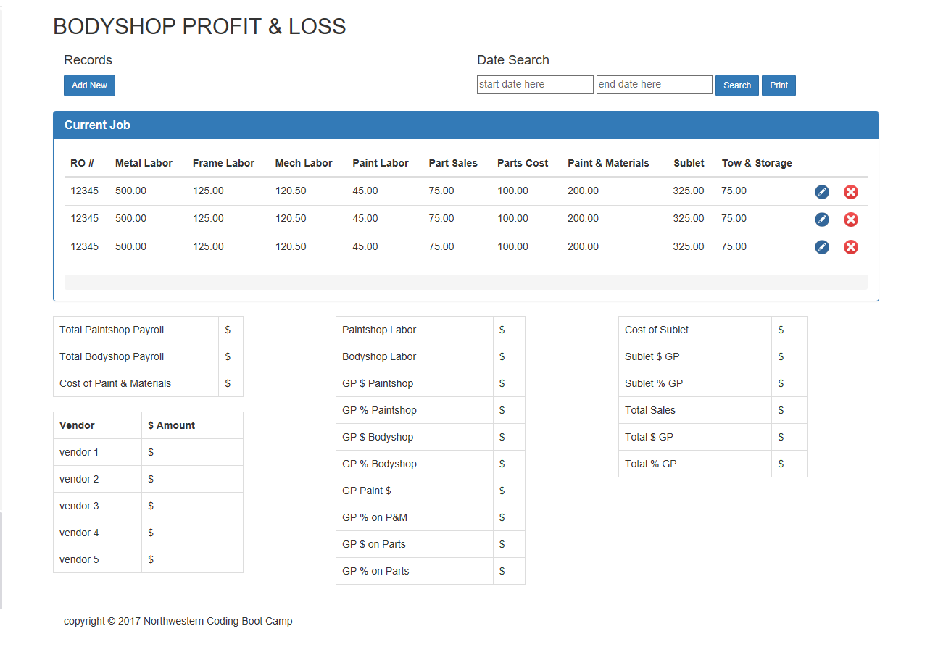
First Wireframe
reviseD Wireframe

Slide 5
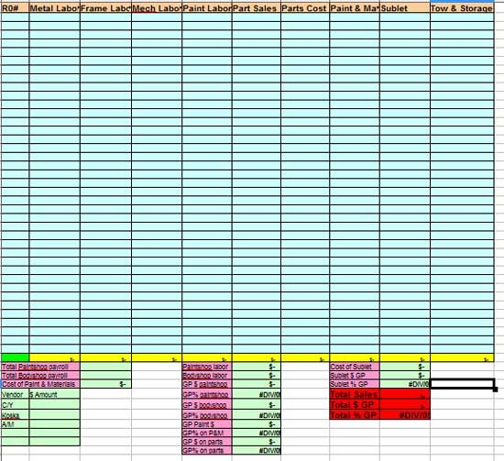
Original

Slide 6
tools
Pencil
Sublime Text
Bootstrap
jQuery
CSS
Firebase
Google FOO!!!
Communication
Trello
Slack
Google Hangout
Notes:
Project Management / Communication
How did your team built a list of tasks and shared duties?
How did your team handle communications?
What tools did you use for project management?
What was the most difficult part of project management?

Slide 7
Technology
The technology used was determined by the needs of the application
JavaScript and Firebase implementation were the most difficult to use.
Issues: 1. Version control
2. Firebase calculations
3. Authentication

Slide 8
Technology
What features would you add if you had more time?
Customizable features for the client (logo)
What would you do different if you could start again?
Have better organization, re-evaluate database structure and layout.

Slide 9

hurdles
Merging branches/conflicts
Dividing work
We are all beginners!
Meeting up outside of class
Bugs and code organization!

Slide 10

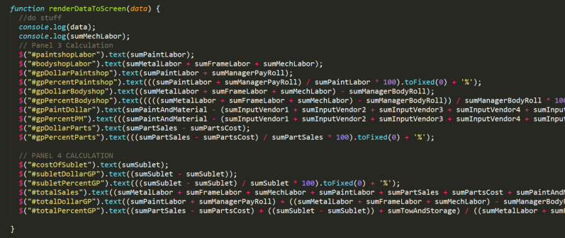
javaSCRIPT

Slide 11
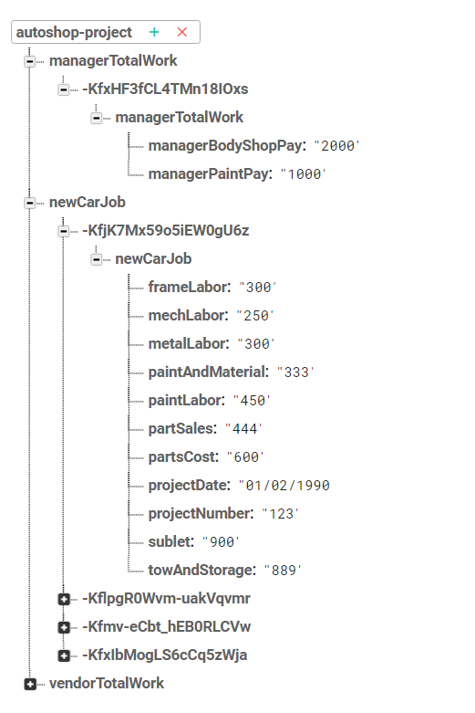
Firebase

