Slide 1


Progress Review
Marketing Executive Level 4 Apprenticeship
Bethanie-Taylor Grenfell
Employer: Spinnaker Global Limited
Manager: Helen McCaughran
Review period: April, May and June 2026

Slide 2

Review Snapshot
A strong quarter: high attendance, meaningful workplace application and one small evidence-admin gap to close.
100%
74%
195h
100%
RAG
Attendance across Apr, May, Jun
Programme progress
OTJ hours completed
KSB course complete
Amber-Green
Catch-ups used where needed
Target: 75%
Approx. 42h ahead
Keep clicking complete
Evidence admin only
Coach summary
• Workplace evidence is rich, current and clearly linked to Spinnaker’s commercial priorities.
• April–June assignments show data analysis, promotional planning and social media strategy.
• Additional activities show practical ownership across content, events, AEO/SEO, emails and consultant support.
Immediate focus
• Close overdue evidence for February and March attendance.
• Continue the quick 30–45 minute catch-up routine after any missed lecture.
• Prioritise four KSB gaps: K4.1, K4.2, S3.3 and S4.1.
Overall: Bethanie is on track, ahead on OTJ, and very close to target progress.
Marketing Executive Level 4 Apprenticeship | Progress Review | Bethanie-Taylor Grenfell

Slide 3

EXCEED LEARNING PARTNERSHIP
Progress Review Closure & Next Learning Phase
The only overdue activity is this progress review. Once signed and refreshed in Aptem, Curtis moves into MarTech and focused KSB evidence development.
9 September 2026
September–October 2026
Progress Review 2
Live KSB evidence project
Complete today and confirm the Aptem status within 48 hours
Agree one project by 17 September; submit the verified pack by 31 October
What will evidence each MarTech activity
• Exact LMS resource title and completion screenshot.
• Date, start time, finish time and actual hours.
• Concise notes and one example of workplace application.
• Reflection and relevant KSB mapping uploaded within 48 hours.
Future protocol
• Protect one paid half-day each week, or two two-hour blocks.
• Record only genuine new learning and avoid duplicate OTJ claims.
• Retain drafts, screenshots, analytics and approval evidence.
• Raise access, release or workload barriers promptly.
Practical action: close Progress Review 2 today; begin MarTech this week; agree the live KSB project by 17 September.
Marketing Executive Level 4 Apprenticeship | Progress Review | Curtis Cooper

Slide 4
Attendance & Engagement
Bethanie has maintained strong attendance habits and has made up missed learning through catch-up sessions.
April
May
June
Attendance: 100%
Attendance: 100%
Attendance: 100%
Engagement sustained
Catch-up approach used
Consistent participation
What is working well
• When a lecture is missed, Bethanie has made up the absence through a catch-up session.
• This is the right professional habit and protects both learning continuity and compliance evidence.
Future protocol
• Going forward, any missed lecture should trigger a quick one hour catch-up booking.
• The agreed routine keeps the learning plan tidy and avoids last-minute evidence gaps.
Practical action: February and March attendance catch-up booked for 20 July.
Marketing Executive Level 4 Apprenticeship | Progress Review | Bethanie-Taylor Grenfell

Slide 5
Programme Progress, OTJ & LMS
Strong learning volume; the dashboard now needs to reflect the work already completed.
Programme progress
Off-the-Job hours
Current: 75%
75%
✓
195
+42
Target: 75%
75%
Total hours
Ahead of track
Healthy pace
Bethanie is on track with progress.
Hours look proportionate to the scale of live workplace projects and are not exaggerated.
KSBs course 100%
Impact & Planning 22%
Social Media 0%
LMS
• Action: click “complete” after each LMS activity so progress updates accurately and the evidence trail reflects the learning already done.
Marketing Executive Level 4 Apprenticeship | Progress Review | Bethanie-Taylor Grenfell

Slide 6
EPA Readiness & Evidence Admin
The portfolio content is promising; the main risk is making sure all evidence is uploaded, named and verified.
Current readiness
Overdue learning-plan evidence
Action already agreed
Good → Strong
Zero overdue
•• Any future missed lecture = 30–45 minute catch-up
Strong once overdue attendance evidence and four KSB gaps are closed.
EPA area | Confidence | Evidence focus
Multiple Choice Test | Good | KSB course complete; keep revising theory from assignments.
Project Showcase | Good → Strong | Workplace projects are strong: 30 Under 30, MHRA, OSCAR, AEO/SEO, conference.
Professional Discussion | Strong potential | Good range of examples; prepare concise STAR stories for each KSB.
Marketing Executive Level 4 Apprenticeship | Progress Review | Bethanie-Taylor Grenfell

Slide 7
Assignments Submitted: April, May and June
The submitted assignments are strongly workplace-based and link well to Spinnaker’s maritime recruitment and HR context.
April Assignment
May Assignment
June Assignment
Secondary Data Analysis
Promotion Report
Social Media Strategy
• Used internal email, website and LinkedIn data to evaluate Spinnaker’s performance.
• Strong metrics: 29% email open rate, 136,829 LinkedIn impressions and +834 followers.
• Recommendations: people-led content, video, conversion tracking, LinkedIn dependency reduction.
• Audited the June Marketing Content Strategy across MHRA and OSCAR Dragon Boat Race activity.
• Identified CTA inconsistency, fragmented tracking and LinkedIn over-reliance.
• Recommendations: UTM/GA4 tracking, one MHRA CTA and stronger multi-channel integration.
• Mapped social media’s role within Spinnaker’s wider marketing strategy.
• LinkedIn remains the primary B2B hub: 80,343 impressions, +992 followers, strong job content clicks.
• Recommendations: video-led content, consultant personal branding and channel-role review.
Evidence value: strong, real workplace application
Evidence value: strong, real workplace application
Evidence value: strong, real workplace application
Next step: ensure every assignment is linked to one or more artefacts and a short reflective note in APTEM.
Marketing Executive Level 4 Apprenticeship | Progress Review | Bethanie-Taylor Grenfell

Slide 8
Assignment Portfolio Review
Evidence is relevant, current and reflective; keep tightening the golden thread from activity → data → insight → business impact.
Strong
Strong
Strong
Good→Strong
April: data analysis
May: promotion audit
June: social strategy
EPA readiness
Good for S5 and K3
Good for S1/S5/K4.3
Good for K1/K2/S6
Upload & map evidence
What is already strong
• Bethanie is doing more than reporting activity; she is analysing what the evidence means.
• The assignments link directly to Spinnaker’s B2B maritime audience, commercial priorities and channel strategy.
• There is good balance between quantitative analytics and qualitative insight from stakeholders.
How to make it EPA-ready
• For each assignment, add a one-page evidence cover sheet stating: task, result, KSBs, business impact and next improvement.
• Keep adding witness comments from Helen, Lucy and campaign stakeholders where possible.
• Use screenshots of dashboards, UTMs, website updates and campaign assets to prove personal contribution.
Best practice: show the assessor what changed because Bethanie did the work.
Marketing Executive Level 4 Apprenticeship | Progress Review | Bethanie-Taylor Grenfell

Slide 9
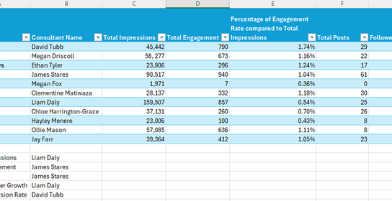
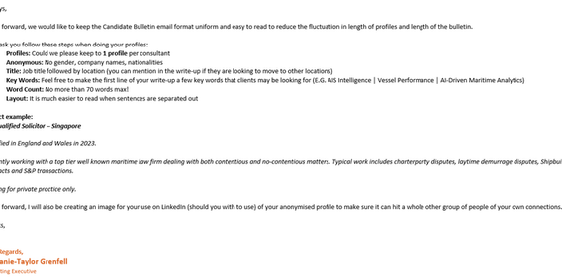
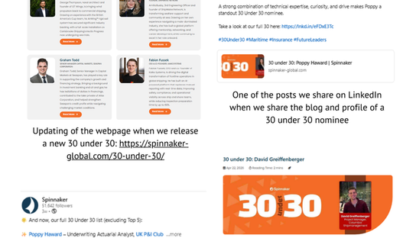
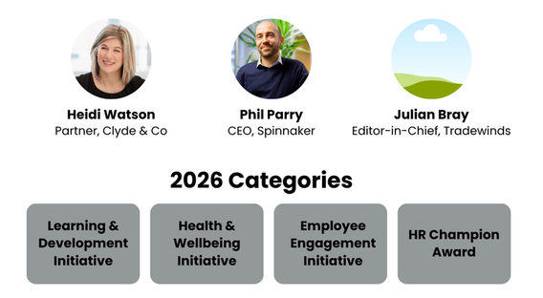
Additional Job Activities: April
Strong evidence of analytics, content governance, campaign materials and thought-leadership support.
Strongest April evidence
• Q2 LinkedIn consultant analysis and discussion with the Director of Recruitment.
• OSCAR business card with QR code and written URL for accessible campaign communication.
• Candidate bulletin guidelines to standardise anonymous profiles and reduce compliance risk.
• HR Initiative Awards leaflet template and recruitment blog writing.
• 30 Under 30 blog, website updates and LinkedIn campaign support.
LinkedIn consultant performance analysis
Candidate bulletin guidance
30 Under 30 campaign evidence
Award leaflet template
April OTJ submitted: 13.15 hours — proportionate to the volume and quality of workplace artefacts.
Marketing Executive Level 4 Apprenticeship | Progress Review | Bethanie-Taylor Grenfell

Slide 10
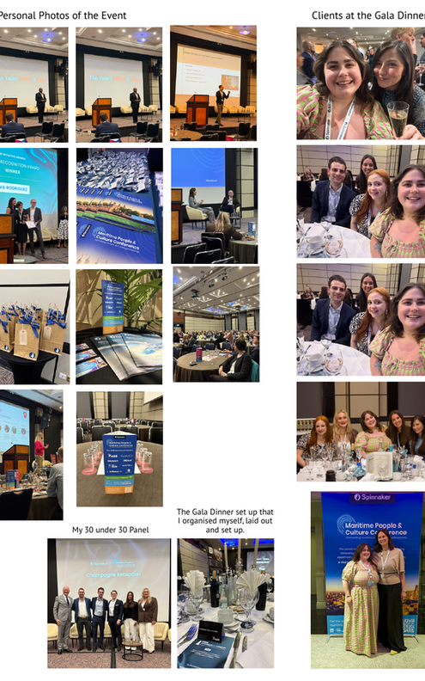
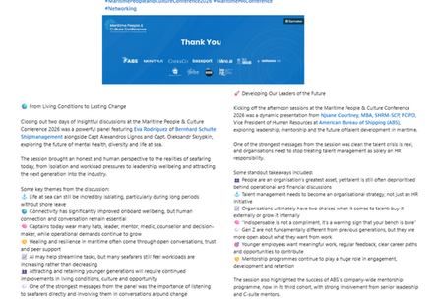
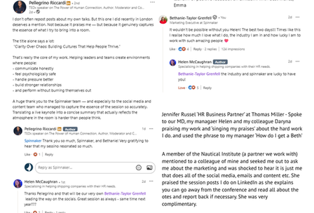
Additional Job Activities: May
The Maritime People & Culture Conference evidence is especially strong for campaign delivery, content creation and stakeholder impact.
Strongest May evidence
• Conference session notes captured detailed sector insight across geopolitics, AI, wellbeing, mentorship, inclusion and leadership.
• Produced/managed 20 LinkedIn posts and 78 Instagram Stories across the event period.
• Wrap-up blog translated two days of conference content into a coherent thought-leadership summary.
• Evidence shows event photos, conference content, feedback and recognition for the 30 Under 30 panel concept.
• External praise highlighted the usefulness of Bethanie’s LinkedIn session posts for delegates reporting back after the event.
Conference LinkedIn content
Event photos and conference set-up
Stakeholder feedback
Portfolio value: strong evidence for S1.3, S2.1, S2.2, S3.1, S3.2, S5.3 and B4.1.
Marketing Executive Level 4 Apprenticeship | Progress Review | Bethanie-Taylor Grenfell

Slide 11
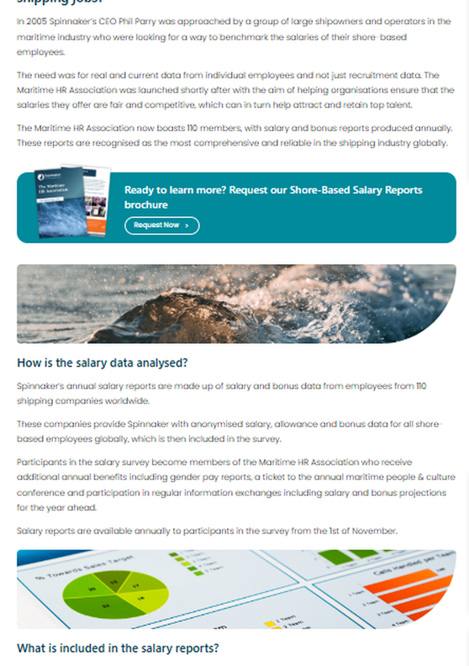
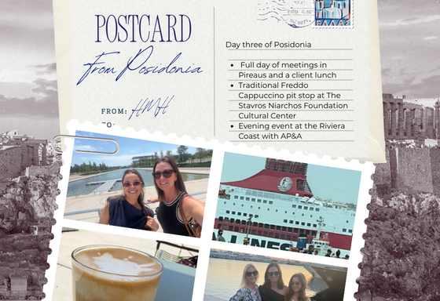

Additional Job Activities: June
June shows Bethanie stepping into emerging digital practice: AEO, SEO, website changes, email campaigns and consultant enablement.
Strongest June evidence
• AEO/AI visibility learning with AngelFish, followed by internal meetings and AI-friendly content changes.
• Website improvements: CV registration form, job search page SEO wording and salary benchmarking page changes.
• Campaign assets: Equal Pay Day, MHRA testimonials, OSCAR email and consultant LinkedIn post bank.
• OSCAR email to previous participants supported three additional team sign-ups.
• Posidonia postcards and Marketing in Maritime webinar reflection strengthened creative and strategic thinking.
Creative event content: Posidonia postcard
Salary page / AEO-related website update
OSCAR QR / campaign asset
June OTJ submitted: 19 hours — strong workplace learning and immediate application.
Marketing Executive Level 4 Apprenticeship | Progress Review | Bethanie-Taylor Grenfell

Slide 12
Workplace Application & Impact at Spinnaker
Bethanie’s work is adding value in a niche, relationship-led maritime recruitment and HR market.
Brand visibility
Lead generation
LinkedIn growth, 30 Under 30 and conference content strengthened Spinnaker’s authority in maritime people management.
MHRA brochure downloads, email campaigns and OSCAR sign-up activity created clearer commercial pathways.
Operational efficiency
Strategic learning
Candidate bulletin guidelines, CV form changes and consultant post banks reduce friction and improve consistency.
AEO/SEO activity shows adaptability to changing search behaviour and future-proofs digital visibility.
Marketing Executive Level 4 Apprenticeship | Progress Review | Bethanie-Taylor Grenfell

Slide 13
KSBs Evidenced: Knowledge
Full standard wording shown for the Knowledge areas evidenced through assignments and workplace activity.
Code | Knowledge evidenced
K1.1 | The fundamentals of marketing theory (e.g. 7Ps, product development, segmentation)
K1.2 | Brand positioning, brand management, and corporate reputation
K1.3 | Stakeholder and customer relationship management (CRM), internal and external
K2.1 | Business and sector characteristics, vision, and values
K2.2 | Marketing's contribution to business objectives
K2.3 | Customer decision-making process and marketing influence
K2.4 | Legal, regulatory, and compliance frameworks (e.g. Data Protection)
K3.1 | Principles of effective market research, sources, methodologies, and use (quantitative/qualitative)
K4.3 | Features and benefits of communication channels (digital and offline)
Marketing Executive Level 4 Apprenticeship | Progress Review | Bethanie-Taylor Grenfell

Slide 14
KSBs Evidenced: Skills
Skill evidence is strongest where Bethanie has planned, created, coordinated, analysed and improved live workplace activity.
Code | Skills evidenced
S1.1 | Coordinate marketing channels (digital/offline)
S1.2 | Plan/deliver tactical campaigns using SMART objectives
S1.3 | Manage production/distribution of materials
S2.1 | Create clear and effective communications, presentations, briefs
S2.2 | Collaborate with internal and external stakeholders
S3.1 | Use time and project management effectively
Code | Skills evidenced
S3.2 | Coordinate campaigns/projects to deadlines
S5.1 | Evaluate campaign effectiveness using digital/offline data
S5.2 | Analyse information from various sources
S5.3 | Derive insights to improve future campaigns
S6.1 | Use business systems/software to deliver marketing outcomes
S6.2 | Use technologies (e.g. analytics, social media, CRM)
Marketing Executive Level 4 Apprenticeship | Progress Review | Bethanie-Taylor Grenfell

Slide 15
KSBs Evidenced: Behaviours
Bethanie’s behavioural evidence is strong and shows the habits of a reliable, reflective and collaborative marketer.
Code | Behaviours evidenced
B1.1 | Tenacious and driven to complete projects
B1.2 | Adaptable and self-starting
B2.1 | Willing to think creatively and analytically
B2.2 | Generates ideas and solutions to support delivery
B3.1 | Learns from setbacks and improves performance
B4.1 | Shows professionalism, reliability, and customer passion
B4.2 | Works collaboratively with empathy and consideration
B4.3 | Acts ethically, valuing equality and diversity
Evidence row
K1.1, K1.2, K1.3, K2.1, K2.2, K2.3, K2.4, K3.1, K4.3, S1.1, S1.2, S1.3, S2.1, S2.2, S3.1, S3.2, S5.1, S5.2, S5.3, S6.1, S6.2, B1.1, B1.2, B2.1, B2.2, B3.1, B4.1, B4.2, B4.3
Marketing Executive Level 4 Apprenticeship | Progress Review | Bethanie-Taylor Grenfell

Slide 16
KSBs to Strengthen Next
These are not concerns; they are the next evidence-building opportunities to make Bethanie’s portfolio more rounded.
K4.1
Product development and product/service portfolios
K4.2
Routes to market and distribution models
Evidence idea: map Spinnaker’s services as a portfolio — recruitment, salary benchmarking, conferences, training, associations and leadership development.
Evidence idea: create a routes-to-market map for LinkedIn, website, email, BD outreach, webinars, events and consultant personal profiles.
S3.3
Manage stakeholders and suppliers for outcomes
S4.1
Monitor project budgets using appropriate controls
Evidence idea: use AngelFish, IT, SEO agency, BD, consultants, event partners and sponsors, with meeting notes and witness comments.
Evidence idea: build a simple campaign or event budget tracker showing planned vs actual spend, sponsorship pricing and ROI indicators.
Suggested manager decision: assign one live campaign where Bethanie can own budget, supplier and route-to-market evidence.
Marketing Executive Level 4 Apprenticeship | Progress Review | Bethanie-Taylor Grenfell

Slide 17
Next Actions: Learning Evidence Opportunities
This is a learning and evidence-planning conversation, not a performance concern.
KSB gaps to close
Open project prompts
Aptem evidence
Focus areas
K4.1 Product development and product/service portfolios
K4.2 Routes to market and distribution models
S3.3 Manage stakeholders and suppliers for outcomes
S4.1 Monitor project budgets using appropriate controls
For Bethanie and Helen
• Which upcoming projects can Bethanie contribute to meaningfully?
• Where can she own a clear task from planning through to evaluation?
• Can she support a budget, supplier, route-to-market or service-portfolio decision?
• Which outputs would be genuinely useful to Spinnaker?
• Who can verify her personal contribution and impact?
Evidence Bethanie can upload
• Project brief or mini-plan with objectives
• Service portfolio or product/service map
• Routes-to-market or channel distribution map
• Stakeholder/supplier log with outcomes
• Simple budget tracker: planned vs actual
• Reflection: learning, application and business impact
Learning message
Treat these as portfolio-building opportunities from live work, not extra tasks.
Decision today: agree 1-2 live learning projects, Bethanie’s role, evidence owner and upload deadline.
Marketing Executive Level 4 Apprenticeship | Progress Review | Bethanie-Taylor Grenfell

Slide 18
Professional Responsibilities & EPA Brief
A short reminder before closing: safeguarding, British Values and what EPA evidence needs to prove.
Safeguarding
British Values
EPA in brief
Workplace reminder
• Protect everyone’s right to learn and work safely, free from abuse, neglect or exploitation.
• Use the 5 Rs: Recognise, Respond, Report, Record and Refer.
• Raise concerns early with the appropriate manager, safeguarding lead or college contact.
• In marketing work, keep data, AI use, photos, consent and wellbeing considerations safe and professional.
What this looks like here
• Democracy: encourage voice, challenge and feedback in campaigns and meetings.
• Rule of law: follow GDPR, advertising rules and company policies.
• Individual liberty: support professional choice and responsible decision-making.
• Mutual respect and tolerance: inclusive language, accessible content and respectful stakeholder communication.
Assessment route
• Multiple Choice Test: 50 questions, 90 minutes.
• Project Showcase: work-based project report, then presentation and Q&A.
• Professional Discussion: evidence-rich examples of KSBs achieved in role.
• Project evidence should be workplace-based, mapped to KSBs, measured where possible and verified by the employer.
Keep it practical: every strong EPA example should show context, Bethanie’s action, evidence, outcome and reflection.
Marketing Executive Level 4 Apprenticeship | Progress Review | Bethanie-Taylor Grenfell

Slide 19
Manager Questions: Workplace Impact Check
Helen’s feedback will help measure programme impact on Bethanie’s work, confidence and EPA readiness.
Questions for Helen McCaughran
Manager notes
1. What improvements have you seen in Bethanie’s confidence, independence or marketing judgement?
2. Where has she added the clearest value: quality, efficiency, engagement, commercial results or risk reduction?
3. Have you seen stronger use of data, insight, planning or evaluation in her marketing work?
4. Which examples best show applied learning rather than routine activity?
5. Which future projects should she contribute to in order to evidence K4.1, K4.2, S3.3 and S4.1?
6. What evidence can you verify or sign off for Aptem and EPA?
7. What support, exposure or autonomy would help her progress towards gateway?
8. Are there any concerns or barriers we should address early?
Impact observed:
Improvements noticed:
Support agreed:
Agreed evidence project
Project / activity:
Bethanie’s role:
Evidence to upload:
Review date:
Q/A: agree the next workplace learning opportunity and the evidence Bethanie will submit on Aptem.
Marketing Executive Level 4 Apprenticeship | Progress Review | Bethanie-Taylor Grenfell

