Slide 1
Code Generation With CodeLlama 70b
AITechGuy😉
Notes:
Hello. This is steve. I gonna start my presentation with the title of code generation with codellama 70b

Slide 2
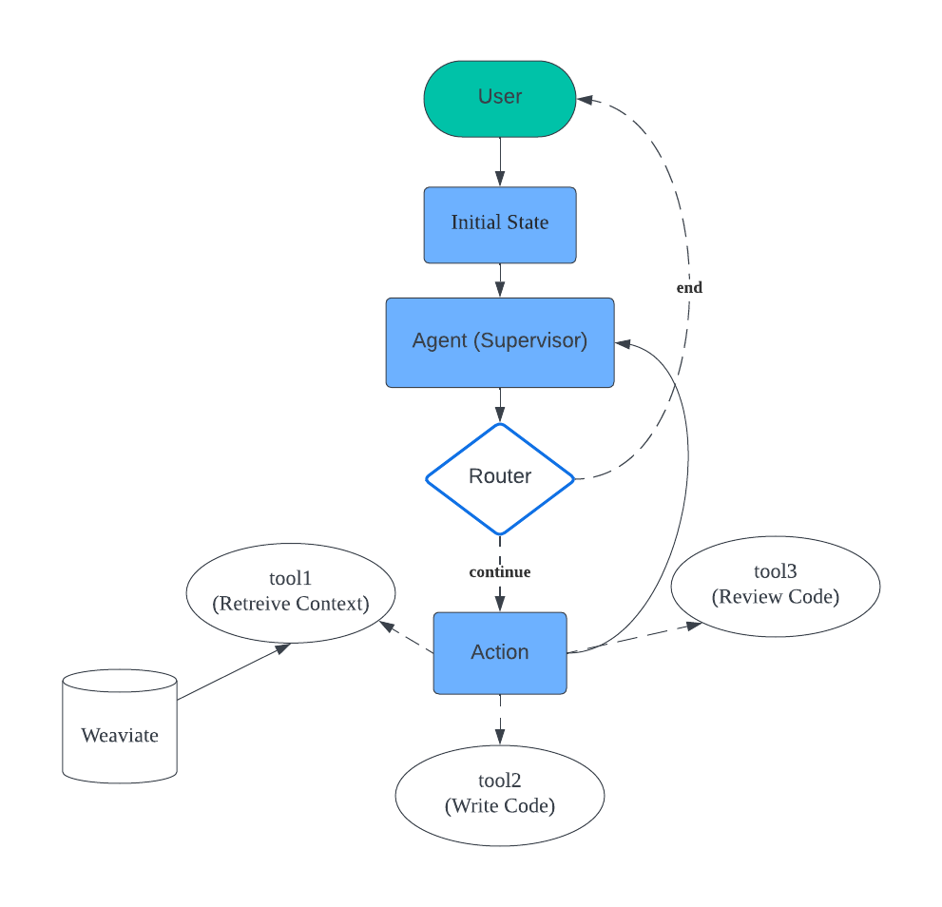
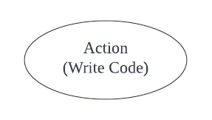
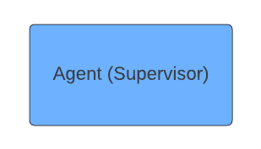
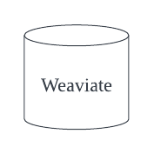
CodeLlama 70b
Gpt-3.5-turbo
Vector Store
Notes:
In this project, we are gonna use langgraph and langchain expression.
This is diagram showing node and edges of langgraph.
The code is generated by Codellama7b and of course the logic of agent is generated by GPT model.

Slide 3
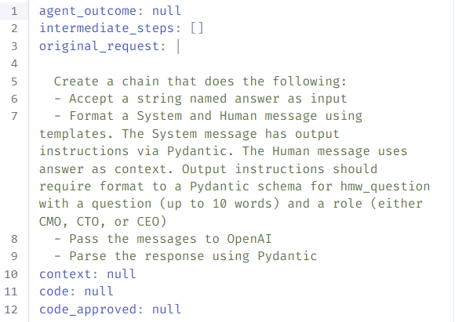
Graph State
Notes:
For the first step, user input feature request.
So the original_request propery of gragh state is initizlied with user input.
Then, it automatically moves from initial state node to agent node.

Slide 4
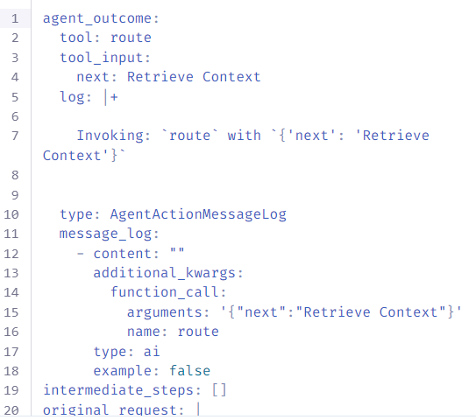
Graph State
Notes:
For the second step, the agent decide what action is to. In this case, the next action is retreive context.

Slide 5
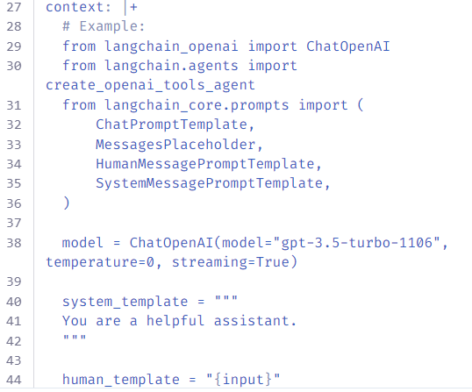
Graph State
Notes:
For third step, Agent retrieves context from weaviate vector store, so the context property of graph state is initialized with this context.

Slide 6
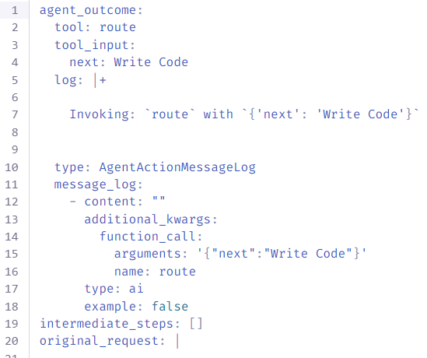
Graph State
Notes:
For the fourth step, it automatically moves from action node to agent node.
Then, agent decide take write code action.
These decisions are determined using gpt model.

Slide 7
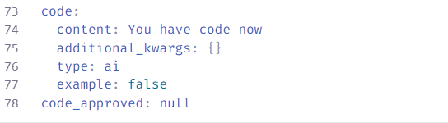
Graph State
Notes:
For the fifth step, the agent write code using codellama in together cloud platform.

Slide 8
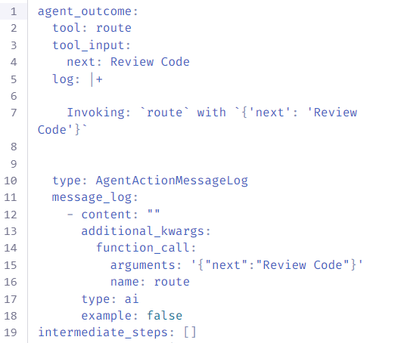
Graph State
Notes:
For the sixth step, the agent decide to review code.

Slide 9
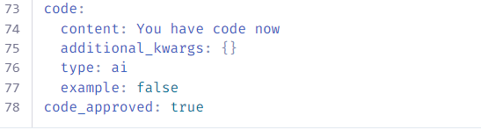
Graph State
Notes:
Then on action node, the agent reivew code and code_approved property of graph state is set to true.

Slide 10
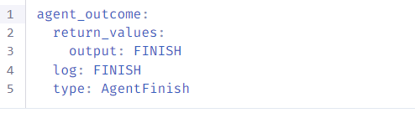
Graph State
Notes:
Finally it comes back to agent node, and it’s output is finish, so the agent returns result.

Slide 11
Thanks

