Slide 1
Intermediate AI & Data Science
AI Education for All
From Models to Production
Amir Charkhi, PhD
Founder – AI TECH INSTITUTE
August 2025

Slide 2

About Me
Amir Charkhi
PhD, AI & Machine Learning
20+ years teaching & industry experience
Leadership roles at various industries
Founder, AI Tech Institute – shaping the next generation of AI talent

Slide 3
About This Course
Course details:
Course code: INT-AI-DS-25-08
Course Instructor: Amir Charkhi
Course Assistant Instructor: Rei Masuda

Slide 4
What This Course Is
Not just data science. Applied, Production-Level AI.
Build end-to-end workflows (from data to deployment)
Learn how to deploy, monitor & retrain models
Work on hands-on, industry-style projects
Develop skills to be job-ready in AI & data roles

Slide 5
Why This Course is Different
Not “cookie-cutter” bootcamps.
100% hands-on learning (no endless theory)
Real-world case studies & projects
Focus on skills employers actually hire for
Designed by industry leaders, not “AI copy-paste”
Built over 2 years of research, design, and testing

Slide 6
How We Compare
Other Programs:
Poor industry reputation
Overly theoretical or generic content
Limited real-world relevance
AI Tech Institute:
Curated by industry experts
Supportive, hands-on teaching
Career-oriented: every module builds practical skills
Students graduate with deployable projects they can showcase
1-on-1 coaching

Slide 7
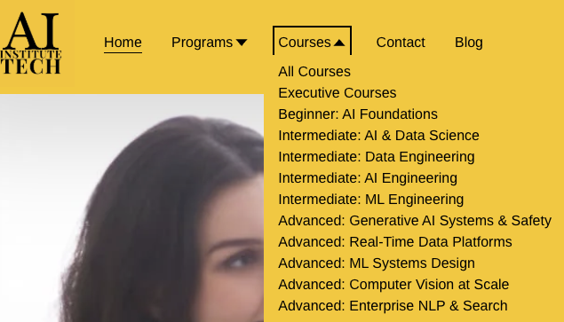
The AI Tech Institute Curriculum
Designed for career growth.
Beginner → Intermediate → Advanced
Bootcamps (24 weeks), Skill-Ups (12 weeks), Short Courses (6 weeks)
Every course fits together like building blocks
This course is your next step toward becoming a professional Data Scientist / ML Engineer

Slide 8
Career Pathways
Beginner Pathways
6 Weeks
AI Beginner
Intermediate Pathways
Shared Core Modules
4 Weeks
6 Weeks
Data Scientist
6 Weeks
ML Engineer
AI Engineer
Data Engineer
6 Weeks
6 Weeks
Advanced Pathways
12 Weeks
Advanced AI Engineering
12 Weeks
Advanced Deep Learning
12 Weeks
MLOps & Productionisation
Real-Time Data Engineering
LLM Engineering
12 Weeks
12 Weeks

Slide 9
What You’ll Gain
By the end of this course, you will:
Understand ML model deployment pipelines
Be able to build & deploy production-ready models
Be prepared for roles in data science & AI engineering
Leave with portfolio-ready projects

Slide 10
Today’s Plan
Introductions
Course overview & expectations
Curriculum walkthrough
Project preview
Q&A
Week 0 content

Slide 11
Using AI Tools
This course recognizes the potential of generative artificial intelligence (AI) tools to enhance learners’ learning and creativity. Participants are welcome to use AI tools to assist with their assignments when appropriate, ensuring that they do so in an ethical and responsible manner. Some assignments may even integrate AI tools.

Slide 12
Using AI Tools
Use AI tools only when appropriate for your level of learning and understanding. AI tools should not be used to replace your own thinking or analysis, or to avoid engaging with the course content.
Explain and provide evidence of how you used the AI tool and how it contributed to your assignment. Explain what you learned from the AI tool, how you verified its accuracy and reliability, how you integrated its output with your own work, and how you acknowledged its limitations and biases.
When working in groups, discuss the use of AI tools with your group members and come to a main consensus for how you plan to use them and how you will explain and provide evidence of how the AI tool contributed to your assignment.
Cite any AI tools you use properly. For example, APA references require you to include the name of the AI tool, the date of access, the URL of the interface, and the specific prompt or query you used to generate the output. For example:
ChatGPT. “How can I implement a sustainability strategy in my company?”
Accessed May 8, 2024. https://www.chat.openai.com (Links to an external site.)
For further information on how to cite and reference generative AI consistently, consult the following website: https://libguides.mit.edu/cite-AI-tools (Links to an external site.)
4. Take full responsibility for any mistakes or errors made by the AI tool. Always fact check and edit the output before submitting your work.

