Slide 1
Train – test split
EDA
Model Building
Final Evaluation
X
y
X_train (70%)
Y_train
X_train
Y_train
X_train
Y_train
X_valid (15%)
Y_valid
X_valid (15%)
Y_valid
X_valid (15%)
Y_valid
X_test (15%)
Y_test
X_test (15%)
Y_test
Data Split

Slide 2
Data
90% of patient healthy
10% with cancer
Data Split

Slide 3
90% of patient healthy
10% with cancer
90% of patient healthy
10% with cancer
Data
Data
Ensure EQUAL representation of target variable (cancer vs. healthy) across ALL FOLDS
`sklearn.model_selection.StratifiedKfold`
Stratify and Split

Slide 4
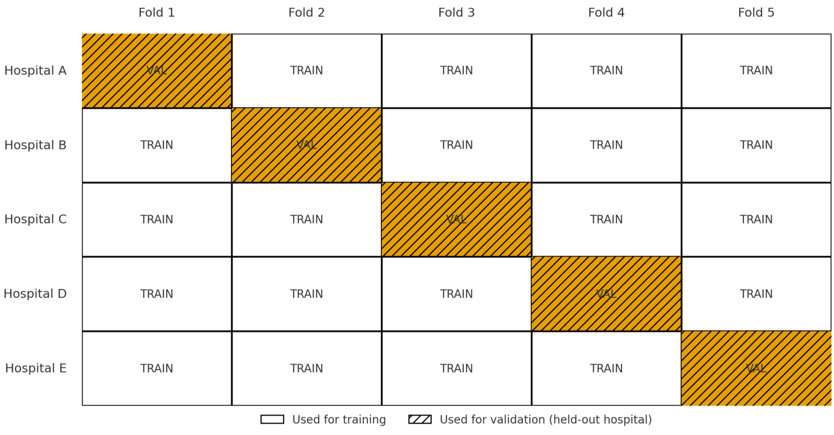
Stratify and Split

Slide 5

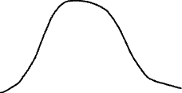
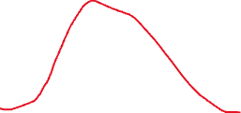
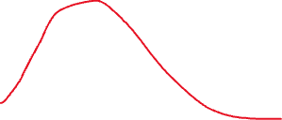
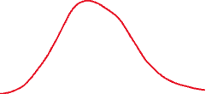
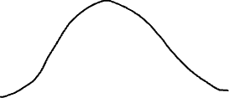
Feature EDA

Slide 6
X_train (120 samples)
Y_train (120 answers here)
Y_test (30 answers here)
LogisticRegression
X_test (30 samples here)
Y_pred (30 predictions here)
Model Training

Slide 7
Regression
X
y
Age | Sex | Experience | Salary
19 | M | 0 | 54000
26 | M | 3 | 67000
34 | F | 10 | 85000
56 | M | 25 | 120000
44 | F | 10 | 95000
27 | F | 7 | 87000
Model Training: Regression

Slide 8
Classification
X
y
Age | Sex | Sugar Every Week | Cancer
19 | M | 0 | 0
26 | M | 3 | 0
34 | F | 10 | 0
56 | M | 25 | 1
44 | F | 10 | 1
27 | F | 7 | 0
Model Training: Classification

Slide 9
Age | Sex | Sugar
X_test (15%)
Y_pred
Target
54000
65000
120000
18000
Y_test
Target
80000
60000
110000
25000
Model
Model Training and Prediction

Slide 10



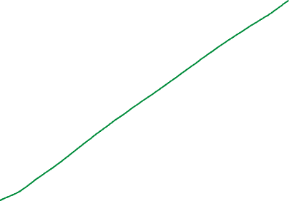
Y_pred
54000
65000
120000
18000
Y_test
80000
60000
110000
25000
Linear Regression

Slide 11
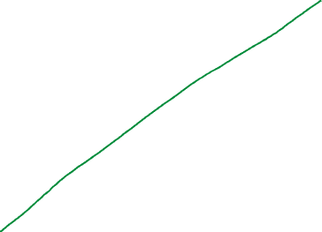
Linear Regression

Slide 12
Age | Sex | Sugar Every Week | Y_test
19 | M | 0 | No
26 | M | 3 | No
34 | F | 10 | No
56 | M | 25 | Yes
44 | F | 10 | Yes
27 | F | 7 | No
Y_pred
No
Yes
No
Yes
No
No
Model Training and Prediction

Slide 13
Defintions
True Positives (TP): actually positive and predicted as positive
True Negative (TN): actually negative and predicted as negative
False Positive (FP): actually negative and predicted positive
False Negative (FN): actually positive and predicted negative
Confusion Matrix

Slide 14
X
y
X_train (70%)
Y_train
X_train (70%)
Y_train
X_valid (15%)
Y_valid
X_valid (15%)
Y_valid
X_test (15%)
Y_test
Data Split

Slide 15
Fold 1
Fold 2
Fold 3
Fold 4
Fold 5
X_train
Y_train
X_train
Y_train
X_train
Y_train
X_train
Y_train
X_valid
Y_valid
X_train
Y_train
X_valid
Y_valid
X_valid
Y_valid
X_train
Y_train
X_valid
Y_valid
X_train
Y_train
X_valid
Y_valid
X_train
Y_train
X_test (15%)
Y_test
R2 = 78%
R2 = 79%
R2 = 58%
R2 = 98%
R2 = 78%
Cross Validation
Linear Regression Model, tol=(1,5,1)

Slide 16
X
y
X_temp
Y_temp
X_train
Y_train
X_val
Y_val
X_test
Y_test
Data Split

Slide 17
X_train
Y_train
Model
X_val
Y_val
Totalsales = 5 * numberofitems + 10 *uniqueitems + 100000000 * Country
Model Training

Slide 18
Tol/n_jobs | 10 | 100 | 1000
0.1 | 0.1 - 10 | 0.1 - 100 | 0.1 - 1000
0.2 | 0.2 - 10 | 0.2 - 100 | 0.2 -1000
Confusion Matrix

Slide 19


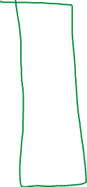
Decision Trees
Decision Trees

Slide 20


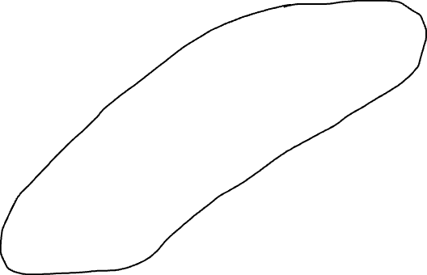

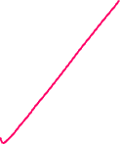
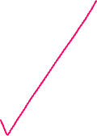
Parent Node
Age < 65
Branch Node
Age > 15
Not Survived
Sex = M
Survived
Price > 20$
Survived
Leaf Node
Leaf Node
Survive
Not Survived
Leaf Node
Decision Trees

Slide 21
Leaf Node
Decision Trees - Purity

Slide 22
Classification

Slide 23

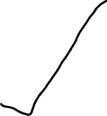
Classification

Slide 24
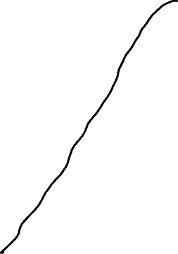




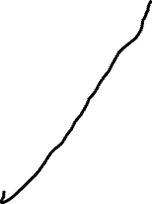
Support Vector Machines

Slide 25



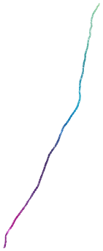




Support Vector Machines

Slide 26


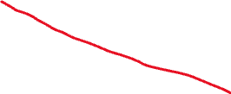
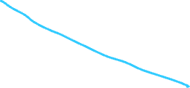
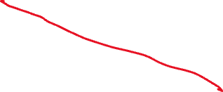











KNN

Slide 27








KNN

Slide 28









KNN

