Slide 1
Statistical Thinking & Causal Inference
From Correlation to Causation
Week 5 · Intermediate AI & Data Science
Instructor: Amir Charkhi

Slide 2
Netflix can predict what you'll watch with correlation. But to CHANGE what you watch, they need causation

Slide 3
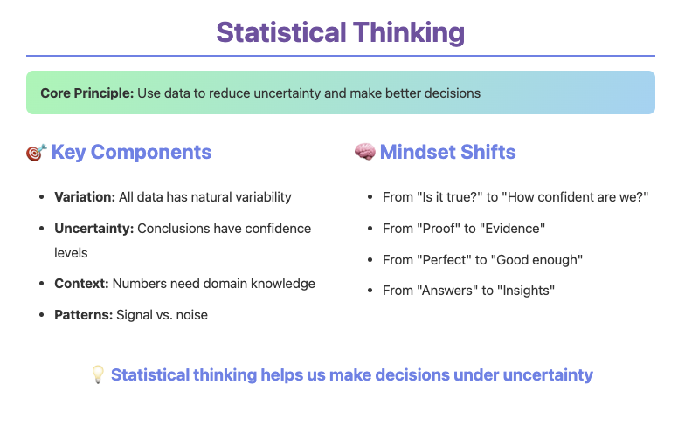
Notes:
Proof: Math certainty (2+2=4 always) Evidence: Statistical support (smoking→cancer, 99.9% sure) Say: "Criminal trials use evidence 'beyond reasonable doubt,' not absolute proof"

Slide 4
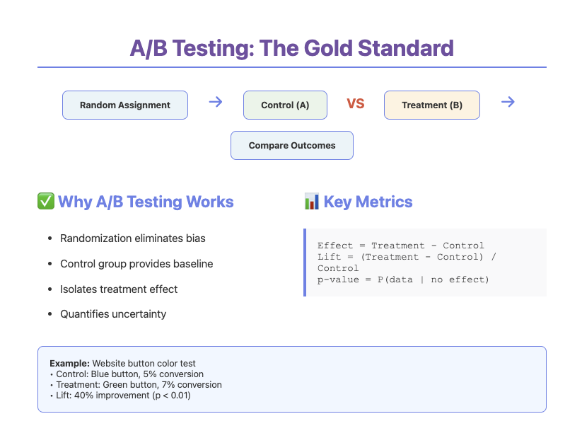
Notes:
Meaning: Coin flip decides who gets treatment Why: Only way to balance EVERYTHING (even unknown factors) Say: "Like shuffling cards - ensures fairness”
40% lift: 5% → 7% conversion (that's 40% increase) p < 0.01: Less than 1% chance this is just random luck Say: "If treatment did nothing, we'd see this less than 1 in 100 times"

Slide 5
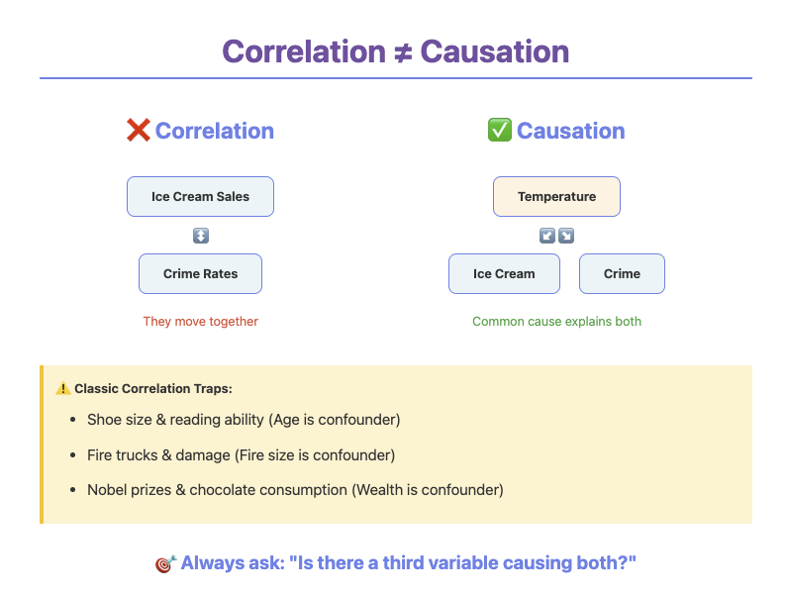

Slide 6
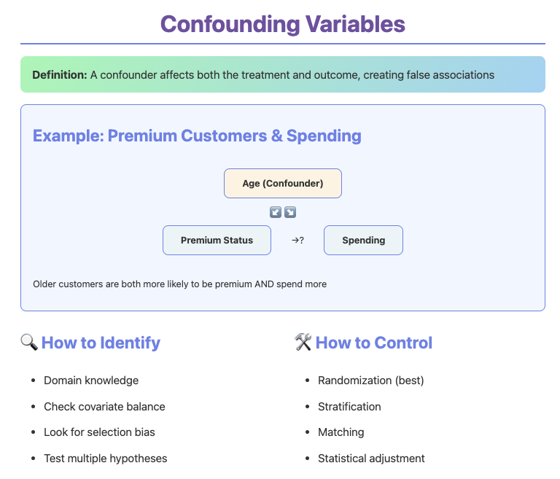
Notes:
Matching: Find "twins" - compare similar people Example: Compare 30-year-olds with engineer parents
Statistical Adjustment: Math to "hold things constant" Example: Like handicapping in golf - levels playing field mathematically
What: Trend reverses when groups combined Berkeley: Women win in each dept, lose overall Why: Different group sizes + selection effects Say: "Hospital A has more deaths but handles sicker patients"

Slide 7
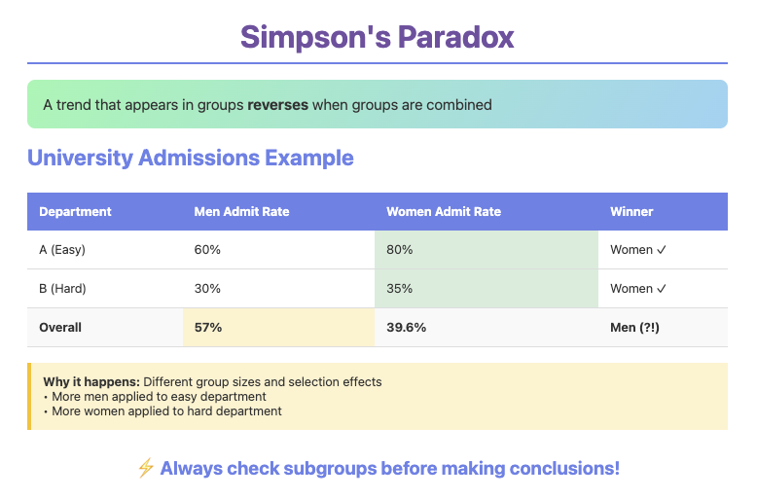

Slide 8
When we can't randomize, we get creative

Slide 9
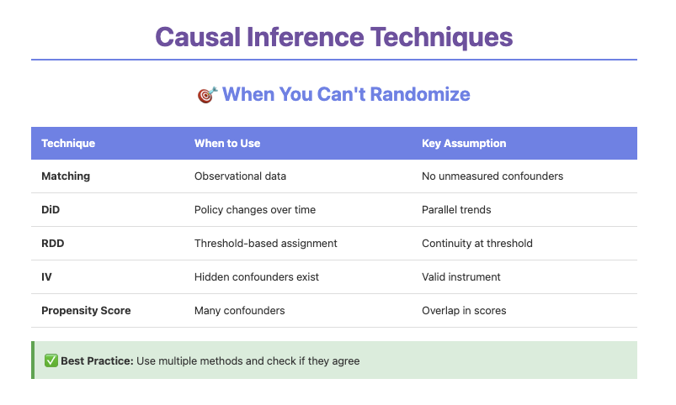

Slide 10
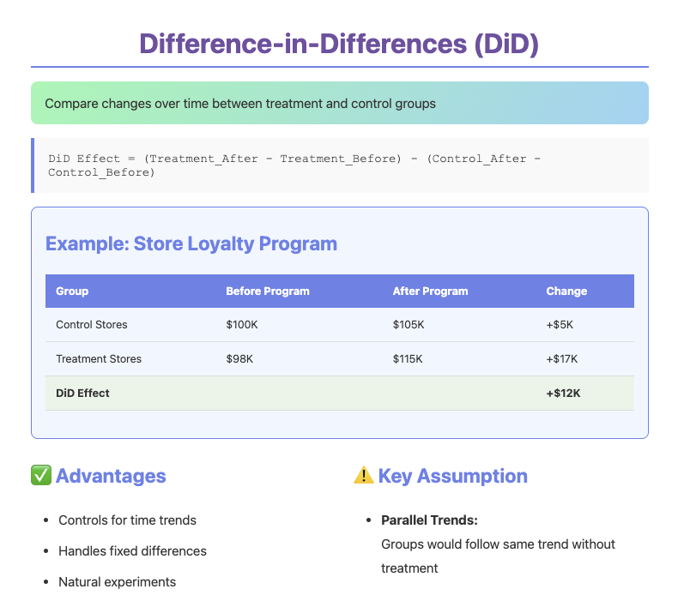

Slide 11
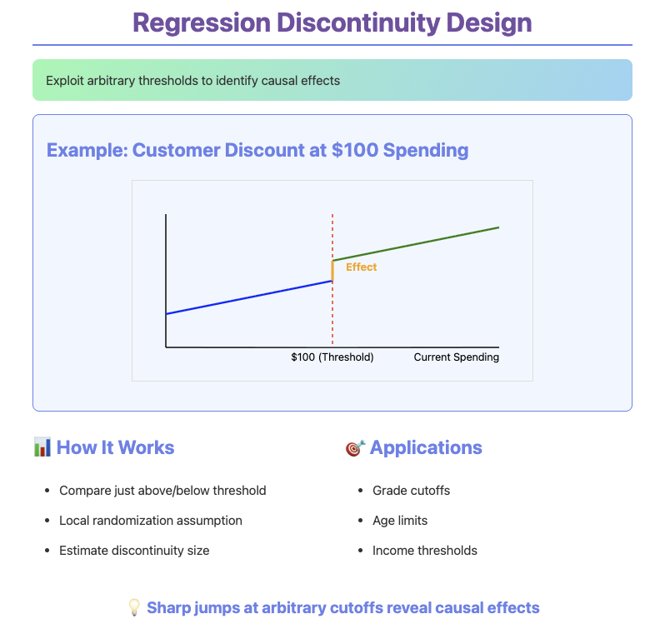

Slide 12
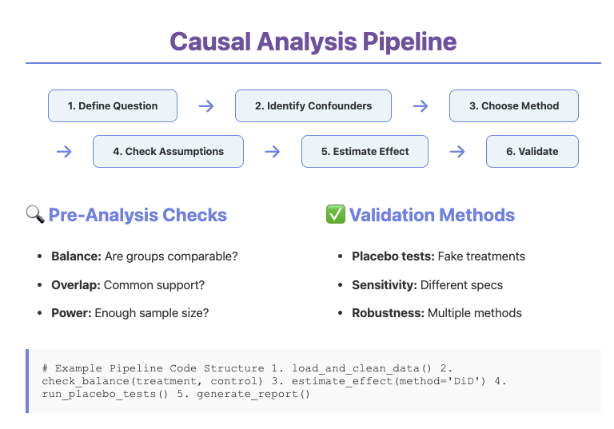

Slide 13
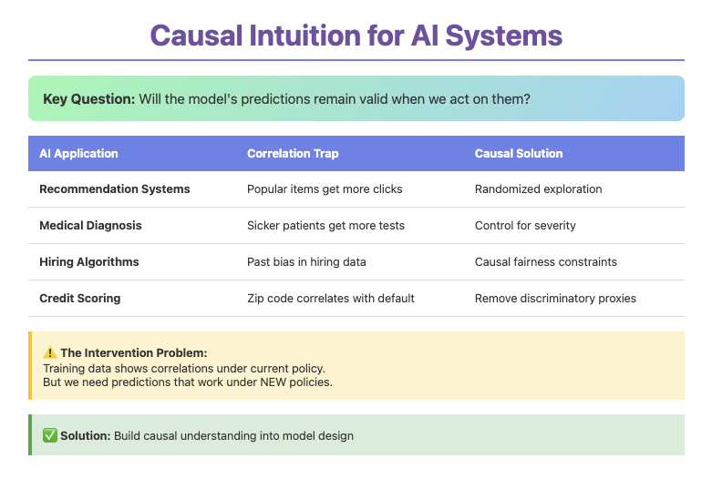

Slide 14
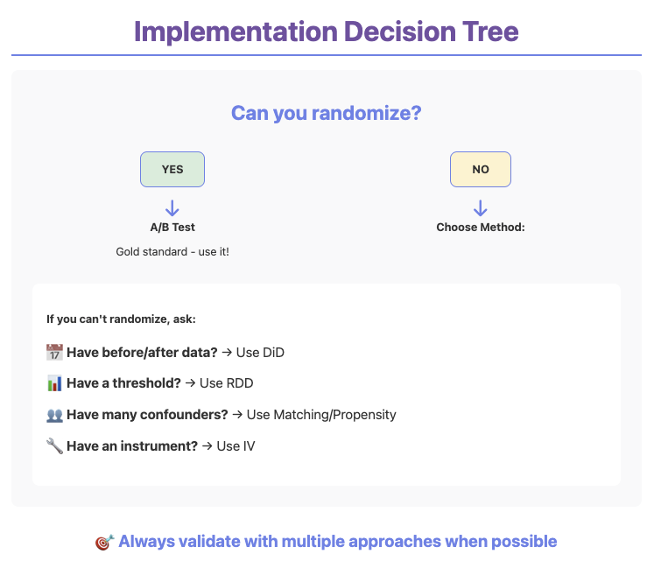

Slide 15
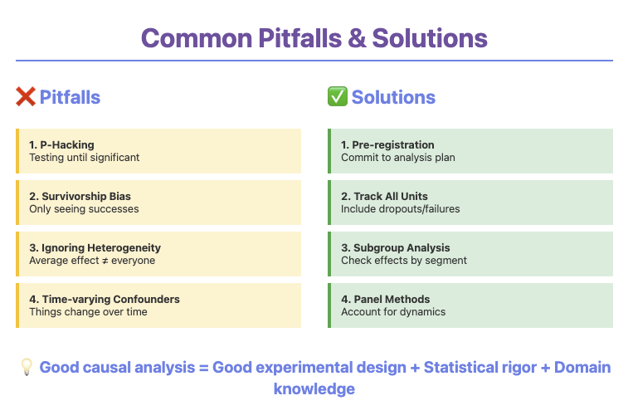

Slide 16
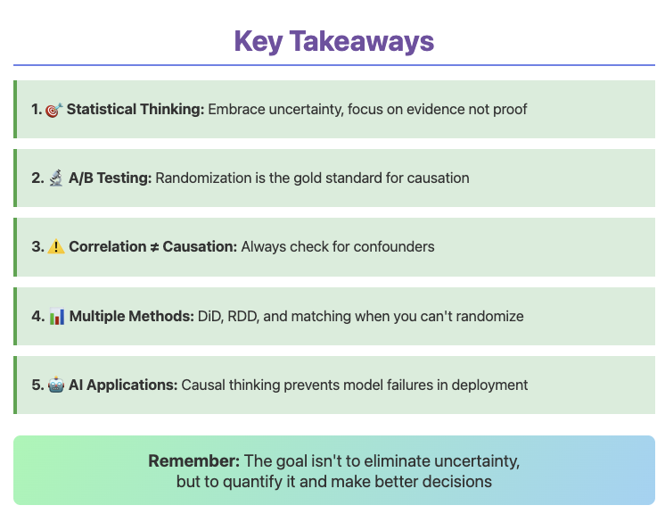

Slide 17
