Slide 1
Train – test split
EDA
Model Building
Final Evaluation
X
y
X_train (70%)
Y_train
X_train
Y_train
X_train
Y_train
X_valid (15%)
Y_valid
X_valid (15%)
Y_valid
X_valid (15%)
Y_valid
X_test (15%)
Y_test
X_test (15%)
Y_test
Data Split

Slide 2
Data
90% of patient healthy
10% with cancer
Data Split

Slide 3
90% of patient healthy
10% with cancer
90% of patient healthy
10% with cancer
Data
Data
Ensure EQUAL representation of target variable (cancer vs. healthy) across ALL FOLDS
`sklearn.model_selection.StratifiedKfold`
Stratify and Split

Slide 4
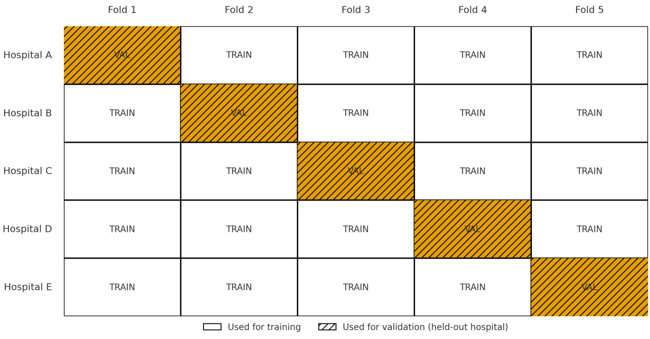
Stratify and Split

Slide 5

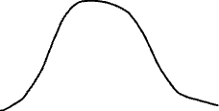
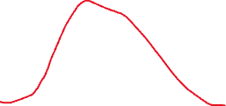
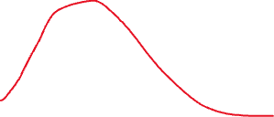
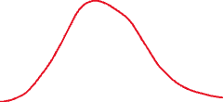
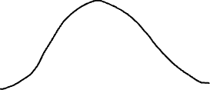
Feature EDA

Slide 6
X_train (120 samples)
Y_train (120 answers here)
Y_test (30 answers here)
LogisticRegression
X_test (30 samples here)
Y_pred (30 predictions here)
Model Training

Slide 7
Regression
X
y
Age | Sex | Experience | Salary
19 | M | 0 | 54000
26 | M | 3 | 67000
34 | F | 10 | 85000
56 | M | 25 | 120000
44 | F | 10 | 95000
27 | F | 7 | 87000
Model Training: Regression

Slide 8
Classification
X
y
Age | Sex | Sugar Every Week | Cancer
19 | M | 0 | 0
26 | M | 3 | 0
34 | F | 10 | 0
56 | M | 25 | 1
44 | F | 10 | 1
27 | F | 7 | 0
Model Training: Classification

Slide 9
Age | Sex | Sugar
X_test (15%)
Y_pred
Target
54000
65000
120000
18000
Y_test
Target
80000
60000
110000
25000
Model
Model Training and Prediction

Slide 10



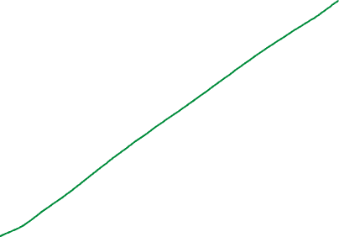
Y_pred
54000
65000
120000
18000
Y_test
80000
60000
110000
25000
Linear Regression

Slide 11
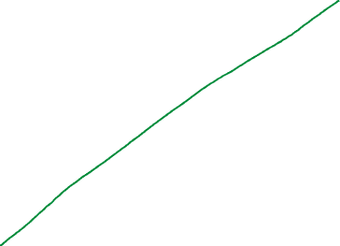
Linear Regression

Slide 12
Age | Sex | Sugar Every Week | Y_test
19 | M | 0 | No
26 | M | 3 | No
34 | F | 10 | No
56 | M | 25 | Yes
44 | F | 10 | Yes
27 | F | 7 | No
Y_pred
No
Yes
No
Yes
No
No
Model Training and Prediction

Slide 13
Defintions
True Positives (TP): actually positive and predicted as positive
True Negative (TN): actually negative and predicted as negative
False Positive (FP): actually negative and predicted positive
False Negative (FN): actually positive and predicted negative
Confusion Matrix

Slide 14
X
y
X_train (70%)
Y_train
X_train (70%)
Y_train
X_valid (15%)
Y_valid
X_valid (15%)
Y_valid
X_test (15%)
Y_test
Data Split

Slide 15
Fold 1
Fold 2
Fold 3
Fold 4
Fold 5
X_train
Y_train
X_train
Y_train
X_train
Y_train
X_train
Y_train
X_valid
Y_valid
X_train
Y_train
X_valid
Y_valid
X_valid
Y_valid
X_train
Y_train
X_valid
Y_valid
X_train
Y_train
X_valid
Y_valid
X_train
Y_train
X_test (15%)
Y_test
R2 = 78%
R2 = 79%
R2 = 58%
R2 = 98%
R2 = 78%
Cross Validation
Linear Regression Model, tol=(1,5,1)

Slide 16
X
y
X_temp
Y_temp
X_train
Y_train
X_val
Y_val
X_test
Y_test
Data Split

Slide 17
X_train
Y_train
Model
X_val
Y_val
Totalsales = 5 * numberofitems + 10 *uniqueitems + 100000000 * Country
Model Training

Slide 18
Tol/n_jobs | 10 | 100 | 1000
0.1 | 0.1 - 10 | 0.1 - 100 | 0.1 - 1000
0.2 | 0.2 - 10 | 0.2 - 100 | 0.2 -1000
Confusion Matrix

Slide 19


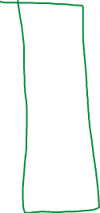
Decision Trees
Decision Trees

Slide 20


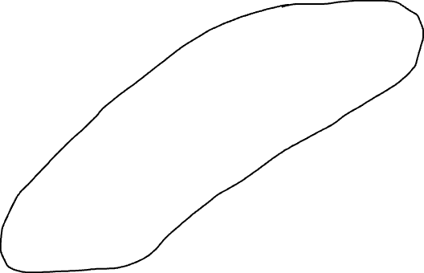

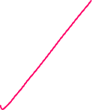
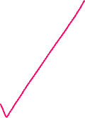
Parent Node
Age < 65
Branch Node
Age > 15
Not Survived
Sex = M
Survived
Price > 20$
Survived
Leaf Node
Leaf Node
Survive
Not Survived
Leaf Node
Decision Trees

Slide 21
Leaf Node
Decision Trees - Purity

Slide 22
Classification

Slide 23

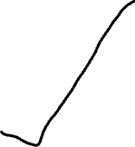
Classification

Slide 24





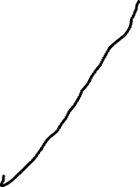
Support Vector Machines

Slide 25



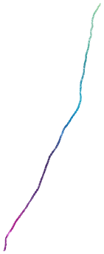




Support Vector Machines

Slide 26


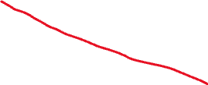
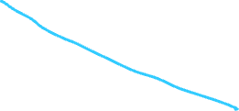
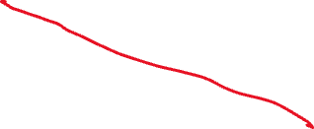











KNN

Slide 27








KNN

Slide 28









KNN

Slide 29




Time Series

Slide 30

Time Series

Slide 31









Time Series

Slide 32










Time Series

Slide 33















Time Series

Slide 34


Time Series

Slide 35



Time Series

Slide 36












Dimensionality Reduction

Slide 37

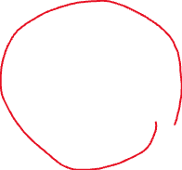




Dimensionality Reduction

Slide 38

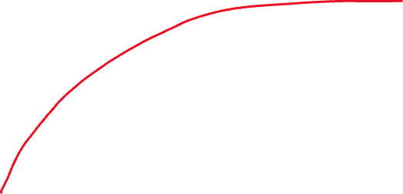


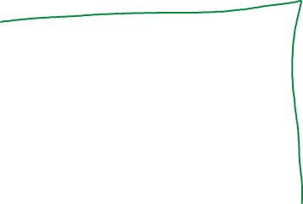

Dimensionality Reduction

Slide 39



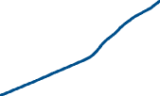









Dimensionality Reduction

Slide 40








Dimensionality Reduction

Slide 41











Package Conflicts

Slide 42
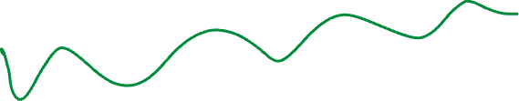

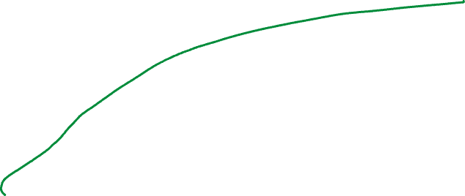
Dimensionality Reduction

