Slide 1

Sprocket Central Pty Ltd
Data analytics approach

Slide 2
Agenda
Introduction
Data Exploration
Model Development
Interpretation

Slide 3
Introduction
Data Insights
Sprocket Central Pty Ltd is a long-standing KPMG client whom specializes in high-quality bikes and accessible cycling accessories to riders. Their marketing team is looking to boost business by analyzing their existing customer dataset to determine customer trends and behavior.
Using the existing 3 datasets (Customer demographic, customer address and transactions) as a labeled dataset, we will recommend which of these 1000 new customers should be targeted to drive the most value for the organization.
We will prepare a detailed approach for completing the analysis including activities – i.e. understanding the data distributions, feature engineering, data transformations, modeling, results interpretation and reporting. This detailed plan needs to be presented to the client to get a sign-off. Please advise what steps you would take.

Slide 4
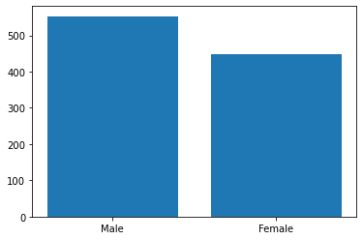
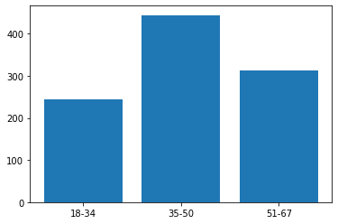
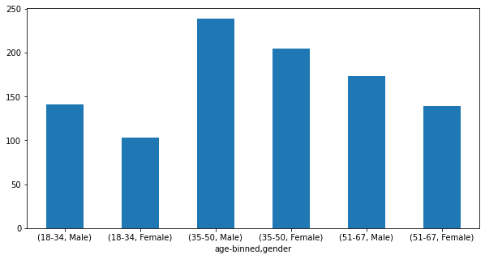
Data Exploration
Gender Distribution
Most of the buyers are Male
Most of the buyers have age between 35-40
Most of the customers which are from age 35-50 are Male

Slide 5
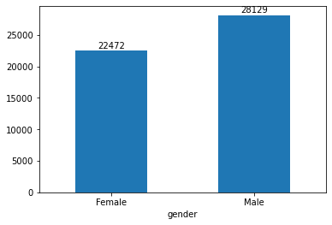
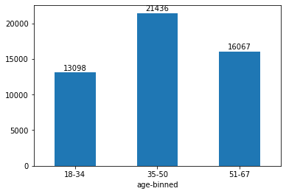
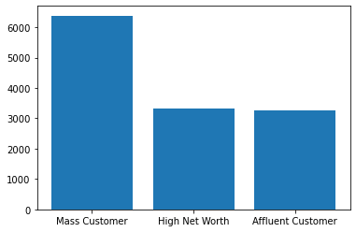
Data Exploration
Past 3yrs Purchases
Most Purchases in the last year are done by Male
We can see that in the past 3 years most of the bikes purchases are from the age 35-50
Wealth Segment
Most customers belongs to Mass Customer

Slide 6
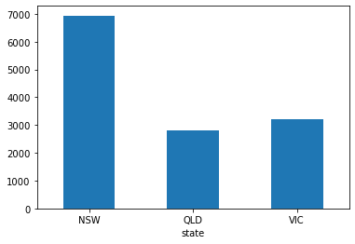
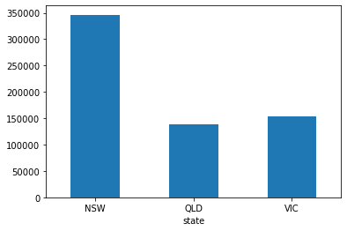
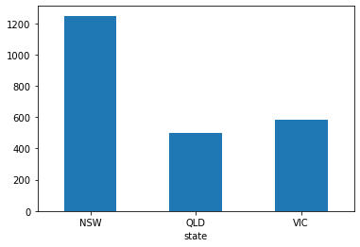
Data Exploration
State Distribution
We see that QLD state has lower no of people which can own car so we can target this state
Most of our customers are from NSW
Also most bikes were sold to people from NSW in past 3 years.

Slide 7
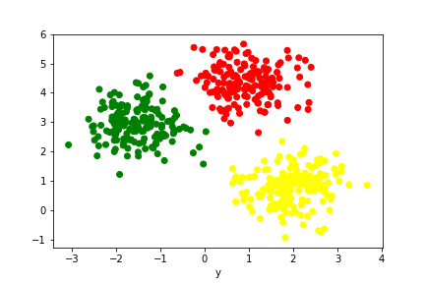
Model Development
Cluster and Segmentation of Customers using K-Means Algorithm
We will be applying customer segmentation to cluster them using K-means algorithm. As we want to target customer based on their trends and behavior K-means algorithm is best suitable as it can group customer base into groups of individual which has similar characteristics so we easily determine their behavior and easily target them and boost our business.

Slide 8
Interpretation
Examine and Interpret Clusters
After running our algorithm, the algorithm segments our dataset into three different clusters based on their behavior.
Cluster 0: Male customers, Mass customers, don't owns a car, state VIC, purchasing product class medium, age between 18-89 and total purchase of 237,057
Cluster 1: Female customers, Mass customers, owns a car, state NSW, purchasing product class high, age between 18-89 and total purchase of 401,719
Cluster 2: Female customers, Affluent customers, owns a car, state NSW, purchasing product class medium, age of 50 and total purchase of 656
We can see that Cluster 1 has highest number of purchases in the past 3 years so we may target this cluster to get better results.

