Slide 1
DAS732 / DATA VISUALIZATION
What does
01
Country relationships
the summary
02
leave out?
Uneven progress
03
Internet and Weather / an evidence-led story
Weather through time
Internet first → Weather second
Notes:
What does the summary leave out?
Speaker: Parikshith
Raw recording: 0:00-0:10 (10 seconds)
Chapter: Internet
Narration
What do averages and snapshots leave out? We examine Internet first, then Weather, following the evidence to a conclusion.
On screen
Look inside groups. Follow the measurements. Check time.
Actions
State the main question. Explain that Internet finishes before Weather starts. Do not list every method.
Transition
Look inside groups. Follow the measurements. Check time.
Source
Current report: question and conclusions. Current report: ../pdf/DAS732_A2_Report_IEEE.pdf

Slide 2
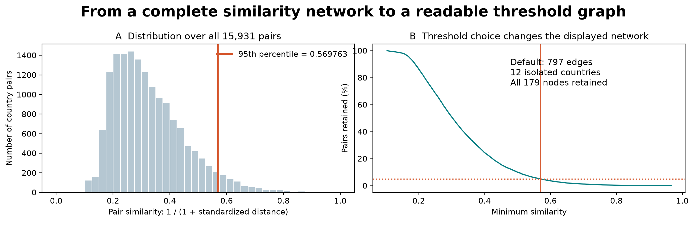
INTERNET / COUNTRY SIMILARITY
Similarity needs a visible threshold
15,931 possible pairs → 797 retained links
P95 threshold: 0.569763 | 12 isolated countries retained
Source: report Figs. 1 and 3; all-pair threshold audit. Similar profiles, not physical cables.
Notes:
Parikshith | 10-35s raw
Madam confirmed that similarity networks are suitable. We now score all fifteen thousand nine hundred and thirty-one country pairs. This histogram shows their similarities. Our declared ninety-fifth-percentile threshold keeps seven hundred and ninety-seven links. Twelve countries have no pair above it, but remain in the data. The browser can show every pair or change the threshold.
Actions: Point to the histogram and cutoff. State that the top five percent is a transparent starting view, not an optimal or significant threshold. Keep the retained-edge count and isolated-node count visible.
Source: Updated report Figure 1; data/network_threshold_audit.json; all-pair scores.

Slide 3
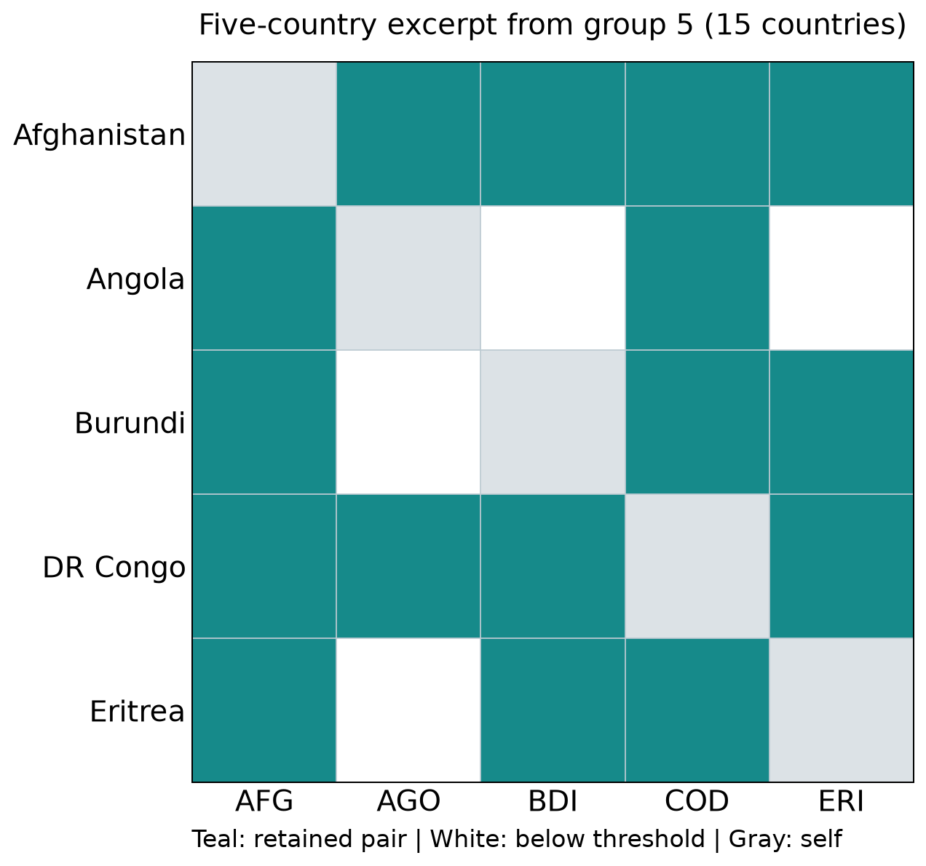
INTERNET / COUNTRY SIMILARITY
Groups still contain unequal relationships
93 / 105
pairs retained in group 5
Full-group degrees
Afghanistan: 14
Angola: 7
White means below the threshold, not an unmeasured pair.
Source: report Figs. 1 and 3; all-pair threshold audit. Similar profiles, not physical cables.
Notes:
Parikshith | 35-65s raw
NodeTrix now uses the filtered graph. Group five retains ninety-three of its one hundred and five possible pairs. This excerpt shows five of its fifteen countries. Afghanistan has fourteen links within the full group, while Angola has seven. Teal means above our similarity threshold; white means below it. A shared group label still hides different relationships. These links describe profiles, not physical cables.
Actions: Read the five-country excerpt. Compare Afghanistan and Angola; state that 14 and 7 are degrees in the full 15-country group, not only in this excerpt. Explain the Angola-Burundi white cell. Do not count excerpt cells as the full 93 edges.
Source: Updated report Figure 3; output/network_revision/nodetrix_detail_matrix.csv and facts.json.

Slide 4
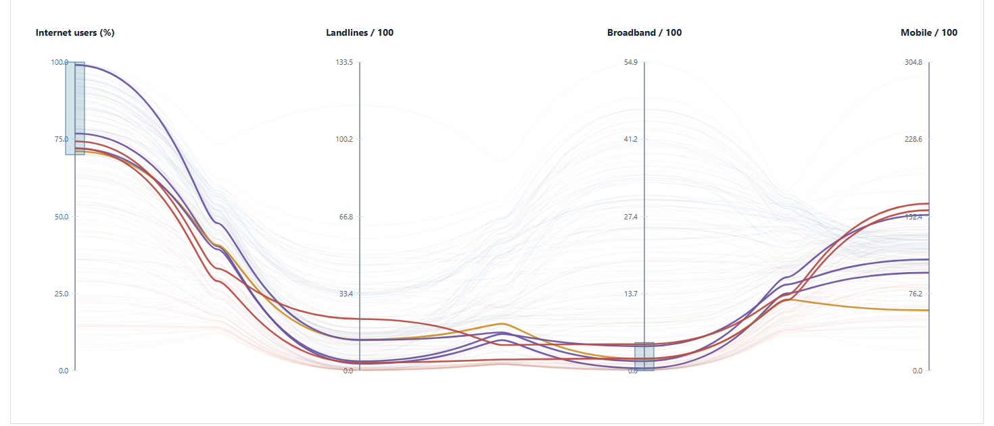
INTERNET
04 / 14
Does high internet use mean high fixed broadband?
Expectation: higher adoption should mean more fixed broadband. Does every country fit?
1
One line
One country across four
axes
2
Read crossings
Each axis has
its own scale
3
Apply the brush
≥70% online
≤5 broadband / 100
QUESTION
READ THE PLOT
EVIDENCE
CONCLUSION
Report Fig. 4, 5
Notes:
Does high internet use mean high fixed broadband?
Speaker: Varshith
Raw recording: 1:05-1:35 (30 seconds)
Chapter: Internet
Narration
Does high internet use always come with high fixed broadband? One line follows the same country across four measurements. Each axis has its own scale. Read where the line crosses an axis, not the bend between axes. Faint lines keep the other countries visible. I select at least seventy percent internet use and at most five fixed-broadband subscriptions per hundred people.
On screen
Follow one country across all four axes.
Actions
Show the four axes, then point at the two brush ranges. On the live browser page, apply Inspect high adoption / low broadband. Focus on one selected line; do not demonstrate unrelated controls yet.
Transition
Follow one country across all four axes.
Source
Report Fig. 4, 5. Current report: ../pdf/DAS732_A2_Report_IEEE.pdf

Slide 5
INTERNET
05 / 14
Six countries break the simple expectation
SAME PROFILES / test the expectation with a visible selection
6 / 175
High adoption +
low broadband
Cuba
Kuwait
South Africa
Bhutan
Kyrgyzstan
Libya
Show the live selection →
QUESTION
READ THE PLOT
EVIDENCE
CONCLUSION
Report Fig. 5
Notes:
Six countries break the simple expectation
Speaker: Varshith
Raw recording: 1:35-2:10 (35 seconds)
Chapter: Internet
Narration
Six of the one hundred and seventy-five matched countries meet both conditions. Their lines start high on internet use and cross low on fixed broadband. Cuba, Kuwait and South Africa are among them. I change the brush, then restore it, to demonstrate the selection. Fixed broadband alone therefore does not describe internet access. We cannot tell from this plot which connection each person uses.
On screen
High adoption can exist with little fixed broadband.
Actions
Record the real browser interaction from the slide link: apply the preset, move one brush slightly, then restore it. Keep six names and the 6-of-175 denominator visible. Return to the finding slide. Avoid a tour of every feature.
Transition
High adoption can exist with little fixed broadband.
Source
Report Fig. 5. Current report: ../pdf/DAS732_A2_Report_IEEE.pdf

Slide 6
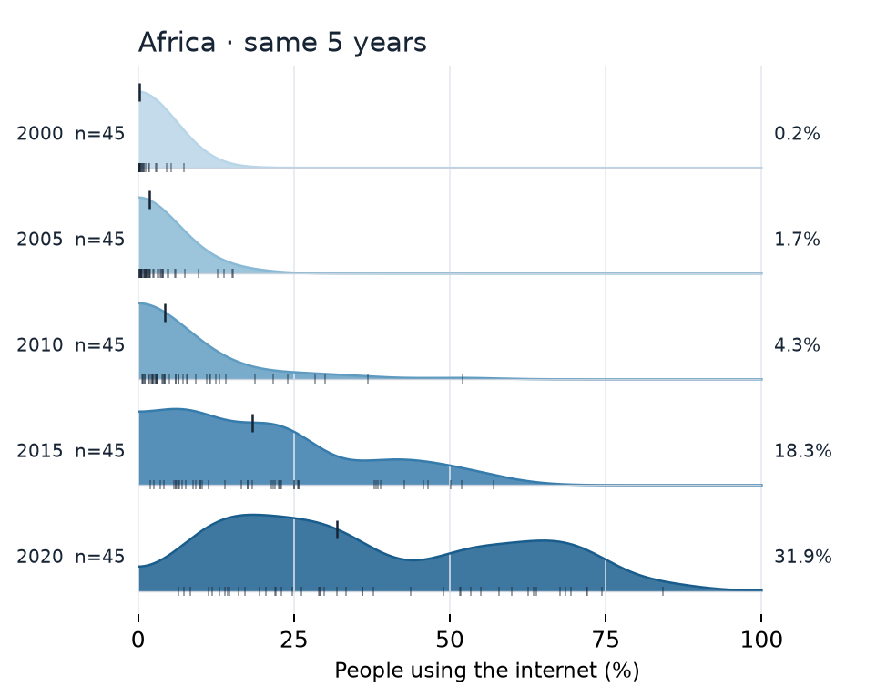
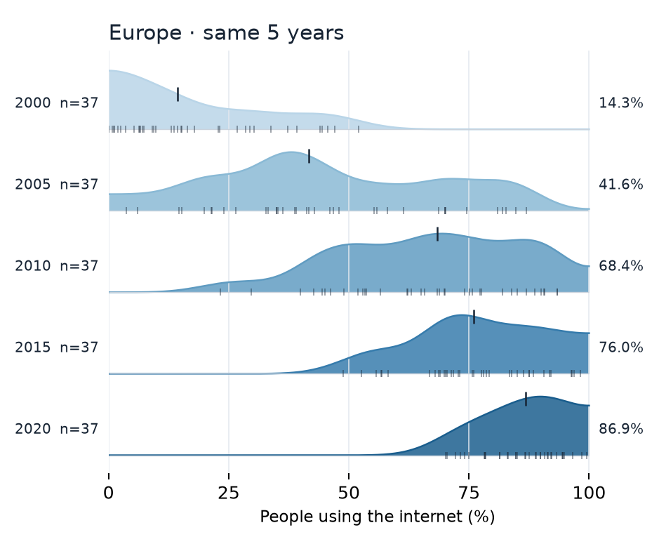
INTERNET
06 / 14
Progress does not mean everyone caught up
Read where the curves sit, then look at their spread.
1
Rightward shift
Adoption rises over time.
2
Remaining spread
Countries still differ in 2020.
Africa / same 45 countries
Europe / same 37 countries
Progress is clear. Large gaps remain within and between regions.
QUESTION
READ THE PLOT
EVIDENCE
CONCLUSION
Report Fig. 16
Notes:
Progress does not mean everyone caught up
Speaker: Sindhoor
Raw recording: 2:10-2:50 (40 seconds)
Chapter: Internet
Narration
Has progress closed the divide? These ridgelines follow the same countries at five dates. Moving right means higher internet use. Each curve shows the spread of countries; small ticks mark individual countries. Africa’s median rises from about zero to thirty-two percent, but its final curve remains wide. Europe moves right and reaches a much higher median. Progress is clear, yet differences remain within and between regions. Curve height is not a count of people.
On screen
Compare where the curves sit AND how widely they spread.
Actions
Read the 0–100 horizontal scale once. Trace Africa from 2000 to 2020; point at the wide final curve and the country ticks. Then compare Europe on the SAME scale. These are two labelled panels selected from report Fig. 16, not all regions.
Transition
Compare where the curves sit AND how widely they spread.
Source
Report Fig. 16. Current report: ../pdf/DAS732_A2_Report_IEEE.pdf

Slide 7
INTERNET
07 / 14
Internet: three findings, one answer
Finish Internet before starting the Weather case.
01
02
03
Relationships
Infrastructure
Progress
93 / 105 pairs linked in G5
6 / 175 fit the brush
Two regions, five dates
A group label hides
High adoption has
A rising median can
missing links.
different profiles.
leave wide gaps.
One adoption number cannot describe the whole connection profile.
QUESTION
READ THE PLOT
EVIDENCE
CONCLUSION
Report Fig. 3, 5, 16
Notes:
Internet: three findings, one answer
Speaker: Sindhoor
Raw recording: 2:50-3:15 (25 seconds)
Chapter: Internet
Narration
The internet evidence gives a connected answer. The matrix reveals different relationships inside one group. The selected profiles show high internet use with little fixed broadband. The ridgelines show progress with remaining gaps. A single adoption number cannot describe these differences. We need the relationships, other measurements and the spread of countries before saying the divide has closed.
On screen
A single adoption number cannot describe the whole connection profile.
Actions
Use the three numbered evidence statements to recap the reasoning. Introduce no new figure. Pause before the Weather section.
Transition
A single adoption number cannot describe the whole connection profile.
Source
Report Fig. 3, 5, 16. Current report: ../pdf/DAS732_A2_Report_IEEE.pdf

Slide 8
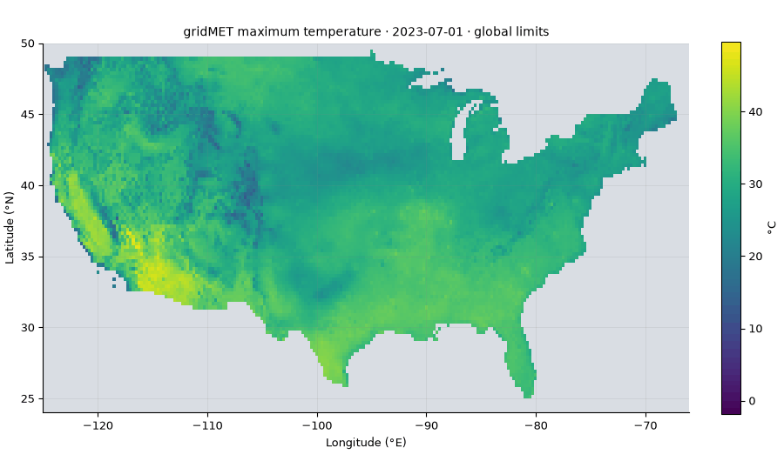
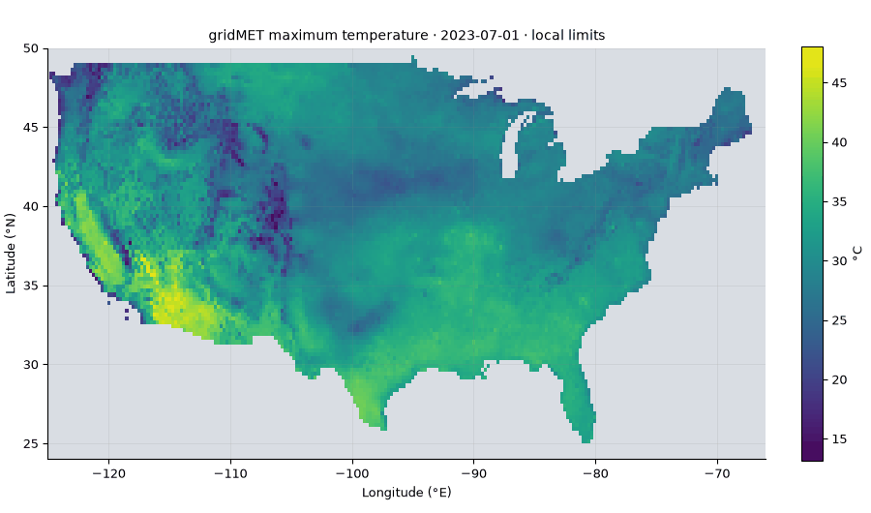
WEATHER
08 / 14
Weather: can the same colour mislead us?
NEW CASE / daily US weather, July–September 2023
FIXED SCALE
DAILY SCALE
Colour keeps its temperature meaning
Colour meaning can change each day
WATCH THE LEGENDS / same fields, different normalisation
QUESTION
READ THE PLOT
EVIDENCE
CONCLUSION
Report Fig. 17, 18
Notes:
Weather: can the same colour mislead us?
Speaker: Parikshith
Raw recording: 3:15-3:45 (30 seconds)
Chapter: Weather
Narration
We now move to ninety-two days of United States weather. These animations show the same temperature fields. The left legend stays fixed, so a colour keeps its temperature meaning across dates. The right legend resets each day. Local variation becomes clearer, but the same colour can mean a different temperature. Watch that changing legend. We use fixed scales to compare dates fairly.
On screen
Read the legend before comparing dates.
Actions
Stay in desktop PowerPoint Slide Show. Let both embedded GIFs complete at least two 6.4-second loops. Point to each colour bar; do not open another animation window.
Transition
Read the legend before comparing dates.
Source
Report Fig. 17, 18. Current report: ../pdf/DAS732_A2_Report_IEEE.pdf

Slide 9
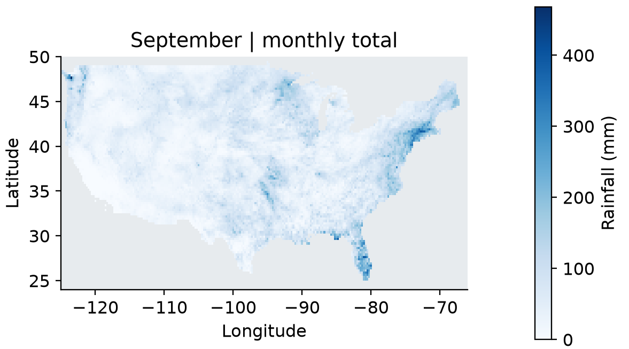
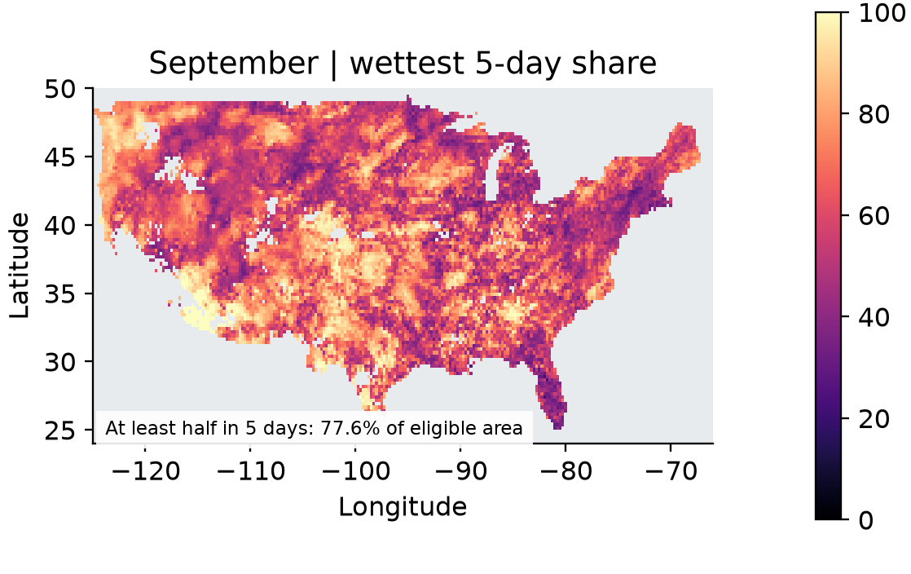
WEATHER
09 / 14
A monthly total cannot tell us when rain fell
September 2023 / same field of locations, two different questions
01 HOW MUCH?
02 HOW CONCENTRATED?
Legend: share of monthly rain in the wettest five days (%)
77.6%
of eligible area: ≥ half the monthly rain
in five consecutive days
Eligible cells: monthly rain ≥10 mm. A total alone cannot show the timing.
QUESTION
READ THE PLOT
EVIDENCE
CONCLUSION
Report Fig. 23
Notes:
A monthly total cannot tell us when rain fell
Speaker: Parikshith
Raw recording: 3:45-4:20 (35 seconds)
Chapter: Weather
Narration
The left map shows September rainfall totals. The right map asks when that rain fell: what share arrived in the wettest five consecutive days? Bright areas have strongly concentrated rain. Across seventy-seven point six percent of the eligible area, at least half the monthly rain fell within five days. A monthly total therefore hides whether rain arrived steadily or in short bursts. Daily observations recover that timing.
On screen
The same month needs both a total and a timing view.
Actions
Read the monthly-total map on the left, then the wettest-five-day share on the right. Point to the 0–100% legend. State that 77.6% is eligible area, not a percentage of all rain. Eligible cells have September rainfall of at least 10 mm.
Transition
The same month needs both a total and a timing view.
Source
Report Fig. 23. Current report: ../pdf/DAS732_A2_Report_IEEE.pdf

Slide 10
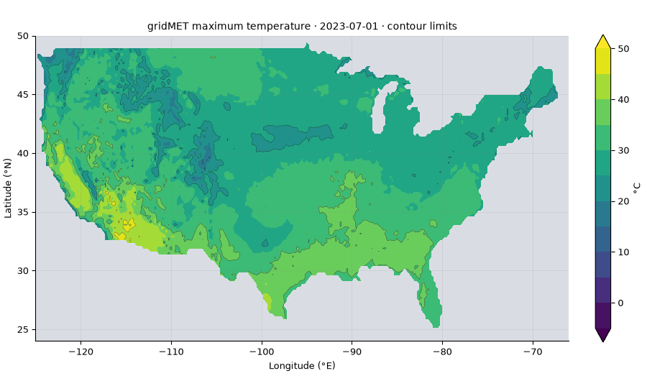
WEATHER
10 / 14
Contours let us follow temperature boundaries
Follow equal-temperature boundaries as the dates advance.
1
Trace a line
Same temperature along a
boundary
2
Follow time
Watch boundaries
move with dates
Smaller intervals add detail—and more lines to read.
QUESTION
READ THE PLOT
EVIDENCE
CONCLUSION
Report Fig. 19
Notes:
Contours let us follow temperature boundaries
Speaker: Sindhoor
Raw recording: 4:20-4:45 (25 seconds)
Chapter: Weather
Narration
Each contour line follows equal temperature, while filled bands show ranges. As dates advance, we can follow those boundaries. Smaller intervals expose more detail but create more lines to read. We choose an interval that keeps the regional pattern visible. More detail is useful only when it helps answer the question.
On screen
A contour follows equal temperature, not a state border.
Actions
Let the embedded contour GIF complete two loops. Point to one boundary and its value on the legend. Explain why changing the interval changes detail; keep the same temperature field as the reference.
Transition
A contour follows equal temperature, not a state border.
Source
Report Fig. 19. Current report: ../pdf/DAS732_A2_Report_IEEE.pdf

Slide 11
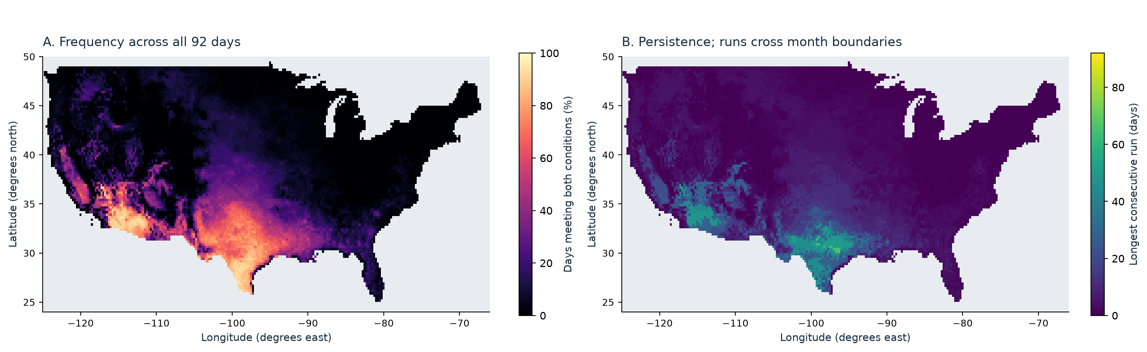
WEATHER
11 / 14
How often and how long are different questions
Same places and days / different summaries of hot-and-dry conditions
HOW OFTEN
HOW LONG WITHOUT A BREAK
Frequency counts qualifying days.
Longest local run: 67 days in this window.
Hot: Tmax ≥35°C / Dry: rain <1 mm per day / Different legends and units
QUESTION
READ THE PLOT
EVIDENCE
CONCLUSION
Report Fig. 30
Notes:
How often and how long are different questions
Speaker: Sindhoor
Raw recording: 4:45-5:25 (40 seconds)
Chapter: Weather
Narration
The left map counts how often a place was both hot and dry. The right records its longest uninterrupted run. Hot means at least thirty-five degrees; dry means less than one millimetre of daily rain. Many qualifying days can be separated by breaks, so frequency cannot tell us persistence. The longest local run in this ninety-two-day window is sixty-seven days. Reading both maps separates repeated events from sustained conditions.
On screen
Frequent hot-and-dry days need not form one long spell.
Actions
Read the left frequency legend and the right run-length legend separately. Point to the southwest pattern and compare the maps; do not equate their colours because the units differ. The 67-day maximum is somewhere in the grid and is bounded by the study window.
Transition
Frequent hot-and-dry days need not form one long spell.
Source
Report Fig. 30. Current report: ../pdf/DAS732_A2_Report_IEEE.pdf

Slide 12
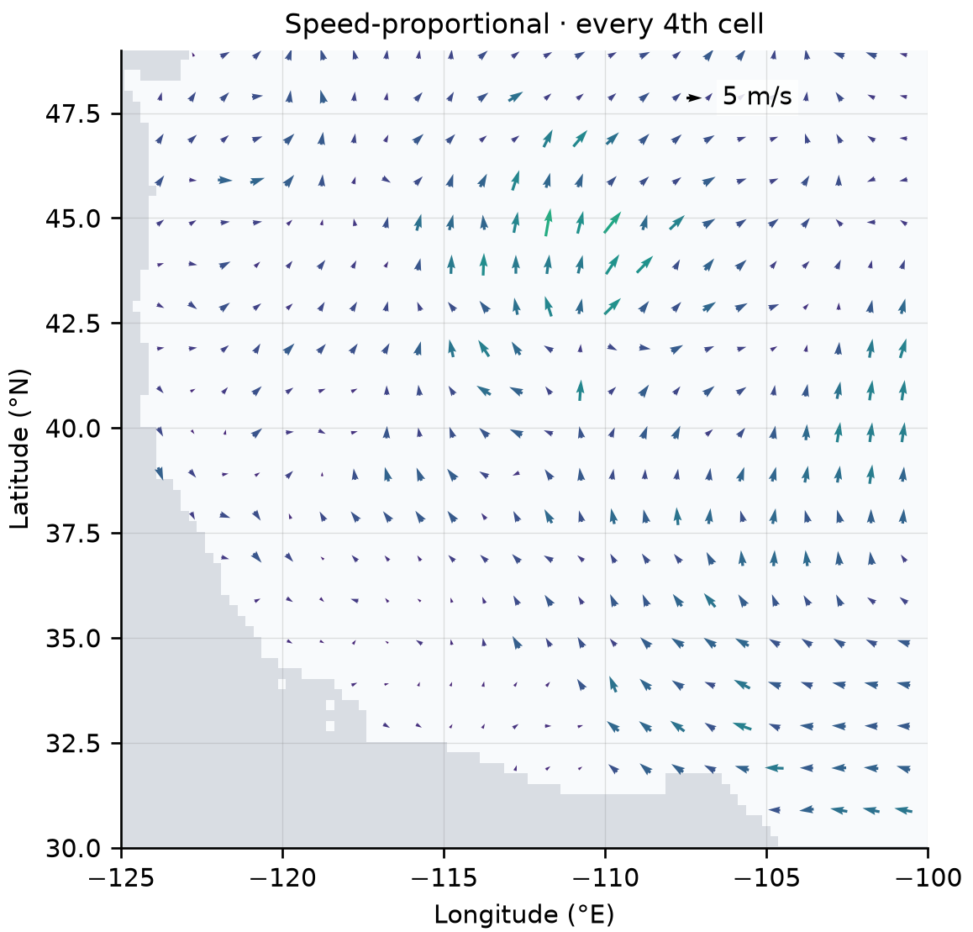
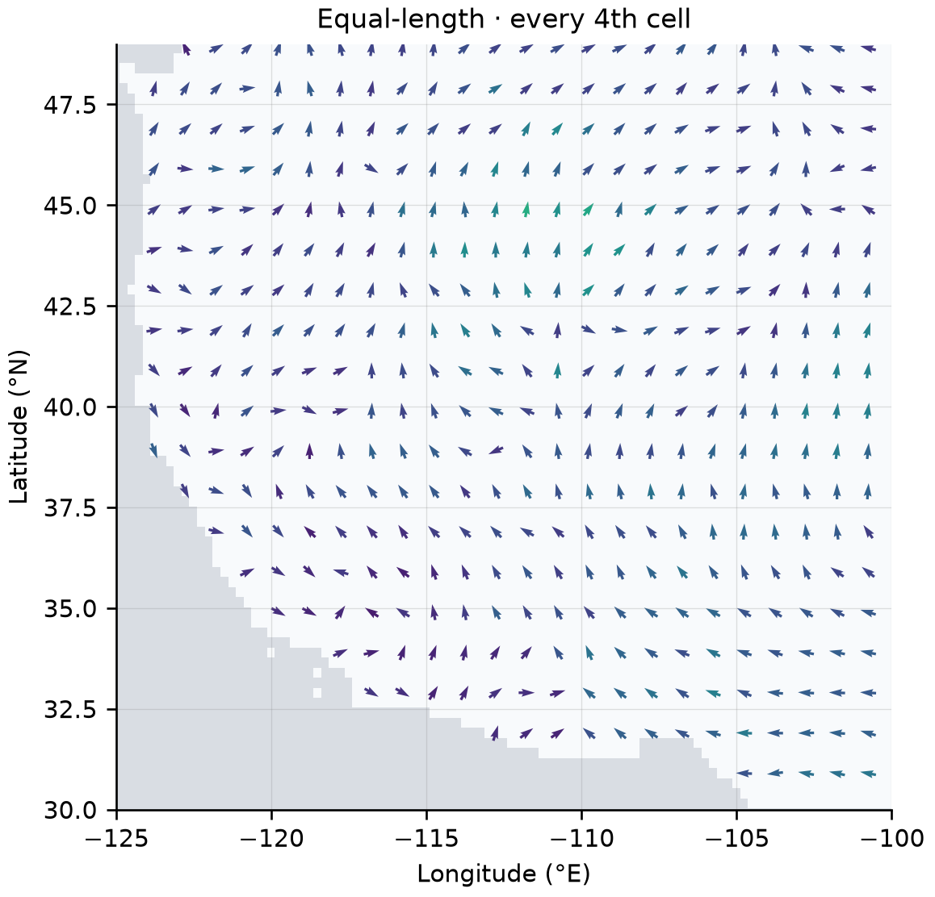
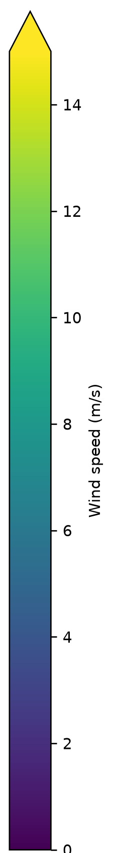
WEATHER
12 / 14
Arrow length changes the pattern we notice
Same field • same sampled locations • 22 August 2023
LENGTH = SPEED
EQUAL LENGTHS
Speed differences stand out
Directions become easier to follow
Arrows show flow TO. Colour retains speed in both views.
QUESTION
READ THE PLOT
EVIDENCE
CONCLUSION
Report Fig. 26
Notes:
Arrow length changes the pattern we notice
Speaker: Varshith
Raw recording: 5:25-6:00 (35 seconds)
Chapter: Weather
Narration
Both maps use the same wind field and sampled locations. On the left, arrow length grows with speed, so slow winds can be hard to follow. Equal lengths on the right make directions clearer; colour still shows speed. Arrows point where air moves, after converting the source wind-from direction. The measurements stay the same. We choose the view according to whether we need speed differences or direction patterns.
On screen
Use length for speed; use equal lengths to inspect direction.
Actions
Compare the same western-US area in the two panels. Both retain every fourth sampled grid cell from the source experiment. Point first to short arrows and then to matching equal-length arrows. Use the retained common speed colour key.
Transition
Use length for speed; use equal lengths to inspect direction.
Source
Report Fig. 26. Current report: ../pdf/DAS732_A2_Report_IEEE.pdf

Slide 13
WEATHER
13 / 14
What do averages and snapshots leave out?
The conclusion follows from the evidence already shown.
INTERNET
WEATHER
Differences inside the summary
Time inside the summary
Same group: unequal links.
Monthly rain: short bursts.
High adoption: different profiles.
Event counts: different run lengths.
Progress: remaining gaps.
Drawing choices: different emphasis.
Pair the summary with the detail needed to answer the question.
QUESTION
READ THE PLOT
EVIDENCE
CONCLUSION
Report Fig. 3, 5, 16, 23, 30
Notes:
What do averages and snapshots leave out?
Speaker: Varshith
Raw recording: 6:00-6:24 (24 seconds)
Chapter: Weather
Narration
Our answer is that summaries leave out differences and time. For Internet, the group label and adoption number miss different country profiles and uneven progress. For Weather, monthly totals and event counts miss bursts and long uninterrupted spells. The strongest explanation therefore pairs the summary with the detail needed for the question, and draws its conclusion from that visible evidence.
On screen
Show the pattern, explain the evidence, state what follows.
Actions
Connect each conclusion to the named evidence already shown. Introduce no new numbers or chart. Advance to credits after the final sentence.
Transition
Show the pattern, explain the evidence, state what follows.
Source
Report Fig. 3, 5, 16, 23, 30. Current report: ../pdf/DAS732_A2_Report_IEEE.pdf

Slide 14
DAS732 / ASSIGNMENT 2
Team Plot Twist
Parikshith Aithal K V
Network / scalar fields
BT2024249
Sindhoor Ganapathi Hegde
Temporal views / contours
BT2024014
Varshith M Gowda
JavaScript profiles / quiver
BT2024227
OWID / ITU country data • gridMET weather • sources and full methods in the report
Notes:
Team Plot Twist
Speaker: Silent closing card
Raw recording: 6:24-6:30 (6 seconds)
Chapter: Weather
Narration
[Silent closing card]
On screen
Internet complete. Weather complete.
Actions
Hold for six seconds. End recording.
Transition
Internet complete. Weather complete.
Source
Current report: question and conclusions. Current report: ../pdf/DAS732_A2_Report_IEEE.pdf

