Slide 1

OPTIMIZED ANALYSIS OF EMOTION RECOGNITION THROUGH SPEECH SIGNALS
Team-A10
Aitha Sahith(19311A1206)
Balle Naresh(19311A1216)
P Swethan Goud(19311A1226)
Under the guidance of
Dr.K.Vijaya Lakshmi
Professor & Associate Dean(R&D)

Slide 2


CONTENTS
INTRODUCTION
WHAT IS DEEP LEARNING
THE PROCESS FLOW
ALGORITHM
THE DATASET
DATA VISUALIZATION
PROS AND CONS
APPLICATIONS
CONCLUSION
REFERENCES

Slide 3

INTRODUCTION
Emotion recognition from speech signals is an important but challenging component of Human-Computer Interaction (HCI).
In the literature of speech emotion recognition (SER), many techniques have been utilized to extract emotions from signals, including many well-established speech analysis and classification techniques.
Deep Learning techniques have been recently proposed as an alternative to traditional techniques in SER.

Slide 4
Execution Video
https://drive.google.com/file/d/1qQjPlAv42k7UiG6Xnl4kK3qFzgG-TPcj/view?usp=sharing

Slide 5

ABSTRACT
Emotion recognition from speech has evolved from being a niche to an important component for Human-Computer Interaction (HCI). These systems aim to facilitate the natural interaction with machines by direct voice interaction instead of using traditional devices as input to understand verbal content and make it easy for human listeners to react. Some applications include dialogue systems for spoken languages such as call center conversations, onboard vehicle driving system and utilization of emotion patterns from the speech in medical applications.

Slide 6
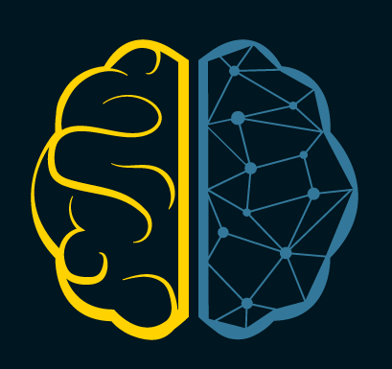
What is Deep Learning?
Deep Learning is a sub domain of Machine Learning whose algorithms are based on the architecture and structure of human brain called Artifical Neural Networks.

Slide 7
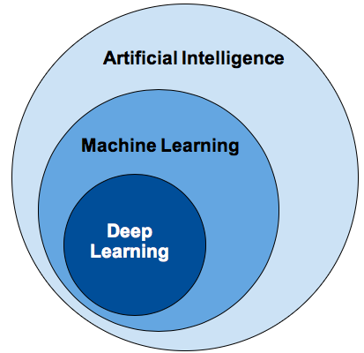

Slide 8
Data Collection
Feature Extraction
Training and Testing
The Process Flow

Slide 9
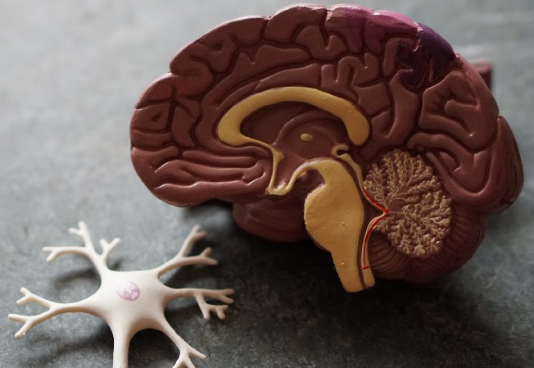
Algorithm
MULTI CLASSIFICATION
A Convolutional Neural Network (ConvNet/CNN) is a Deep Learning algorithm that can take in an input image, assign importance (learnable weights and biases) to various aspects/objects in the image, and be able to differentiate one from the other.
LSTM is often used in classification problems. When an input is present, the first layer computes the distance from the input vector to the training input vectors(The first LSTM layer with 64 nodes). This produces a vector where its elements indicate how close the input is to the training input

Slide 10

DEPENDENCIES
Python 3.7
Scikit-learn
Librosa
Tensorflow
Pydub

Slide 11

THE DATASET
Lots of data has to be collected in order to build an efficient model.
In this the dataset that is chosen is RAVDESS dataset; this is the Ryerson Audio-Visual Database of Emotional Speech and Song dataset.
This dataset has 7356 files rated by 247 individuals 10 times on emotional validity, intensity, and genuineness.
The entire dataset is 24.8GB from 24 actors.We can download the data set with the below link.
https://drive.google.com/file/d/1wWsrN2Ep7x6lWqOXfr4rpKGYrJhWc8z7/view

Slide 12
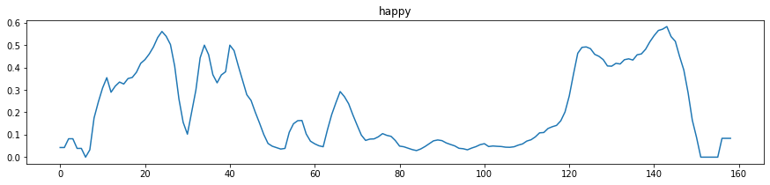
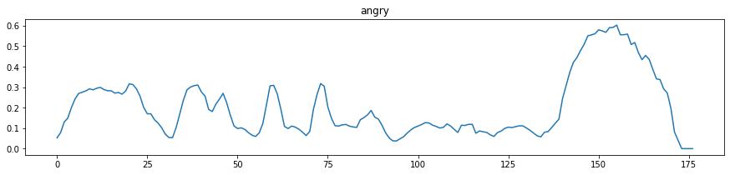
DATA VISUALIZATION-I

Slide 13
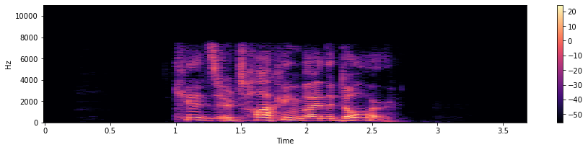
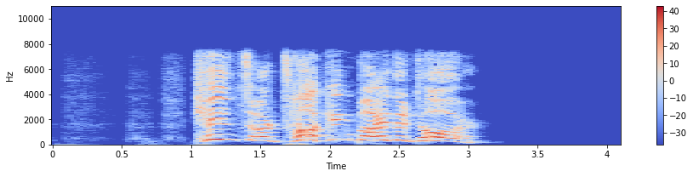
DATA VISUALIZATION-II

Slide 14
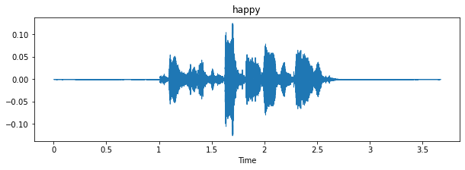
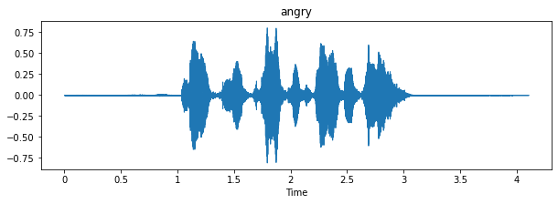
DATA VISUALIZATION-III

Slide 15
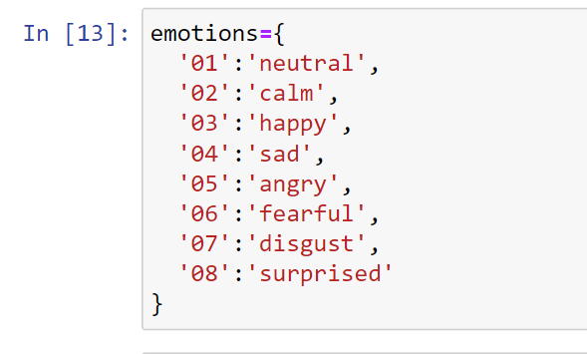
CREATING A DICTIONARY

Slide 16
CLASSIFIER-I
CNN:
A Convolutional Neural Network (CNN) is a type of Deep Learning architecture commonly used for image classification and recognition tasks. It consists of multiple layers, including Convolutional layers, Pooling layers, and fully connected layers. The Convolutional layer applies filters to the input image to extract features, the Pooling layer downsamples the image to reduce computation, and the fully connected layer makes the final prediction. The network learns the optimal filters through backpropagation and gradient descent.
In a regular Neural Network there are three types of layers:
Input Layers: It’s the layer in which we give input to our model. The number of neurons in this layer is equal to the total number of features in our data (number of pixels in the case of an image).
Hidden Layer: The input from the Input layer is then feed into the hidden layer. There can be many hidden layers depending upon our model and data size. Each hidden layer can have different numbers of neurons which are generally greater than the number of features. The output from each layer is computed by matrix multiplication of output of the previous layer with learnable weights of that layer and then by the addition of learnable biases followed by activation function which makes the network nonlinear.
Output Layer: The output from the hidden layer is then fed into a logistic function like sigmoid or softmax which converts the output of each class into the probability score of each class.

Slide 17
CLASSIFIER-II
LSTM:
A LSTM also known as Long Short term memory is a Recurrent neural network, which is widely used in classification and pattern recognition problems. In the LSTM algorithm, the neural network is trained in such a way that the model is not over fitted on numerous training epochs or iterations.
LSTM is often used in classification problems. When an input is present, the first layer computes the distance from the input vector to the training input vectors(The first LSTM layer with 64 nodes). This produces a vector where its elements indicate how close the input is to the training input. The second layer is a similar layer with 32-64 nodes in the network with Softmax activation function in order to produce the output containing multiple class predictions(Emotions in our case).

Slide 18
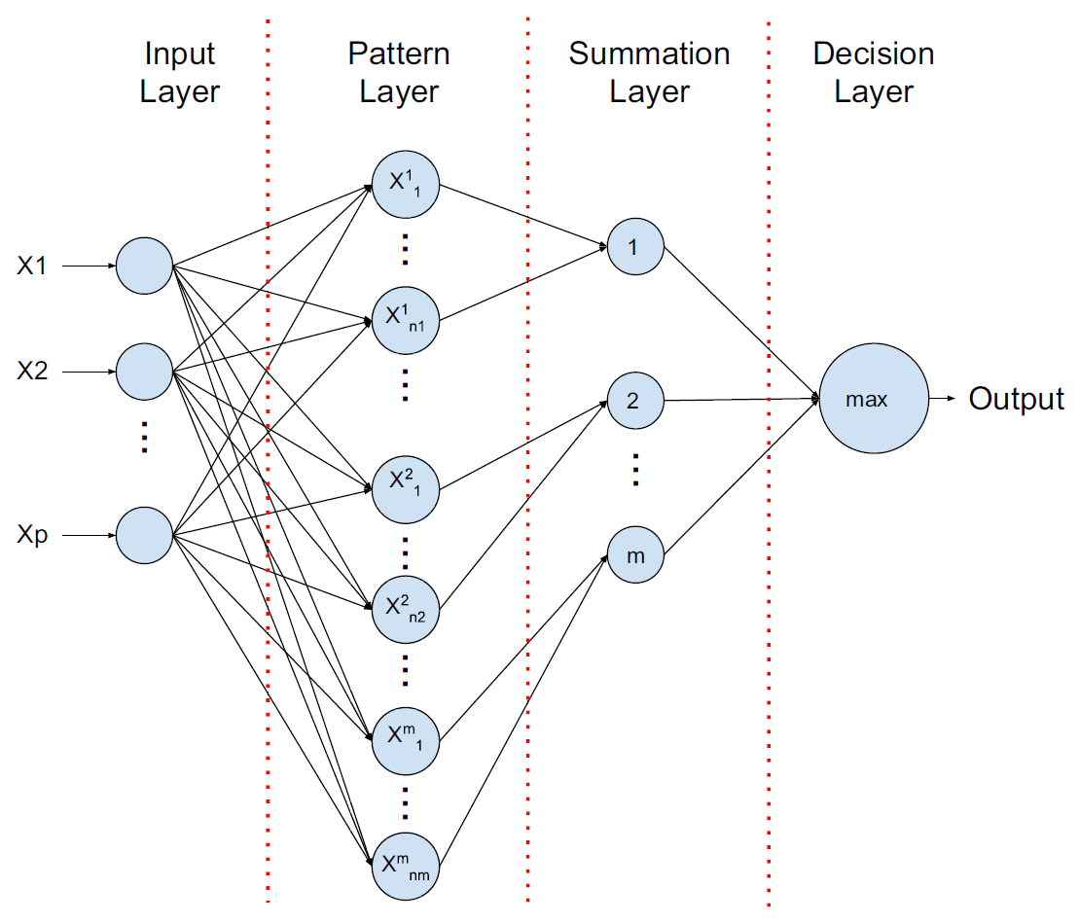

Slide 19
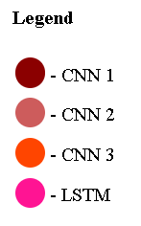
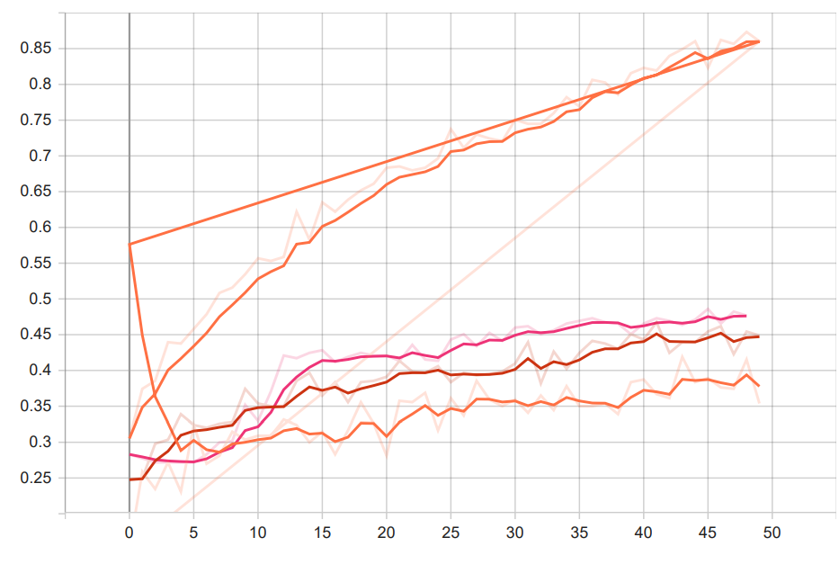

Overall Accuracy Comparisons
Highest Accuracy

Slide 20
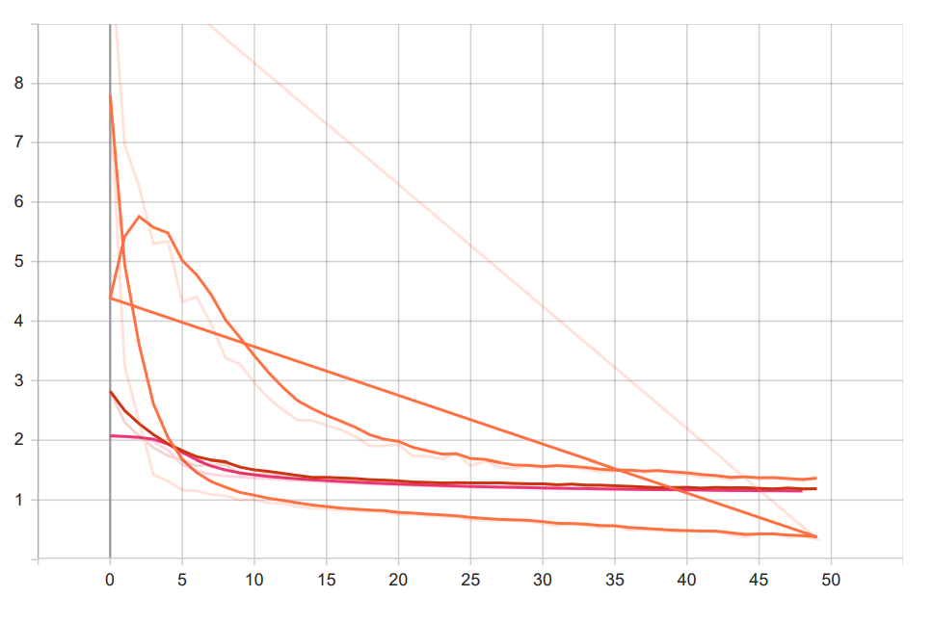
Overall Loss Comparisons
Lowest Loss

Slide 21
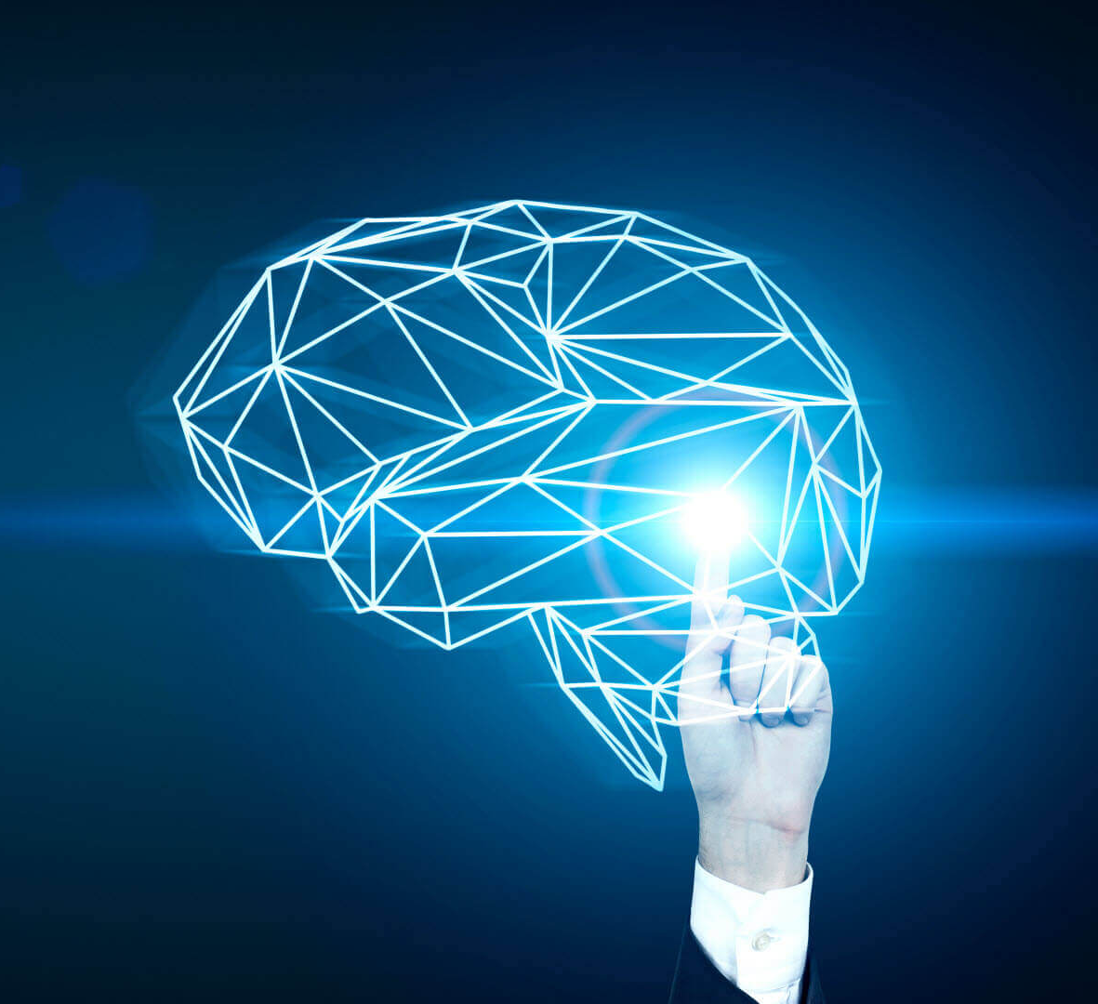
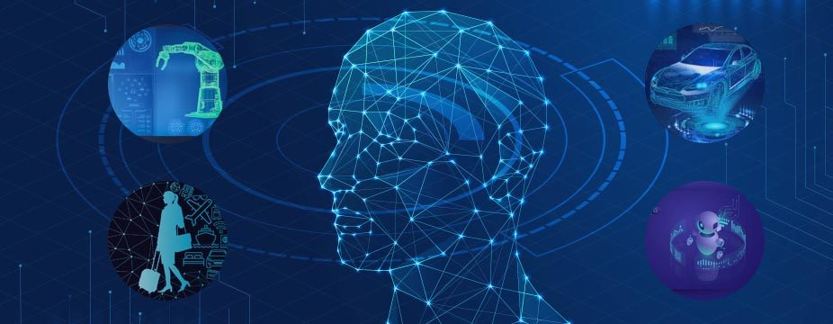
APPLICATIONS
INVESTIGATION
A machine which can detect emotions can be used to interrogate the suspect.
This could replace human being and produce efficient output.
EMPLOYEE RECRUITMENT
A machine can be used to interview a person for recruitment.
A machine can efficiently detect the metal fitness of the candidate.
HUMAN MACHINE INTERFACE
A machine with this ability can interact with the customer more than a human.

Slide 22

PROS
These are very efficient.
Accuracy of the model increases with training.
Can be implemented anywhere.
CONS
Takes a lot of time for computation and building.
Requires a large Dataset for efficient results.
Requires skilled professionals.

Slide 23

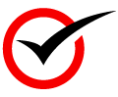

CONCLUSION
Deep Learning Algorithms are very much useful and powerful to solve real life problems.
Large number of applications of SER make this one of the most popular technology now.
Technologies like this should be implemented wherever needed as a part of our path towards development.

Slide 24

REFERENCES
www.google.com
https://www.microsoft.com/en-in/msidc
https://machinelearningmastery.com/what-is-deep-learning/
https://ieeexplore.ieee.org/document/8805181
https://ieeexplore.ieee.org/document/9023737
https://medium.com/analytics-vidhya/speech-emotion-recognition-using-machine-learning-df31f6fa8404
https://www.youtube.com/watch?v=yvxpxcncSGs
https://www.youtube.com/watch?v=XWGuzODhRNo

Slide 25

THANK YOU
FOR LISTENING…🙂

