Slide 1
Severless
Harika

Slide 2
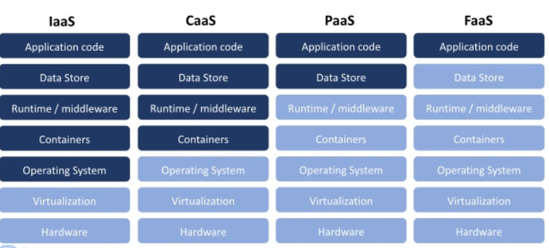
From Iaas to Faas

Slide 3
History of Serverless
2008 - Google released Google App Engine
2014 – AWS launched Lambda
2015 – AWS launches API Gateway

Slide 4
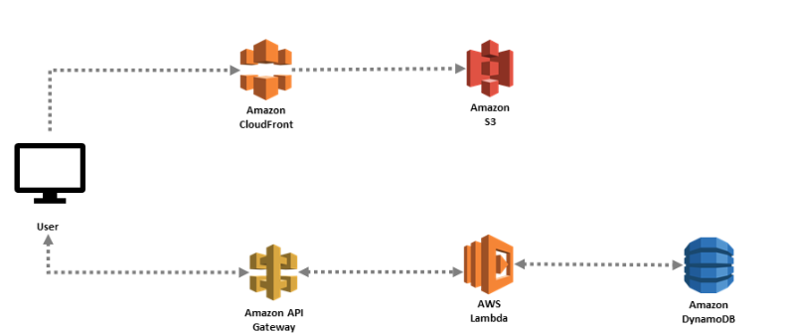
Serverless Services in AWS
AWS Lambda
API Gateway
Amazon S3
Amazon SNS
CloudFront
Amazon SQS
DynamoDB
StepFunction
AppSync

Slide 5
What is AWS Lambda
AWS Lambda lets you run code without provisioning or managing servers.
You pay only for the compute time you consume.
With Lambda, you can run code for virtually any type of application or backend service - all with zero administration.
Just upload your code and Lambda takes care of everything required to run and scale your code with high availability.
You can set up your code to automatically trigger from other AWS services or call it directly from any web or mobile app.
It is Event-Driven.
*File upload
*Api requests

Slide 6
Languages:
Node.js
Java
Python
C#
Go

Slide 7
Limitations:
Uncompressed code and dependencies <250MB
Compressed function package <50MB
Total function packages in a region <75GB
Maximum execution duration < 900 sec
1000 concurrent functions
Memory: 128MB – 3GB

Slide 8
Benefits of AWS Lambda
Pay per use
Fully managed infrastructure
Automatic scaling
Integration with other AWS products

Slide 9
Challenges of AWS Lambda
Debugging
Control
Cold start time

Slide 10
Sample code
exports.handler = async (event) => {
// TODO implement
const response = {
statusCode: 200,
body: JSON.stringify('Hi prod some another change Lambda!'),
};
return response;
};
Whenever the Lambda function is invoked lambda calls handler function.

Slide 11
Severless Application Model
Simplifies deployment of serverless resource
It is not a AWS service
New resources with SAM:
AWS Lambda Functions (AWS::Serverless::Function)
Amazon API Gateway (AWS::Serverless::Api)
Amazon DynamoDB Tables (AWS::Serverless::SimpleTables)
SAM-CLI – It can used to test locally using sam commands.
sam package command
sam deploy command

Slide 12
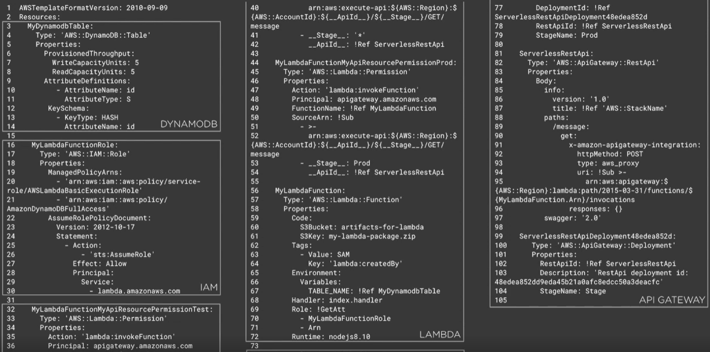
Creating DynamoDB, LAMBDA, API Gateway using CloudFormation template

Slide 13
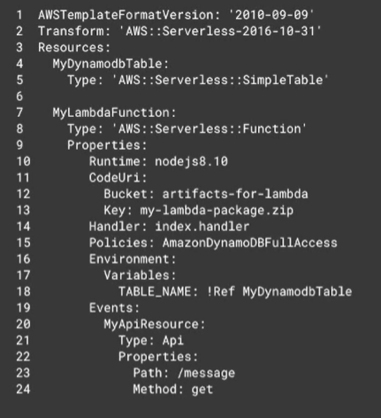
Creating DynamoDB, LAMBDA, API Gateway using SAM template

Slide 14
Sample SAM template
AWSTemplateFormatVersion: 2010-09-09
Transform: AWS::Serverless-2016-10-31 //Must use transform for sam
Description: HelloWorldLambdaJava
Resources:
HelloWorldLambda:
Type: AWS::Serverless::Function
Properties:
FunctionName : sample-function
Runtime: java8
MemorySize: 512
Handler: capgemini.HelloWorld::handler
CodeUri: target/lambda.zip

Slide 15
Versioning and aliasing
Versions
When we work on a Lambda Function we work on $LATEST
When we ready to publish a Lambda function, we create a version
Versions are immutable
Versions have increasing version numbers
Versions have there own ARN

Slide 16
Versioning and Aliasing
Aliases
Aliases are pointers to Lambda function versions.
We can define dev, qa and prod alias and point them to different lambda versions.
Aliases are mutable.
Alias enable Canary deployments by assigning weights.
Aliases have their own ARN

Slide 17
DevOps Implementation

Slide 18
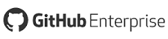
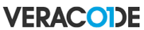
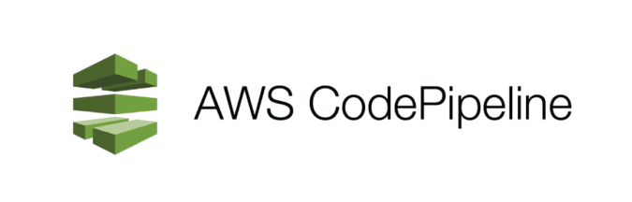
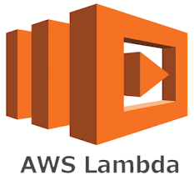
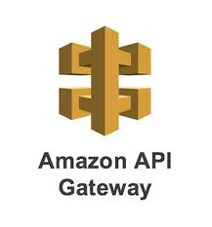
Proposed solution Architecture
Dev
Dev
+
Dev
+
QA
QA
+
Branches
QA
Prod
Prod
Manual Approval
+
Prod

Slide 19
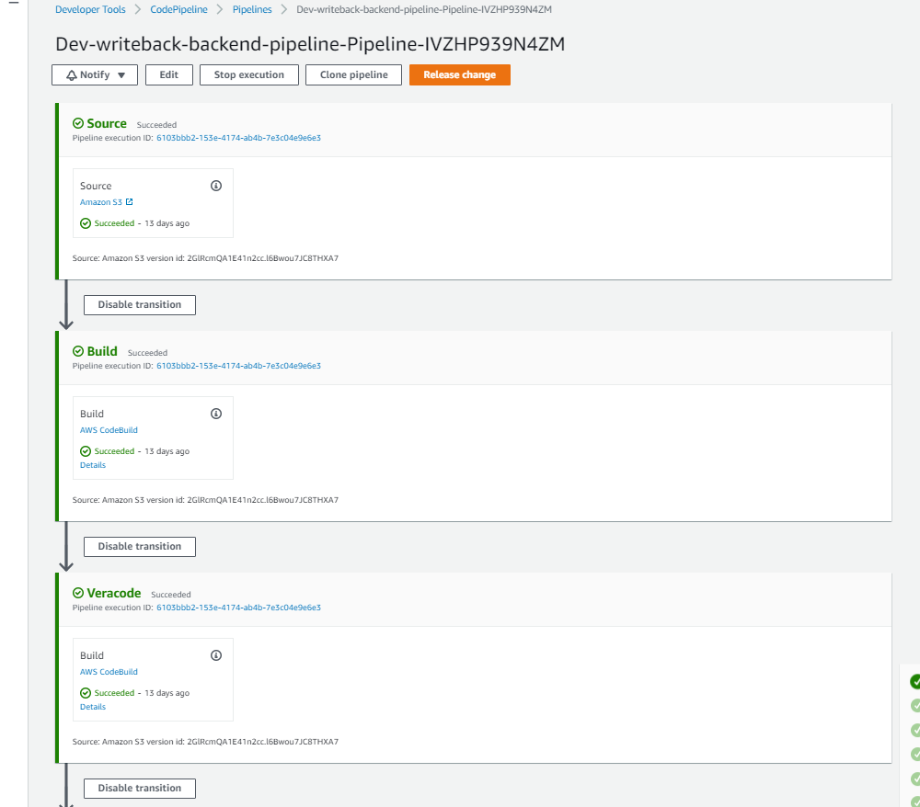

Slide 20
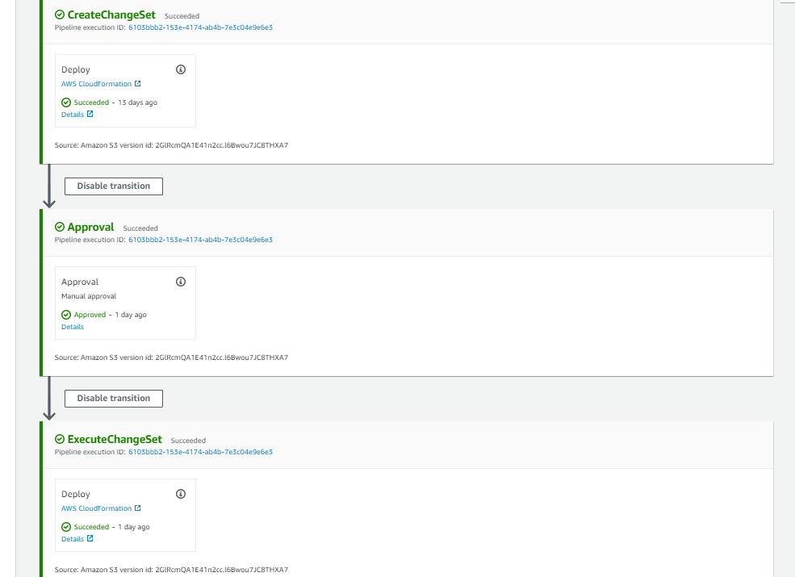

Slide 21
Proposed solution
Summary
Automated Infrastructure creation(AWS lambda Funtions,API Gateways):
created SAM template for the various AWS resources such has AWS lambda functions(For DEV , QA and PROD Enviornments, API Gateways(DEV/QA/PROD) ).
DevOps pipeline for both Infrastructure and application code:
Created a cloudformation template to create a CodePipeline with the following stages:
Source – On code commits to GitHub this stage pulls the source code
Build – This stage takes source code from the previous stage, builds the source artifacts and provides them to the next stage.
Veracode – This stage performs security scan on the build artifacts.
CreateChangeSet – This stage creates a list of changes that will be applied to a stack so that user can review the changes before executing them.
Approval – This stage provide manual approval gate for deployment
ExecuteChangeSet – This stage executes the deployment
Inclusion of DevSecOps utilizing existing veracode license:
Created a docker images and a CodeBuildProject to trigger the security scan

Slide 22
Thank you!!

