Slide 1
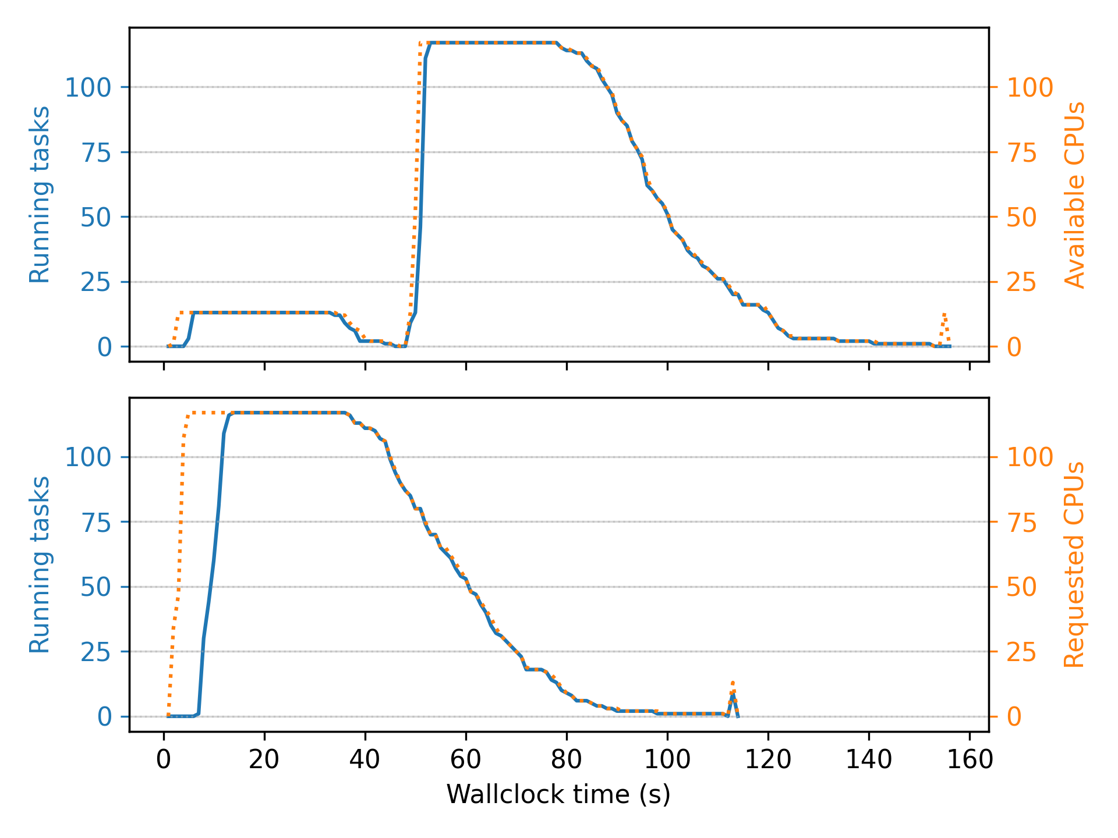
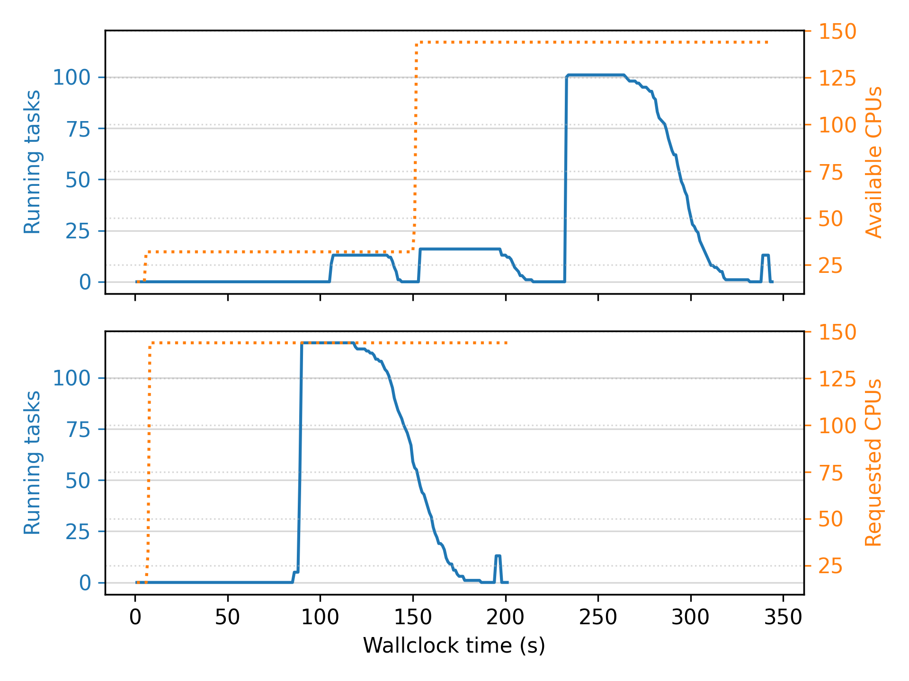
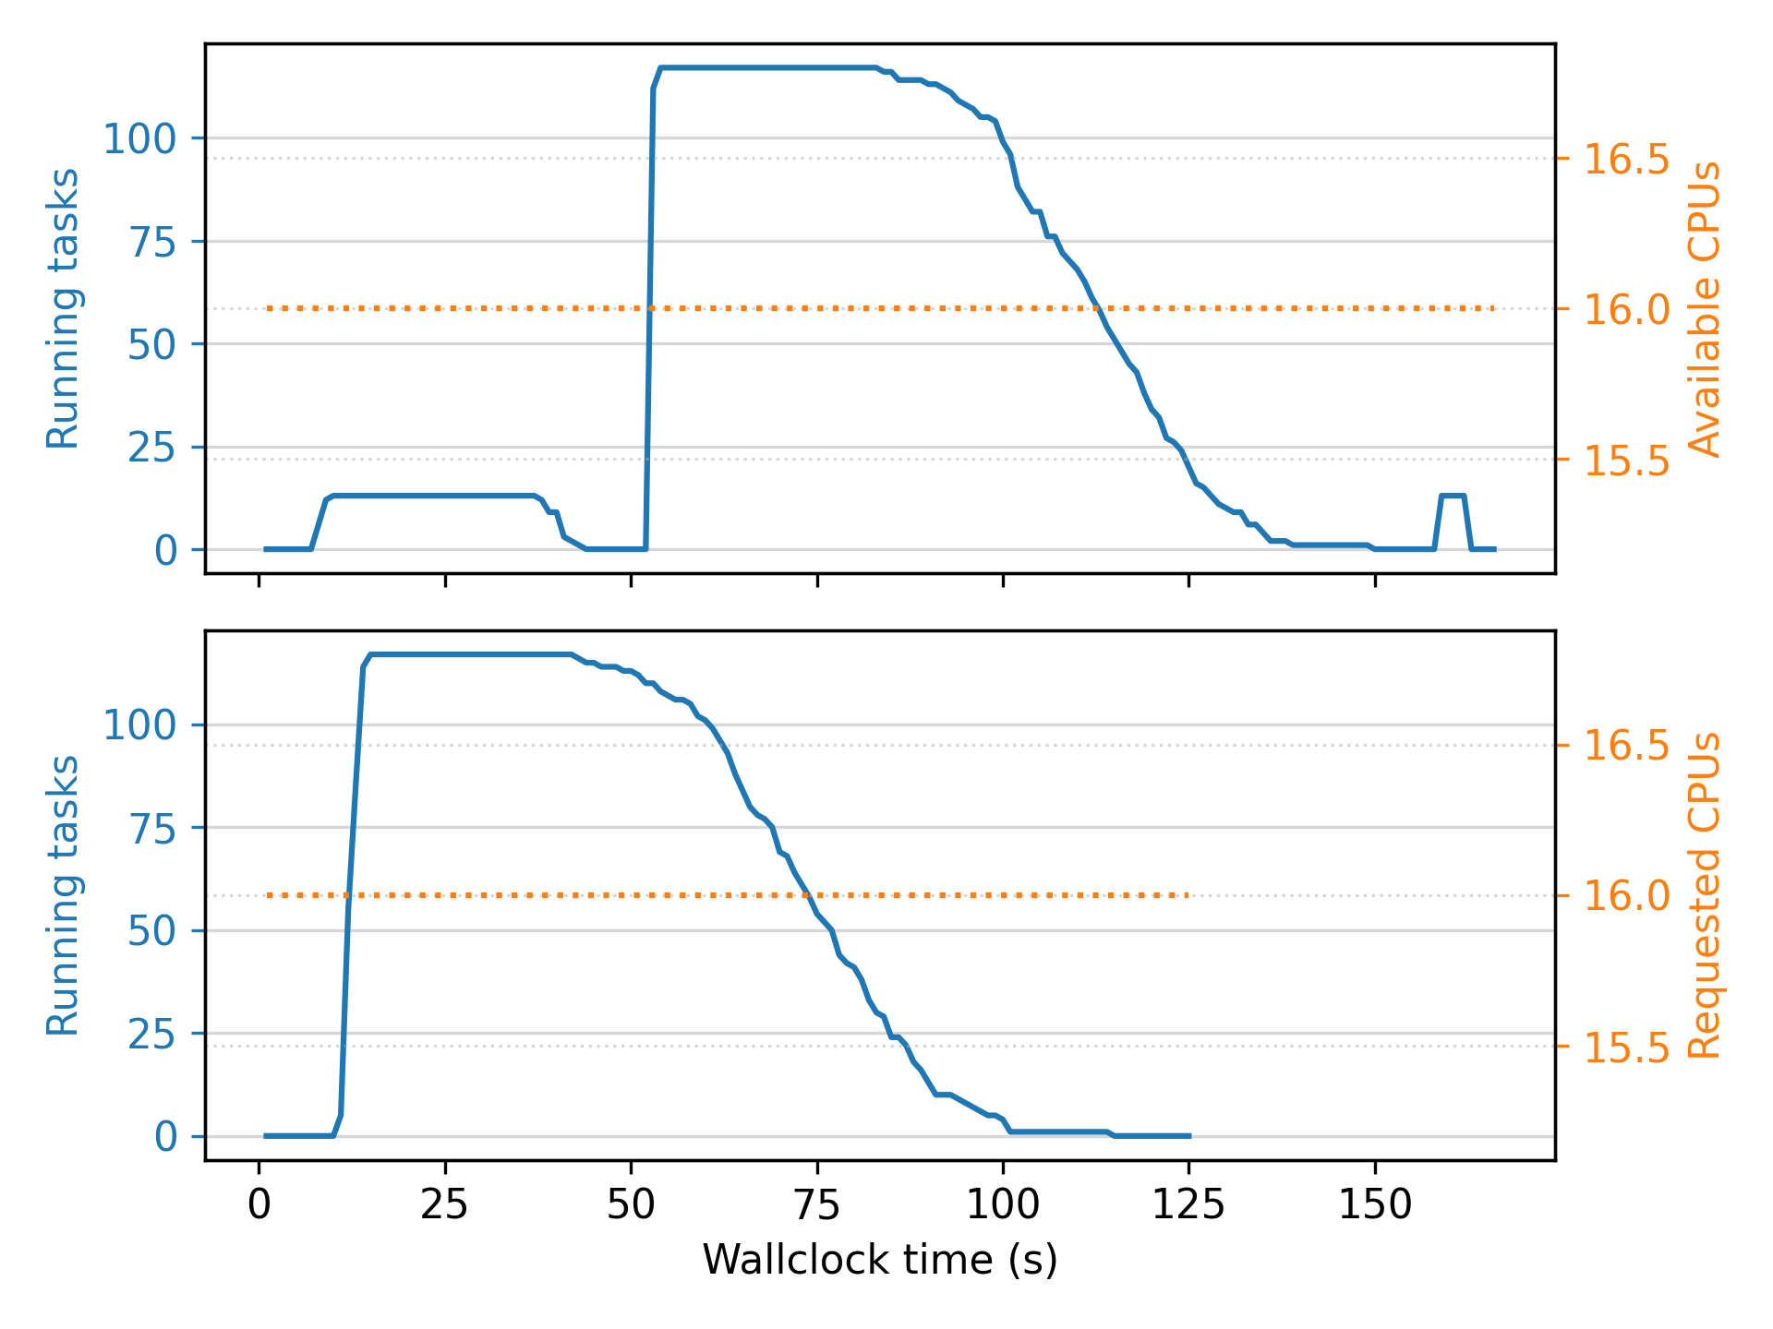
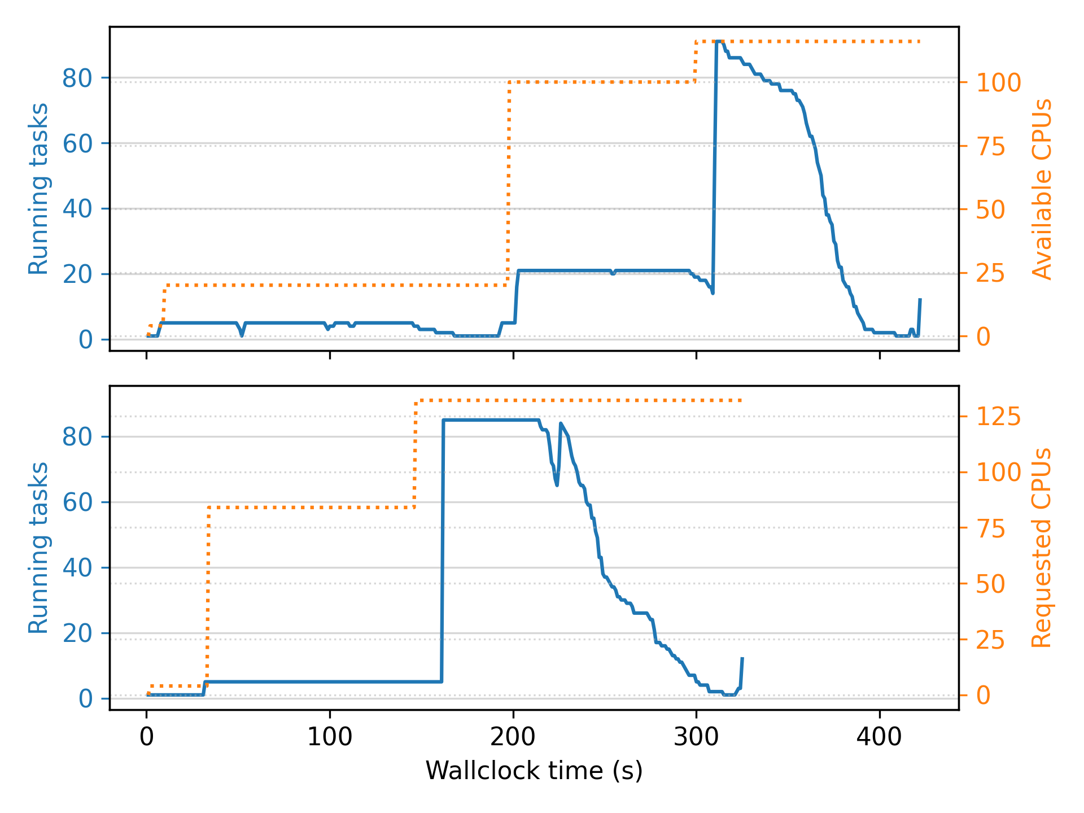
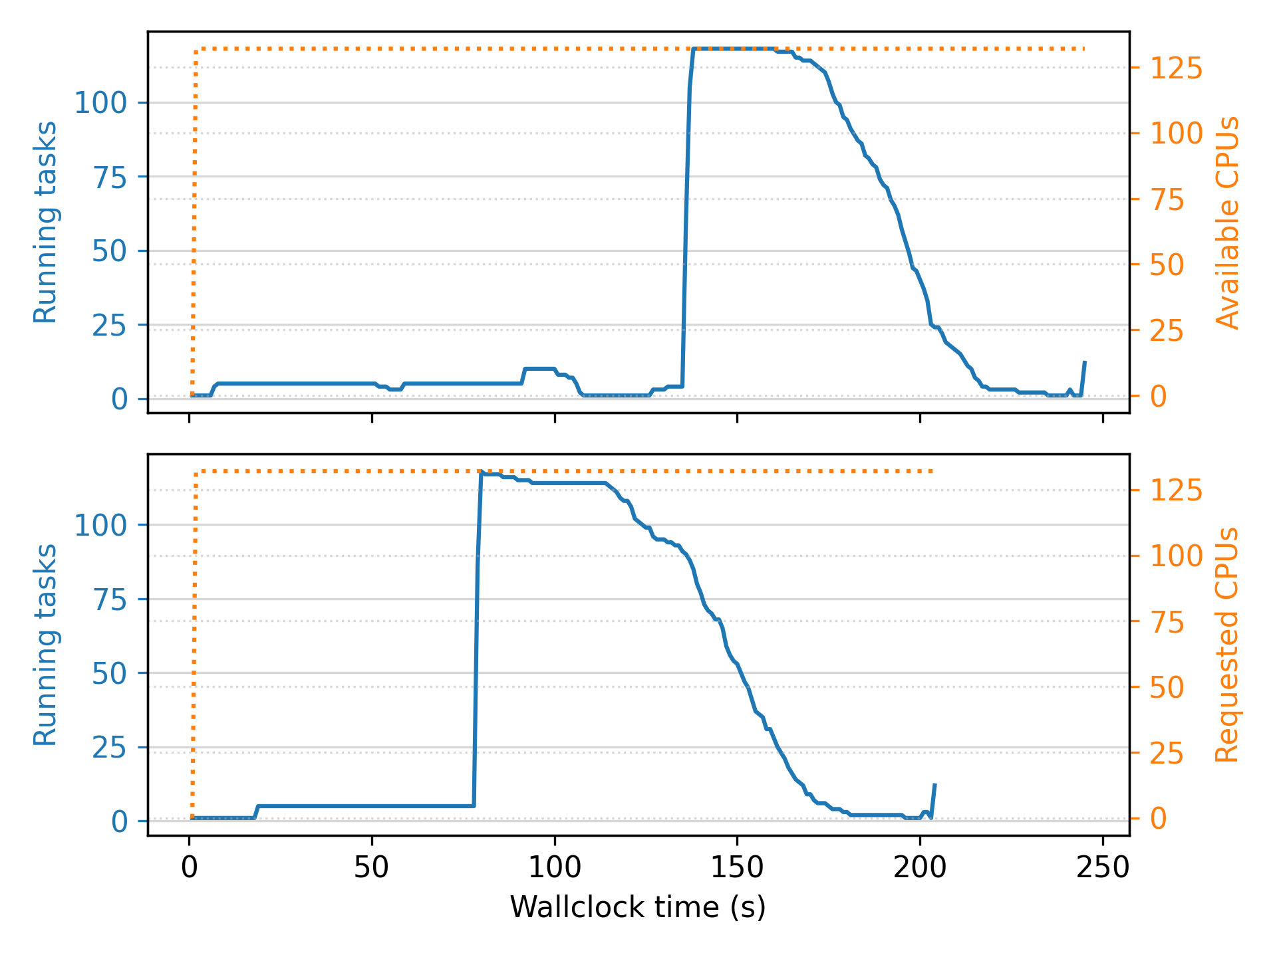
Lithops Lambda
Lithops EC2 Autoscaler
Lithops EC2 Fixed cluster
Ray EC2 Autoscaler
Ray EC2 Fixed Cluster

Slide 2
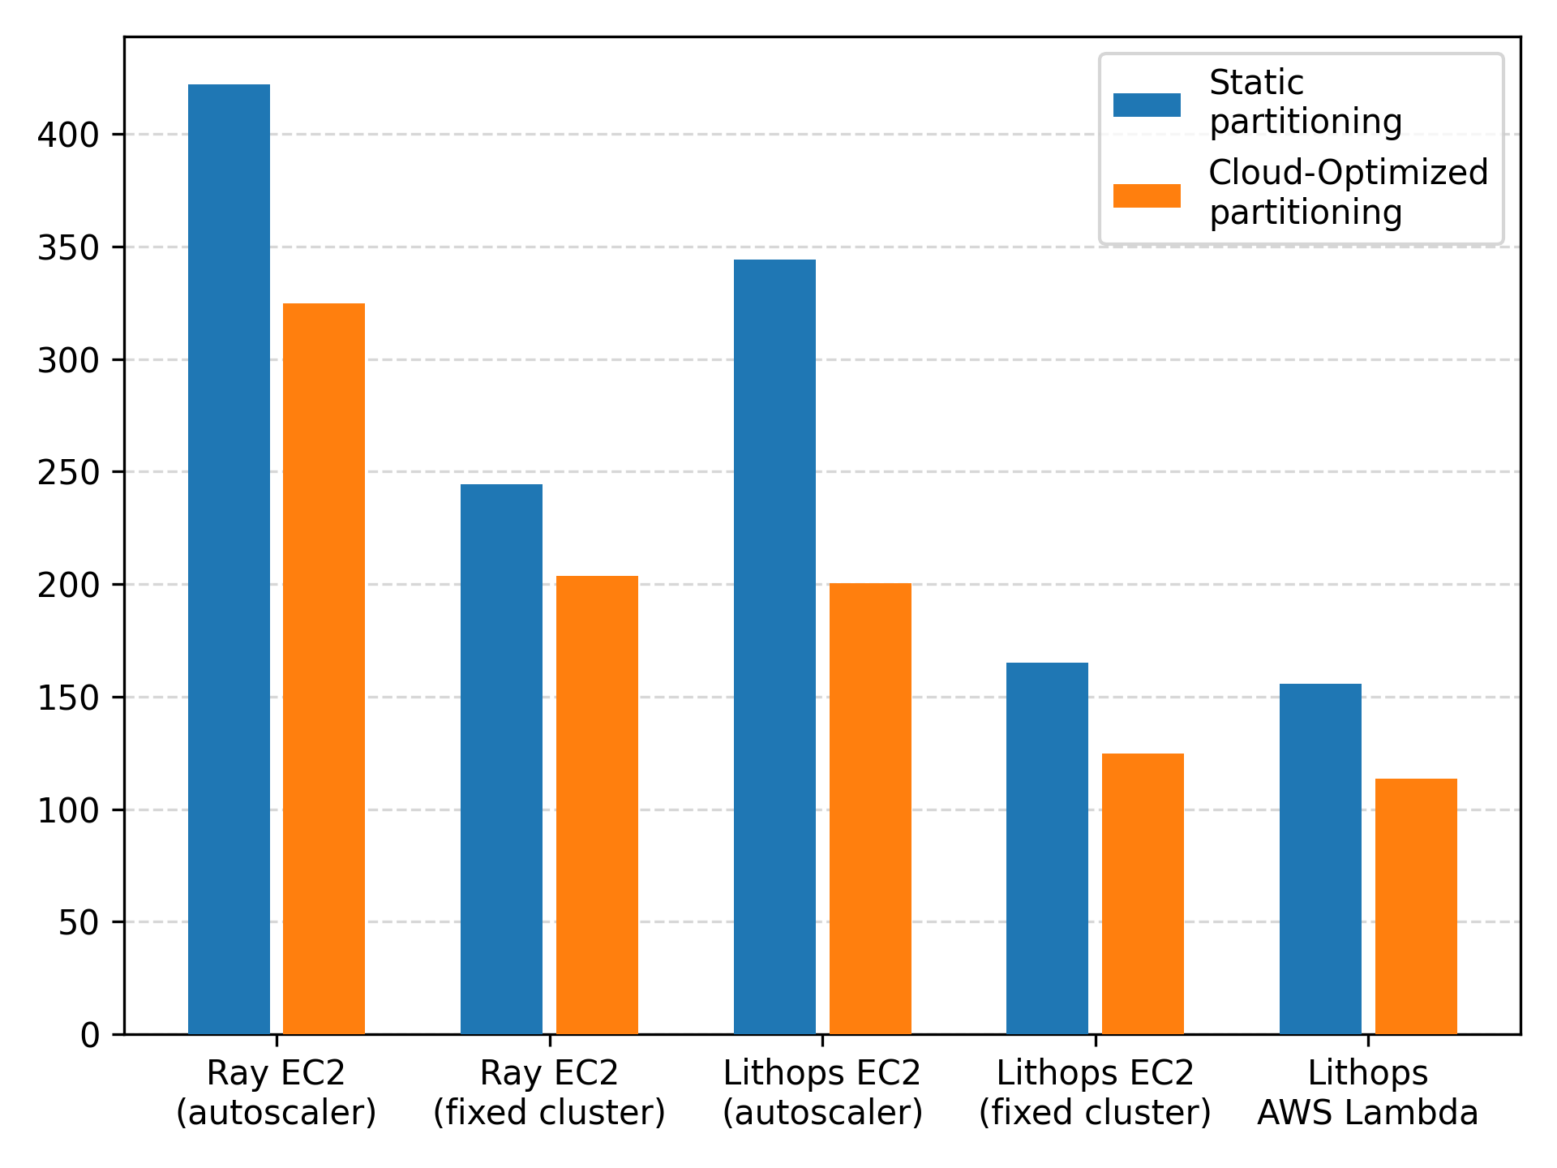
 | Static Partitioning | Cloud-Optimized Partitioning | % Improvement
Lithops AWS Lambda | 155.80 s | 113.43 | 37.34%
Lithops EC2 Autoscaler | 344.36 s | 200.51 s | 71.74%
Lithops EC2 Fixed cluster | 165.23 s | 124.94 s | 32.24%
Ray EC2 Autoscaler | 422.21 s | 324.78 s | 30.0%
Ray EC2 Fixed Cluster | 244.54 s | 203.58 s | 20.11%

