Slide 1

All-You-Can-Inference : Serverless DNN Model Inference Suite
Subin Park* Jaeghang Choi* Kyungyong Lee
Dept. of Computer Science, Kookmin University, Seoul, South Korea
*Both authors contributed equally to this work
Notes:
Hello. My name is Jaeghang Choi. I’m a master student from the Kookmin University in South Korea. I’m working on Distributed Data Processing System Lab.
I’m going to talk about All-You-Can-Inference: Serverless DNN model Inference Suite.

Slide 2

DNN inference task with Serverless Computing
DNN Inference task
Latency constraints
Challenges with serverless computing
limited file storage
unstable performance
large search space
handling bursty request arrivals
Dynamically requests
Not A Major DNN Inference Platform Yet
Notes:
Then, let's see how the dnn inference task will be performed in a serverless environment.
Unlike the DNN training process, the inference process takes user-faced serving.
So, it have to handle bursty request arrivals and the high scalability of serverless computing can perform well to handle it.
But there is still challenges with dnn inference task with serverless computing.
It has the limitation of local file storage, unstable performance and large search space to find optimize configuration.
So, Serverless computing is still not utilized as a major deep learning inference service.

Slide 3
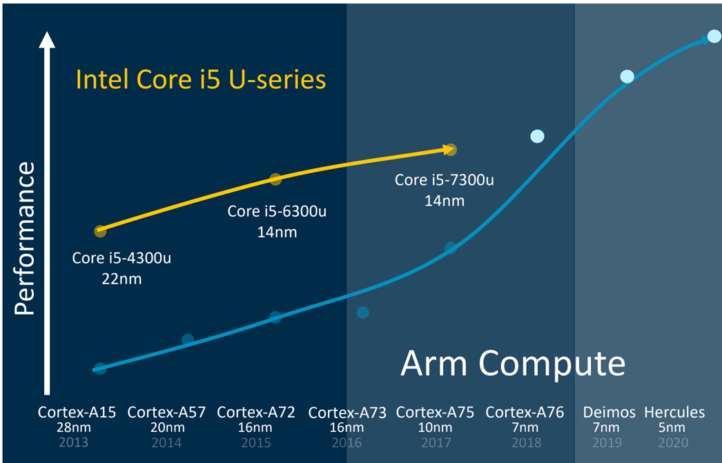
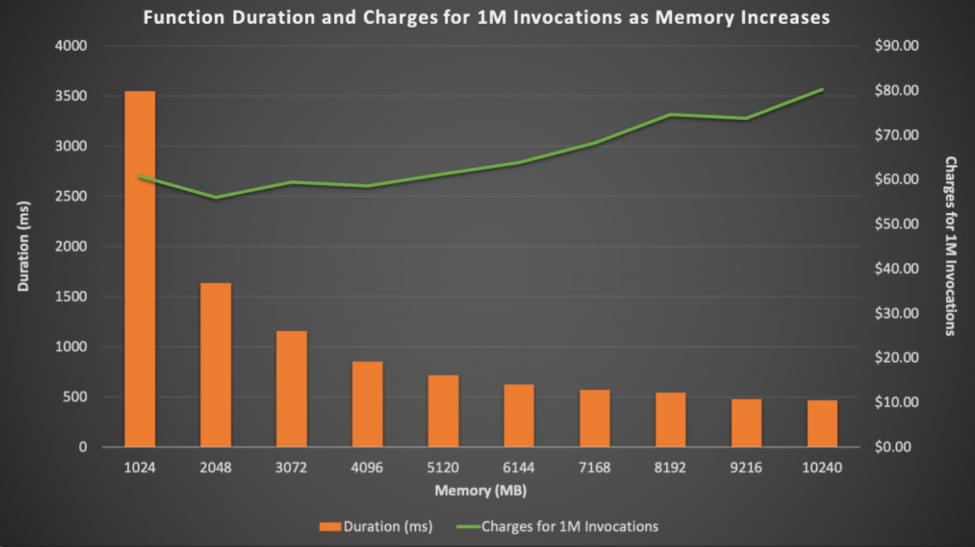
Opportunity to Enhance Serverless DNN Inference
ARM Hardware support
new hardware type of AWS Lambda AWS Gravition2 processors
Larger Memory Size Support (upto 10GB)
higher memory allocations
higher performance
higher price
https://www.engadget.com/2018-08-16-arm-says-chips-will-outperform-intel-laptop-cpus.html
https://docs.aws.amazon.com/lambda/latest/operatorguide/computing-power.html
Notes:
https://www.engadget.com/2018-08-16-arm-says-chips-will-outperform-intel-laptop-cpus.html
Despite these limitations, Serverless Computing has a lot of opportunities for the performance optimization.
aws announced AWS Graviton2 Processors for AWS Lambda based on ARM architecture, so we could choose the hardware types in serverless computing.
Recently, the CPU based on arm architecture are trending ahead of Intel-based CPUs in terms of performance.
So, this new hardware for AWS Lambda can bring high performance for deep learning inference tasks.
https://docs.aws.amazon.com/lambda/latest/operatorguide/computing-power.html
nowadays, we can allocate memory to 10GB for AWS Lambda, it is more than a 3x increase compared to previous limits.
and, as you can see the picture, higher memory allocations result in higher performance and require higher prices.
So, we have more memory allocation ranges to choose from than before, and we need to find the optimal memory allocation with performance and cost trade off.

Slide 4
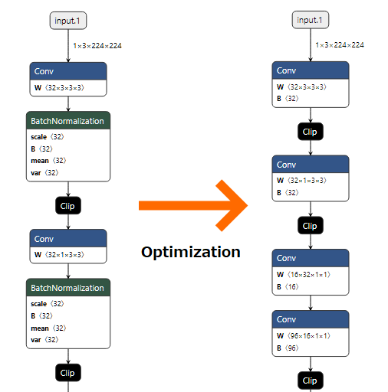
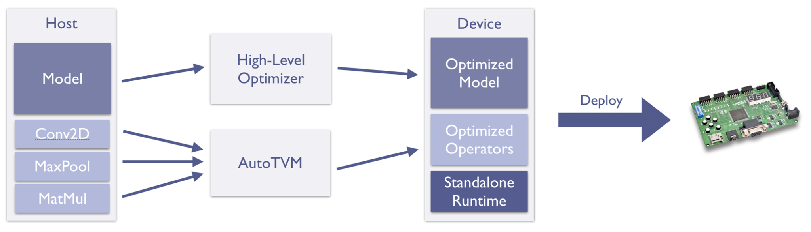
Opportunity to Enhance Serverless DNN Inference
ONNX (Open Neural Network Exchange)
graph optimizer
Apache TVM
operator level compiler
https://community.arm.com/arm-community-blogs/b/ai-and-ml-blog/posts/tinyml-tvm-taming-the-final-ml-frontier
https://github.com/microsoft/onnxruntime-openenclave/blob/openenclave-public/docs/InferenceHighLevelDesign.md
Notes:
https://github.com/microsoft/onnxruntime-openenclave/blob/openenclave-public/docs/InferenceHighLevelDesign.md
https://medium.com/axinc-ai/using-the-onnx-official-optimizer-27d1c7da3531
we can use dnn model optimizer for inference.
the ONNX is the model graph optimizer to improve performance. it provides small graph simplifications and node eliminations to more complex node fusions and layout optimizations.
using ONNX, user can optimize deep learning models for inference faster
https://community.arm.com/arm-community-blogs/b/ai-and-ml-blog/posts/tinyml-tvm-taming-the-final-ml-frontier
There is one more dnn model optimizer Apache TVM.
TVM is the compiler that provides operator level optimization for the corresponding backend depending on the given hardware.
User can optimize the model for their hardware using tvm.
We will see how well tvm will be optimized for Intel and ARM architectures in a serverless environment

Slide 5
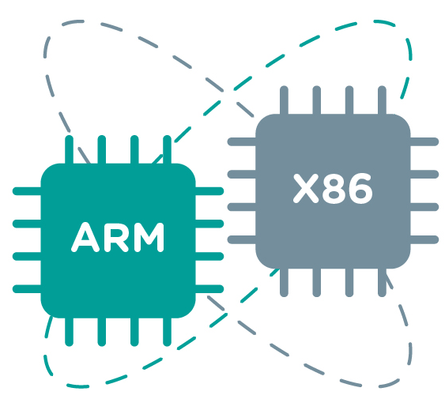




DNN inference task with Serverless Computing
In summary of opportunities for the performance optimization,
Hardware architecture
Inference Elements
Optimizer
Memory Allocation
Limitations
No prior work using the serverless computing with large search space
Notes:
In summary,
We can use heterogeneous hardware and optimize compute resource allocation in serverless computing.
And we can optimize dnn model using onnx and tvm, we can also use batch processing for dnn inference
Despite these various optimization options, there are no prior work that can help developers to deploy dnn model serving workloads using the serverless computing that provides a large configuration space
https://www.horiba.com/gbr/scientific/products/detail/action/show/Product/batch-processing-1681/
https://www.esa-automation.com/en/arm-or-x86-esa-automation-suggestions-to-choose-the-best-processor/

Slide 6
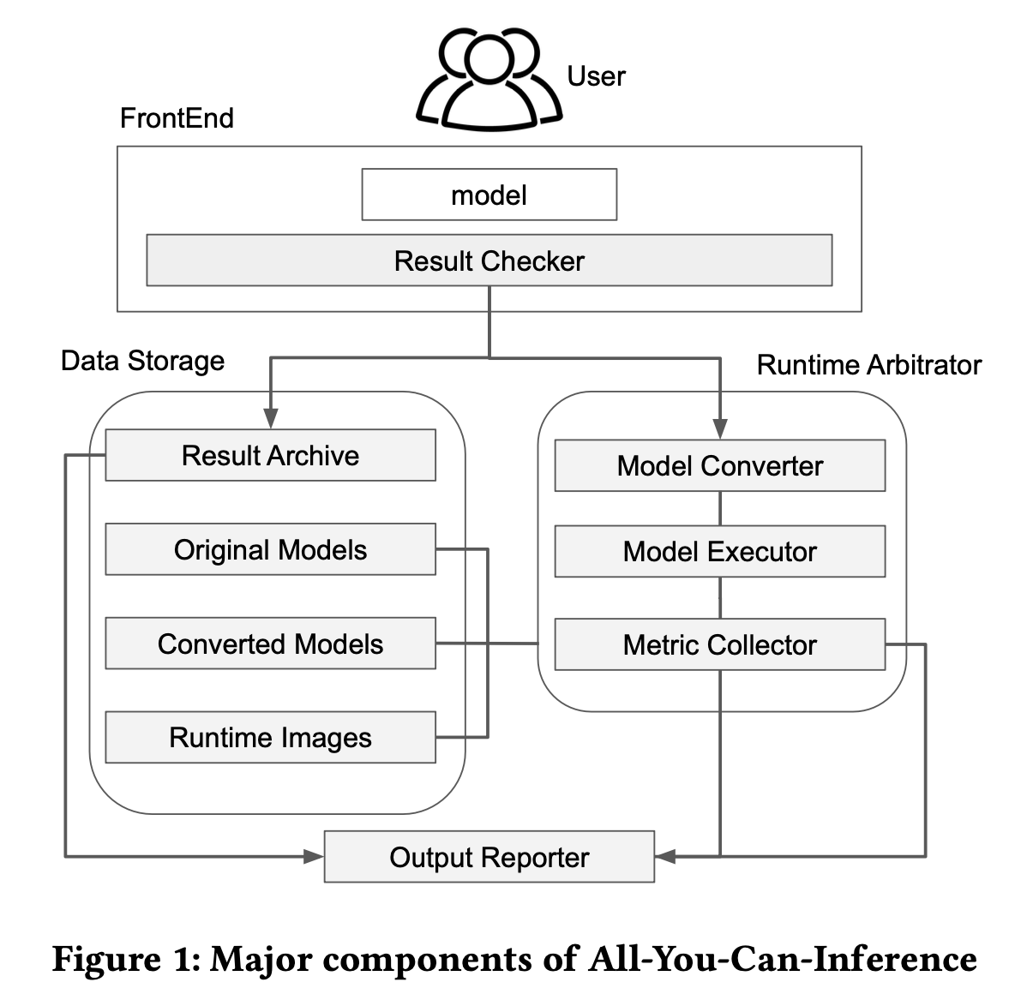
Proposed Method
All-You-Can-Inference
estimate the performance of inference tasks on various configurations of FaaS
Notes:
We propose All-You-Can-Inference, a publicly available DNN inference environment suite on a serverless computing environment
All-You-Can-Inference help DNN application developers to estimate the performance of inference tasks on various configurations
so users can build an optimal serverless model serving environment.
All-You-Can-Inference consists of frontend, data storage, runtime arbitrator, and output reporter.

Slide 7
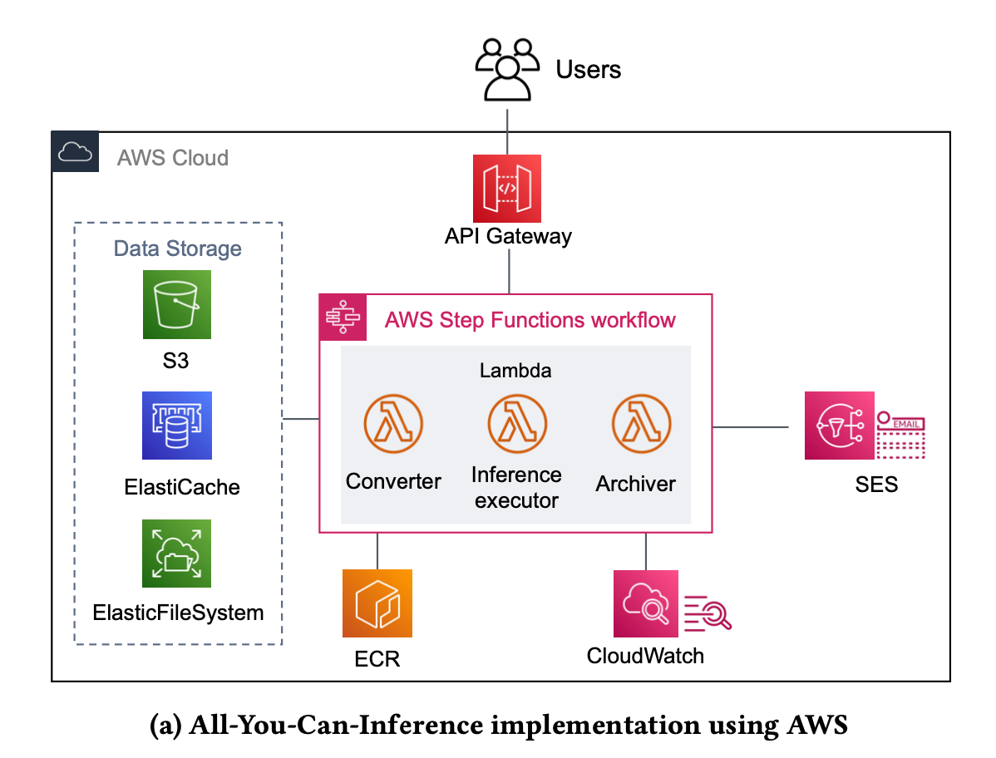
All-You-Can-Inference
Frontend request with API Gateway
Web frontend request api gateway url to perform AYCI inference task
Notes:
FrontEnd takes a DNN model to execute as an input argument from a user provided web-page.
User can specify the FaaS runtime configuration of the target hardware intel or arm, user can specify the usage model optimizations and hardware compilers, user can also specify the batch size for batch processing and the allocated memory size for serverless environments.
after the configure, Frontend requests aws api gateway to perform inference task with user specified FaaS configuration
Result Checker check result archive in data storage that save the result already been executed each models.
and if the model already been executed, the system do not operate any tasks and respond previous results in data storage to user.

Slide 8
All-You-Can-Inference
Data Storage with AWS Services
Data storage stores the results of inference task metrics
AWS ECR saves images of lambda environments
Notes:
Data Storage is consisted of AWS S3, ElasticCache and Elastic File System. It stores original models and converted models by optimizers which is onnx or tvm,
and also store user’s execution results.
and Data Storage consisted of AWS ECR stores runtime container images as a FaaS run-time environment

Slide 9
All-You-Can-Inference implementation using AWS
Runtime Arbitrator with AWS Step Functions
Sequentially proceed converter, inference executor and archiver consisting of aws lambda
Collect lambda metric saved from AWS CloudWatch
Notes:
if the model does not executed any work, the system operate serverless runtime arbitrator configured aws step functions
Use AWS step functions, we can configure sequentially proceed model converter, inference executor and archiver consisting of aws lambda.
Metric Collector collect execute results and executed lambda metric saved from AWS Cloudwatch

Slide 10
All-You-Can-Inference implementation using AWS
Output Report with SES
Reports the results of inference task metrics to user via an e-mail
Notes:
After the step function work finished, it sends the result to user e-mail with AWS SES.

Slide 11
All-You-Can-Inference
Demo Web Video
https://youtu.be/J9fhEb7jEVA
Notes:
1분 30초 정도 소요 예상
데모 웹을 구동하여 실제로 유저 입장에서 AYCI 서비스를 이용하는 영상
Let’s see how to operate our system in user side

Slide 12
Evaluation Setting
Hardware Type
DNN Models
Inference Elements
CNN
SqueezeNet
ShuffleNet
MobileNetV2
MNasNet
EfficientNetB0
ResNet18
ResNet50
InceptionV3
AlexNet
VGG16
NLP
BERT
batch size of 1, 2, 4, 8, 16, 32
lambda memory size of
0.5, 1, 2, 4, 8, 10GB
Memory Allocation
Optimizer
Vanilla
Notes:
We configure for experiment using our system two hardware type and three case of optimizer.
and use eleven DNN models include 10 CNN models and 1 NLP model for comparison various models.
we allocate lambda memory and set batch sizes of these ranges

Slide 13
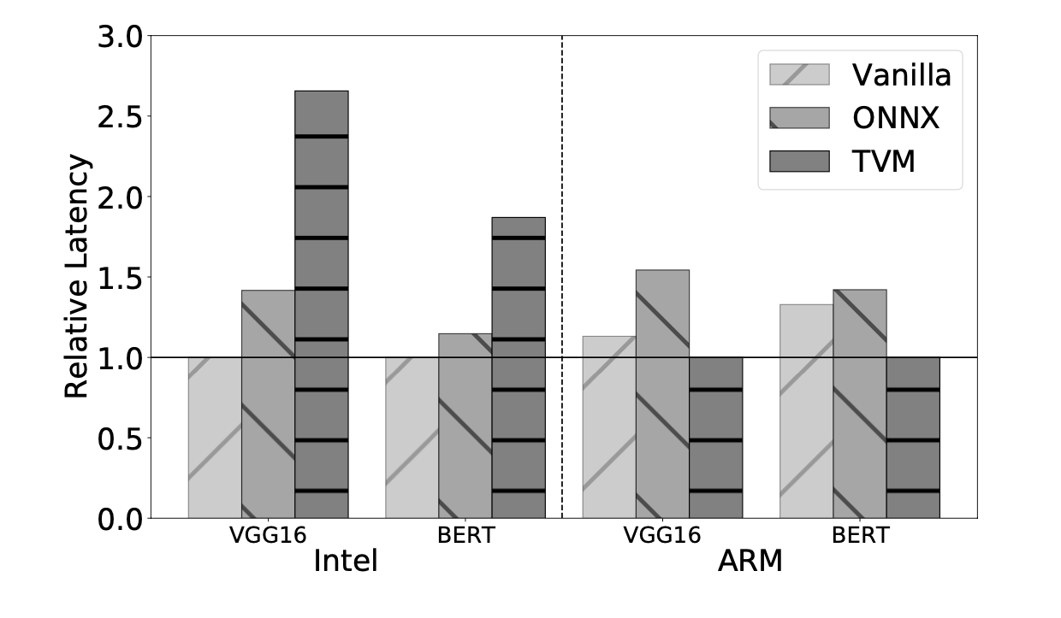
Compare between CNN and NLP model
Observation 1 : Similar performance patterns with CNN and NLP
Setting
Models : VGG16 and BERT
Memory size : 10GB
Best Performance
Intel hardware : Vanilla
ARM hardware : TVM
Notes:
First, We will show comparison of the model in CNN and NLP and how the models perform differently for each hardware and compiler.
We set the model VGG16 and BERT to represent CNN and NLP. Because they have similar model size so it’s good to compare. We allocated enough lambda memory to ten GB since the size of the models is large,
The y-axis of the figure shows 1 as the lowest latency value, and the rest are calculated based on the default value.
We saw both models show same performance grade each hardware.
In intel case, Vanilla model shown the low latency
and in arm case, tvm model shown the low latency.
So, we observed that CNN and NLP models show similar performance patterns with different hardware and model optimization.

Slide 14
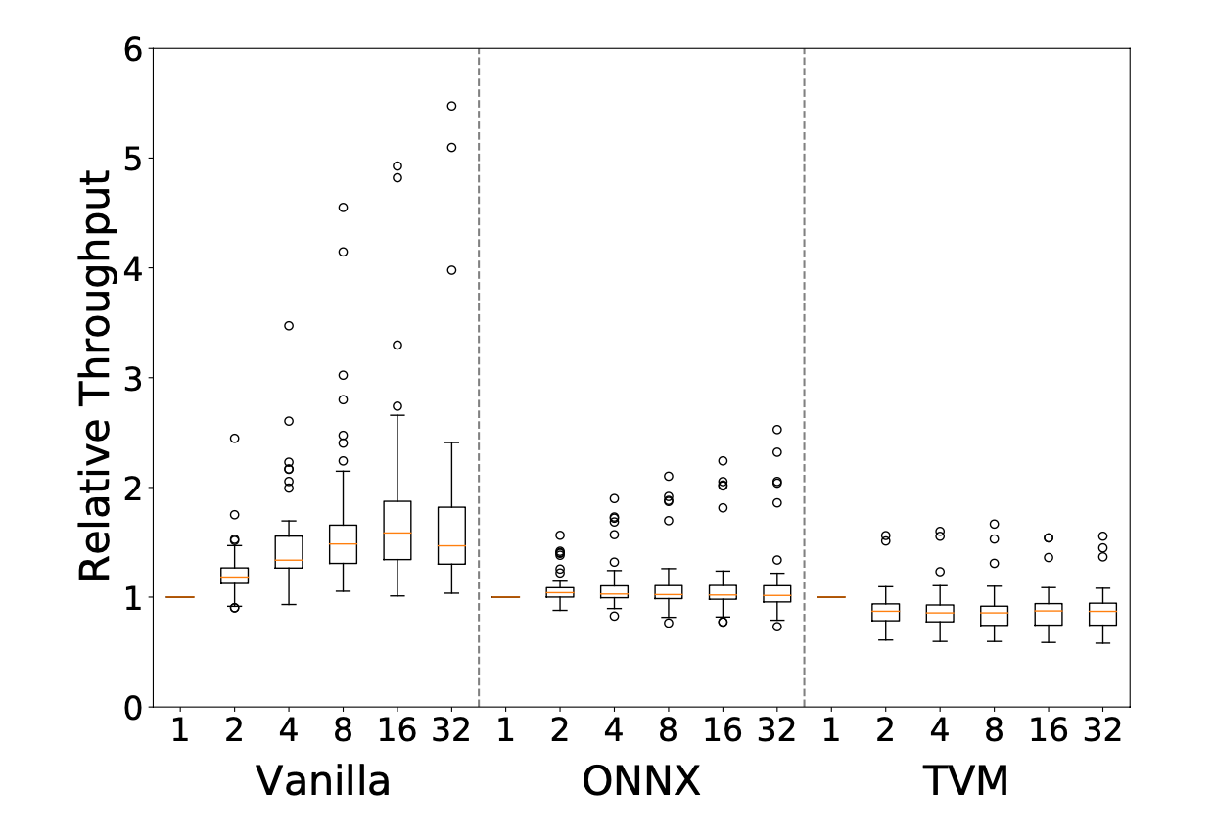
Performance benefit with batch processing
Observation 2 : Batch processing improves performance higher in vanilla
Setting
Intel hardware and 10 CNN models
Batch sizes : 1 ~ 32
Memory size : 0.5 ~ 10GB
Evaluation
Vanilla model shows performance benefit especially about 1.58x with batch size of 16
Notes:
we make an experiment to know performance patterns with batch processing.
We set the intel hardware, 10 CNN models, 6 different batch sizes and 6 lambda memory sizes
We showed the throughput that batch size of 1 value as 1 and the others relative to the default value as the figure y axis.
As you can see, only vanilla model shows performance benefit.
But there is no performance benefit in most cases using optimized models.
we observed that Batch processing improves especially with a vanilla serverless environment but shows insignificant performance gain with optimization

Slide 15
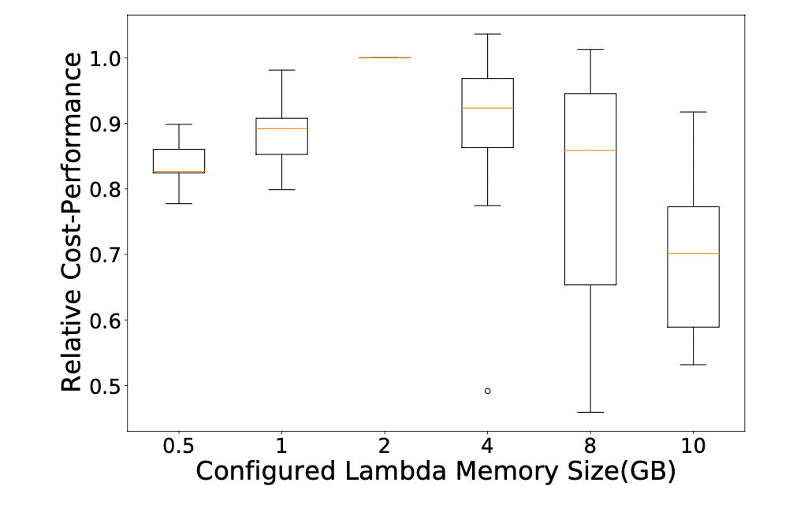

Efficient memory allocation
Observation 3 : memory size of 2GB results in the best performance in most cases
Denotation
Relative cost-performance normalization
Evaluation
Performance peak point : 2GB
As the configured memory size becomes larger, cost-performance metric drops
Notes:
We try to know efficient memory allocation in serverless.
The y-axis of the figure shows 1 as the configured lambda memory size of 2gb,
and the others are calculated based on the default value.
The results show when the configured Memory size of 2GB is the best performance and as the configured memory size becomes larger, cost-performance drops quite significantly
So, we observed that in a serverless DNN inference, setting the memory size of Lambda to 2GB results in the best performance in most cases.

Slide 16
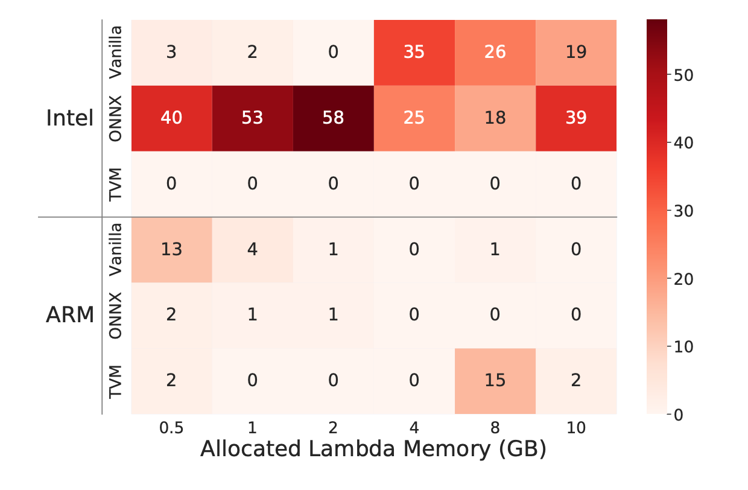
The number of most efficient cases
Observation 4 : Performance of ARM hardware is not as good as Intel hardware
Denotation
count the number of best performing cases
Evaluation
Best performance : Intel-ONNX
ARM-Vanilla, ARM-TVM, and Intel-Vanilla often perform the best
Notes:
We count the number of best performing cases to know what is the most efficient hardware-optimizer combinations it is.
as a result, intel-onnx combinations achieves the best performance all of the allocated lambda memory sizes in the most case.
ARM-Vanilla, ARM-TVM,Intel-Vanilla, these 3 combinations often perform the best.
So in summary, we observed the dnn inference performance of ARM hardware is not as good as that of Intel hardware with an optimized model.

Slide 17
Conclusion
Proposed system uncovering challenges in the FaaS environment setup and performance variations for distinct models
Helps users to build an optimal serverless DNN inference system
Notes:
So, We showed the practicality of the proposed system uncovering challenges in the FaaS environment setup and performance variations for distinct models
and by using our system, it can help users to build an optimal DNN inference system in serverless environment.
We show the work with the system to determine the performance benefits of each model
and to generalize the performance patterns in each case.
and then we are going to research to predict performance the new DNN models we did not perform in our system
Thank you!

Slide 18
Q&A
Notes:
Thank you for listening my presentation. Do you have any question about this research? Please speak slowly and clearly. Thank you

