Slide 1
Sentinel: A Fast and Memory-Efficient Serverless Architecture for Lightweight Applications
8th International Workshop on Serverless Computing (WoSC8) 2022
https://www.serverlesscomputing.org/wosc8/papers/p3
Joe Hattori, Shinpei Kato
The University of Tokyo

Slide 2

Background: Security Concern in Serverless Computing
From cloud provider’s point of view…
Executes many applications on the same machine
Vulnerability in host kernel can be fatal without secure execution environment
Goals
Execute each application securely
Spawn the environment quickly
App 1
App 2
App 3
App 4
Host Kernel

Slide 3
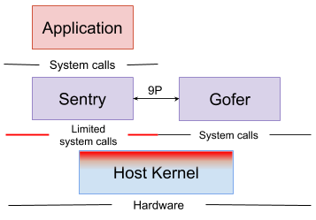
Existing Architecture: gVisor
Container-based architecture
Traps every syscall and emulate in userspace
Main components
Sentry: Untrusted userspace kernel
Gofer: A process handling filesystem operations
https://gvisor.dev/docs/

Slide 4
Existing Architecture: Firecracker
VM-based architecture
Shortens boot time with a lightweight VM specialized in serverless execution
Agache, Alexandru, et al. "Firecracker: Lightweight virtualization for serverless applications." 17th USENIX symposium on networked systems design and implementation (NSDI 20). 2020.
Application code
Guest Kernel
Firecracker (VMM)
Host Kernel
KVM

Slide 5
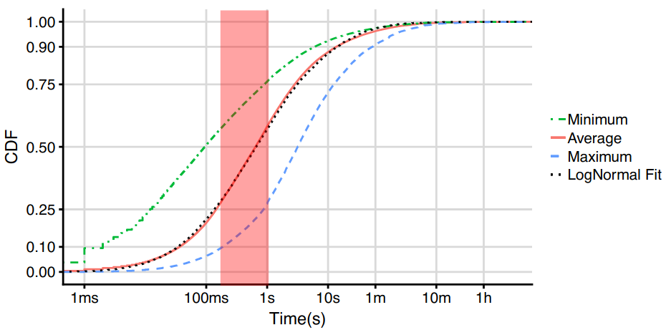
Serverless in the Wild
Shahrad, Mohammad, et al. "Serverless in the wild: Characterizing and optimizing the serverless workload at a large cloud provider." 2020 USENIX Annual Technical Conference (USENIX ATC 20). 2020.
50% of applications run within 0.67s
20% of applications run within 0.10s
Cold start latency (100~500ms) is too long for most serverless applications.

Slide 6
Proposal: Sentinel [https://github.com/pflab-ut/sentinel]
Lightweight applications’ characteristics
Short execution time (~1s)
Limited changes to the underlying filesystem
Only issue simple syscalls
Do not use mount(2), bpf(2), etc
Single-threaded
App Container
Sentinel
Syscalls
Limited Syscall
ptrace
Host Kernel
Suited approach to executing lightweight applications
Secure container runtime: shorter spin up time than VM boot time
Quick execution of bare-minimum syscall virtualization
by ptrace(2) with PTRACE_SYSEMU flag

Slide 7
Design Comparison
gVisor (container)
Firecracker (VM)
Sentinel (container)
VM
App
Sentinel
App
Guest Kernel
Syscalls
Limited Syscall
Firecracker
Host Kernel
ptrace
Host Kernel
KVM
IPC over 9P protocol happens upon every file access
Large memory consumption by VM creation and execution
RO mount to host filesystem and retain changes in-memory.
Minimized effect on host kernel when compromised.
Virtualize each app with one process.

Slide 8
Evaluation
Targets
runc: Docker’s default container runtime (No virtualization)
Sentinel’s goal is to perform as close as possible to runc.
runsc: gVisor’s container runtime (container-based)
Firecracker: VMM (VM-based)
kata-runtime: Kata Container’s container runtime (VM-based)
Environment
Ubuntu 20.04 (Linux kernel v5.14)
4 core: Intel Core i7 3.0 GHz

Slide 9
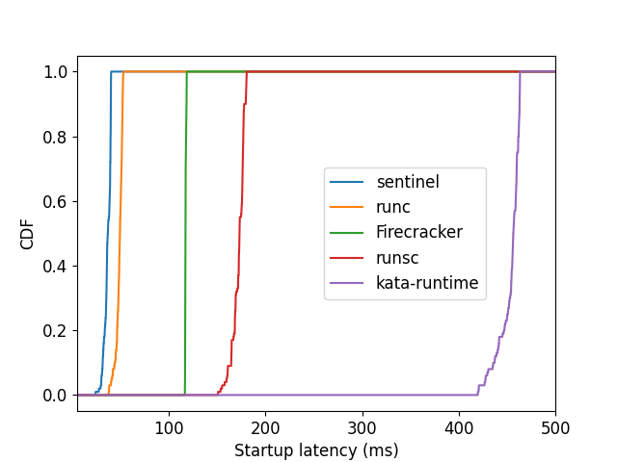
Evaluation: Sandbox Startup Time
Sentinel is the fastest
Faster than runc!
Performance benefit of Rust
Lower tail latency
~10x faster startup

Slide 10
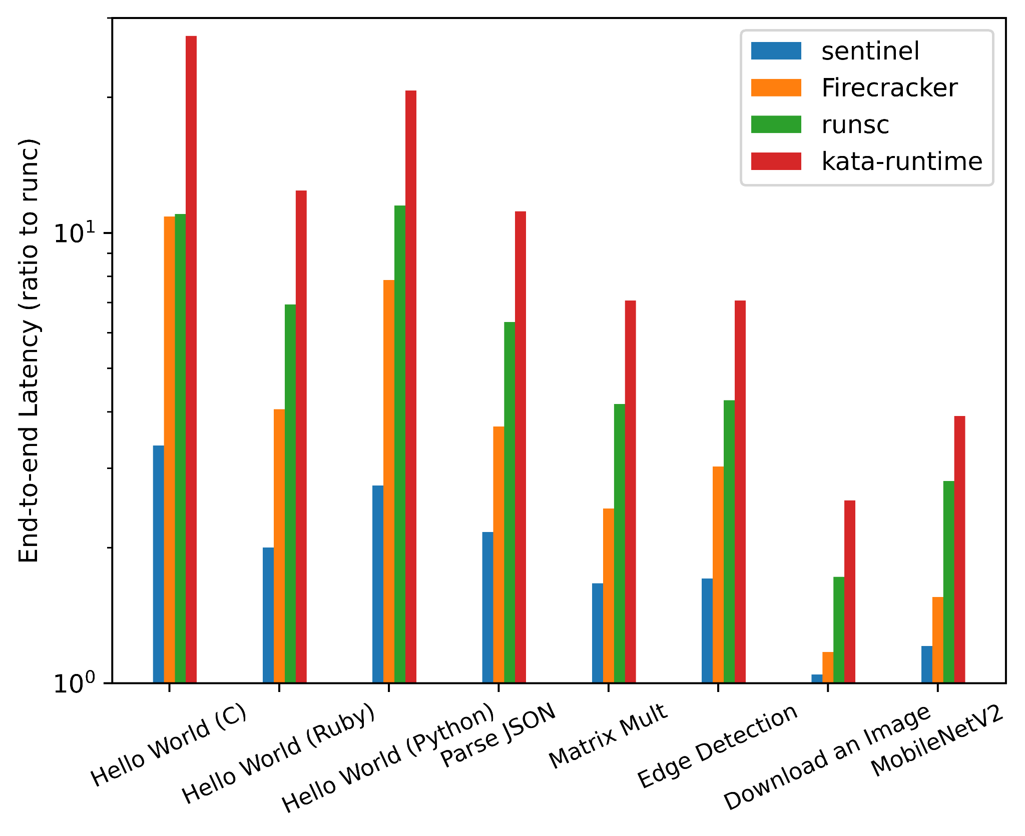
Evaluation: End-to-End Latencies
Benchmark applications:
Hello World - C, Ruby, Python
JSON Parser - Ruby
Matrix multiplication - Python
Edge detection - OpenCV
Downloading an image - Python
MobilenetV2 inference - TensorFlowLite
Sentinel’s speed is the closest to runc’s
~8.13x shorter execution time

Slide 11
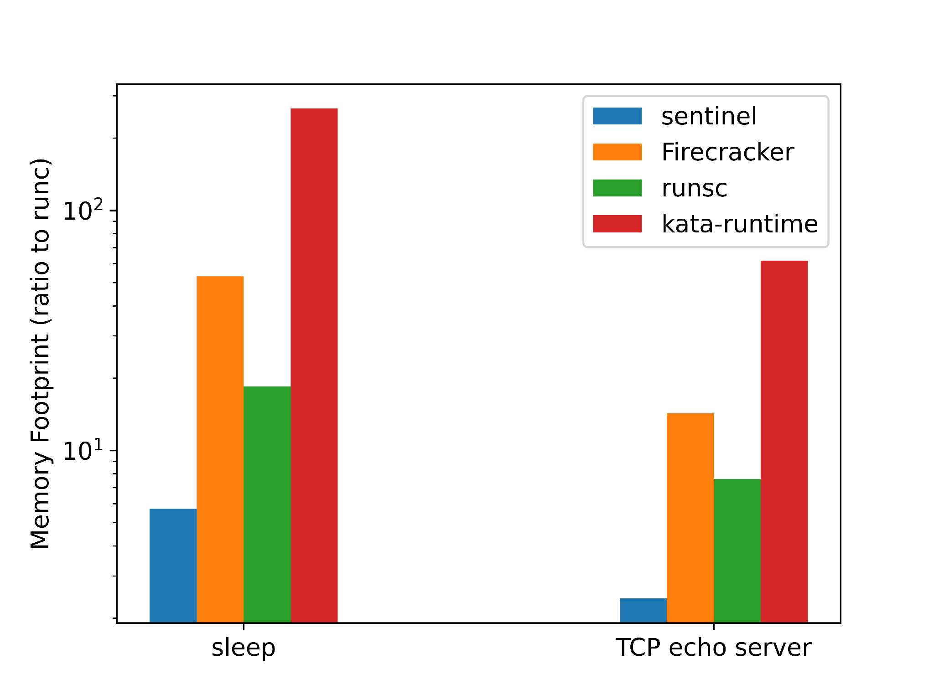
Evaluation: Memory Efficiency
Target applications:
sleep command
TCP echo server
Sentinel’s performance:
vs runsc: ~69% lower
vs Firecracker: ~89% lower
vs kata-runtime: ~98% lower

Slide 12
Summary
Proposed Sentinel, a serverless architecture for lightweight applications
Demonstrated the performance benefits compared to existing architectures
Quicker boot, faster execution, lower memory consumption
Future work
Support for warm start
Full OCI (Open Container Initiative) Spec compatibility
Support environments other than x86 Linux
https://github.com/pflab-ut/sentinel

