Slide 1
Migrating from Microservices to Serverless: An IoT Platform Case Study
8th International Workshop on Serverless Computing (WoSC8)
In conjunction with, ACM/IFIP Middleware 2022
Mohak Chadha, Victor Pacyna, Anshul Jindal, Jianfeng Gu, Michael Gerndt
mohak.chadha@tum.de, victor.pacyna@tum.de, anshul.jindal@tum.de ,jianfeng.gu@tum.de, gerndt@in.tum.de
Chair of Computer Architecture and Parallel Systems,
Technical University of Munich (TUM)
Garching (near Munich), Germany
https://www.serverlesscomputing.org/wosc8/
Notes:
Hi,
My name is Mohak Chadha, I am a third year PhD student at the Chair of Computer Architecture and Parallel Systems at the Technical University of Munich. This is my WoSC 2022 presentation on the topic:

Slide 2
Outline
Motivation
Goals
Background
Migration Methodology
Experimental Setup
Results
Conclusion and Future Work
Notes:
The presentation is structured as follows:
First, I will talk about the motivation behind the work, followed by the goals of the work, then some background information, followed by our migration methodology, experimental setup, results, and finally conclustion and future work.

Slide 3
Outline
Motivation
Goals
Background
Migration Methodology
Experimental Setup
Results
Conclusion and Future Work

Slide 4
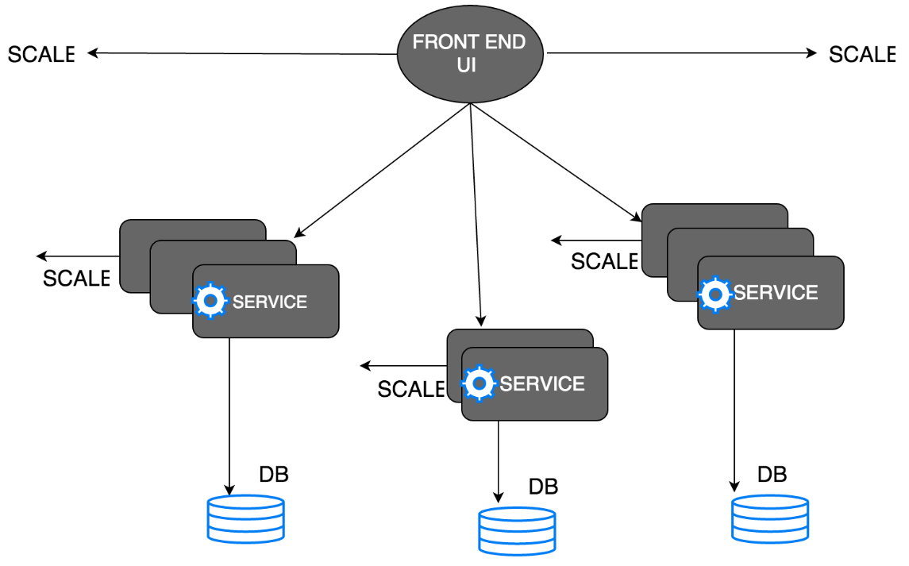
Microservices Architecture
The idea here is to split the application into a set of smaller and interconnected services.
Advantages:
Easier to understand and maintain.
Independence of Service.
No Barrier on Adopting New Technologies.
Independent Service Deployment.
Each Service Scaling.
Disadvantages:
Complexity of creating a distributed system.
Deployment complexity.
Notes:
Most cloud native applications today are microservices.
This type of architecture enables the development of an application as a suite of small independent services communicating with each other.
It has several advantages:
1. The application is decomposed into a set of manageable services which are faster to develop, and easier to understand.
2. Each service can be developed independently by a team that is focused particularly on that service.
3. A particular service is not bounded to a set of technologies.
4. Each service can be deployed independently.
5. Each service can be scaled independently.
Also, it has some disadvantages:
Testing a microservices application is more difficult.
Developer needs to think about of the configuration, deployment, resource provisioning, and scaling of the services.

Slide 5
Introducing: Serverless
Serverless Computing
Provide a platform that developers can use.
No infrastructure management.
Function-as-a-Service (FaaS):
Provides API endpoints that users can call.
Smaller granularity than microservices.
Billed per-use.
Scale-to-zero.
Disadvantages:
Focused on stateless functions.
Performance variations due to restart latencies.
Cloud Service Provider
API
Monitoring
Authentication
Notes:
Another competing cloud computing paradigm is serveless computing aka Function-as-a-Service, in which:
Users are only responsible for writing small pieces of code while all infrastructure management is handled by the cloud service provider.
Developers essentially deploy their functions on the FaaS platform and obtain an API endpoint though which the function can be invoked.
Traditionally, Functions are more fine-granular than independent microservice
More fine-grained, pay-per-use billing.
Better resource utilization with scaling to zero for ideal function instances
However,
FaaS functions are stateless
Significant performance variations in FaaS due to cold starts

Slide 6
Microservices or Serverless?
Notes:
Both microservices and serverless architectures have their advantages and disadvantages, and the decision to adopt one over the other depends on several factors.

Slide 7
Outline
Motivation
Goals
Background
Migration Methodology
Experimental Setup
Results
Conclusion and Future Work

Slide 8
Goals
1
Migrate a IoT platform application onto OpenWhisk and GCR.
Performance evaluation of different deployment strategies.
2
3
Lessons Learned.
Notes:
To try and answer that question, in this work:
We migrate an microservices based IoT platform application onto Apache OpenWhisk and GCR.
We evaluate the different deployment strategies wrt different performance metrics.
And finally
We highlight some lessons learned from this work.

Slide 9
Outline
Motivation
Goals
Background
Migration Methodology
Experimental Setup
Results
Conclusion and Future Work

Slide 10






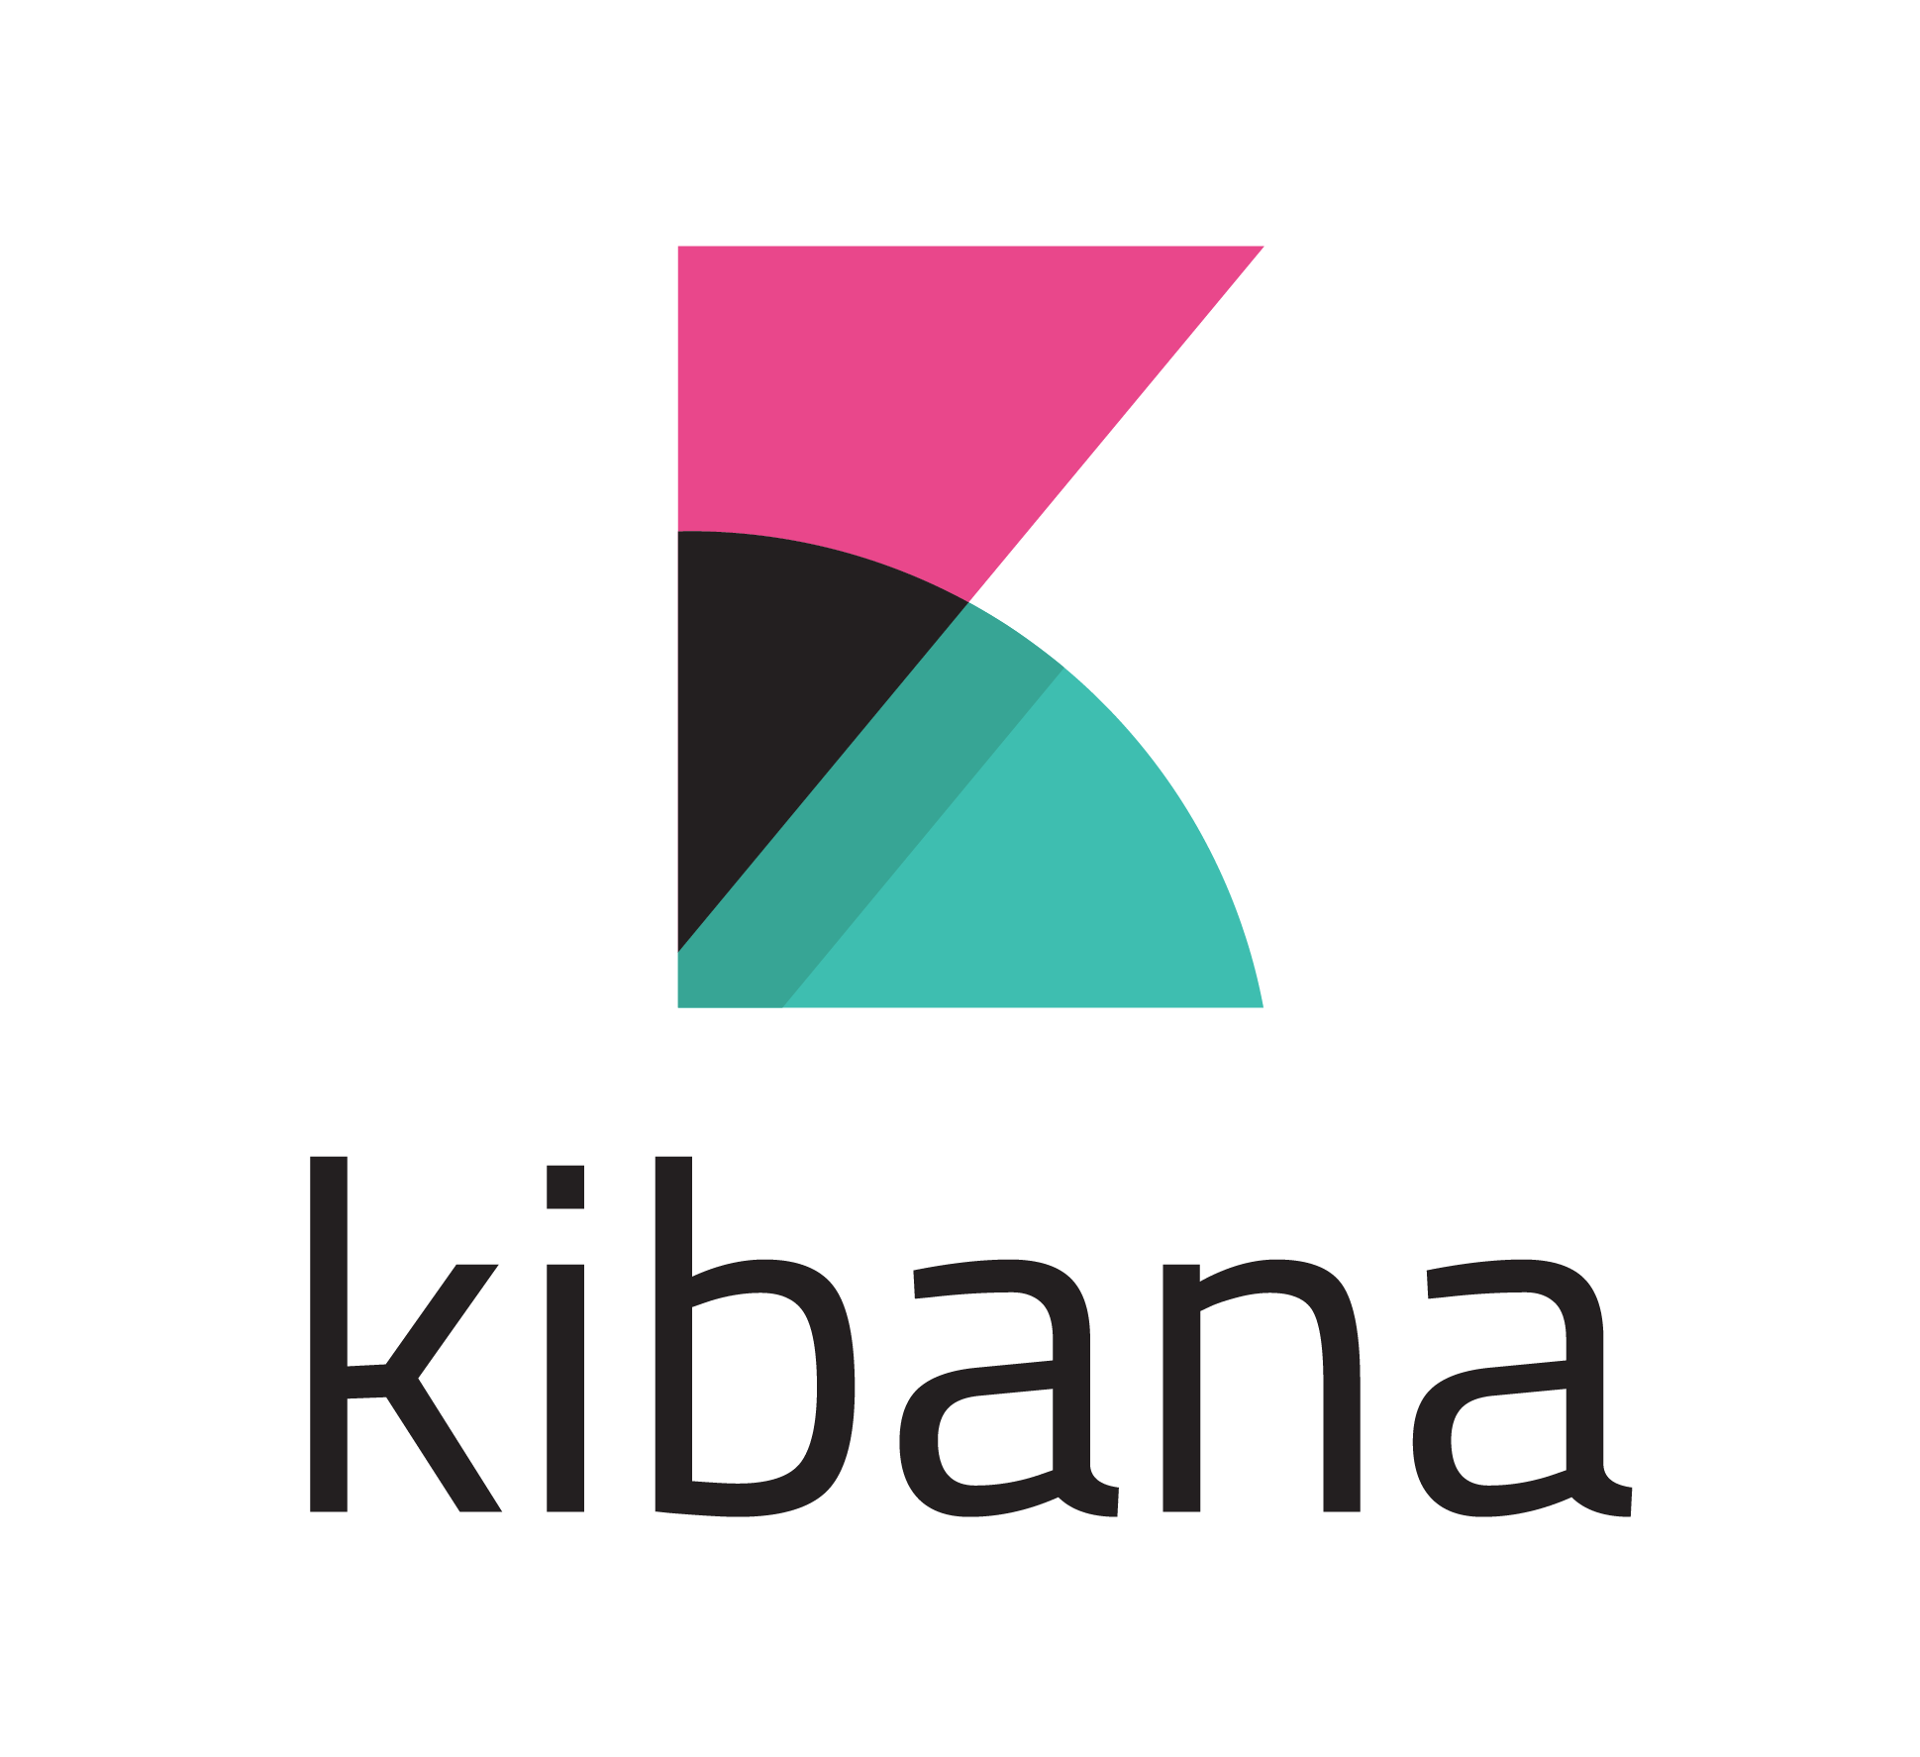

IoT Platform
IoT Devices
Data Insertion
HTTP Gateway (Node.js)
WS Gateway
(Node.js)
MQTT Gateway
(Node.js)
Endpoints under investigation:
Users-Get
Devices-Add
Devices-Get
Sensors-Get
HTTP-Gateway
Consumers-Consume-Get
Users
Consumers
DevOps
IoTCore Front-End
Interconnect Interface
IoTCore Back-End
OpenWhisk
GCR
Maria DB
Kafka Connect
Elasticsearch
Notes:
The IoT plafform application was designed by us to enable numerous IoT applications such as room monitoring.
It consists of several independent microservices that interact with each other to provide different functionalities.
The main component is the IoTCore which allows users to manage devices, sensors, authentication/authorization tokens for secure communication with the end devices.
All data related to users, devices, sensors, and consumers is stored in MariaDB.
The devices can send sensordata using the three different gateways.
The received data is then forwarded to Kafka, which is then finally indexed in ES via Kafka Connect.
The stored data can be visualized using Kibana.
The IoTplaform provides several API endpoints that enable users and consumers to interact with the platform and perform CRUD operations
In this work, we only focus on the mentioned six API endpoints.

Slide 11
Outline
Motivation
Goals
Background
Migration Methodology
Experimental Setup
Results
Conclusion and Future Work

Slide 12
Migration Methodology
IoT Devices
Data Insertion
HTTP Gateway (Node.js)
WS Gateway
(Node.js)
MQTT Gateway
(Node.js)
Endpoints under investigation:
Users-Get
Devices-Add
Devices-Get
Sensors-Get
HTTP-Gateway
Consumers-Consume-Get
Users
Consumers
DevOps
IoTCore Front-End
Interconnect Interface
IoTCore Back-End
OpenWhisk
GCR
Maria DB
Kafka Connect
Elasticsearch
Notes:
To minimize code changes, we do not migrate the “off-the-shelf” software components,
We only focus on adapting and migrating the IoTCore backend component and the HTTP Gateway.
We completely decomposed the different API endpoints in OW and GCR, but only focus on the six mentioned here in the paper.

Slide 13
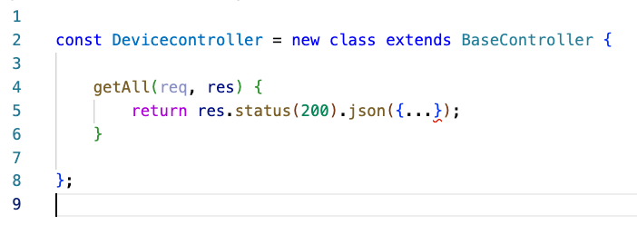
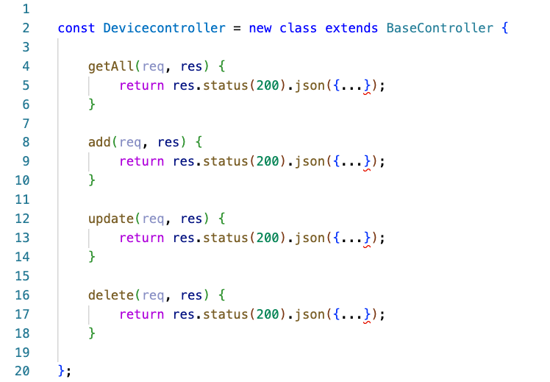
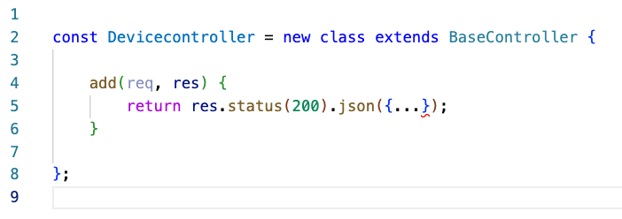
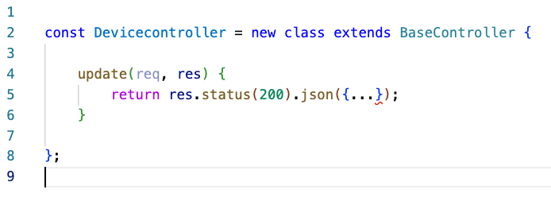
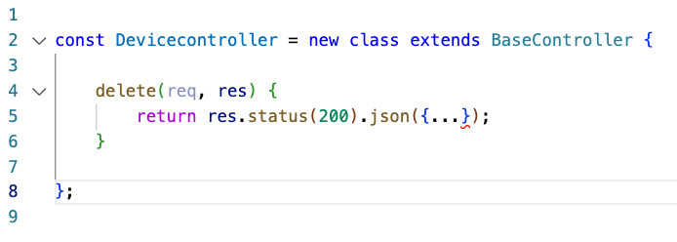
Migration Methodology
Flatten the services
Notes:
The main methodology behind our migration was that we decomposed the application logic, for each specific API endpoint into a seperate function.
For instance the different functionalities of the device controller were migrated into seperate functions.
Also, we made use of action sequencing in OW to chain the authentication function with the different API endpoints.
For GCR, the authentication functionality was merged into the individual middleware functions

Slide 14
Migration Methodology
Externalize state
Adjust communication protocols
Add abstraction layer for invocations
Notes:
To generalize this migration process:
All state that is stored in a service, must be converted to an external datastore.
Moreover, we need to change the communication protocols to work with the particular FaaS platform. For instance, converting ThriftRPC to gRPC for GCR.
Implementation of an abstract interface that intercepts an incoming request to an API endpoint and forwards it to the appropriate OW or GCR function.

Slide 15
Outline
Motivation
Goals
Background
Migration Methodology
Experimental Setup
Results
Conclusion and Future Work

Slide 16

Experiment Setup
Shared services on a separate Google Kubernetes Engine (GKE) cluster
Four different deployments for IoT core and gateway functionalities:
GKE-50 (horizontal pod autoscaling set to 50% CPU utilization)
GKE-80 (80% CPU utilization)
OW (on top of GKE)
GCR
Notes:
All off the off-shelf services were hosted on a separate GKE cluster for fairness
For our experiments, we consider four deployment strategies:
Google Kubernetes Engine,
For GKE, we consider two configurations for the HPA. 50% CPU utilization and 80% CPU utilization
OpenWhisk on top of GKE
Google Cloud Run
For exact configurations, please look in the paper.

Slide 17

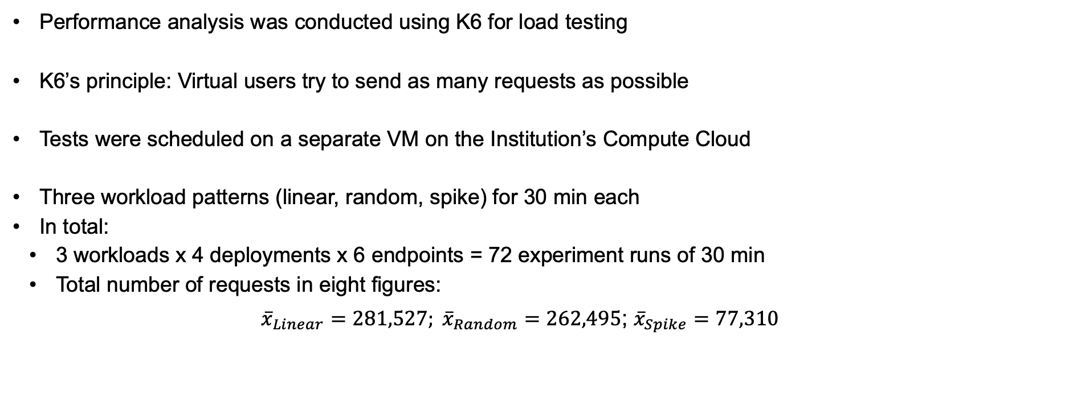
Experiment Procedure
Performance analysis was conducted using K6 for load testing
K6’s principle: Virtual users try to send as many requests as possible
Tests were scheduled on a separate VM on the Institution’s Compute Cloud
Three workload patterns (linear, random, spike) for 30 min each
In total:
3 workloads x 4 deployments x 6 endpoints = 72 experiment runs of 30 min
Total number of requests in eight figures:
$${\overline{x}}_{Linear}=281,527; {\overline{x}}_{Random}=262,495\text{; }{\overline{x}}_{Spike}=77,310$$
Notes:
For load testing, the different deployment strategies we use regression testing tool, k6 by Grafana Labs
K6 utilizes Vus are entities that make HTTP requests and try to perform a given test as often as possible.
For our experiments, we use a VM hosted on our Institute’s compute cloud.
We consider three workload patters, linear, random, and spike
The test duration is 30mins each.
We ran a total of 72 experiements,
With the total number of requests in eight figures.

Slide 18
Outline
Motivation
Goals
Background
Migration Methodology
Experimental Setup
Results
Conclusion and Future Work

Slide 19
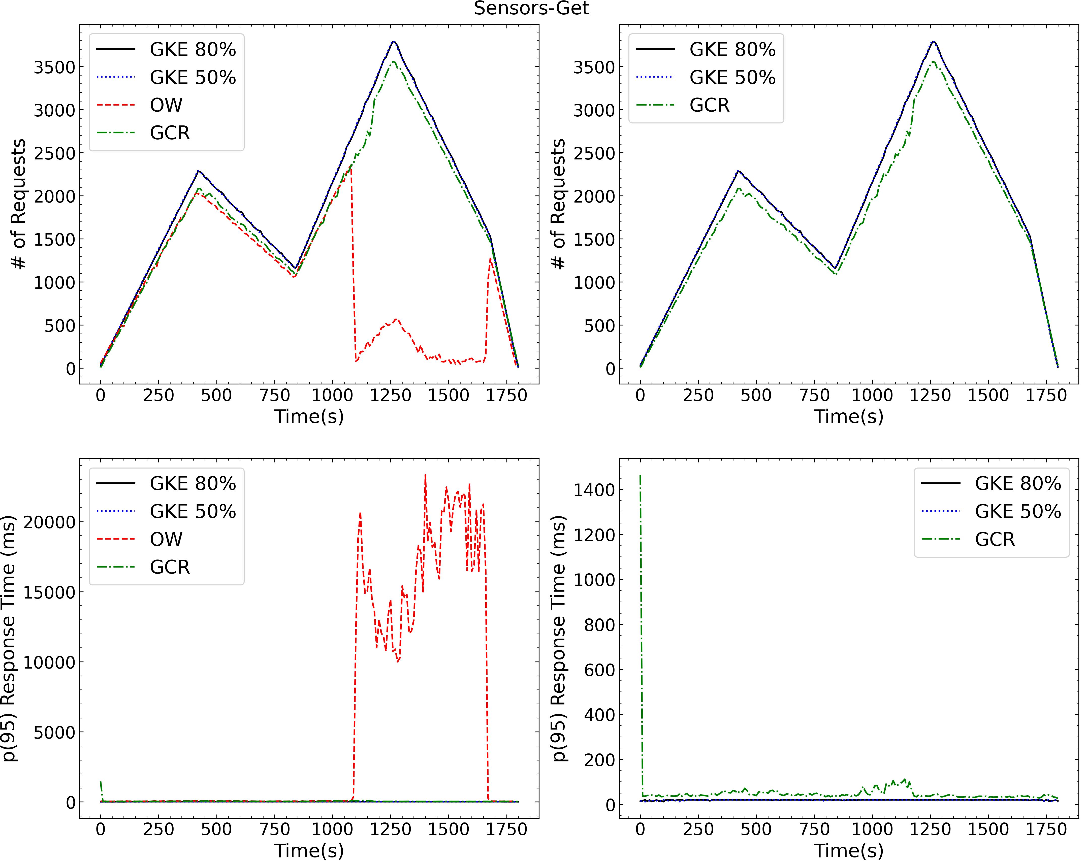
Performance Analysis
Figure: Sensors-Get APIEndpoint for the Random Workload.
Notes:
The top two figures show the number of requests, while the bottom two show the p(95) response times for the different deployment strategies.
For most api endpoints, we observed the GKE deployment strategies performed best, followed by GCR, and then OW.
We had a significant increase in the p95 response time for OW for greater than 2000 requests per ten seconds.
Moreover, the initial response times for GCR was significantly high due to cold starts

Slide 20
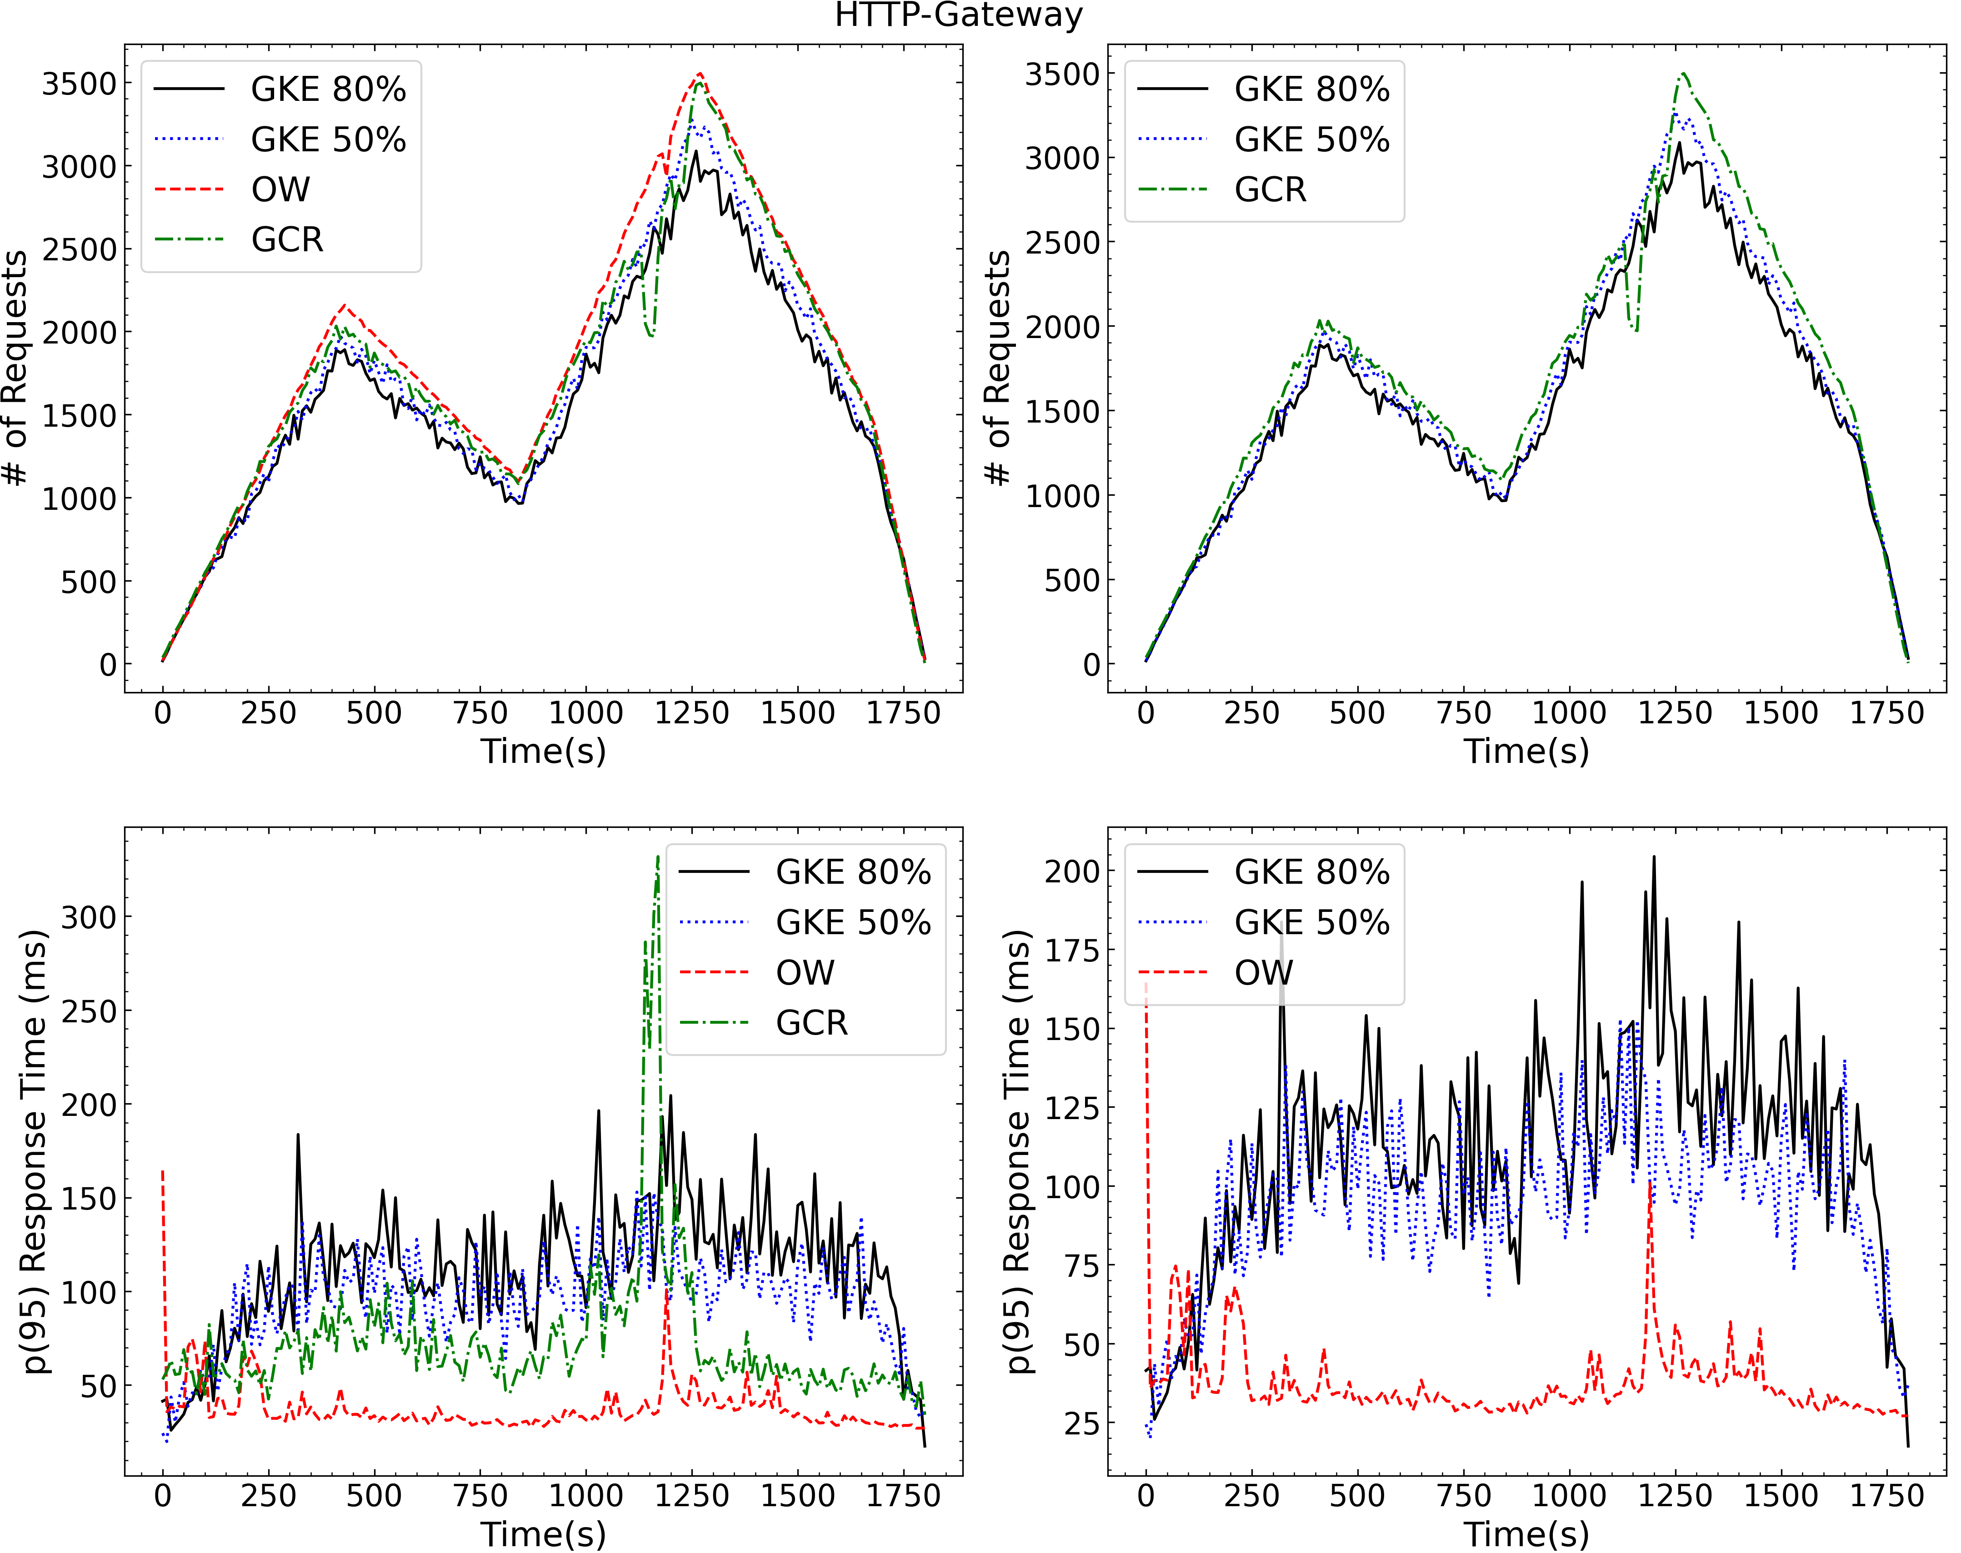
Performance Analysis
Figure: HTTP-Gateway APIEndpoint for the Random Workload.
Notes:
In contrast to the Sensors-Get API endpoint,
For the HTTP-Gateway, the serverless deployments perform better than GKE.
OW deployment performed significantly better.
The main reason for this was the high initial resource provisioning for OW.
Moreover, while GCR limits the amount of CPU resources allocated to a function, with OW no such limit is enforced leading to better performance.

Slide 21
Takeaways: Performance Analysis
Generally, GKE setups with highest performance, followed by GCR. OW fell behind for higher workloads.
Marginal differences for three workload patterns. OW dysfunctional when ~2,000 requests per 10 sec exceeded.
Autoscaling without large effects, GKE-50 performed slightly better than GKE-80.
GCR in general outperformed OW and was more robust.
Notes:
For the different API endpoints, we observed that:
The GKE setups performed best with the highest performance, followed by OW, and GCR.
We observed marginal difference for the three load patterns.
The performance for OW was significantly bad for more that 2000 RPS.
Also, GKE-50 was slightly better than GKE-80.
GCR was more robust than OW. Primarily because it is a managed service.

Slide 22
Cost Analysis
GKE and OW with reservation-based pricing, GCR pay-per-use model
API Endpoint | Workload | GKE-50 | GKE-80 | OW | GCR
Sensors-Get | Linear | 0.1054 | 0.1053 | 0.5195 | 0.0542
 | Random | 0.1054 | 1.0433 | 0.4752 | 0.0544
 | Spike | 0.1054 | 1.0433 | 1.2230 | 0.0586
HTTP-Gateway | Linear | 0.1225 | 0.1276 | 0.2592 | 0.0710
HTTP-Gateway | Random | 0.1217 | 0.1278 | 0.4752 | 0.0630
 | Spike | 0.4760 | 0.4742 | 1.0206 | 0.0539
Costs per 1000 requests in USD cents.
Notes:
We also compared the costs for the API endpoints for the different deployment strategies.
From our experiements, we observed that per 1000 requests GCR was always cheaper.

Slide 23
Outline
Motivation
Goals
Background
Migration Methodology
Experimental Setup
Results
Conclusion and Future Work

Slide 24
Conclusion and Future Work
Migration process is ad-hoc and time-consuming.
GCR is relatively stable with cold start problems on traffc spikes.
GKE in standard mode is best in terms of pure performance.
How much should you decompose?
Future Work:
Experiments with GKE-Autopilot.
Fine-tuning serverless deployment for better comparisons.
Migration of larger scale microservices applications.
Notes:
Main takeways:
Migrating a microservices application is mostly ad-hoc and application dependent. So, before starting the migration process, the developer should consider the amount of code that can be reused.
On traffic bursts, response times in GCR can significantly increase
GKE standard has the best performance.
Amount of decomposition is also important.
From our experiments, we observed that migrating deeply nested microservices applications into individual FaaS functions can lead to worse performce and more costs.
In the future, we plan to experiment with Autopilot, play with different FaaS configuration setting such as concurrency, and migrate bigger microservices applications

Slide 25


Contact
Thank you for your attention!
Questions ?
mohak.chadha@tum.de
Code

