Slide 1

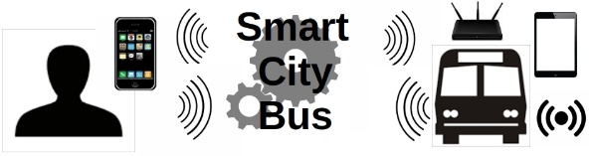


Transferring Transactional Business Processes To FaaS
Eighth International Workshop on Serverless Computing 2022 (WoSC8)
__________________________________________________________________________________________
Kostas Meladakis, Chrysostomos Zeginis, Kostas Magoutis and Dimitris Plexousakis
Foundation for Research & Technology – Hellas (FORTH), Heraklion, Greece
Supported by
WoSC8, 7 Nov 22, Quebec, Canada, https://www.serverlesscomputing.org/wosc8/

Slide 2






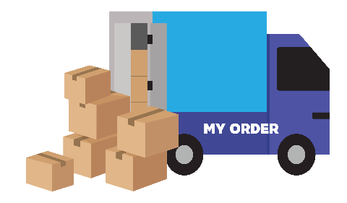

A few thing about BPMN2.0…
Application Area
Community
Managers
Purchases
Business Analysts
Orders
Technical Developers
WoSC8, 7 Nov 22, Quebec, Canada, https://www.serverlesscomputing.org/wosc8/

Slide 3

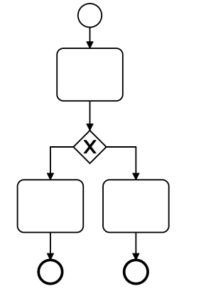






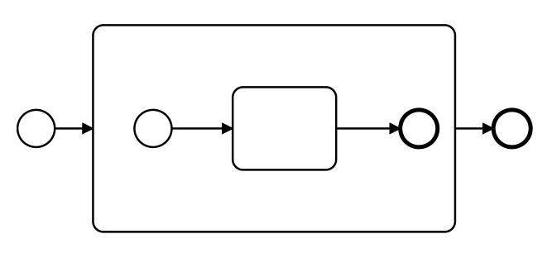
What is BPMN2.0 ?
BPMN symbols
Workflows
XML standard
<bpmn:process id=“1" > BP1
<bpmn:start id=“s1">S1</bpmn:start>
<bpmn:out>flow1</bpmn:out> >
<bpmn:Task>Book</bpmn:Task>
<bpmn:out>flow2</bpmn:out>
<bpmn:end id=“e1”>E1</bpmn:end>
</bpmn:process>
Book Ticket
Is available?
no
yes
ISO/IEC 19510:2013
BPMN2.0 engines
can build whole
applications
Oops, sorry…
Ticket Booked
WoSC8, 7 Nov 22, Quebec, Canada, https://www.serverlesscomputing.org/wosc8/

Slide 4




FaaS is a trend!
Bridge BPMN2.0 & FaaS
Mapping
Sequence(
Action(‘Task’),
Action('Task')
)
parallel(
Action(‘Task’),
Action('Task')
)
map(
Action(‘Task’),
Action('Task')
)
condition(
Action(‘Task’),
Action('Task')
)
Orchestration
Define Relationships
Sequence(
Action(‘Task’),
Action('Task')
)
try(
Action(‘Task’),
Action('Task')
)
BPMN
FAAS
WoSC8, 7 Nov 22, Quebec, Canada, https://www.serverlesscomputing.org/wosc8/

Slide 5




One-to-one mapping of common constructs
BPMN notation
BPMN representation
OpenWhisk concept
Visual representation
Task
name
composer.action(‘name’)
composer.sequence(
action1, action2)
Sequence
composer.if(condition,
path1, path2)
Exclusive gateway
…
composer.parallel(
action1, action2)
Parallel gateway
WoSC8, 7 Nov 22, Quebec, Canada, https://www.serverlesscomputing.org/wosc8/

Slide 6
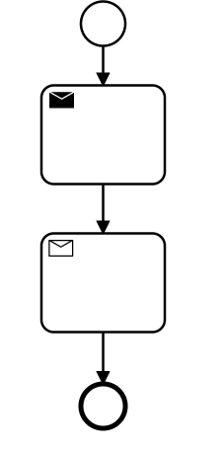



Challenge 1: BPMN blocking vs FaaS event-driven
BPMN
OpenWhisk
composer.action(‘send’)
Send a msg
Send a msg
msg:{
“ref. order”: 1,
“sendTask”: “completed”,
“status” : “ongoing”
}
Process instance stops
Receive a msg
Upon msg receipt, process continues
composer.action(‘receive’)
WoSC8, 7 Nov 22, Quebec, Canada, https://www.serverlesscomputing.org/wosc8/

Slide 7
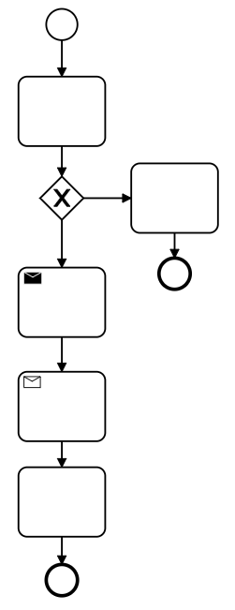


Implementing BPMN waiting states
in OpenWhisk
OpenWhisk
BPMN
composition1
1st part of process 1
msg:{
“ref. order”: 1,
“status” : “ongoing”
}
or
waiting state
2nd part of process 1
composition2
A process can be interpreted into multiple compositions
WoSC8, 7 Nov 22, Quebec, Canada, https://www.serverlesscomputing.org/wosc8/

Slide 8
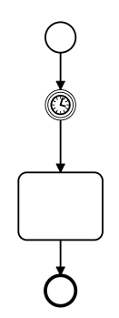




Challenge 2 : Implementing BPMN delays in FaaS
BPMN
orchestration definitions
Sequence(
Function( (input) =>{const date = Date.now();
let now = null;
do { now = Date.now(); }
while (now - date < 1000);
return input; } ),
Action('Task')
)
Wait 1min
Calculation
Timeout limit of 6min
Burns our CPU
WoSC8, 7 Nov 22, Quebec, Canada, https://www.serverlesscomputing.org/wosc8/

Slide 9
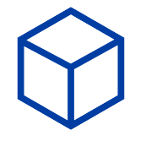


Implementing Delay: Use a timed event cloud-native service
BPMN
OpenWhisk
Call alarms pkg
Wait 1min
Count 1min,
then fire
Calculation
Rule
WoSC8, 7 Nov 22, Quebec, Canada, https://www.serverlesscomputing.org/wosc8/

Slide 10
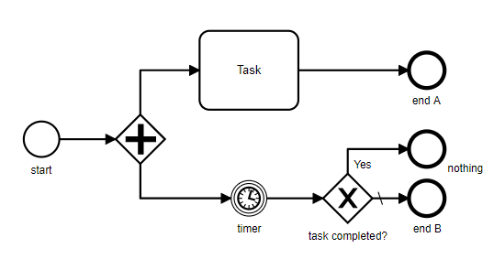
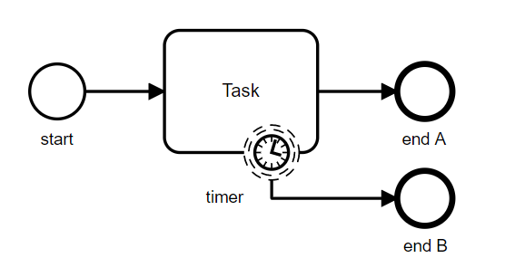
Challenge 3: Boundary Timers
Non-interrupting boundary timer
Think algorithmically
(reduction to a problem with known solution)
Split
BPMN
BPMN
WoSC8, 7 Nov 22, Quebec, Canada, https://www.serverlesscomputing.org/wosc8/

Slide 11



Transformation of boundary timer to OpenWhisk
start
initialize alarm
yes
nothing
alarm trigger
task completed?
end state B
composition
BPMN
OpenWhisk
WoSC8, 7 Nov 22, Quebec, Canada, https://www.serverlesscomputing.org/wosc8/

Slide 12
Transformation of boundary timer to OpenWhisk
start
initialize alarm
yes
nothing
alarm trigger
task completed?
end state B
composition
BPMN
OpenWhisk
WoSC8, 7 Nov 22, Quebec, Canada, https://www.serverlesscomputing.org/wosc8/

Slide 13
Observation: FaaS is structurally more complex
start
initialize alarm
yes
nothing
alarm trigger
task completed?
end state B
composition
WoSC8, 7 Nov 22, Quebec, Canada, https://www.serverlesscomputing.org/wosc8/

Slide 14
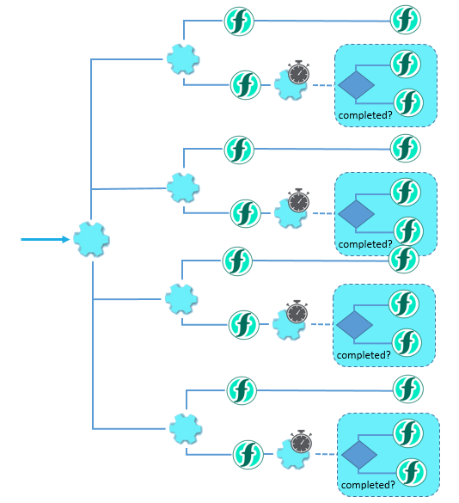
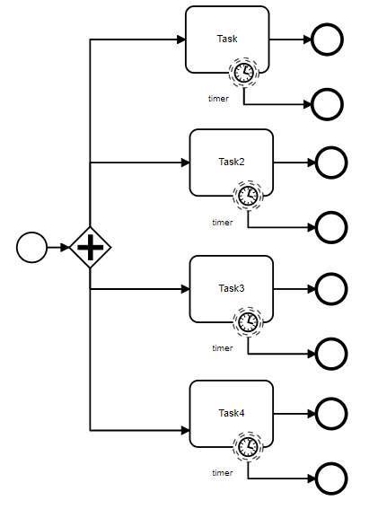
Observation: FaaS is structurally more complex
WoSC8, 7 Nov 22, Quebec, Canada, https://www.serverlesscomputing.org/wosc8/

Slide 15
Observation: FaaS is structurally more complex
start
initialize alarm
yes
nothing
alarm trigger
task completed?
end state B
composition
WoSC8, 7 Nov 22, Quebec, Canada, https://www.serverlesscomputing.org/wosc8/

Slide 16
Observation: FaaS is structurally more complex
start
initialize alarm
alarm trigger
end state B / nothing
WoSC8, 7 Nov 22, Quebec, Canada, https://www.serverlesscomputing.org/wosc8/

Slide 17
Expressing Transactions in BPMN
Traditionally BPMN2.0 is used to describe such transactional applications
Since the majority uses saga → BPMN2.0 supports sagas
BPMN2.0 has high expressive power (semantically strong)
Let’s implement an airline example using BPMN2.0
WoSC8, 7 Nov 22, Quebec, Canada, https://www.serverlesscomputing.org/wosc8/

Slide 18

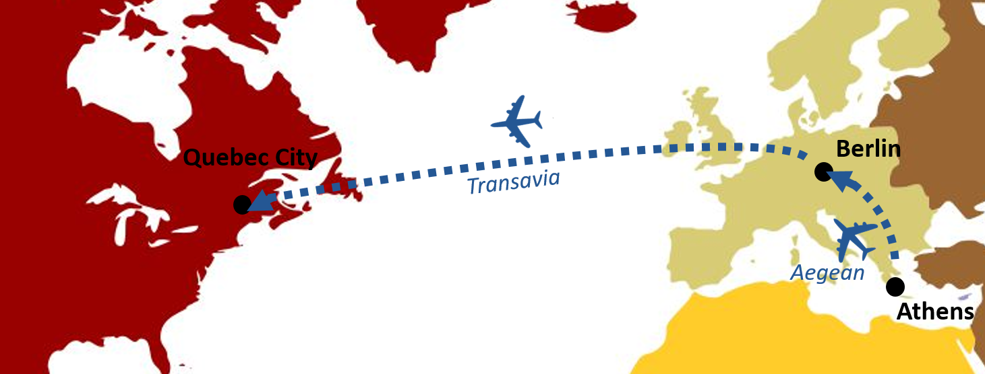
Airline paradigm explanation
Booking two tickets from two airlines
WoSC8, 7 Nov 22, Quebec, Canada, https://www.serverlesscomputing.org/wosc8/

Slide 19
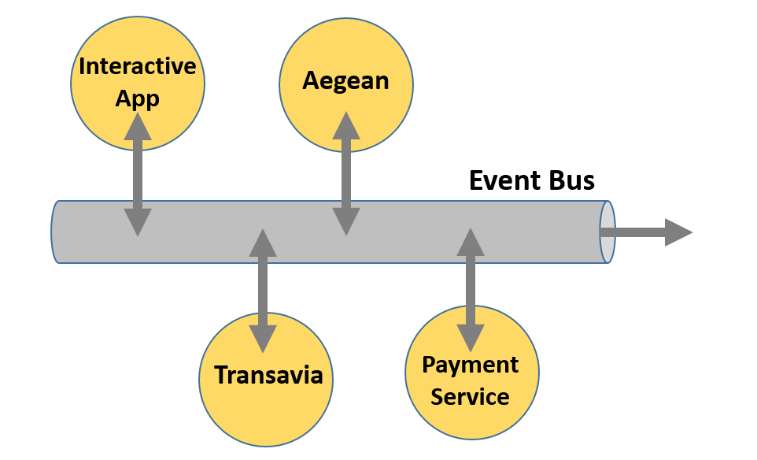




Possible Implementation, multiple participants
Booking two tickets
from two airlines
WoSC8, 7 Nov 22, Quebec, Canada, https://www.serverlesscomputing.org/wosc8/

Slide 20
Possible Implementation, multiple participants
Booking two tickets
from two airlines
WoSC8, 7 Nov 22, Quebec, Canada, https://www.serverlesscomputing.org/wosc8/

Slide 21
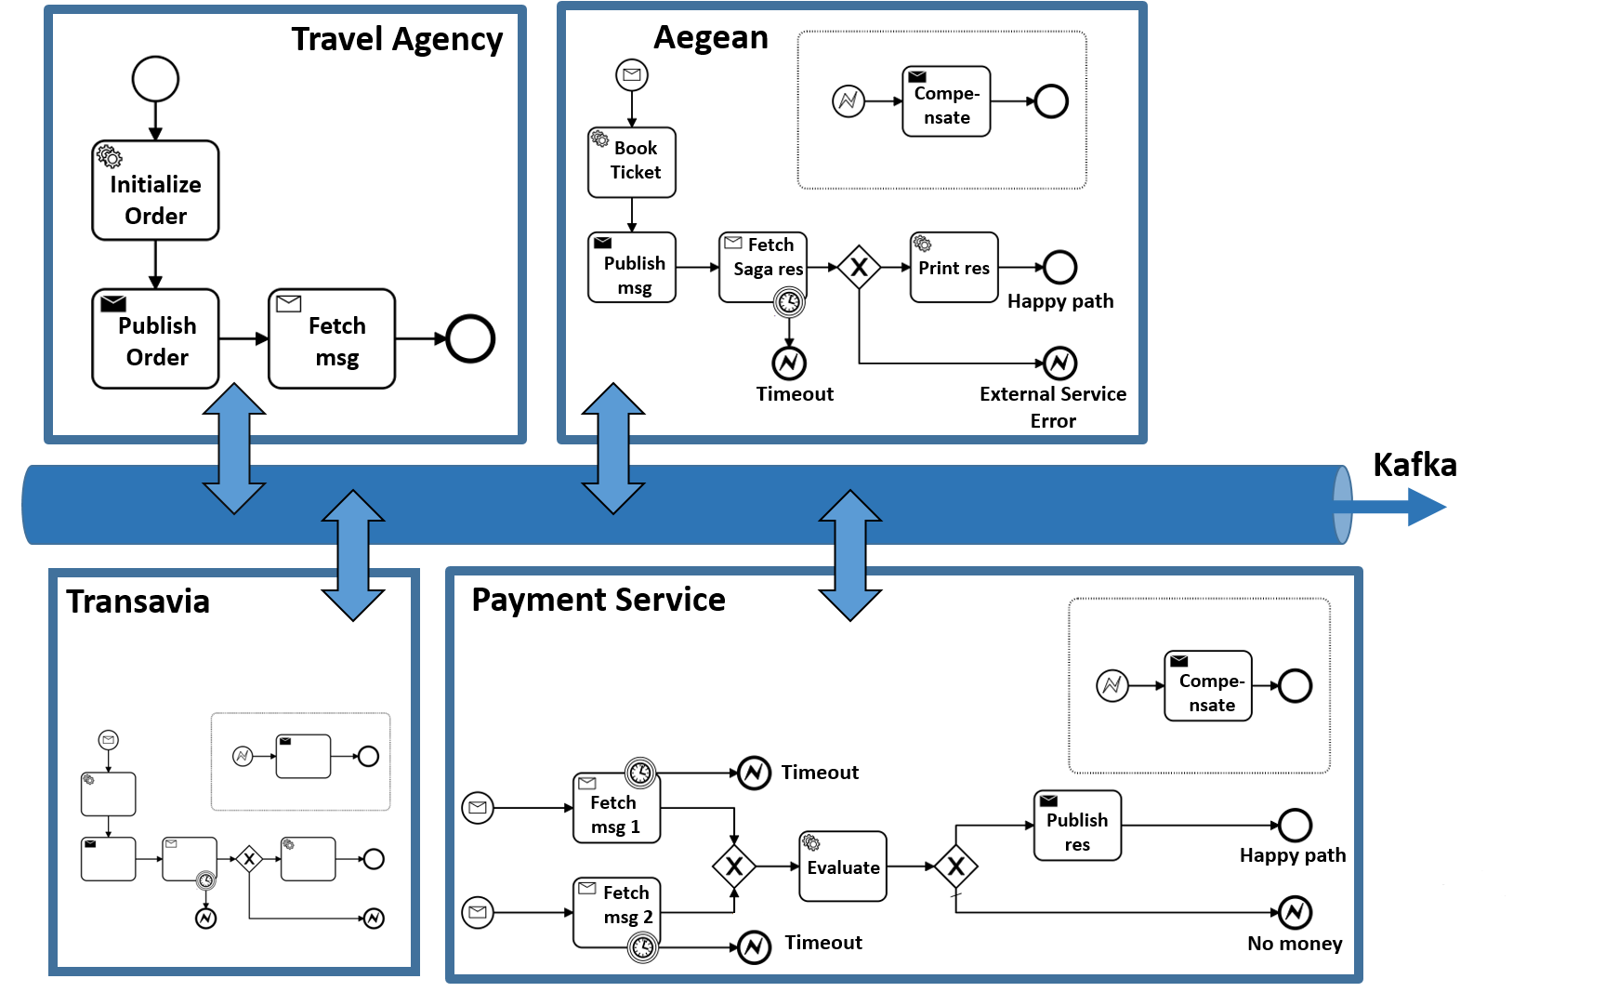
Booking two tickets
from two airlines
in BPMN
Get money back
WoSC8, 7 Nov 22, Quebec, Canada, https://www.serverlesscomputing.org/wosc8/

Slide 22
Booking two tickets
from two airlines
in BPMN
Get money back
WoSC8, 7 Nov 22, Quebec, Canada, https://www.serverlesscomputing.org/wosc8/

Slide 23
Booking two tickets
from two airlines
in BPMN
Get money back
WoSC8, 7 Nov 22, Quebec, Canada, https://www.serverlesscomputing.org/wosc8/

Slide 24
Booking two tickets
from two airlines
in BPMN
Get money back
WoSC8, 7 Nov 22, Quebec, Canada, https://www.serverlesscomputing.org/wosc8/

Slide 25
Booking two tickets
from two airlines
in BPMN
Get money back
WoSC8, 7 Nov 22, Quebec, Canada, https://www.serverlesscomputing.org/wosc8/

Slide 26
Booking two tickets
from two airlines
in BPMN
Get money back
WoSC8, 7 Nov 22, Quebec, Canada, https://www.serverlesscomputing.org/wosc8/

Slide 27
Booking two tickets
from two airlines
in BPMN
Get money back
WoSC8, 7 Nov 22, Quebec, Canada, https://www.serverlesscomputing.org/wosc8/

Slide 28
Booking two tickets
from two airlines
in BPMN
Get money back
WoSC8, 7 Nov 22, Quebec, Canada, https://www.serverlesscomputing.org/wosc8/

Slide 29
Booking two tickets
from two airlines
in BPMN
Get money back
WoSC8, 7 Nov 22, Quebec, Canada, https://www.serverlesscomputing.org/wosc8/

Slide 30
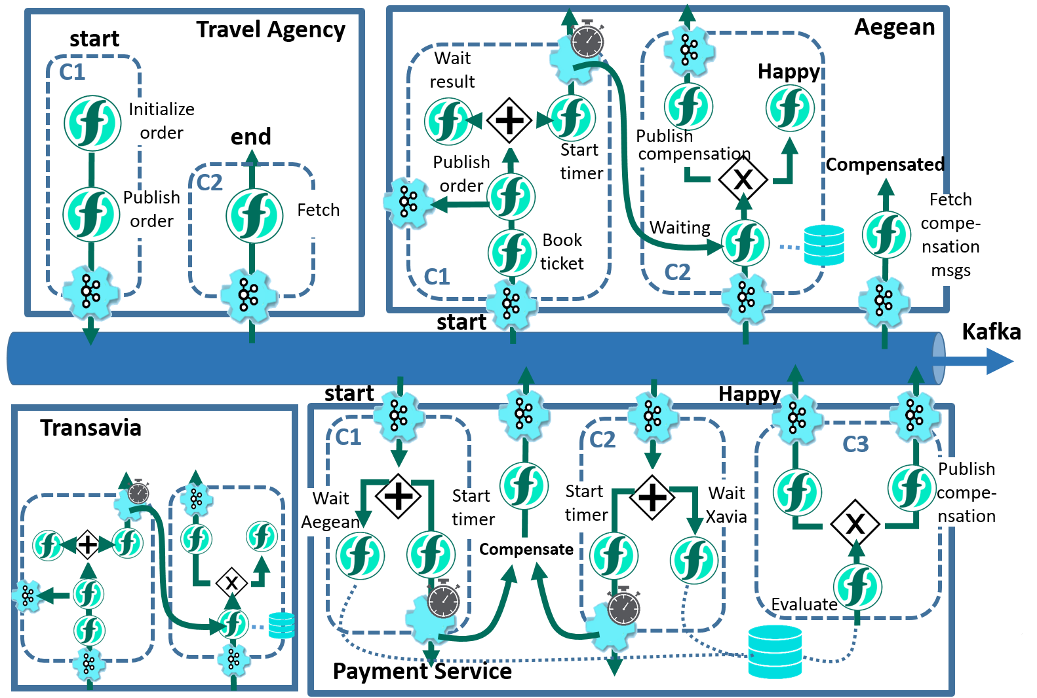
Booking two tickets
from two airlines
in OpenWhisk
WoSC8, 7 Nov 22, Quebec, Canada, https://www.serverlesscomputing.org/wosc8/

Slide 31

FaaS workflow is typically more complex
BPMN
FAAS
WoSC8, 7 Nov 22, Quebec, Canada, https://www.serverlesscomputing.org/wosc8/

Slide 32
Conclusions
Addressed challenges in mapping BPMN2.0 to OpenWhisk
Saga transactions expressed in BPMN straightforwardly carry over to OpenWhisk
This enables business analysts to express processes in a simpler BPMN format compared to the more complex OpenWhisk workflows
Bridges simplicity of BPMN to ubiquity and power of FaaS platforms
WoSC8, 7 Nov 22, Quebec, Canada, https://www.serverlesscomputing.org/wosc8/

Slide 33
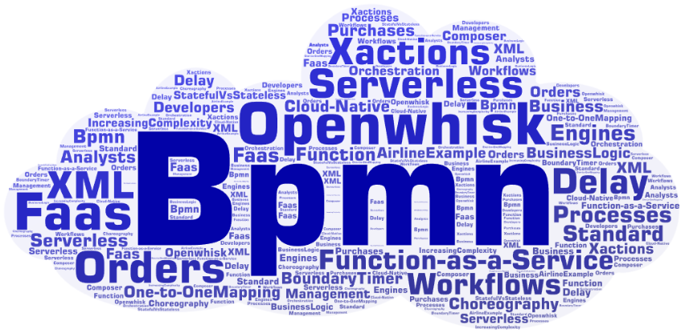
QUESTIONS ?
WoSC8, 7 Nov 22, Quebec, Canada, https://www.serverlesscomputing.org/wosc8/

