Slide 1

Towards Lightweight and
LLM‑Free Semantic Search
for mathlib4
Local retrieval for Lean theorems
Isaac (Rucheng) Li
University of Pittsburgh

Slide 2

Motivation
Suppose you're new to Lean and unfamiliar with everything.
You'll likely craft two queries:
for integers, subtraction is the same as adding a negative
Natural Language style
int m i, m+-i=m-i
Formula style
And you want to find the answer:
Int.add_neg_eq_sub

Slide 3

Sentence embedding model
In natural language processing, a sentence embedding is a representation of a sentence as a vector of numbers which encodes meaningful semantic information.
SentenceTransformers (SBERT) is a Python library for building and using embedding models—powering tasks like semantic search.

Slide 4
Common Strategy
Build informal statements
Convert each of the formal theorem into an informal natural language statement (using LLM).
Use dense vector embeddings
Use an embedding model to embed all informal statements and user input into a shared embedding space. Then retrieve by cosine similarity.
Query augmentation(optional)
Expand vague user queries into richer, precise math statements by online LLM.
Efficient retrieval
Apply approximate nearest neighbor search for fast lookup.

Slide 5


Existing Tools
Old(Lean 4.16.0)
Using a large embedding model(7B)
Hard to deploy locally on laptops
Only web demo
Support natural language and formula style search
New(Lean 4.19.0)
Using a small embedding model(0.1B)
Can deploy locally on laptops
Perform great in natural language
Do not support formula style search

Slide 6
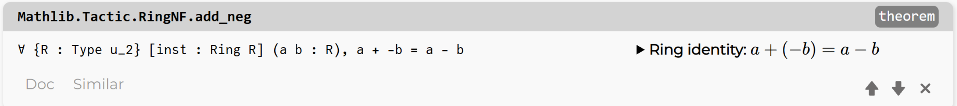
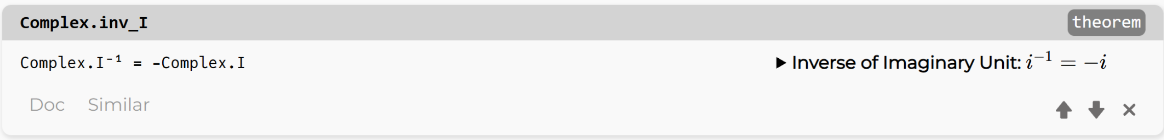
Variable naming bias
LeanSearch exhibits bias based on variable names
a+-b=a-b
m+-i=m-i

Slide 7
Cheap search (ours)
Newest (Lean 4.20.1)
Using a small embedding model(0.6B)
Can deploy locally on laptops
Perform great in natural language
Perform great in formula style search
Greatly reduced variable naming bias

Slide 8
Extending the search ability of a Lightweight Model
Instead of just one detailed statement.
We use Deepseek-chat(online LLM) to generate three detailed possible queries per formal theorem:
1. Natural language
2. formula-style
3. Mixed
Goal: broaden match range → improve tolerance of inputs for small models

Slide 9
Example
full_name | – | Nat.add_comm
statement | – | theorem add_comm : ∀ (n m : Nat), n + m = m + n
queries | natural language | addition is commutative for natural numbers
 | formula-style | ∀ &n& &m& ∈ ℕ, &n& + &m& = &m& + &n&
 | mixed | for natural numbers, the sum of &n& and &m& equals the sum of &m& and &n&
*We wrap variables initially with ampersand(&) for future usage

Slide 10
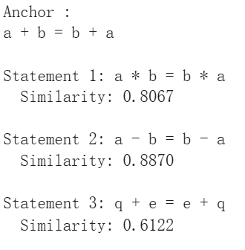
Variable Naming bias?
For QWEN 0.6B (our base model)
What we get
What we want
Fine-tuning? Have some improvement but did not meet our expectation.

Slide 11
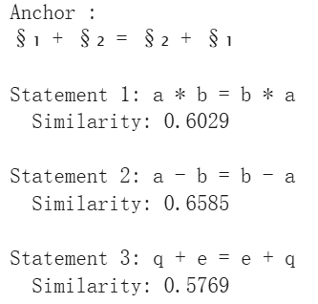
Masking variable names
We reduce all similarities and thereby reduce the naming bias
Masked queries | natural language | addition is commutative for natural numbers
 | formula-style | ∀ §₁ m ∈ ℕ, §₁ + §₂ = §₂ + §₁
 | mixed | the sum of §₁ and §₂ equals the sum of §₂ and §₁

Slide 12
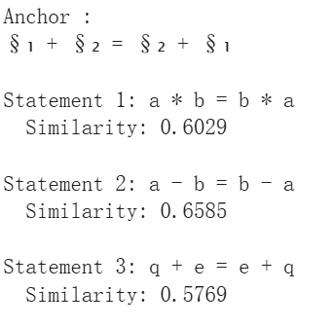
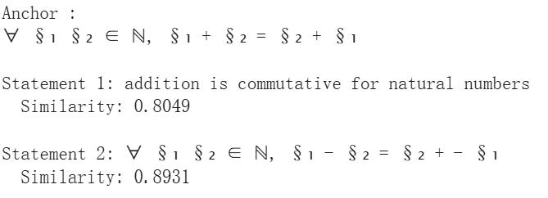
Without fine tuning

Slide 13
Fine-Tuning with MNRL
Goal: bring queries of the same theorem closer in embedding space
Method: fine-tune with MultipleNegativesRankingLoss (MNRL)
Dataset scale:
N = 179,194 theorems
Each theorem has q1, q2, q3
Positive pairs: (q1,q2), (q2,q3), (q3,q1)
Total: 537,582 pairs
Positive
Anchor
addition is commutative | §₁ + §₂ = §₂ + §₁
multiplication is commutative | §₁ * §₂ = §₂ * §₁
Negative

Slide 14
Batching Strategies
*Problem: duplicate queries → false negatives
Quick fix: group duplicates, enforce one-per-batch
Batching strategies:
Low-clustered → random ordering
Medium-clustered → sort by theorem name (area-based)
High-clustered → k-means clusters on base model embeddings

Slide 15
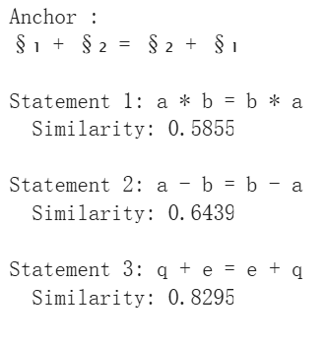
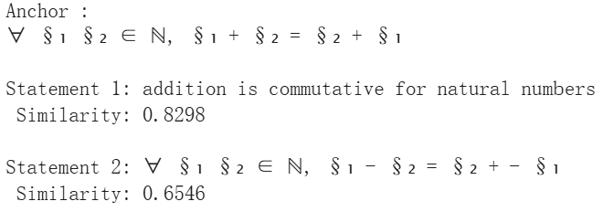
After fine-tuning

Slide 16
Vague query harvesting
For each theorem → generate 5 vague queries with DeepSeek-Chat.
Run each query on the base search engine.
If ground-truth theorem not in top-10 → log (query, target, top-10 results).
These become candidates for adjudication.

Slide 17
Vague query Judging and Finalization
Use DeepSeek-Chat to adjudicate candidates and Drop:
underspecified queries.
overly generic for uncommon variants.
Accept: queries that meaningfully points to the formal theorem.
Merge accepted vague queries with detailed queries → final anchors.
Re-embed anchors + rebuild lookup index → final search engine.

Slide 18
Accepted
Vague Query: law of cos
Vague Query: §₁² + §₂² − 2 §₁§₂ cos()
Rejected(underspecified queries)
Theorem: Nat.le_add_one_of_avg_eq_left
Vague Query: relation between average and elements
Rejected(overly generic for uncommon variants)
Theorem: UInt64.add_comm
Vague Query: §₁ + §₂ = §₂ + §₁

Slide 19
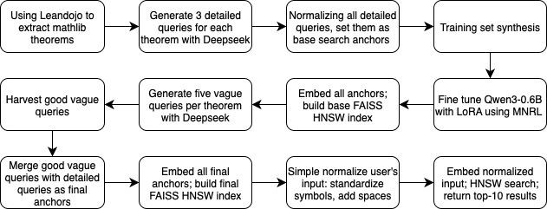
End-to-End Overview

Slide 20
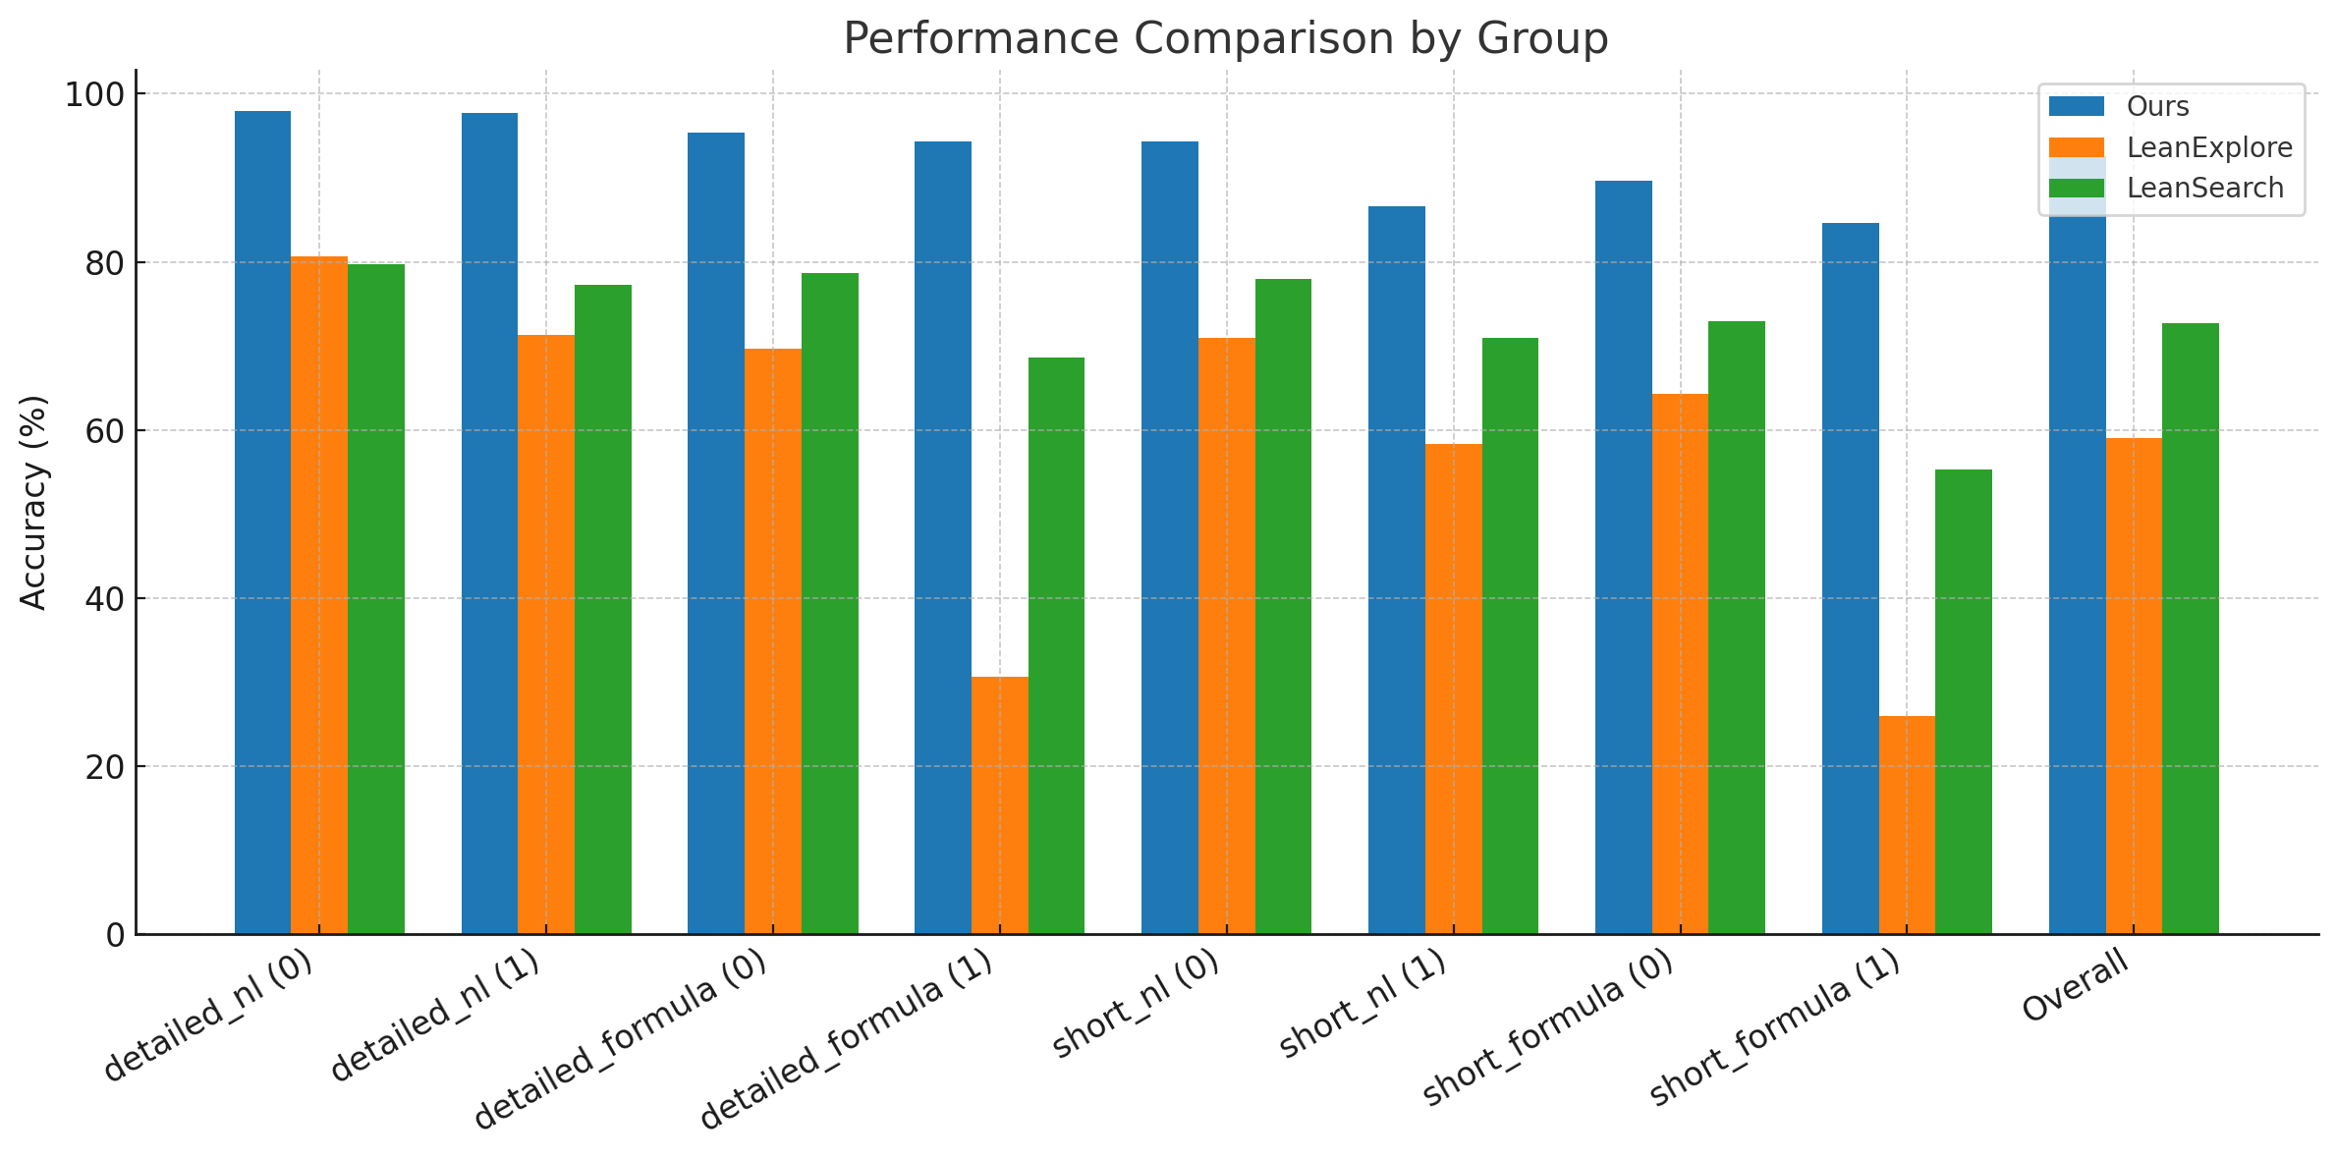

Slide 21
Limitations
1. Incomplete theorem extraction
2. Over-separation in training
Nat.prime_def_lt —> if a number smaller than a prime p divides p, it must be 1
Nat.prime_def_lt’ —> there are no divisors of p in the interval (1,p)
3. Dependence on anchor richness
subgroup transitivity ——> le_trans
4. Potential evaluation bias

Slide 22
Future work
Better training set: Build a high-quality math statement training set.
Benchmarking: Create a detailed benchmark for future theorem search engines.
Optional
Generalization: Adapt design beyond Lean.
Maintainability: Simple updates when libraries evolve.
Self-Improvement: Continuously refine index and anchors over time.

Slide 23
Thank you!

