Slide 1
Thinking Tokens for Language Modeling
David Herel, Tomas Mikolov
CTU FEE, CIIRC CTU
AITP 2023

Slide 2
How much is 56 times 37?

Slide 3
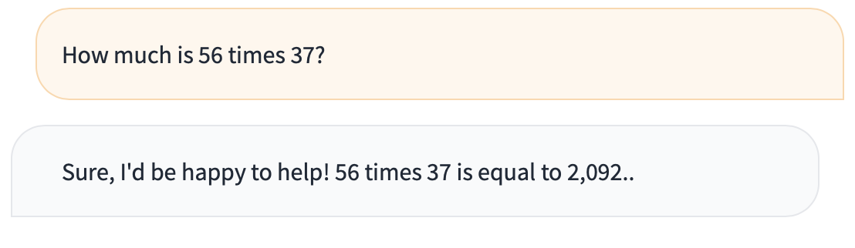
Llama 2 70B

Slide 4
How much is 56 times 37?
Correct answer: 2072

Slide 5
Language models for calculations
LM often make mistakes in difficult calculations
Inability to perform complex reasoning
Large training sets and great memorization capability
Humans also cannot perform this calculation immediately
They require a considerable amount of time to construct the solution

Slide 6
Thinking Tokens
As a parallel to human behavior, we propose to give a more time to “think” by using special “thinking tokens”
Each thinking token buys more time to run additional computations
Great potential in RNNs due to their architecture
Example: “How much is 56 times 37? <T> <T> <T> ...<T> 2072”

Slide 7
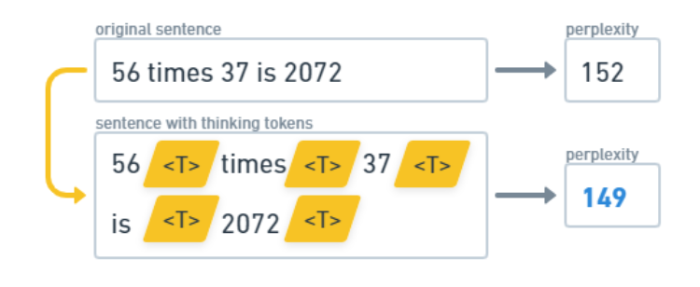
Proof of Concept
We have added N thinking tokens (“<T>”) after each observed word in a dataset
Our vision is that this basic concept can be extended to self-adjusting model, which will decide by itself how many thinking tokens will be used

Slide 8
Proof of Concept
RNN LM as baseline model vs RNN LM with “thinking tokens”
Trained on standard LM tasks, mathematics datasets and economics datasets
We have identified sentences where the largest difference in perplexity was measured to see, where the usage of “thinking tokens” could be beneficial

Slide 9
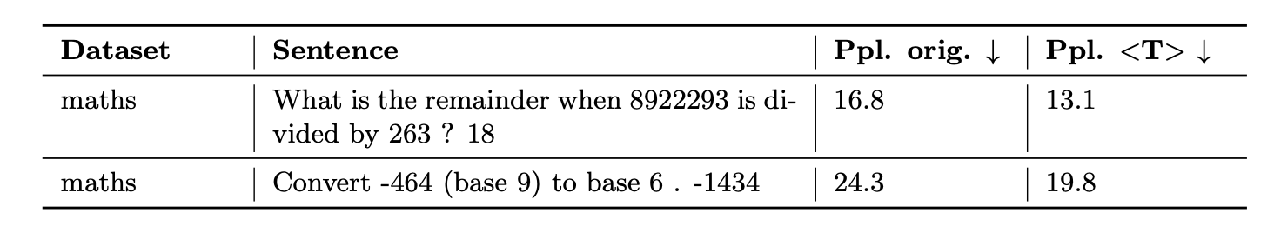
Results
Loss generated by 'thinking tokens' is omitted from the calculation of perplexity
<T> helps in sentences which include specific numbers, e.g. three studios albums, or representative symbols of numerical values, such as N

Slide 10
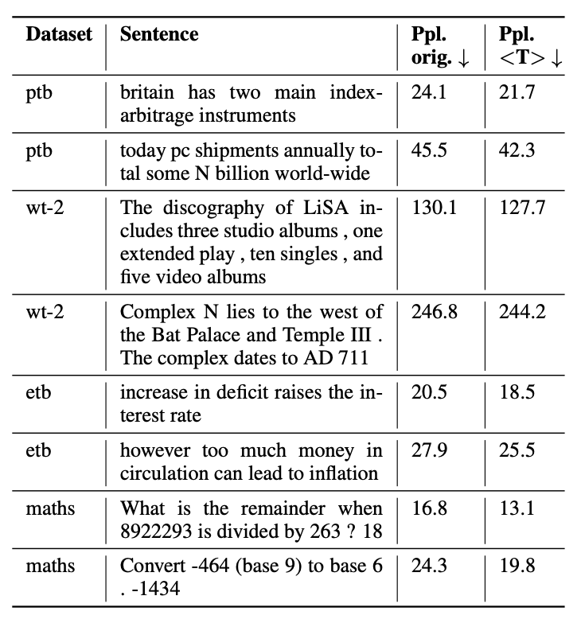
Results

Slide 11
Future work
Create a model that would be able to decide itself how much extra time is needed in order to produce best answer possible
That means it could choose how many or if any thinking tokens should be generated
End Goal example: “How much is 56 times 37? <T> <T> <T> ...<T> 2072”

Slide 12
Thank you!

Slide 13
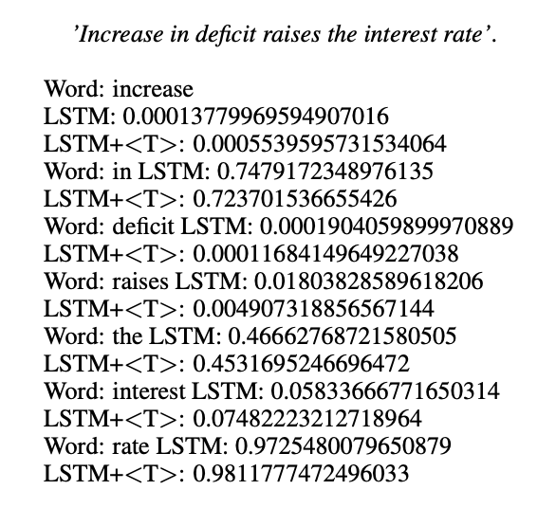
Bonus material

Slide 14
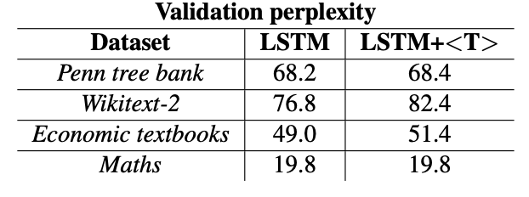
Bonus material

Slide 15
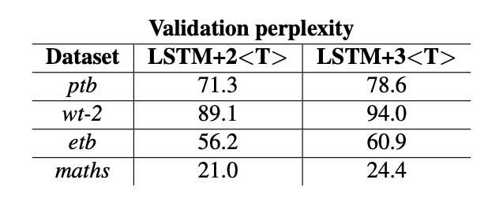
Bonus material

