Slide 1

Adrianna
Aivy
Akin
Aya
Nikki

Slide 2
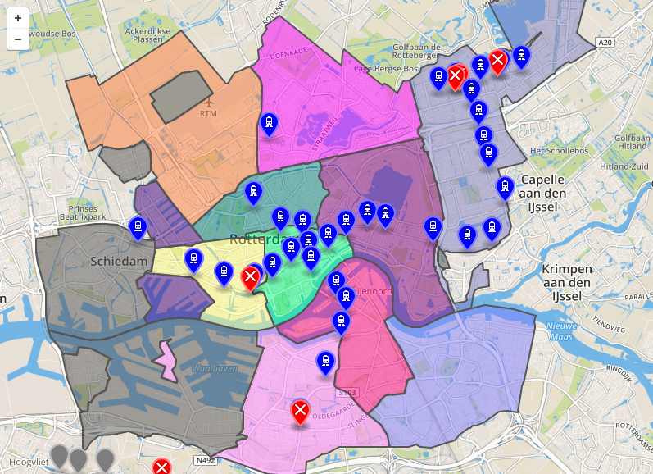
robberdam

Slide 3
Roles
Adrianna - Map, database
Aivy - Months diagram, ERD, dots on map
Akin - Start screen, signals & slots, bugfixes
Aya - UML diagrams, dayparts diagram, start screen, ERD
Nikki - Database, near metrostations diagram

Slide 4
CO-operation
Very good !

Slide 5
Problems
Bad start
Just a bad start, nothing else.

Slide 6
end

