Slide 1
Understanding Your Life Plan (Personal Finances)
Bhru Patel
CFP

Slide 2
Objectives
Setting and Achieving Goals (life longevity)
Identity / Fraud / Cyber Protection
Creating Your Own “Big Picture”
Bonus: Secret to Getting Rich

Slide 3
Life Stages
Phase 1: Learning (birth to ~30 years old)
Phase 2: Accumulation (~30 to 60 years)
Phase 3: Disbursement (~60 to 90+ age)

Slide 4
Path to Success
Plan to Fail
Fail to Plan
Set and Achieve Goals

Slide 5
Basic Terms
Stocks – ownership of a company
Bonds – debt investment / loan to a company
Retirement Accounts (IRA, 401Ks, Annuity, Pension, etc)
College Savings (MESP, MET)
Trusts / Wills (Prince)
“Credit Karma”

Slide 6
You are NEVER too old to set a goal of any type
Set a Positive Goal: (buy a house, lose weight, start exercising, quit smoking, stop day trading, invest in index funds, don’t buy individual stocks, spend more time with family members, payoff mortgage)
Set a date for achieving your goal
Write down your goal (surround yourself with notes)
Stay Focused (get people around you to keep you on track)

Slide 7
Identity Protection / Cyber Thievery
Fraud / Scam Events
Free Credit Reports at annualcreditreport.com
Free Credit Scores from Credit Cards (Discover, Capital One, etc.)
Credit Freeze at Experian, Equifax and Transunion
Dedicated inexpensive laptop for accessing financial accounts & TurboTax only (no emails, web surfing, or any other internet activity)
“Digital Estate Planning”

Slide 8
Personal Direction Letter (PDL) & Master Directory
Letter listing complete details of all assets, liabilities, professional contacts (estate attorney, agents for insurance, location of passwords, life insurance, trust/will location)
ID/Password Directory

Slide 9
MY BIG PICTURE
Health
Estate Plan
Credit Card Debt
Fireproof Safe
No Mortgage in Retirement
Identity Theft
Bucket Strategy
Credit Cards
Reverse Mortgage
Goals
College Savings
Stocks
Annuities
Bonds
Long Term Care
Leasing Vehicles
$$$$$$$$
Credit Freeze
No Day Trading
Expose Yourself
Life Insurance
Car Loan
Cash
Social Security
Beneficiaries
Constant Monitoring of Investments
Free Credit Report/Score
Buy Low – Sell High
ID/Password Directory
Personal Direction Letter

Slide 10
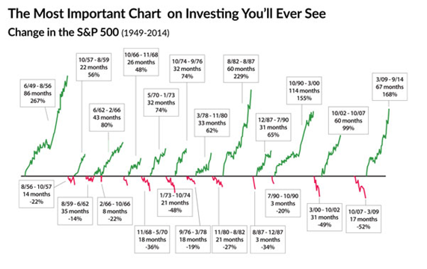

Slide 11
Boring Secret to Getting Rich

