Slide 1
COVID Tracking
Ayodeji Iwayemi, Kevin Hayes, Kol Herget, Neetha Raava

Slide 2
Stage 1: Data and Project Understanding
Aim: The goal was to get acquainted with the different datasets that would be used in our analysis.
Variable dictionaries, set up and merge datasets

Slide 3
Stage 2: Data Modeling
Aim: The goal of Stage II was to develop the data for modeling and comparative analysis.
Weekly statistics & trends

Slide 4
Stage 3: Individual work
Aim: The goal of Stage III was to develop distributions and formal hypothesis tests for the intuitions had in Stage I and II and utilize statistical modeling to prove/disprove them.
Each insert our own findings

Slide 5
Ayodeji Iwayemi –New York State

Slide 6
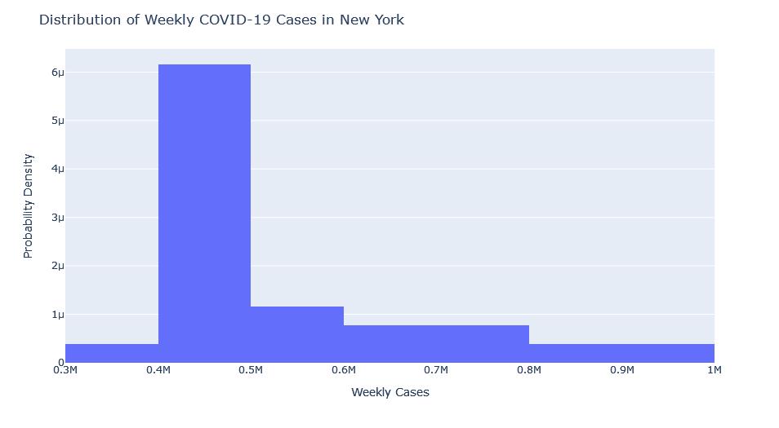
Distribution Analysis of New York State COVID-19 Cases:
Figure 1: A graphical plot of the distribution of COVID-19 cases in New York State

Slide 7
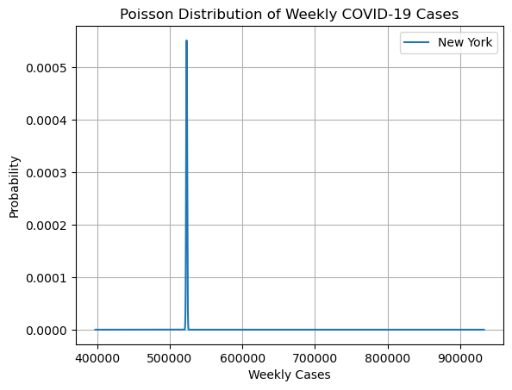
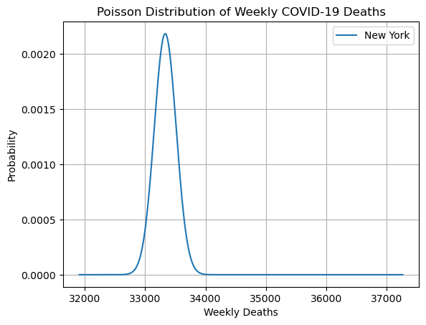
Figure 3: Poisson Distribution of COVID-19 cases and deaths in New York State

Slide 8
Hypothesis Tests
Hypothesis 1: Is there significant correlation between the total number of votes cast in the 2020 presidential election and the number of COVID-19 cases in New York counties between 2020-06-01 and 2021-01-03?
Hypothesis 2: Is there significant difference in the average number of COVID-19 cases between counties where a Democratic candidate won and counties where a Republican candidate won?
Hypothesis 3: Does the victory of Joe Biden in the 2020 presidential election in New York has no significant influence on the increase in COVID-19 cases in the state?

Slide 9
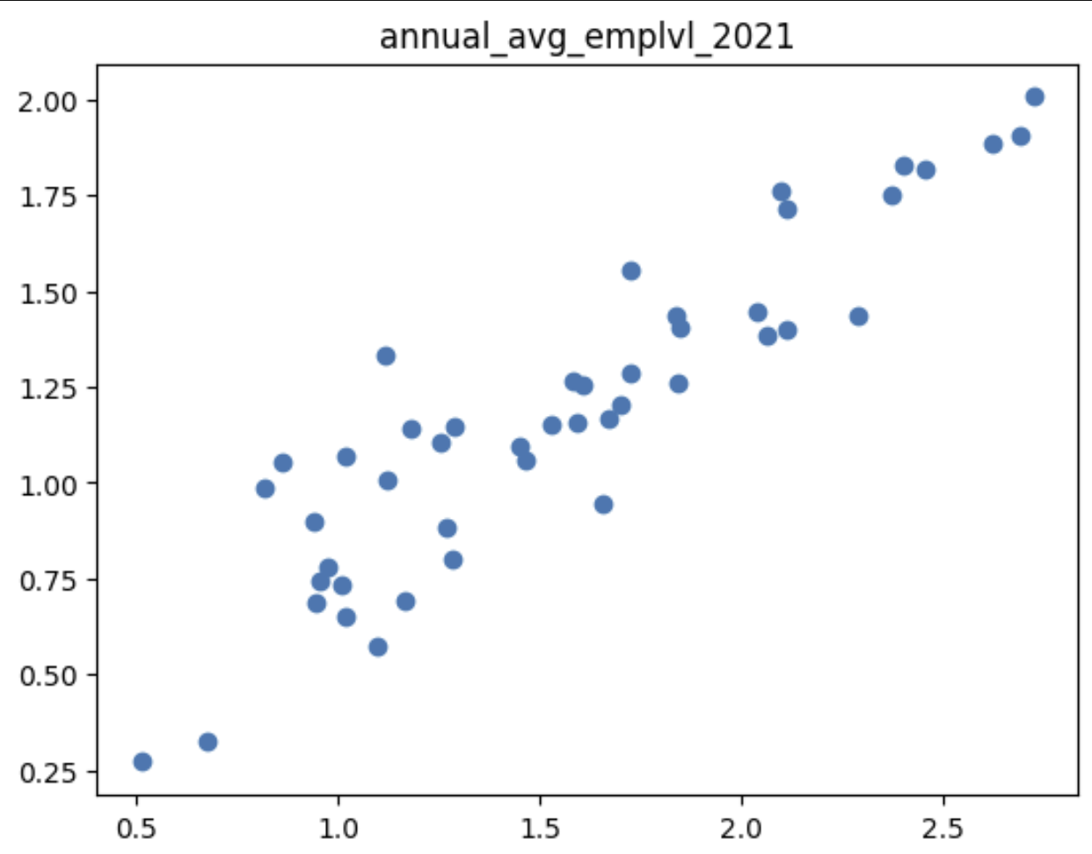
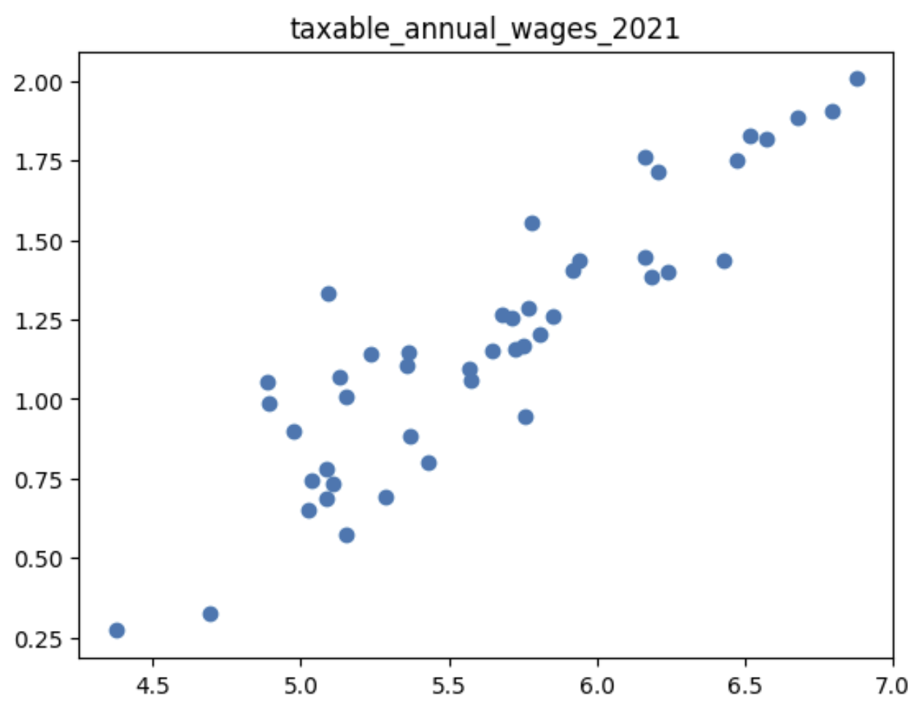
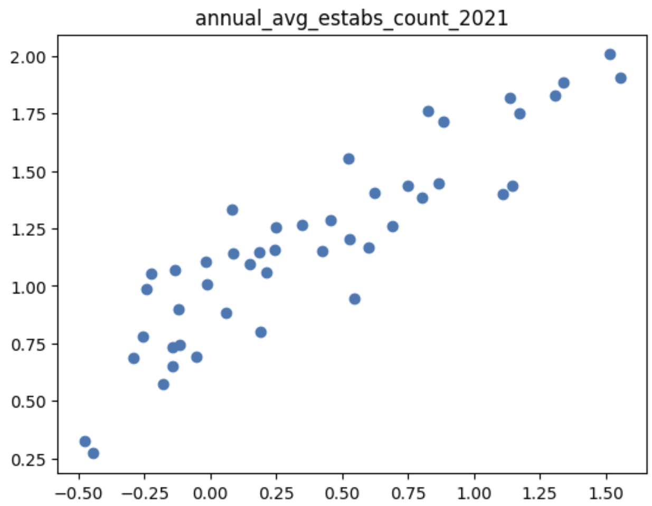
Employment – Kol Herget
Hypotheses:
Higher employment level…
Higher taxable annual wages…
Higher establishments counts…
…lead to higher numbers of cases in all states
Compared normalized data from each category against normalized COVID cases data

Slide 10
Stage 4: Machine Learning
Aim: The goal of Stage IV was to utlize machine learning and statistical models to predict the trend of COVID-19 cases / deaths.
Regression models (linear, polynomial), predictions
One slide each on individual predictions and whether they were correct or not

Slide 11
Stage 5: Dashboard
Aim: Stage V aimed at developing a simple interactive dashboard based on the analysis done so far.

Slide 12
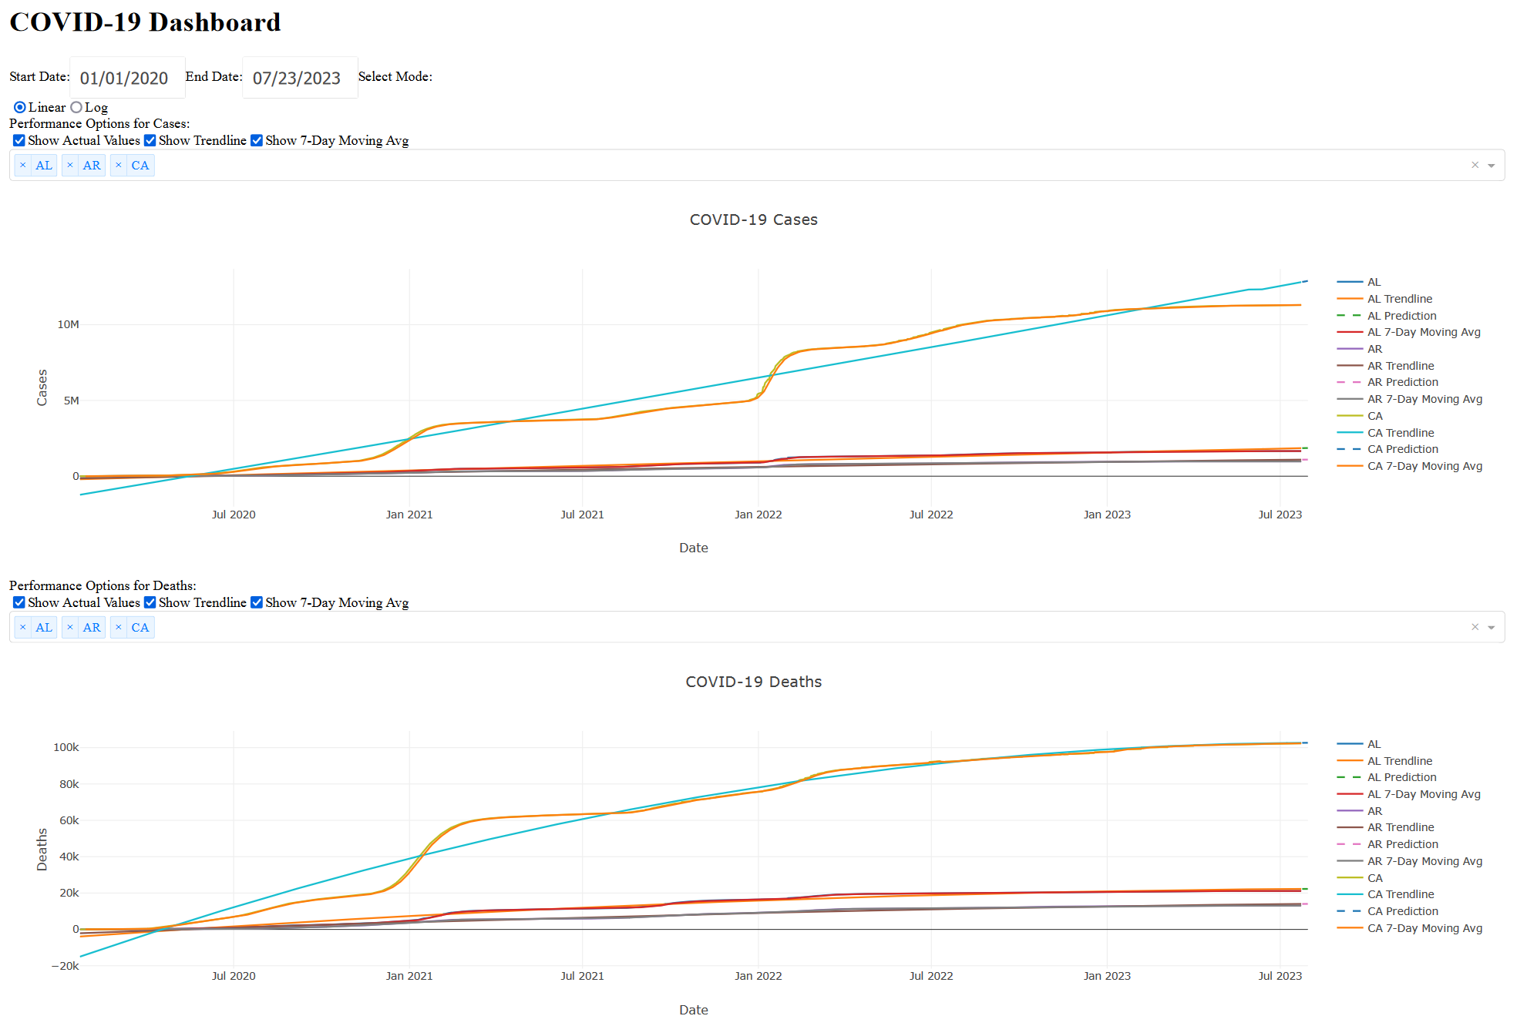

Slide 13
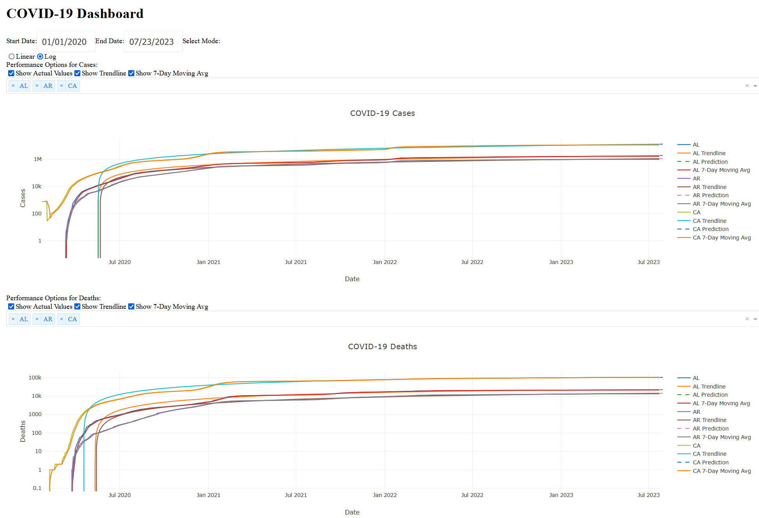

Slide 14
