Slide 1
COVID Tracking
Ayodeji Iwayemi, Kevin Hayes, Kol Herget, Neetha Raava

Slide 2
Stage 1: Data and Project Understanding
Aim: The goal was to get acquainted with the different datasets that would be used in our analysis.
Variable dictionaries, set up and merge datasets

Slide 3
Stage 2: Data Modeling
Aim: The goal of Stage II was to develop the data for modeling and comparative analysis.
Weekly statistics & trends

Slide 4
Stage 3: Individual work
Aim: The goal of Stage III was to develop distributions and formal hypothesis tests for the intuitions had in Stage I and II and utilize statistical modeling to prove/disprove them.
Each insert our own findings

Slide 5
Ayodeji Iwayemi –New York State

Slide 6
1. Mean: Approximately 523,370 cases 2. Median: 460,987.5 cases 3. Standard Deviation: Approximately 144,267.094 4. Variance: Approximately 20,812,994,547.344677 5. Skewness: Approximately 1.527 (positively skewed) 6. Kurtosis: Approximately 1.267
Descriptive statistics for New York's weekly COVID-19 cases

Slide 7
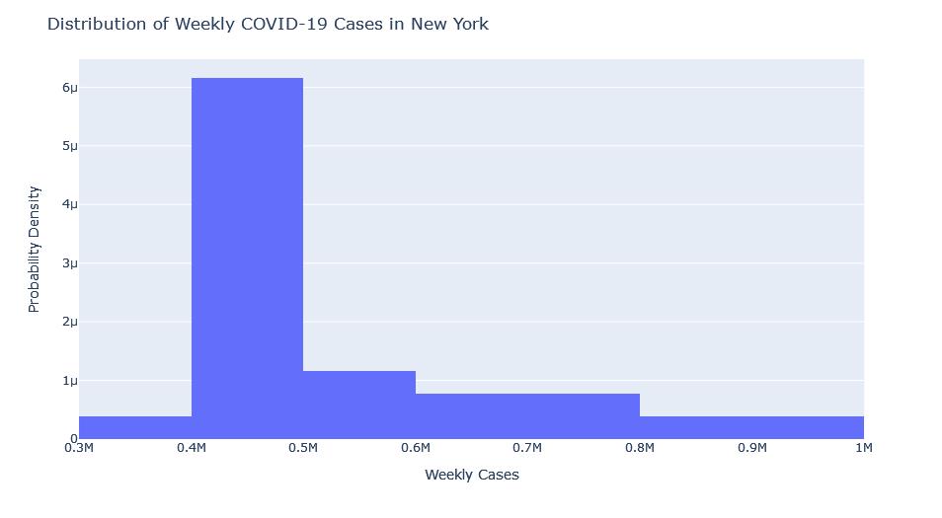
Distribution Analysis of New York State COVID-19 Cases:
Figure 1: A graphical plot of the distribution of COVID-19 cases in New York State

Slide 8
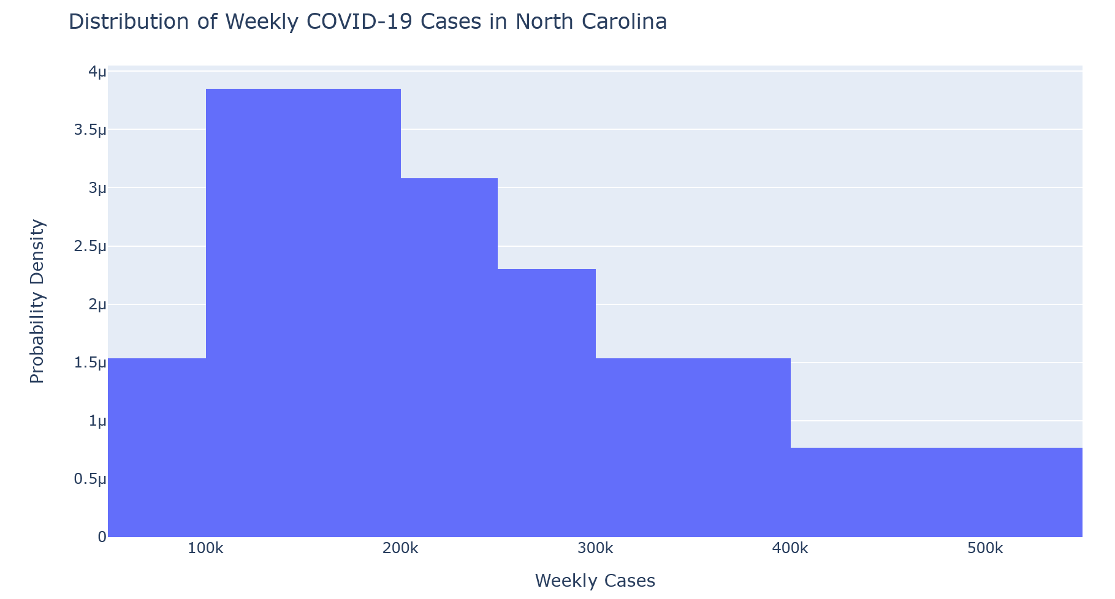
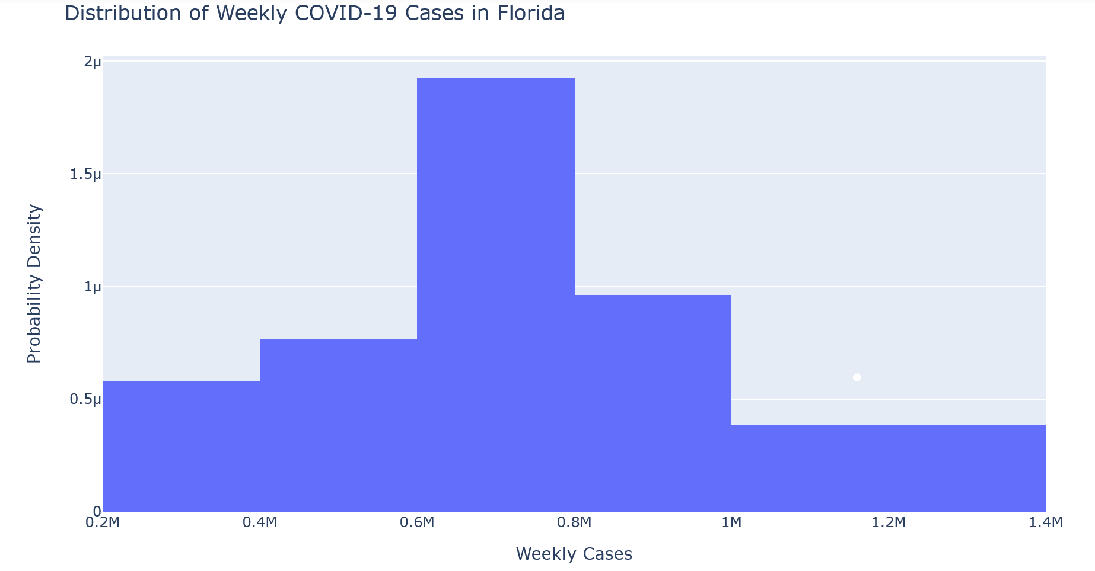
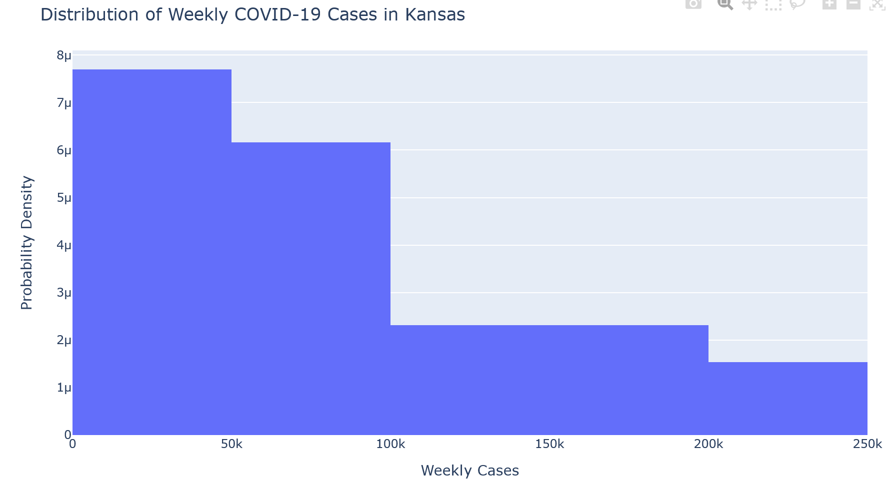
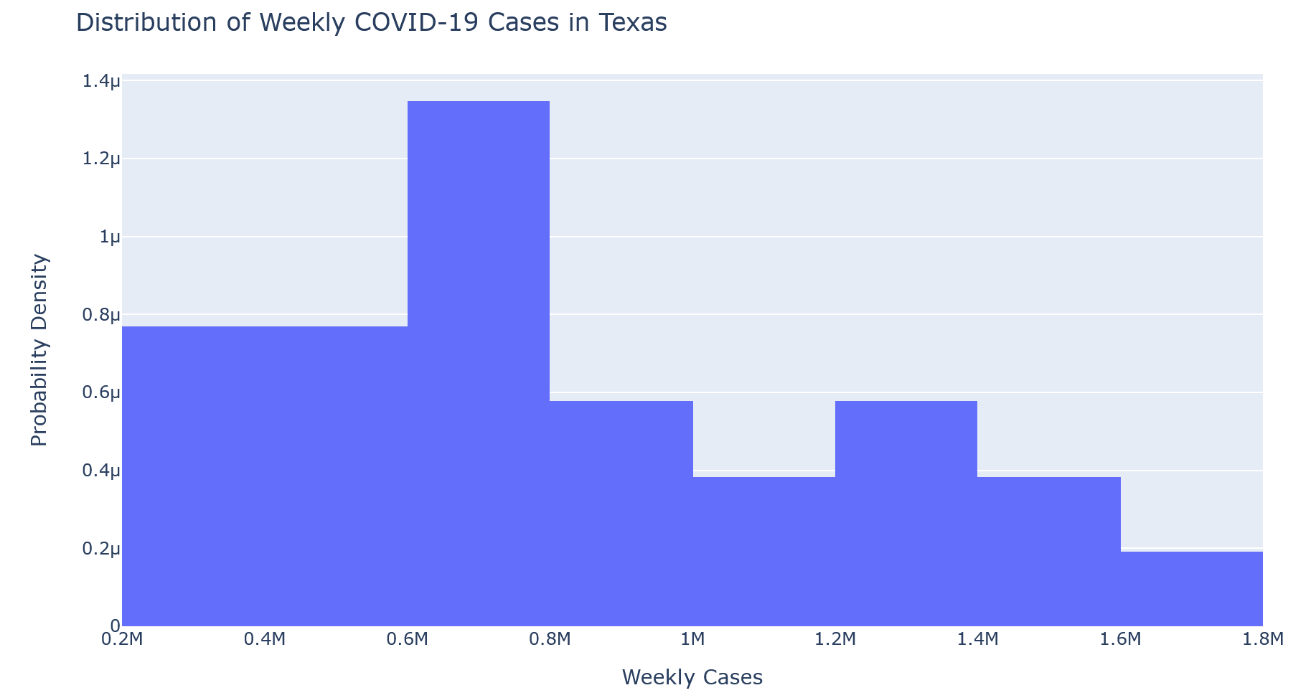
Comparison with Selected States
Figure 2: Distribution of Selected States

Slide 9
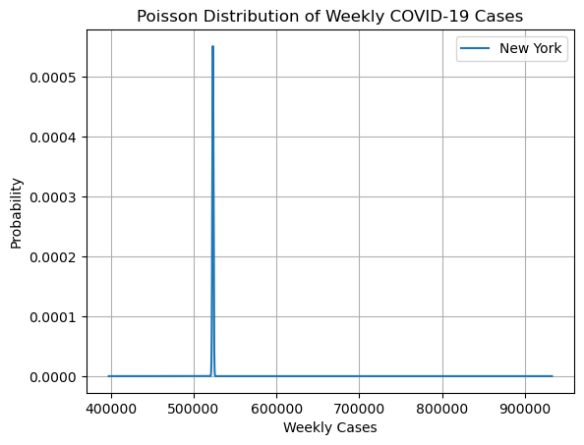
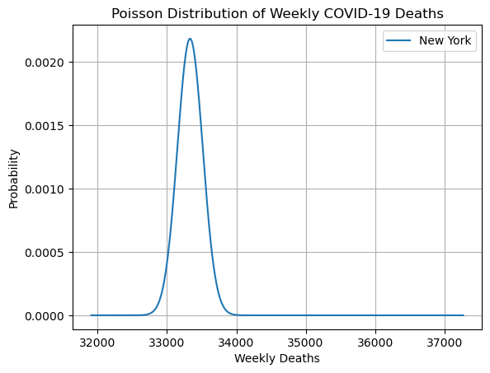
Figure 3: Poisson Distribution of COVID-19 cases and deaths in New York State

Slide 10
Table1: Presidential Election Dataset
 | State | County Name | Candidate | Party | Total_votes | Won
0 | Delaware | Kent County | Joe Biden | DEM | 44552 | True
1 | Delaware | Kent County | Donald Trump | REP | 41009 | False
2 | Delaware | Kent County | Jo Jorgensen | LIB | 1044 | False
3 | Delaware | Kent County | Howie Hawkins | GRN | 420 | False
4 | Delaware | New Castle County | Joe Biden | DEM | 195034 | True
... | ... | ... | ... | ... | ... | ...
32172 | Arizona | Maricopa County | Write-ins | WRI | 1331 | False
32173 | Arizona | Mohave County | Donald Trump | REP | 78535 | True
32174 | Arizona | Mohave County | Joe Biden | DEM | 24831 | False
32175 | Arizona | Mohave County | Jo Jorgensen | LIB | 1302 | False
32176 | Arizona | Mohave County | Write-ins | WRI | 37 | False

Slide 11
Table 2: Merged Dataset of Population and Presidential Election
 | County Name_x | Total_cases | County Name | population
1 | Albany County | 49494994 | Albany County | 305506
2 | Allegany County | 7008616 | Allegany County | 46091
3 | Bronx County | 330601029 | Bronx County | 1418207
4 | Broome County | 37233649 | Broome County | 190488
5 | Cattaraugus County | 12142748 | Cattaraugus County | 76117
... | ... | ... | ... | ...
58 | Washington County | 9288109 | Washington County | 61204
59 | Wayne County | 13519977 | Wayne County | 89918
60 | Westchester County | 223045708 | Westchester County | 967506
61 | Wyoming County | 6540692 | Wyoming County | 39859
62 | Yates County | 2726140 | Yates County | 24913
Correlation coefficient between normalized total votes and normalized total COVID-19 cases: 0.56

Slide 12
Hypothesis Tests
Hypothesis 1
Statement: The total number of votes cast in New York counties is correlated with the number of COVID-19 cases reported in those counties.
Null Hypothesis (H0): There is no significant correlation between the total number of votes cast in the 2020 presidential election and the number of COVID-19 cases in New York counties between 2020-06-01 and 2021-01-03.
Alternative Hypothesis (H1): There is a significant correlation between the total number of votes cast in the 2020 presidential election and the number of COVID-19 cases in New York counties.

Slide 13
Hypothesis 2
Statement: Counties where a Democratic candidate won the election led to a higher number of COVID-19 cases compared to counties where a Republican candidate won.
Null Hypothesis (H0): There is no significant difference in the average number of COVID-19 cases between counties where a Democratic candidate won and counties where a Republican candidate won.
Alternative Hypothesis (H1): Counties where a Democratic candidate won the election have a higher average number of COVID-19 cases compared to counties where a Republican candidate won.

Slide 14
Hypothesis 3
Statement: The conduct of the election in 2020 and the announcement of the victory of Joe Biden in New York State took place on November 3, 2020
Null Hypothesis (H0): The victory of Joe Biden in the 2020 presidential election in New York has no significant influence on the increase in COVID-19 cases in the state.
Alternative Hypothesis (H1): The victory of Joe Biden in the 2020 presidential election in New York has a significant influence on the increase in COVID-19 cases in the state.

Slide 15
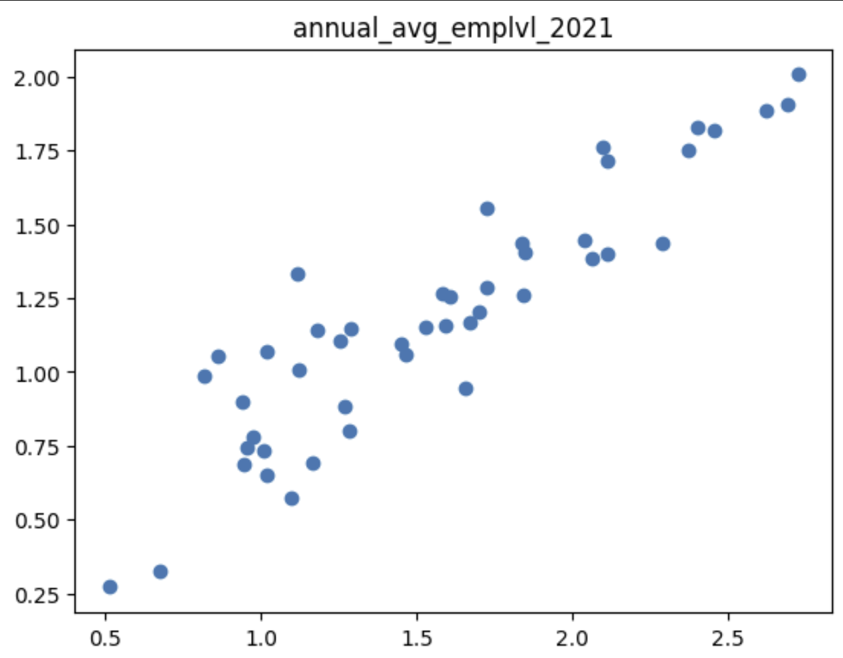
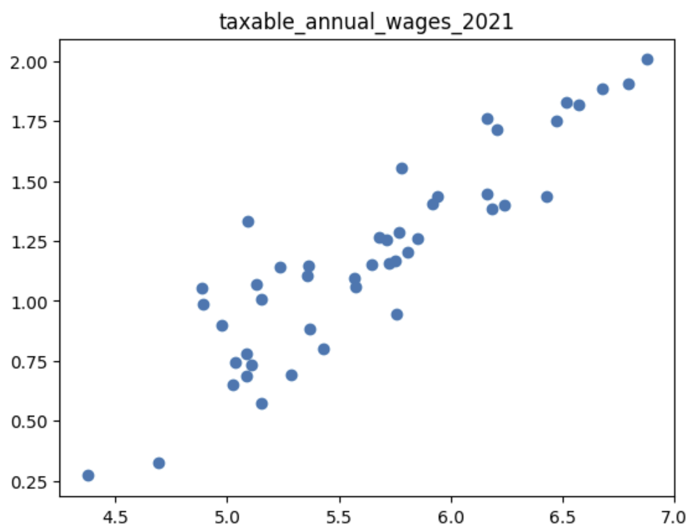
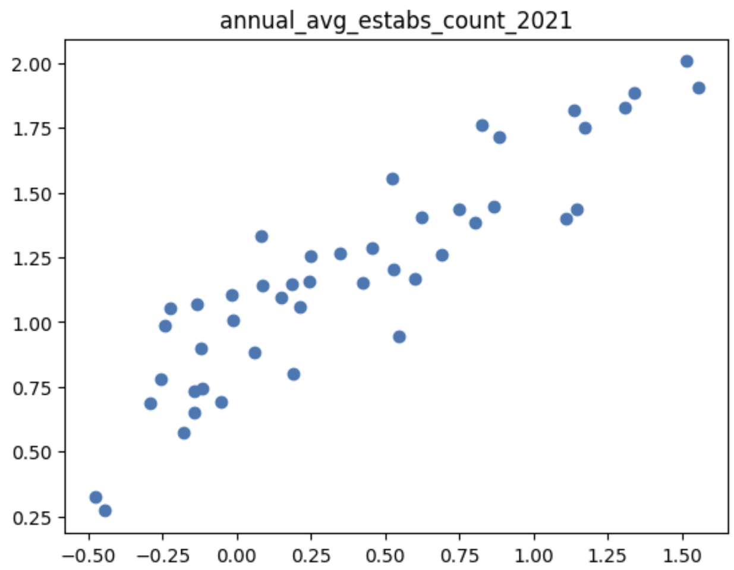
Employment – Kol Herget
Hypotheses:
Higher employment level…
Higher taxable annual wages…
Higher establishments counts…
…lead to higher numbers of cases in all states
Compared normalized data from each category against normalized COVID cases data

Slide 16
Stage 4: Machine Learning
Aim: The goal of Stage IV was to utlize machine learning and statistical models to predict the trend of COVID-19 cases / deaths.
Regression models (linear, polynomial), predictions
One slide each on individual predictions and whether they were correct or not

Slide 17
Stage 5: Dashboard
Aim: Stage V aimed at developing a simple interactive dashboard based on the analysis done so far.

Slide 18
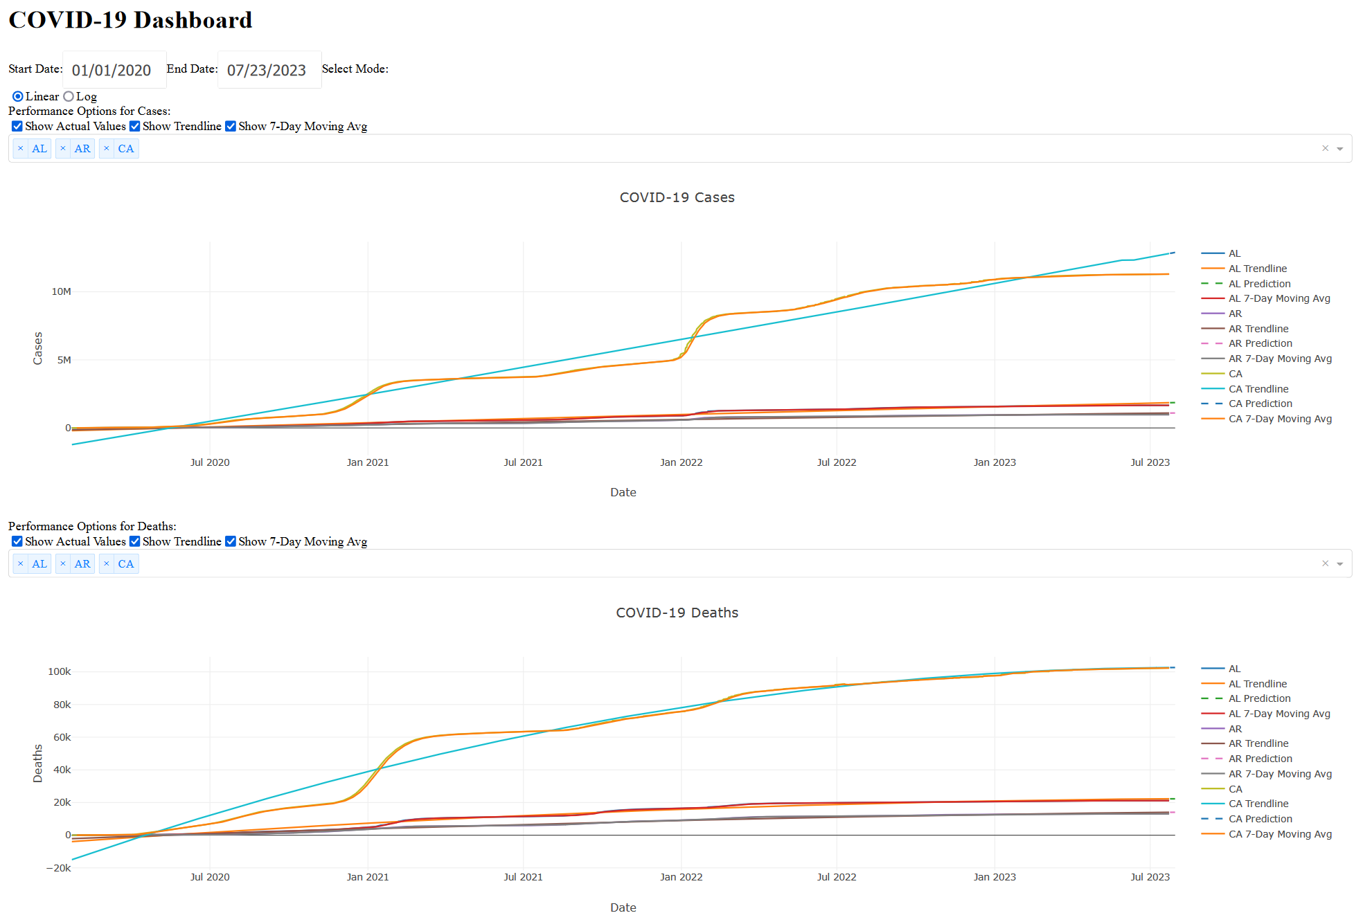

Slide 19
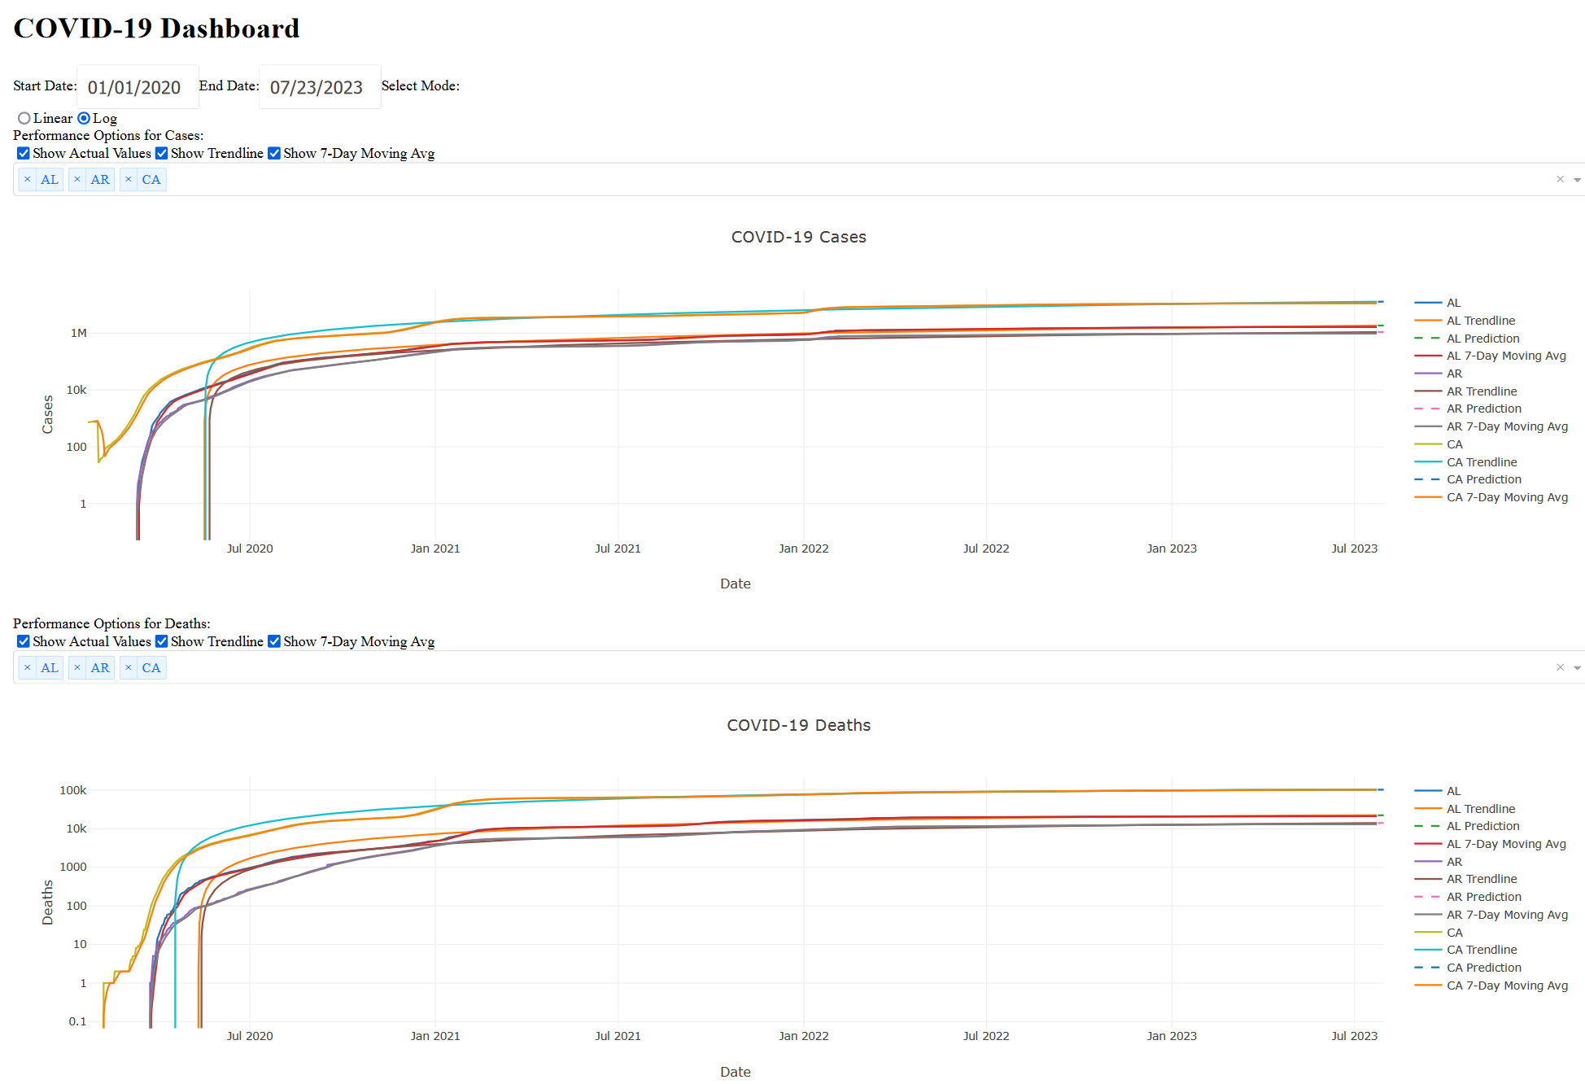

Slide 20
