Slide 1
COVID Tracking
Ayodeji Iwayemi, Kevin Hayes, Kol Herget, Neetha Raava

Slide 2
Stage 1: Set up data
Variable dictionaries, set up and merge datasets

Slide 3
Stage 2: Data Modeling
Weekly statistics & trends

Slide 4
Stage 3: Individual work
Each insert our own findings

Slide 5
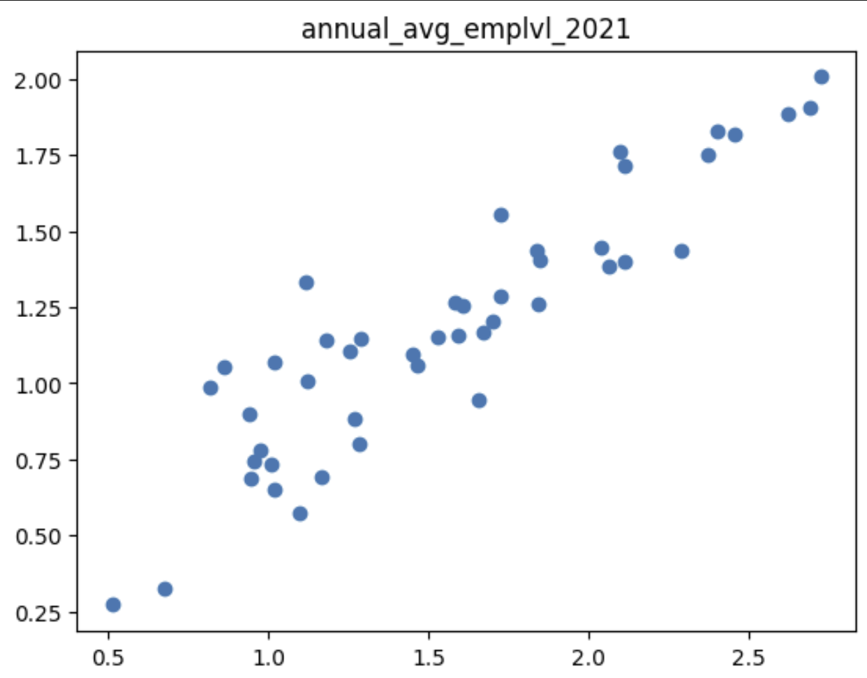
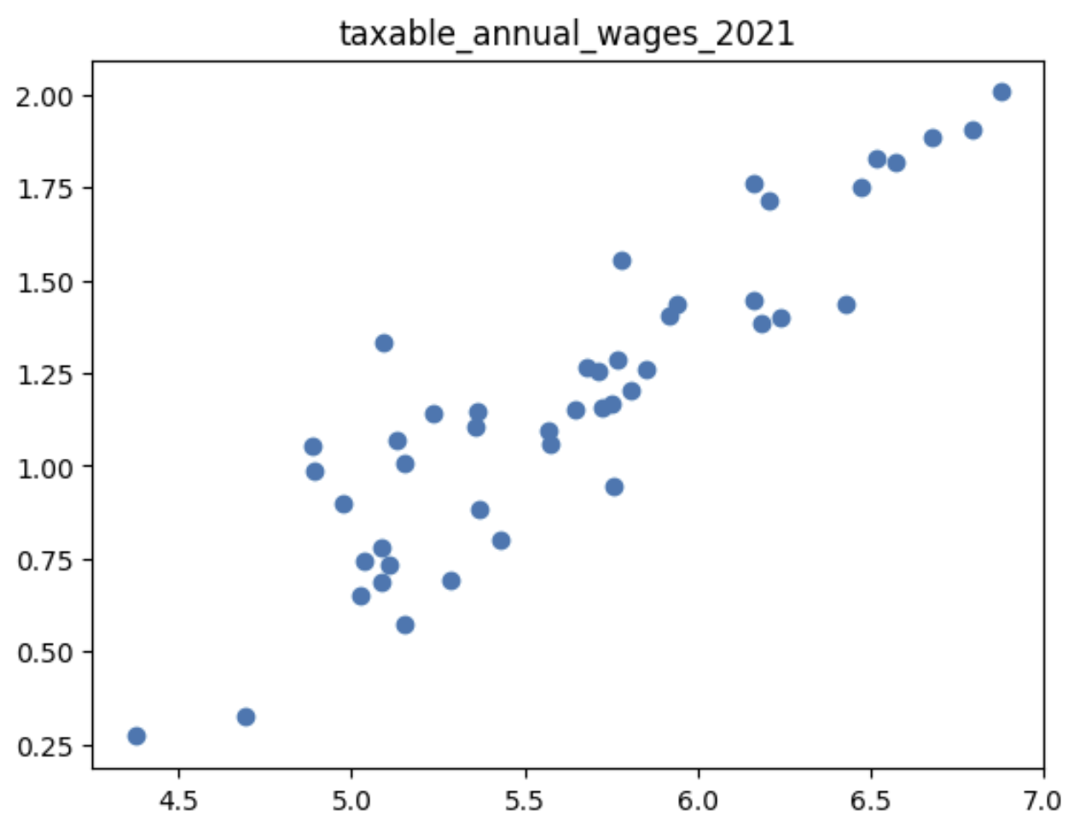
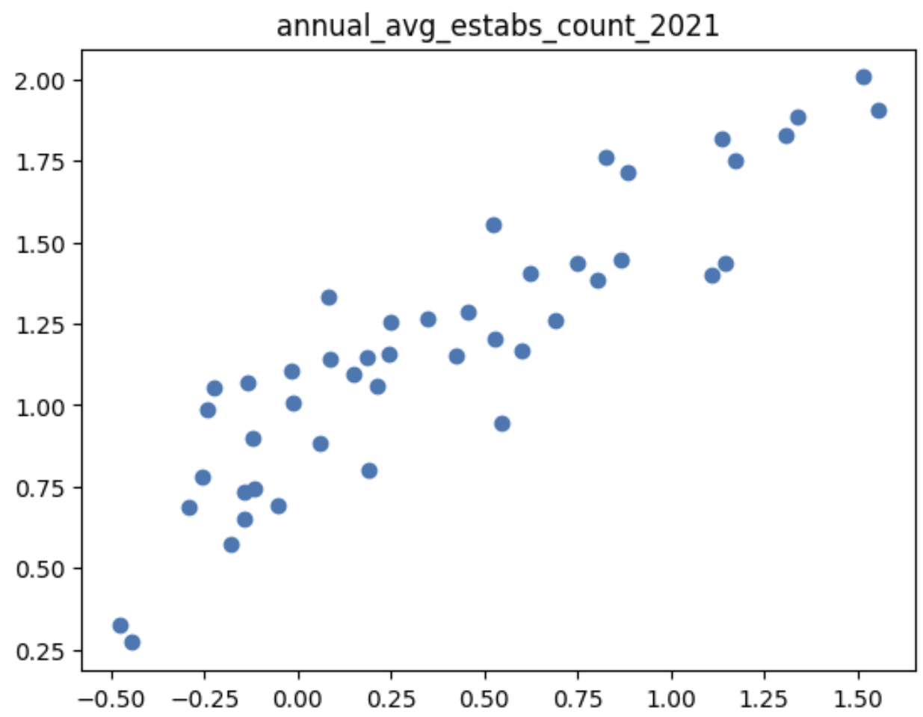
Employment – Kol Herget
Hypotheses:
Higher employment level…
Higher taxable annual wages…
Higher establishments counts…
…lead to higher numbers of cases in all states
Compared normalized data from each category against normalized COVID cases data

Slide 6
Stage 4: Machine Learning
Regression models (linear, polynomial), predictions
One slide each on individual predictions and whether they were correct or not

Slide 7
Stage 5: Dashboard

Slide 8
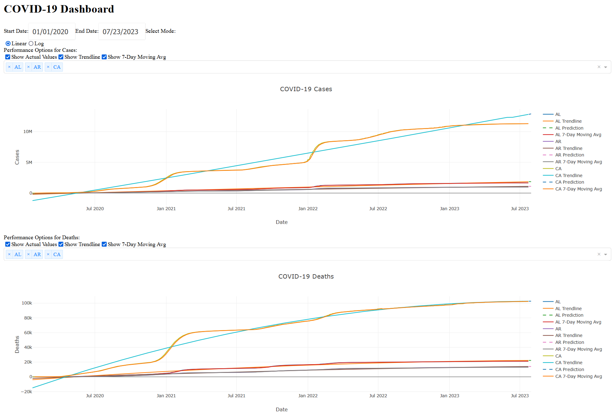

Slide 9
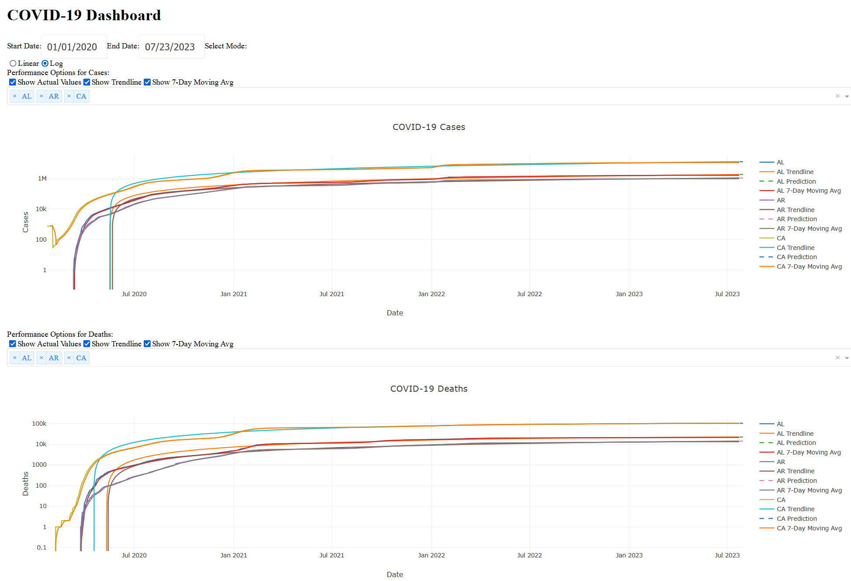

Slide 10
