Slide 1
COVID Tracking
Ayodeji Iwayemi, Kevin Hayes, Kol Herget, Neetha Raava
https://github.com/aiwayemi/Group-1

Slide 2
Stage 1: Data & Project Understanding
Variable dictionaries, set up and merge datasets
Notes:
Aim: The goal was to get acquainted with the different datasets that would be used in our analysis.

Slide 3
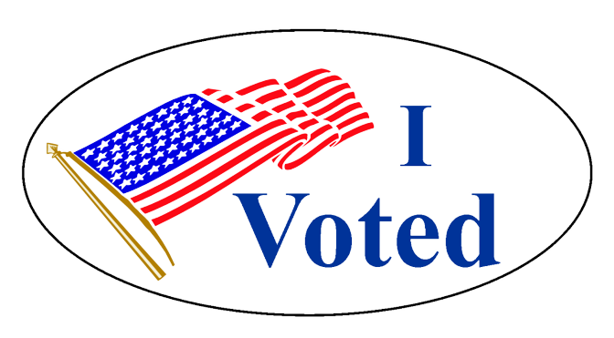


Enrichment data
Presidential – Ayodeji & Neetha
Housing – Kevin Hayes
Employment – Kol Herget
Notes:
Go over who chose what enrichment data, mention that we did data dictionaries, mention merging data

Slide 4
Stage 2: Data Modeling
Weekly statistics & trends
Notes:
Aim: The goal of Stage II was to develop the data for modeling and comparative analysis.

Slide 5
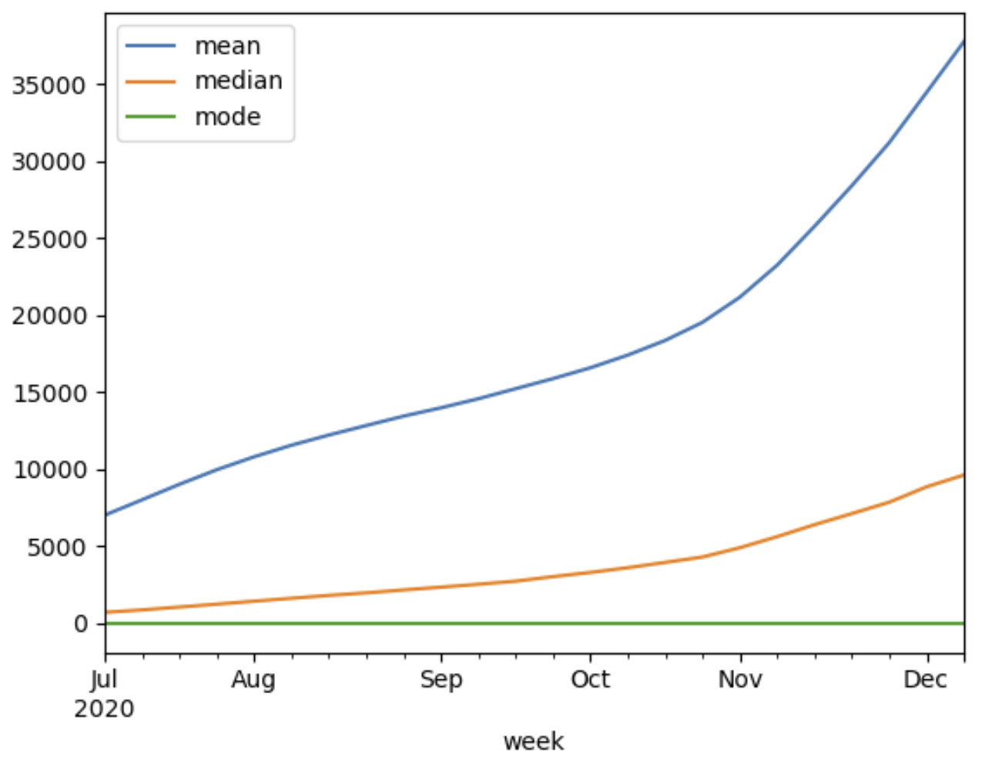
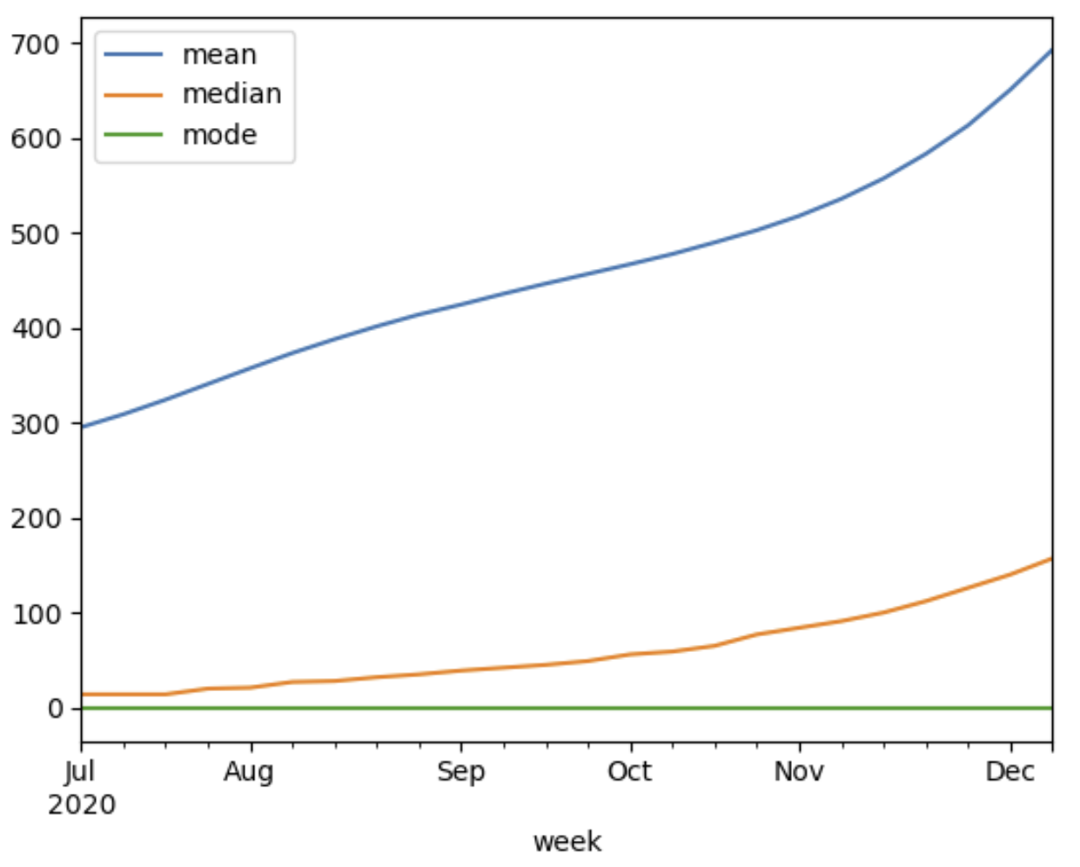
Mean/median/mode trends
US CASES
US DEATHS
Other countries (mean only)
Cases Deaths
1137 – JPN – 13
33963 – BRA – 732
8410 – DEU – 217
1 – GRL – 0
63 – CHN – 1
13615 – RUS – 256
Mean: 17844
Median: 2864
Mean: 472
Median: 49
Notes:
Mode was always 0 for both

Slide 6
Stage 3: Individual work
Using distributions across a chosen state & enrichment data,
develop formal hypotheses for testing
Notes:
Aim: The goal of Stage III was to develop distributions and formal hypothesis tests for the intuitions had in Stage I and II and utilize statistical modeling to prove/disprove them.

Slide 7
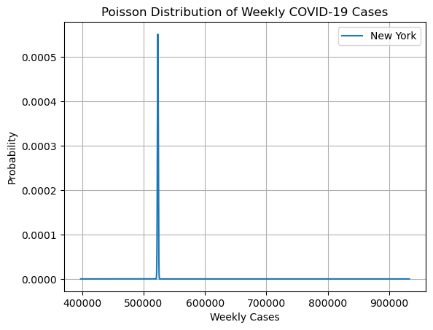
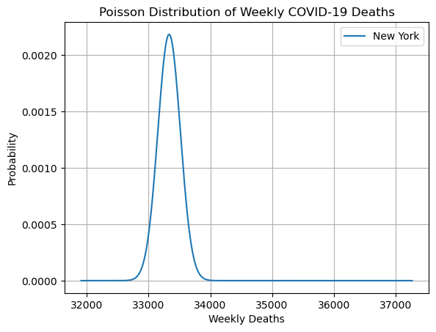
Ayodeji Iwayemi –New York State
Figures: Poisson Distribution of COVID-19 cases and deaths in New York State
Hypothesis 1: There is a significant correlation between the total number of votes cast in the 2020 presidential election and the number of COVID-19 cases in New York counties between 2020-06-01 and 2021-01-03.
Hypothesis 2: Counties where a Democratic candidate won the election led to a higher number of COVID-19 cases compared to counties where a Republican candidate won.
Hypothesis 3: The victory of Joe Biden in the 2020 presidential election in New York has a significant influence on the increase in COVID-19 cases in the state.

Slide 8
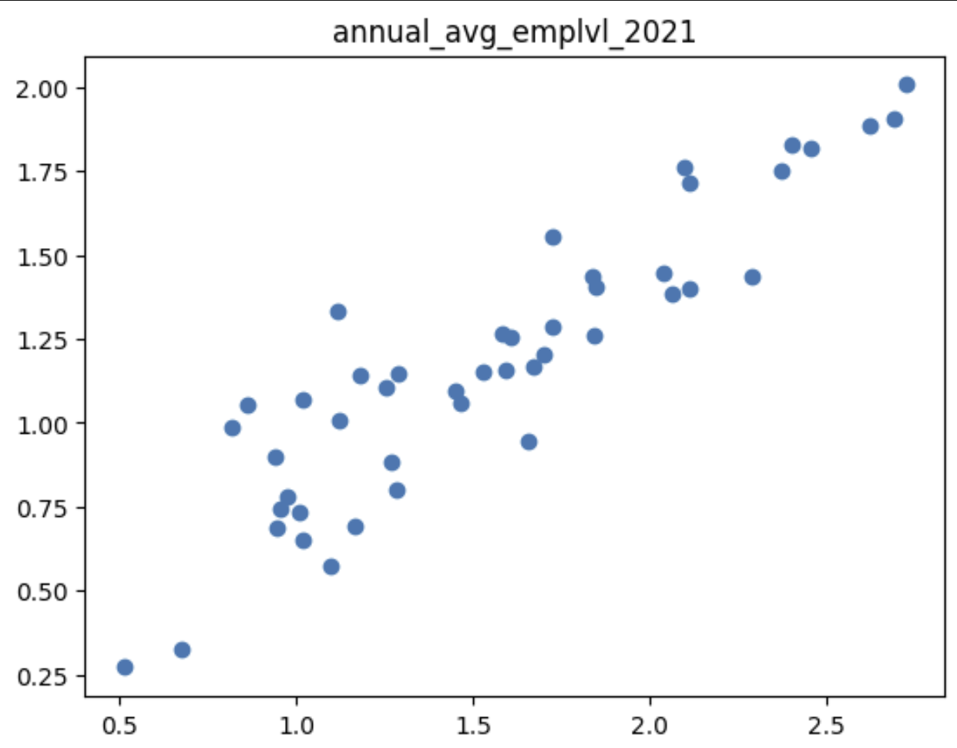
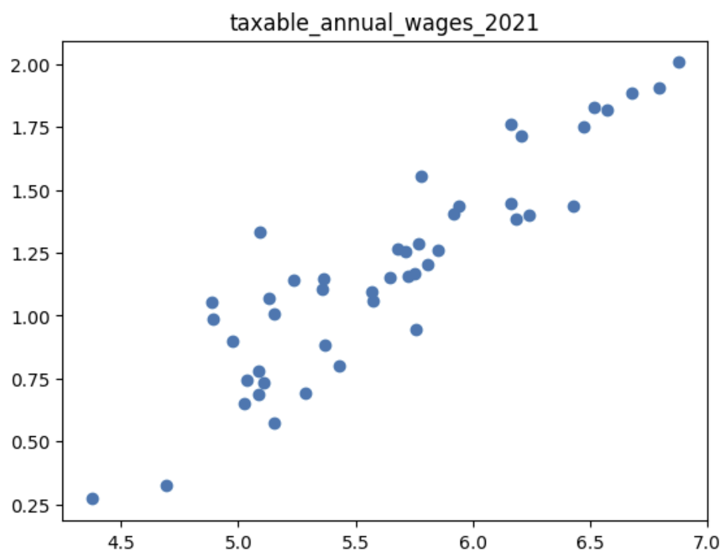
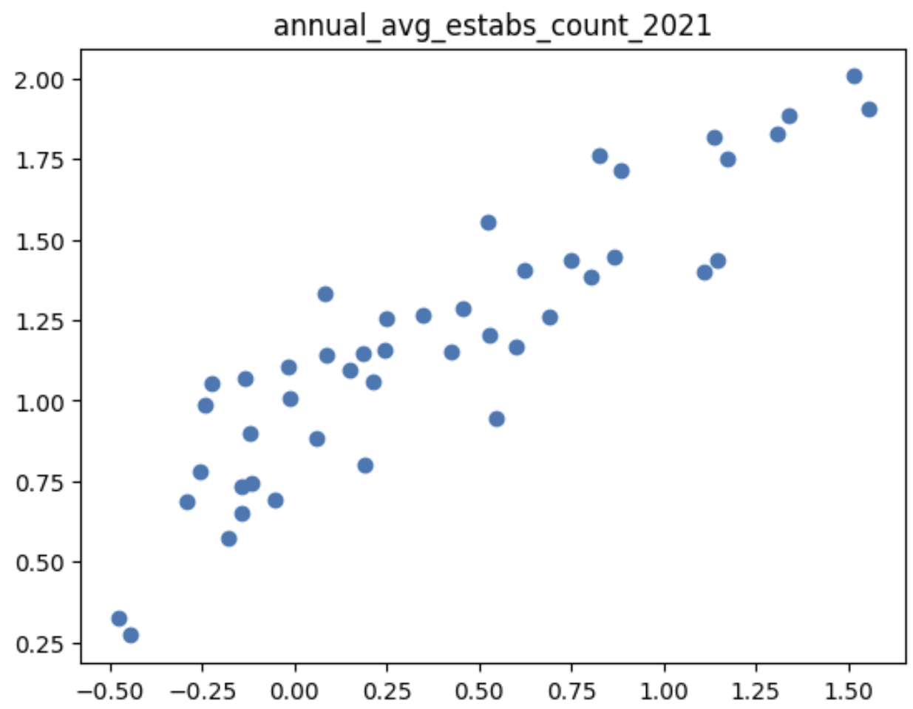
Employment – Kol Herget (SC)
Compared normalized data from each category against normalized COVID cases data
Hypotheses:
Higher employment level…
Higher taxable annual wages…
Higher establishments counts…
…lead to higher numbers of cases in all states

Slide 9
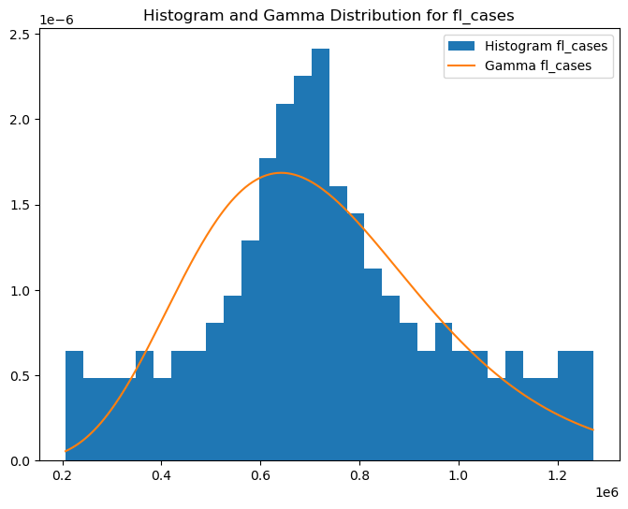
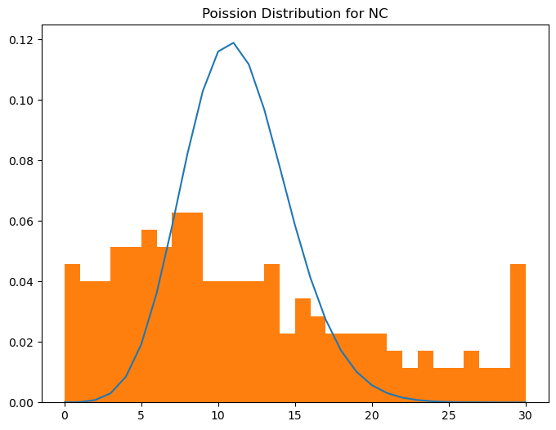
Housing - Kevin Hayes
Does having a higher total population of hispanic or latino people of any race in a given state lead to more covid-19 infections for that state? (Label: DP05_0073E)
Does having more people of 35 to 44 years of age in a given state lead to fewer covid-19 infections for that state? (Label: DP05_0011E)
Does having more people aged 60 to 64 in a given state lead to more covid-19 cases for that state? (Label : DP05_0014E)

Slide 10
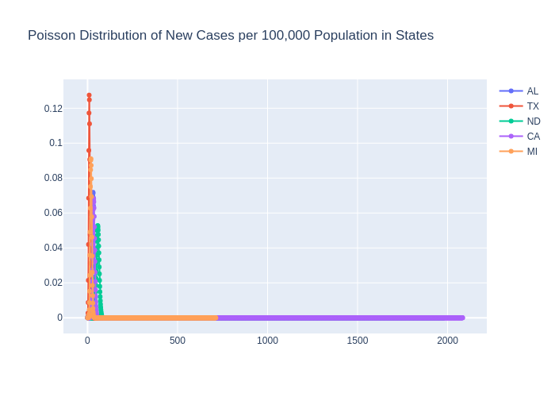
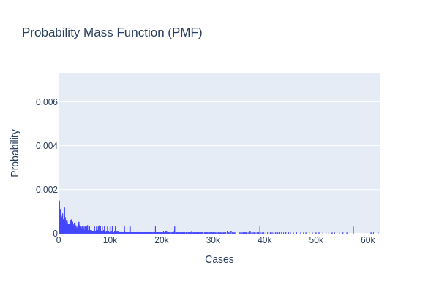
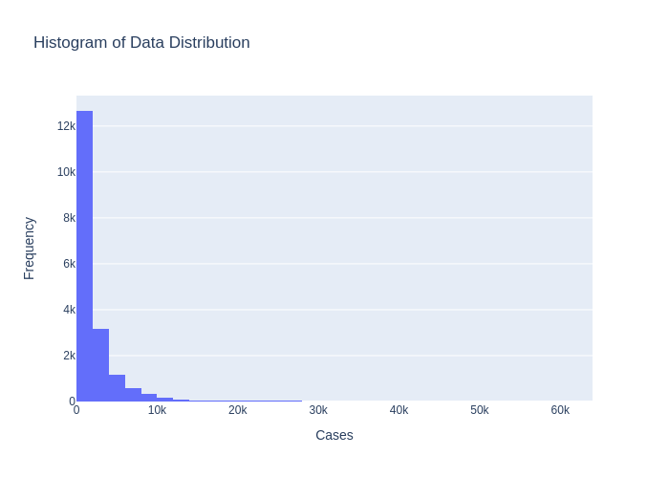
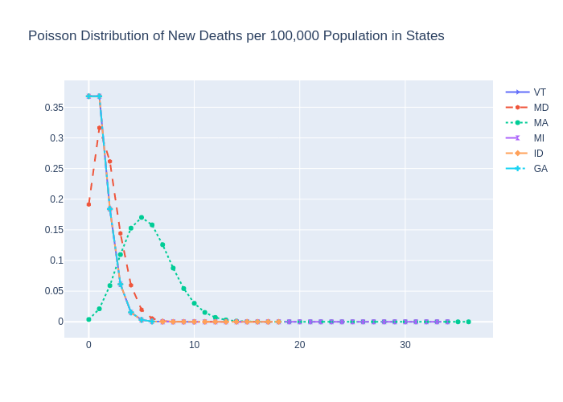
Presidential – Neetha Ravva

Slide 11
Hypothesis
Hypothesis 1: Political Party Affiliation and COVID-19 Case Counts
There is a significant correlation between the political party of the winning candidate in a state and the total number of COVID-19 cases reported in that state.
Hypothesis 2: Voter Turnout and COVID-19 Case Counts
There is a significant relationship between voter turnout in a state and the total number of COVID-19 cases reported in that state.
Hypothesis 3: Population Size and COVID-19 Case Counts
There is a significant correlation between the population size of a state and the total number of COVID-19 cases reported in that state.

Slide 12
Stage 4: Machine Learning
Regression models (linear, polynomial), machine learning, predictions on COVID-19 cases/deaths
Notes:
Aim: The goal of Stage IV was to utlize machine learning and statistical models to predict the trend of COVID-19 cases / deaths.

Slide 13
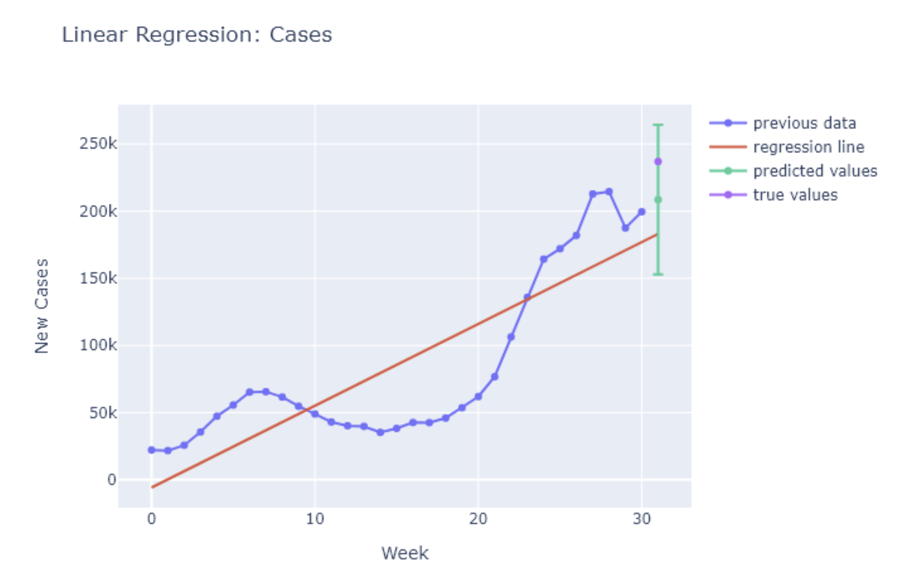
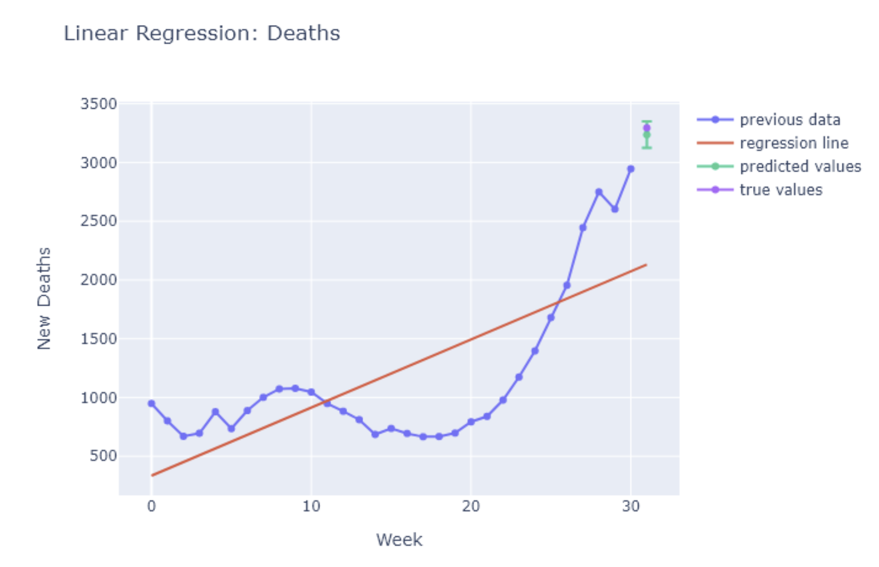
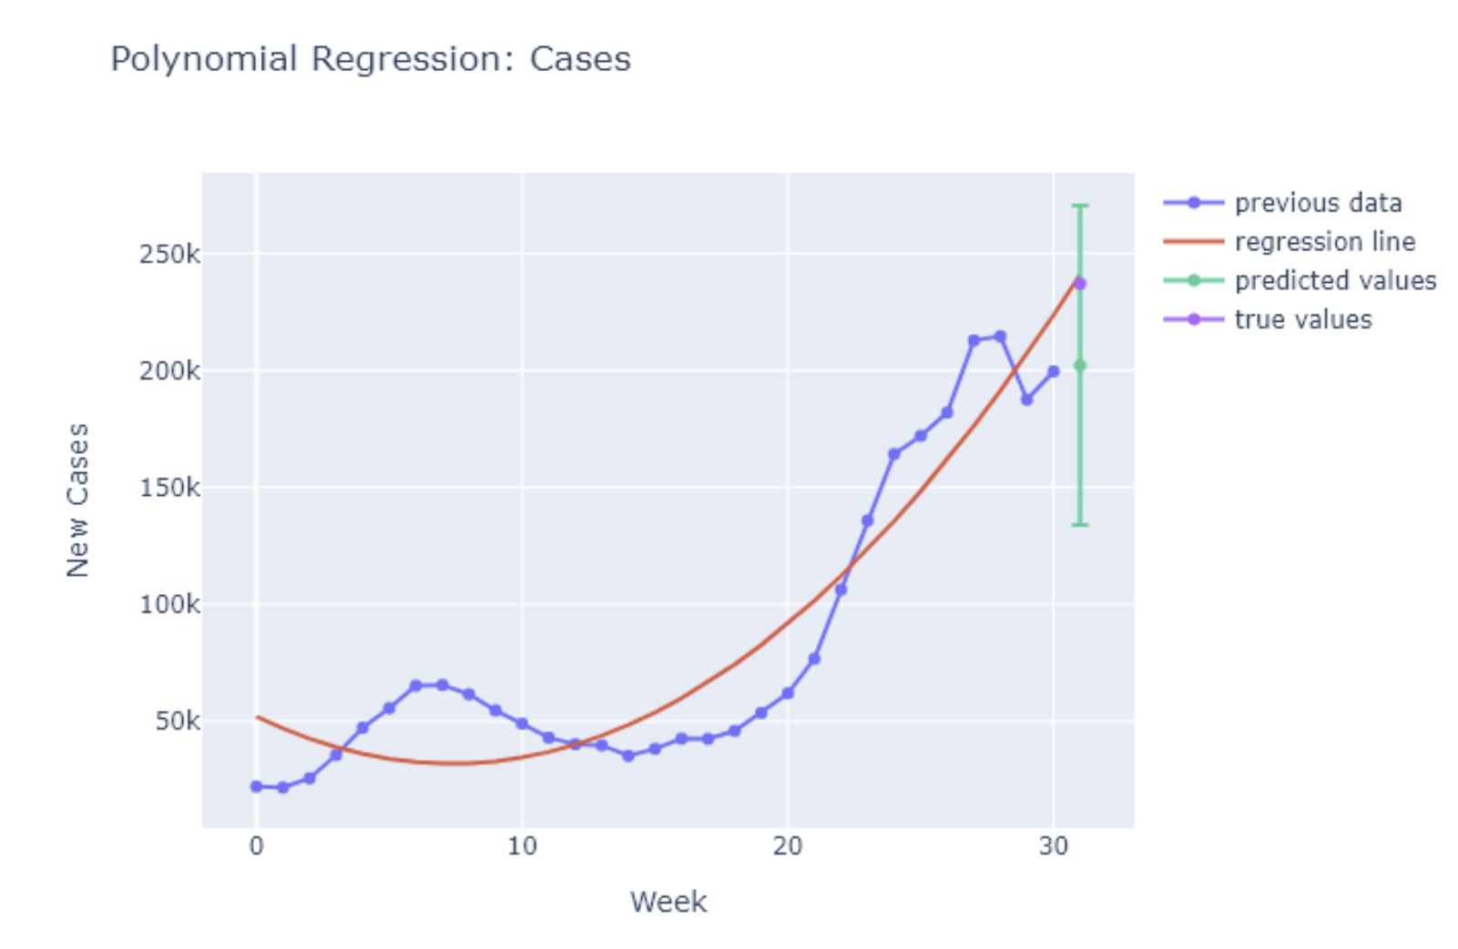
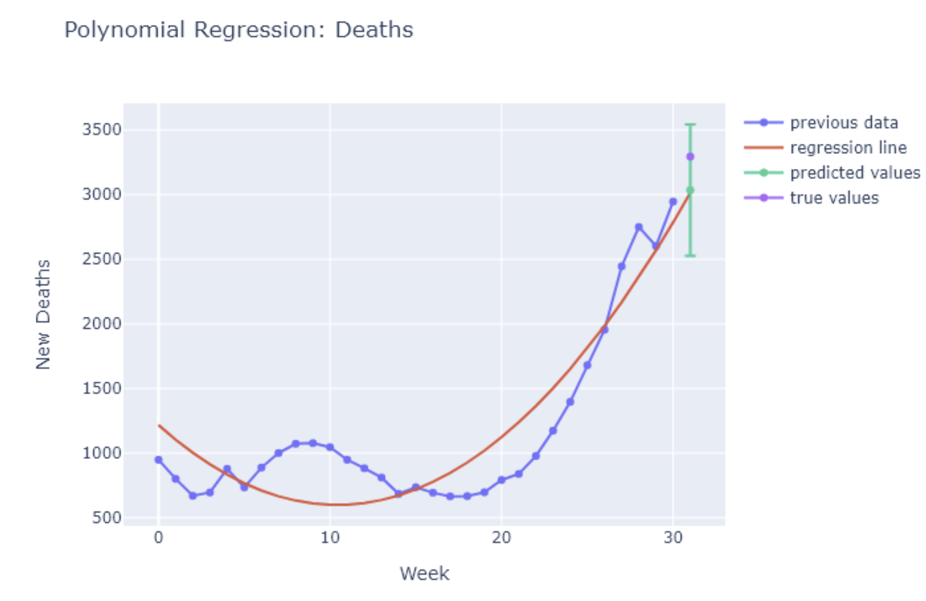
US Cases/Deaths Predictions
Notes:
Talk briefly about predictions for US cases/deaths from linear/polynomial regression

Slide 14
Employment – Kol Herget (SC)
Null hypothesis: there is no correlation between employee level and COVID-19 cases in SC
Null rejected; alternative accepted (significantly positive correlation)
Null hypothesis: there is no correlation between taxable annual wage and COVID-19 cases in SC
Null rejected; alternative accepted (significantly positive correlation)
Null hypothesis: there is no correlation between establishment count and COVID-19 cases in SC
Null rejected; alternative accepted (significantly positive correlation)

Slide 15
Election – Ayodeji Iwayemi (NY)
Null hypothesis: There is no significant correlation between the total number of votes cast in the 2020 presidential election and the number of COVID-19 cases in New York counties between 2020-06-01 and 2021-01-03
Null accepted; alternative rejected (p-value: 0.99, which is~1 )
Null hypothesis: There is no significant difference in the average number of COVID-19 cases between counties where a Democratic candidate won and counties where a Republican candidate won.
Null accepted; alternative rejected (p-value > alpha)
Null hypothesis: The victory of Joe Biden in the 2020 presidential election in New York has no significant influence on the increase in COVID-19 cases in the state.
Null rejected; alternative accepted (p_value < alpha)

Slide 16
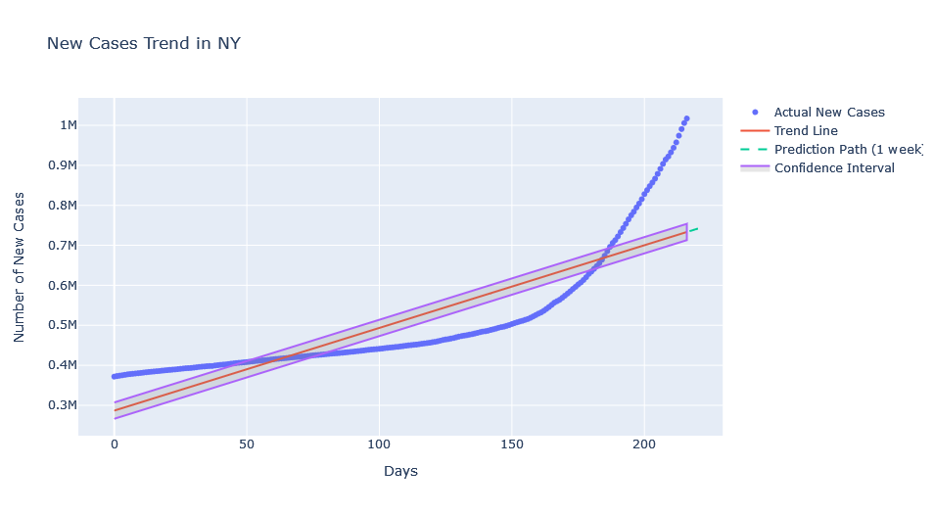
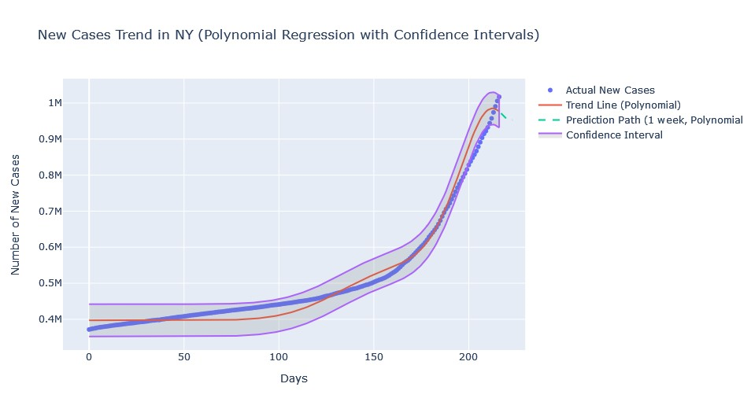
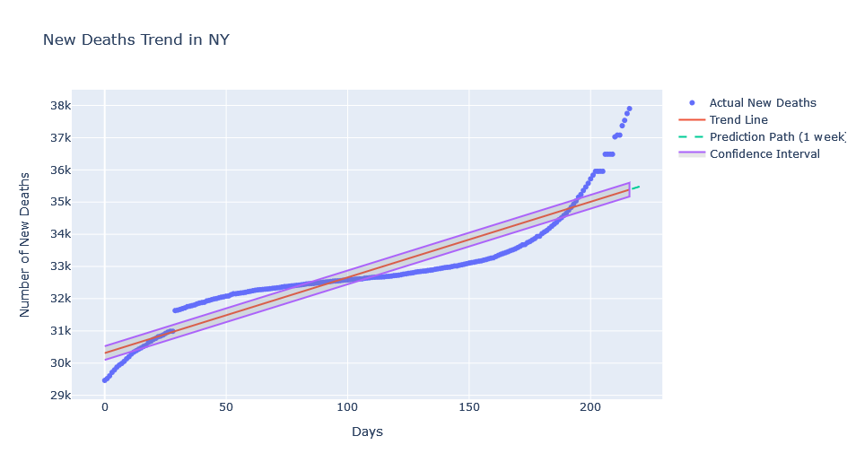
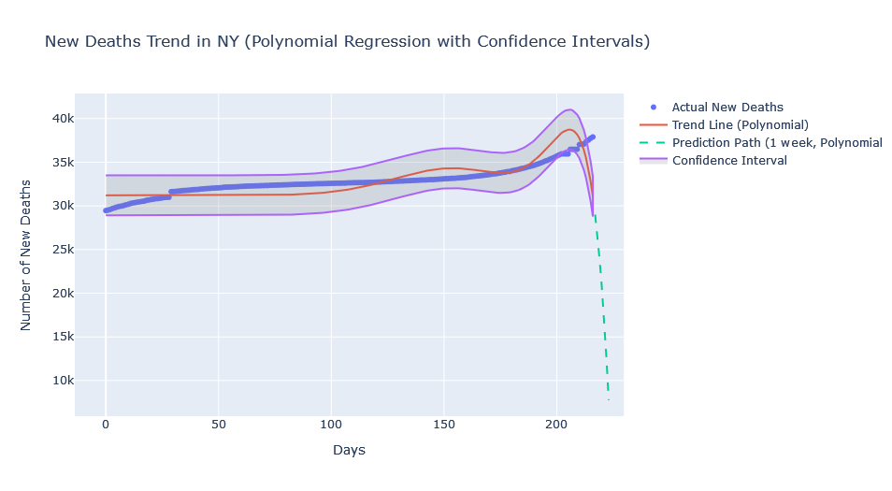
NY Predicted Cases and Deaths

Slide 17
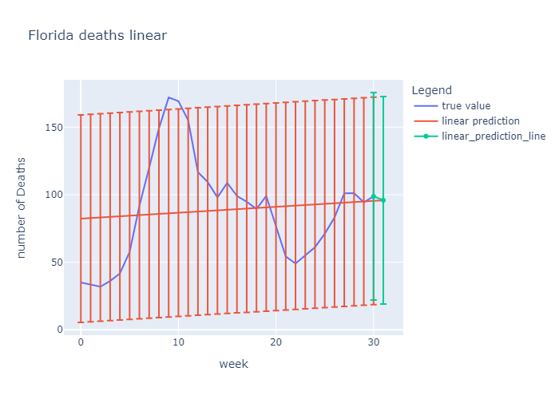
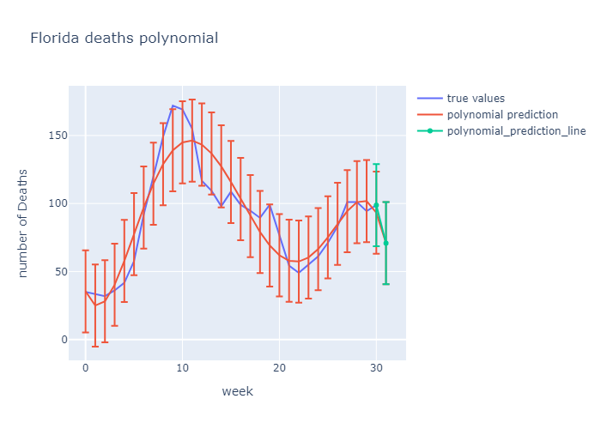
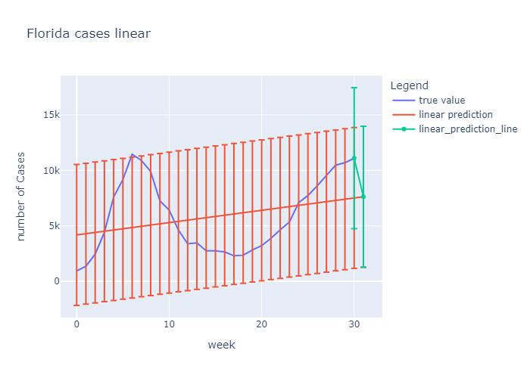
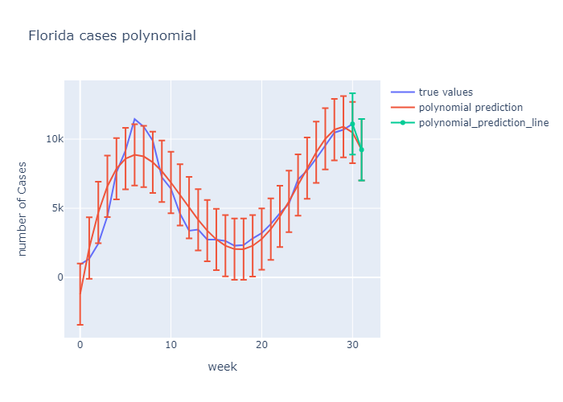
Kevin Hayes- Predicted Cases and Deaths

Slide 18
Kevin Hayes- Hypothesis Tests
Does having a higher total population of hispanic or latino people of any race in a given state lead to more covid-19 infections for that state? (Label: DP05_0073E)
Fail to reject null hypothesis. So no.
Does having more people of 35 to 44 years of age in a given state lead to fewer covid-19 infections for that state? (Label: DP05_0011E)
Reject null hypothesis. So yes.
Does having more people aged 60 to 64 in a given state lead to more covid-19 cases for that state? (Label : DP05_0014E)
Reject null hypothesis. So yes.

Slide 19
Hypothesis test – Neetha Ravva
There is no significant correlation between the political party of the winning candidate in a state and the total number of COVID-19 cases reported in that state.
Reject null hypothesis – so yes.
There is no significant relationship between voter turnout in a state and the total number of COVID-19 cases reported in that state.
Reject null hypothesis – so yes.
There is no significant correlation between the population size of a state and the total number of COVID-19 cases reported in that state.
Fail to reject null hypothesis – so no.

Slide 20
Stage 5: Dashboard
Interactive dashboard based on current analysis
Notes:
Aim: Stage V aimed at developing a simple interactive dashboard based on the analysis done so far.

Slide 21
Features of the Interactive Dashboard
Start Date: Select the start date for the data analysis period.
End Date: Select the end date for the data analysis period.
Mode Selector: Choose between Linear and Log scale for the y-axis of the charts.
State Selector for Cases and Deaths: Select one or more states
Cases and Deaths Graph: Displays the COVID-19 cases and deaths
Performance Options for Cases and Deaths :
Actual values ii. Trendline iii. 7-Day Moving Avg.
Prediction Line
Legends

Slide 22
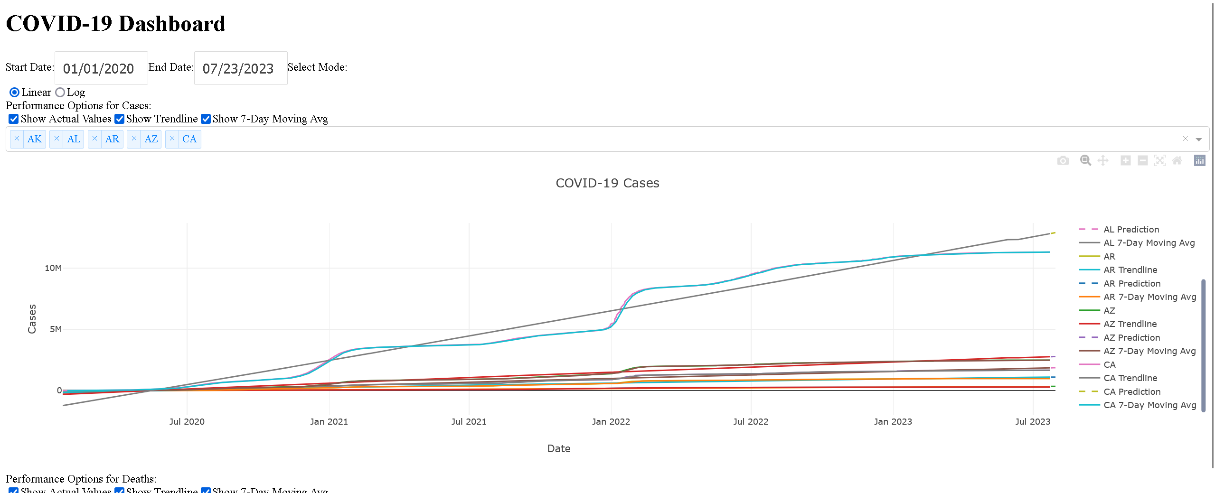

Slide 23
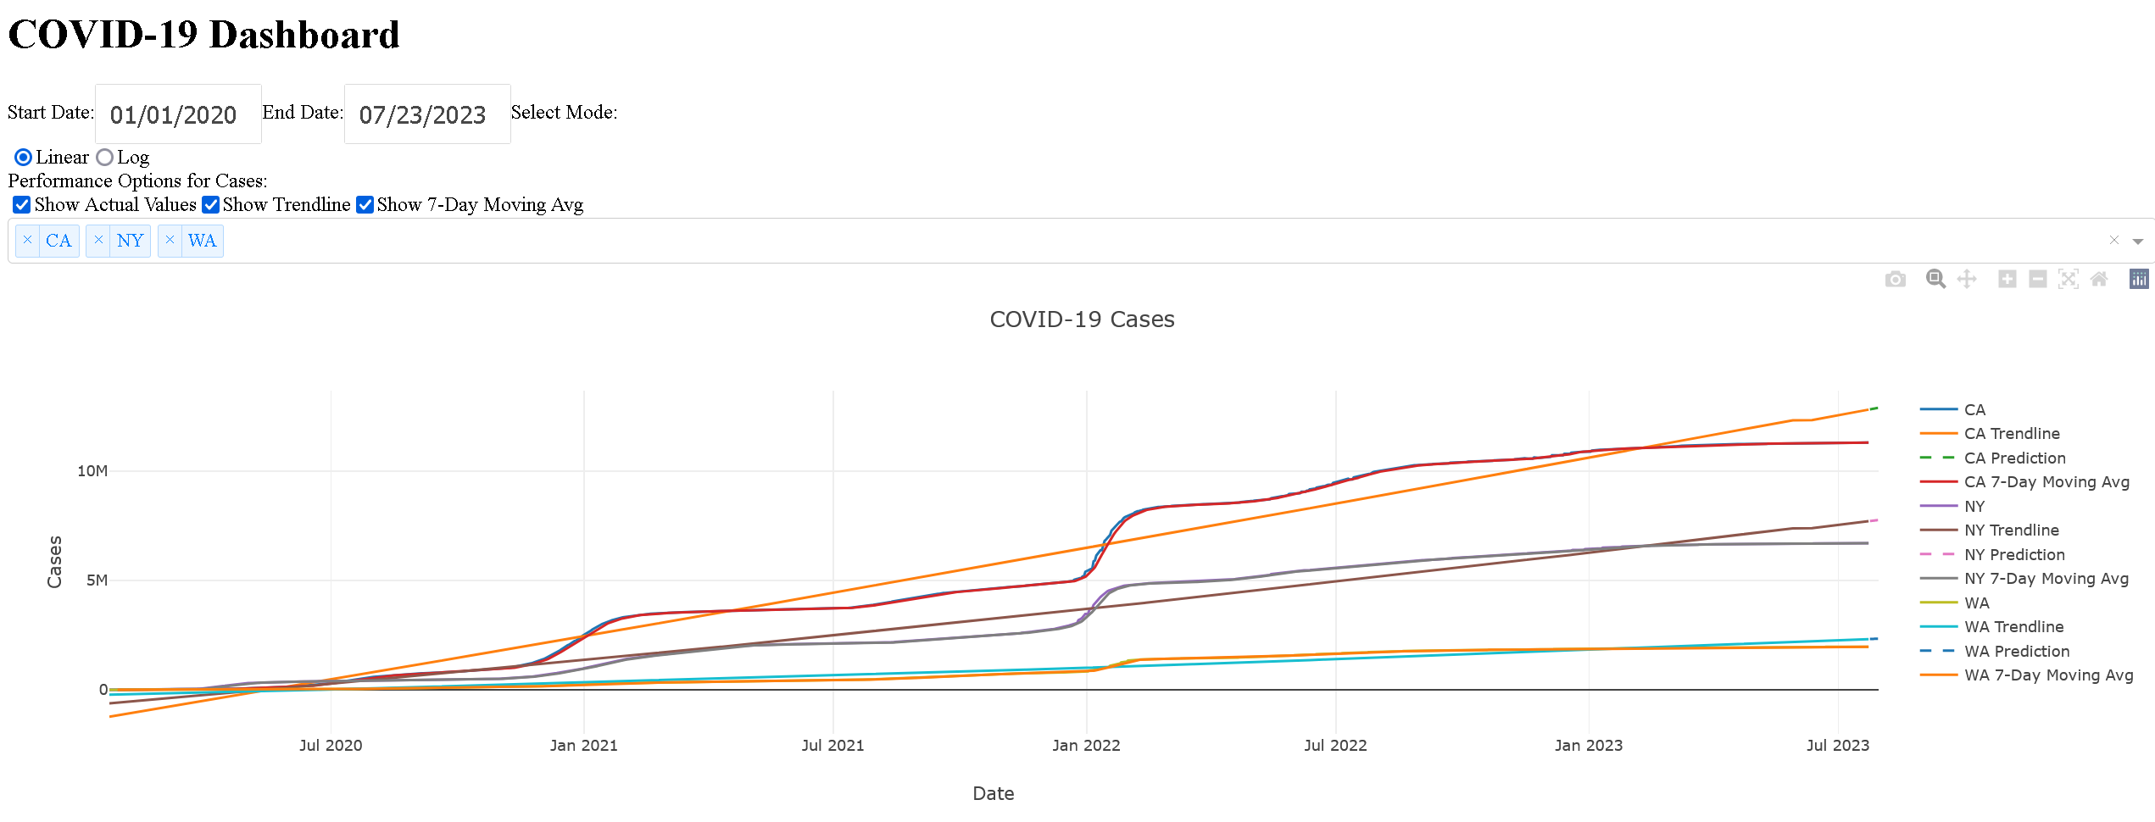

Slide 24
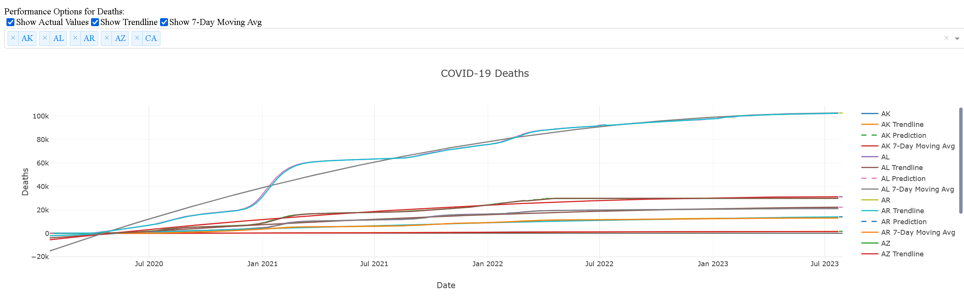

Slide 25
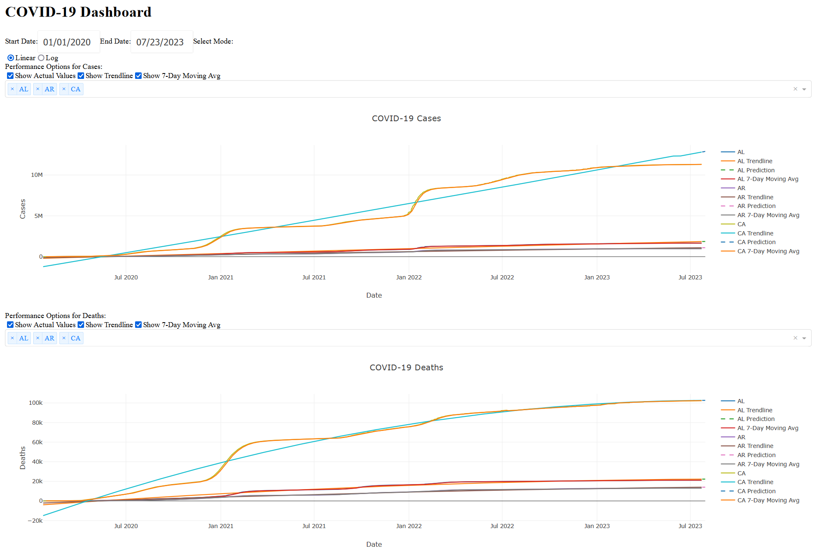

Slide 26
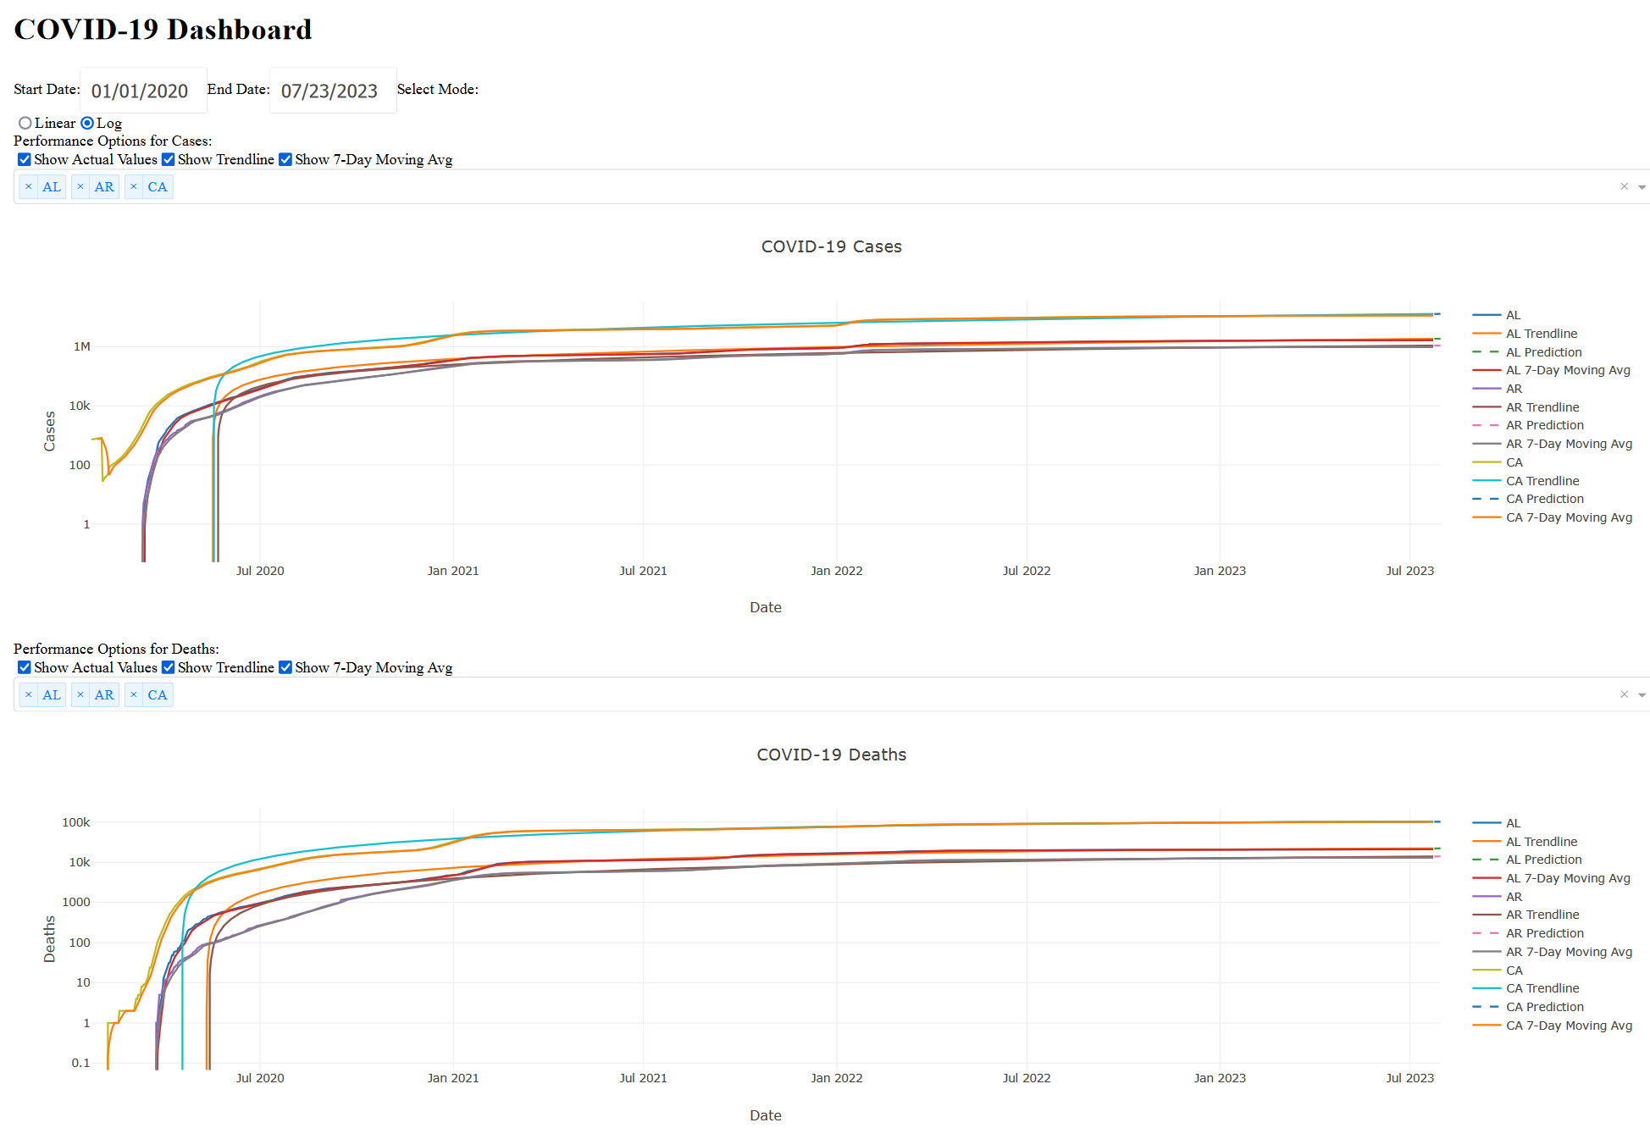

Slide 27
