Slide 1
Finding Tables
An end to end Deep Learning approach to table detection and extraction from invoices
Tanay Dixit & Neham Jain

Slide 2
Tasks
Table Recognition
Given an Invoice structure, identifying the key areas of informations , ie: tables is key task in the pipeline of Automating Invoice registration
(pic of example)
Information Extraction
Once areas of Interest are identified the next key step in the pipeline is to extract the text and transform it into a json/csv format so it can be processed easily

Slide 3
Pipeline/Approach
item,item,item,10,20,10
Item 10
Item 20
Item 10
Table Detection
Table Structure Recognition
OCR /Text Recognition
Invoice
Name
Date
address
json/csv file
item | 10
item | 20
item | 20
Item 10
Item 20
Item 10

Slide 4
Table Detection Approach
We use the open-source framework Detectron2 [Wu et al., 2019] to train models on the TableBank. Detectron2 is a high-quality and high-performance codebase for object detection research, which supports many state-of-the-art algorithms. In this task, we use the Faster R-CNN algorithm with the ResNeXt152 [Xie et al., 2016] as the backbone network architecture, where the parameters are pre-trained on the ImageNet dataset.
The TableBank dataset totally consists of 417,234 high quality labeled tables as well as their original documents in a variety of domains.
We further take a subset of 300 images from the invoice dataset and finetune the parameters as the table structure of general tables and invoices tables would be slightly different.
Our model is able to detect multiple table, borderless tables, bordered tables with amazing accuracy.

Slide 5
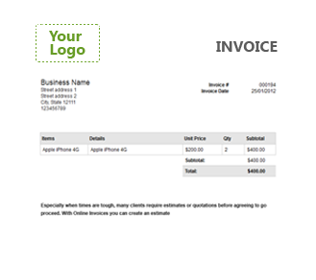
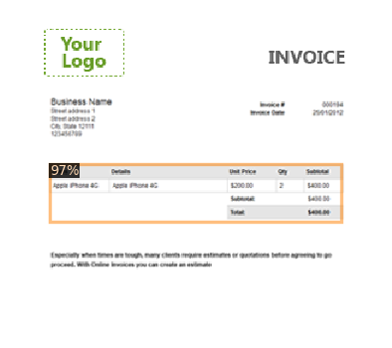
Table Detection (00017.PNG)
PERFECT RESULTS

Slide 6
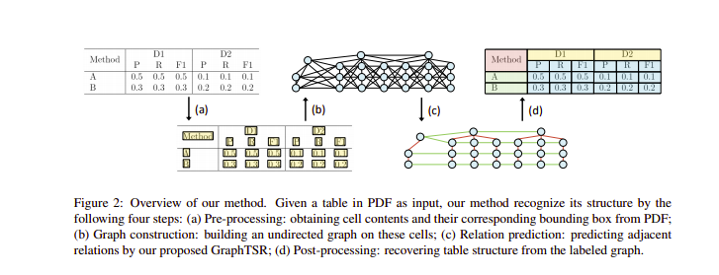
Information Extraction and Table Structure Recognition
Key to extracting text from a table is the ability to understand the Table Structure, many Invoices have borderless tables or complex table structures which can’t be directly alined with an excel or csv file.
The best approach to achieve this is using Graphical Convolution Networks to extract cell relations from the table*
Complicated Table Structure Recognition *note this approach required labelled data

Slide 7
Pipeline for unlabelled Data
OCR for text extraction
We used Google OCR - pytesseract for identifying the bounding boxes and text in the Image. These detected cells are used by LayoutLM** to map each cell as either Question /answer to a question.
This relation can be used to map the key-value pair in a json file
**LayoutLM
LayoutLM for Structure Detection
In-order to understand the flow or order of text detected its key to understand the table structure ie: cell relations
LayoutLM** is an model developed by Microsoft-AI team and based on the transformers model.It identifies the cell relationship as Question -Answers pairs and thus helps to map the outputs to json file

Slide 8
Putting it all together

Slide 9
Thanks

