Slide 1
Numpy
Lingua franca for data exchange

Slide 2

Numpy
Numerical Python
Developed in 2005 by Travis Oliphant
Lingua franca for data exchange
ndarray – a n-dimensional array
Fast operations on entire arrays
Reading/writing array data
Linear algebra operations
Travis Oliphant

Slide 3
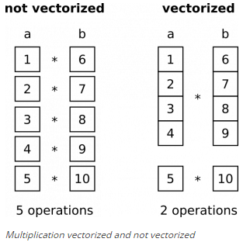
Vectorized operations

Slide 4
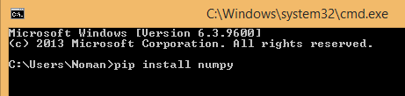
Installation
Prepackaged with Anaconda
Using pip
pip install numpy

Slide 5
nd-array
A fast, flexible container for large datasets in Python
Homogeneous data i.e. all of the elements must be the same type

Slide 6
Creating ndarray
np.array(): convert input data to an ndarray
np.zeros(): produces arrays of 0s
np.ones(): produces arrays of 1s
np.empty(): create new arrays by allocating new memory, but do not populate with any values
np.arange(): like the built-in range but returns an ndarray instead of a list

Slide 7
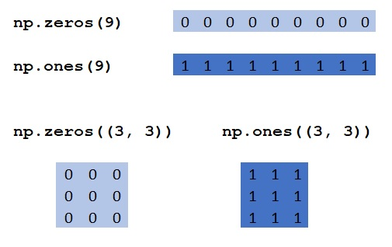
Examples

Slide 8
Attributes of numpy array
shape: a tuple indicating the size of each dimension
dtype: an object describing the data type of the array
ndim: the number of dimensions of the array

Slide 9
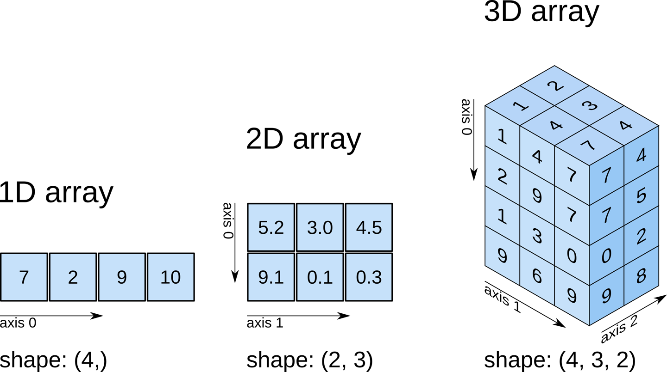
shape attribute

Slide 10
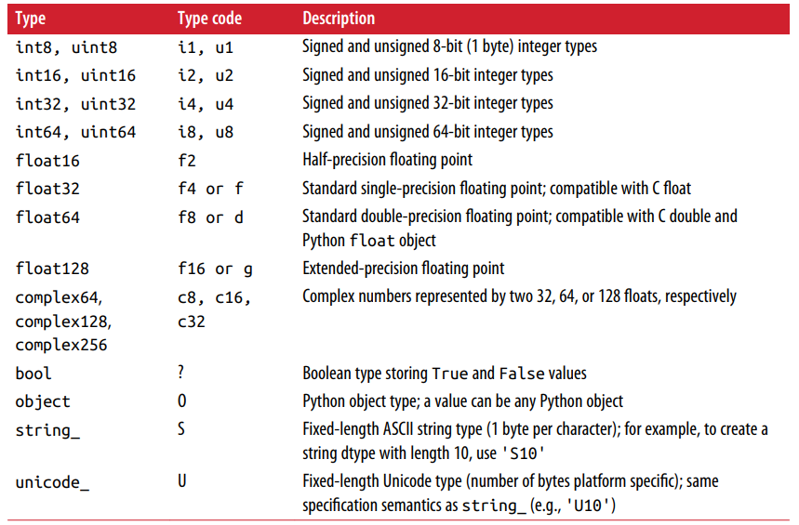
Numpy data types

Slide 11
Vectorization
Express batch operations on data without writing any for loops
Any arithmetic operations between equal-size arrays applies the operation element-wise
Arithmetic operations with scalars propagate the scalar argument to each element in the array
Comparisons between arrays of the same size yield boolean arrays
Operations between differently sized arrays is called broadcasting

Slide 12
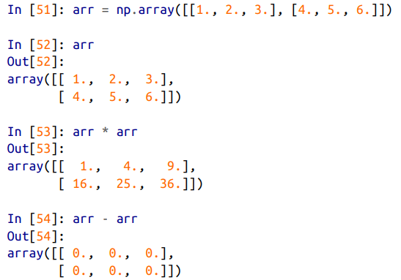
Operations on two matrices

Slide 13
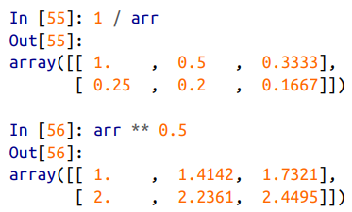
Operations between matrix and scalar

Slide 14
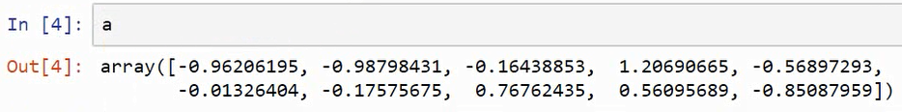
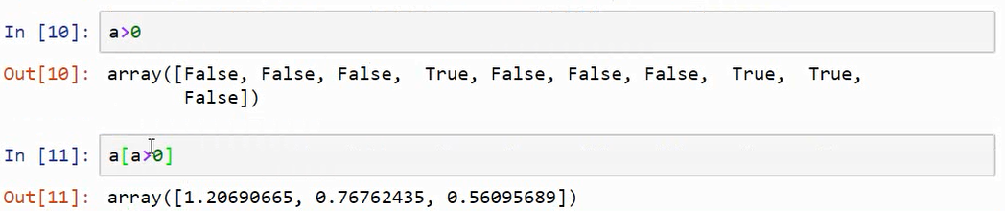
Comparison between matrices

Slide 15
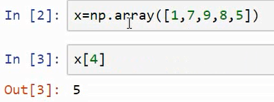
Array indexing

Slide 16
Fancy indexing

Slide 17
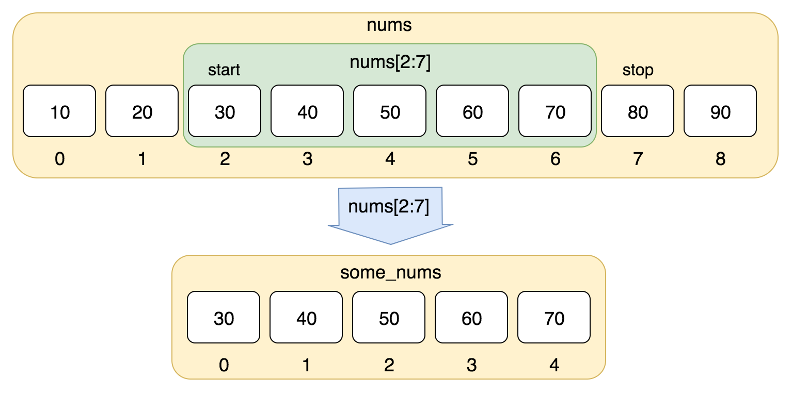
Slicing
Array slices are views on the original array
Format
start: end: step

Slide 18
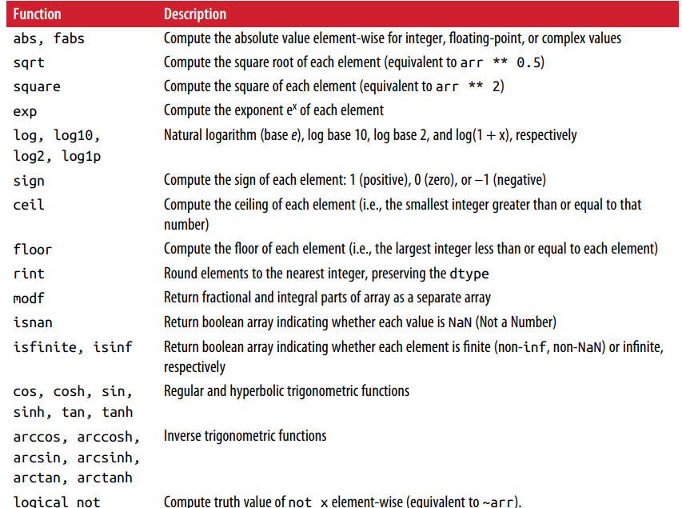
Element-wise array functions

Slide 19
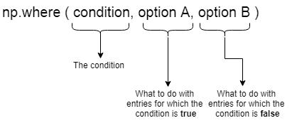
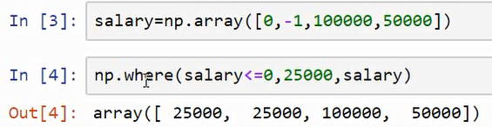
np.where()

Slide 20
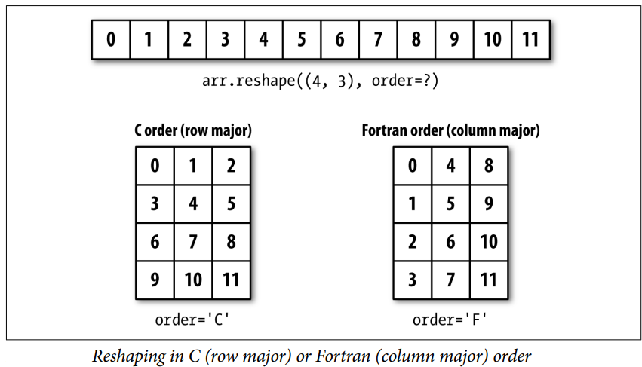
Reshape

Slide 21
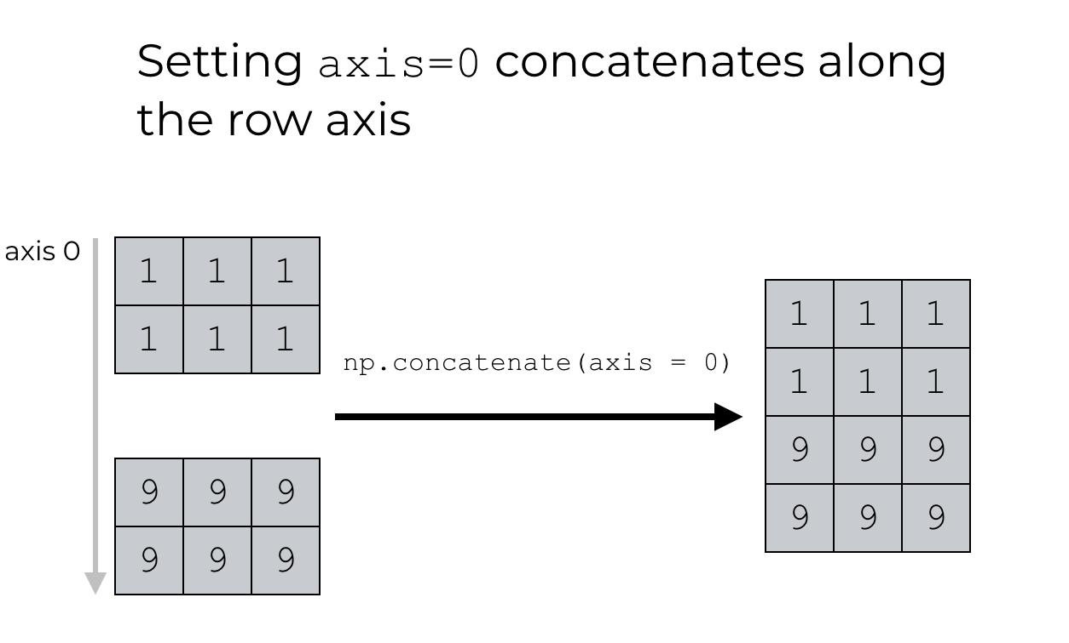
concatenate

Slide 22
Convenience functions
vstack: stack arrays row-wise (along axis 0)
hstack: stack arrays column-wise (along axis 1)

Slide 23
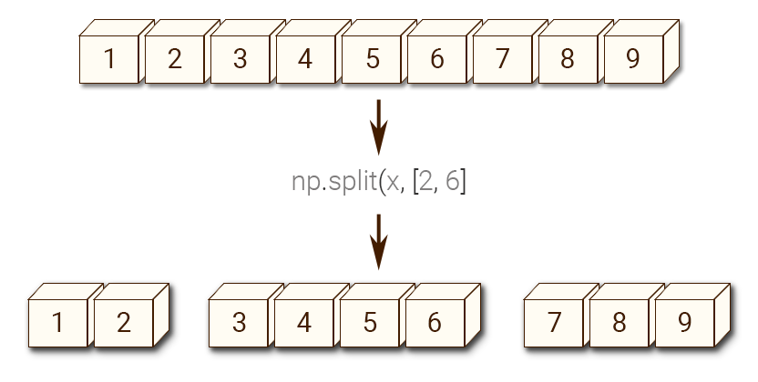
Splitting an array

