Slide 1
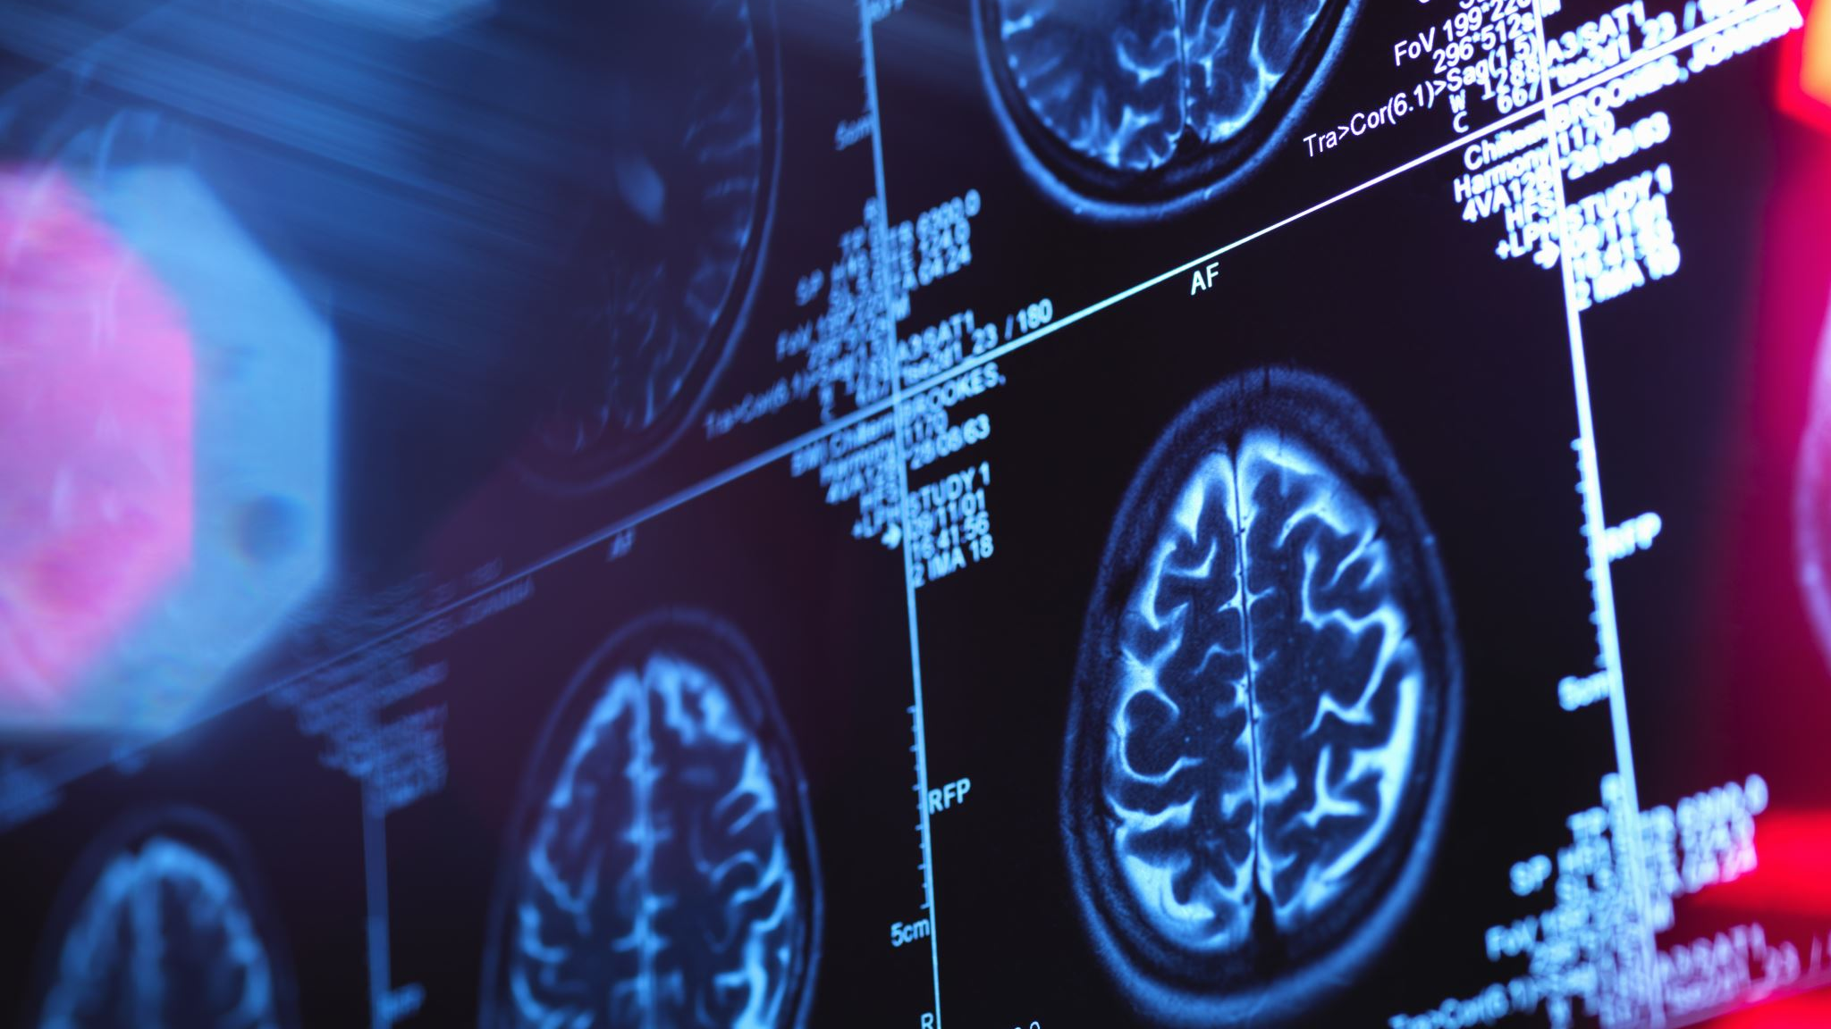
CNN for Alzheimer’s detection
Giulio Fabbri
Valentina Coppi

Slide 2
Agenda
Our data
CNN with two classes: 2.1. Data splitting 2.2. ResNet 2.3. VGG16 2.4. InceptionV3 2.5. MobileNet 2.6. EfficientNet
CNN with data augmentation 3.1. Data splitting 3.2. ResNet 3.3. VGG16 3.4. InceptionV3 3.5. MobileNet 3.6. EfficientNet
CAM interpretation

Slide 3
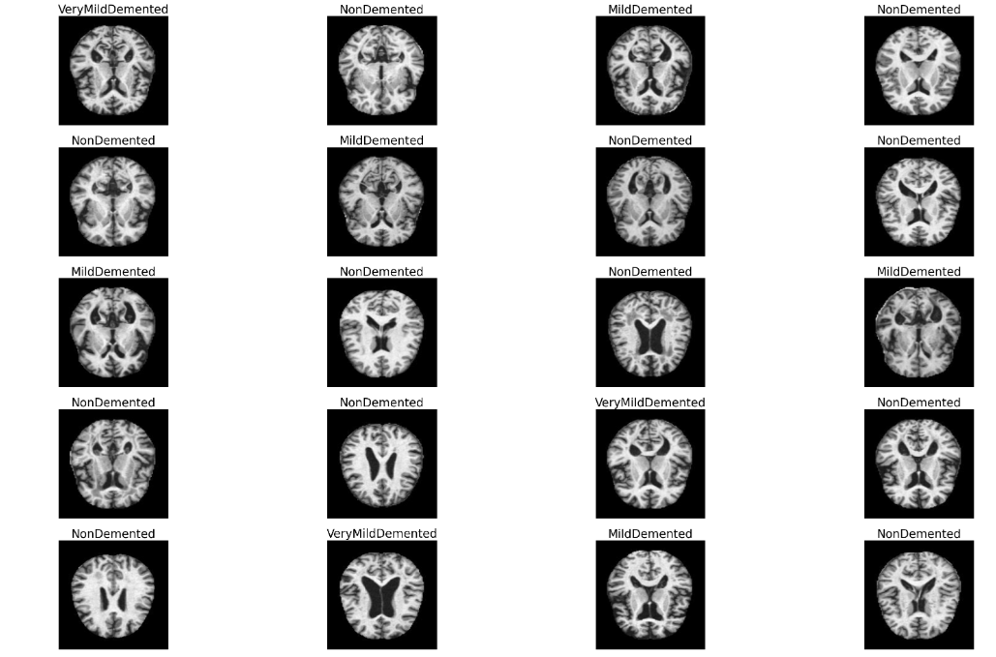
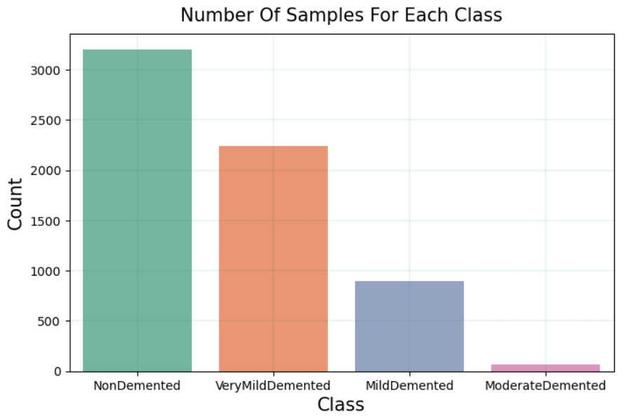
Our Data
Our data are composed of 6400 images of brains, and 4 category labels:
NonDemented;
VeryMildDemented;
MildDemented;
ModerateDemented.

Slide 4
Disclaimer
We are using only pre-trained algorithms, otherwise it would be too computational expansive.
We do not expect really good results, since we had to largely decrease the quality of images in order to be able to process them.
Furthermore, we couldn’t make a big number of epochs for the same reason.

Slide 5
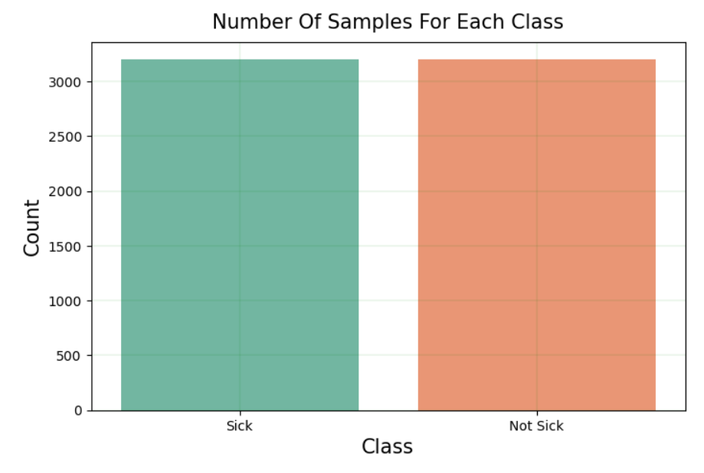
CNN with two classes
In order to balance the dataset we change the classes, splitting our data in only two categories:
Sick ( 0 )
Not sick ( 1 )
At this point we split the data in training and validation dataset with 80% data for training and 20% for validation.

Slide 6
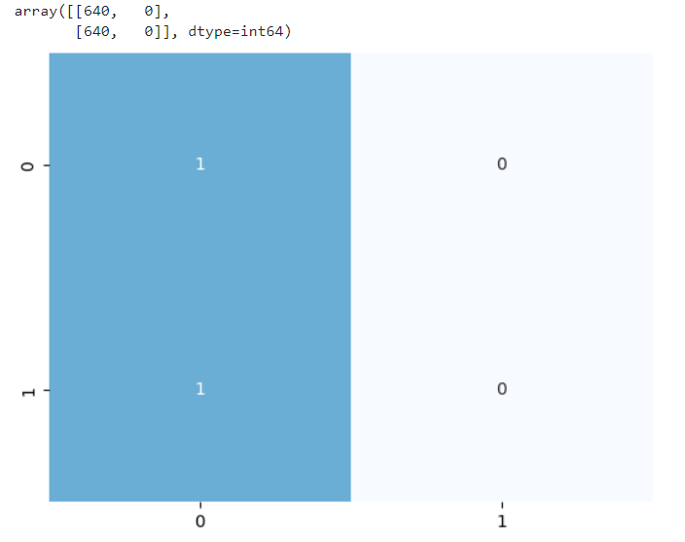
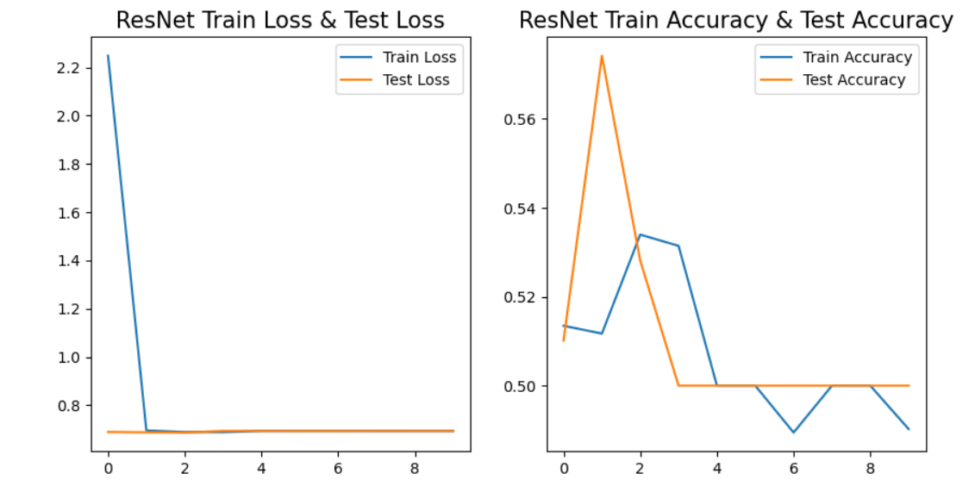
ResNet: Residual skipping blocks
Notes:
ResNet
Residual learning, some signal propagates skipping layers
Try to learn not the best feature map but the best change for improving it
Improves AlexNet reducing vanishing gradient problem
Break cause predicts always sick

Slide 7
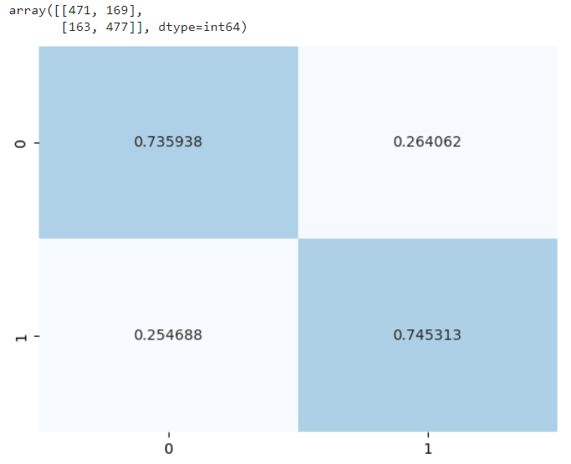
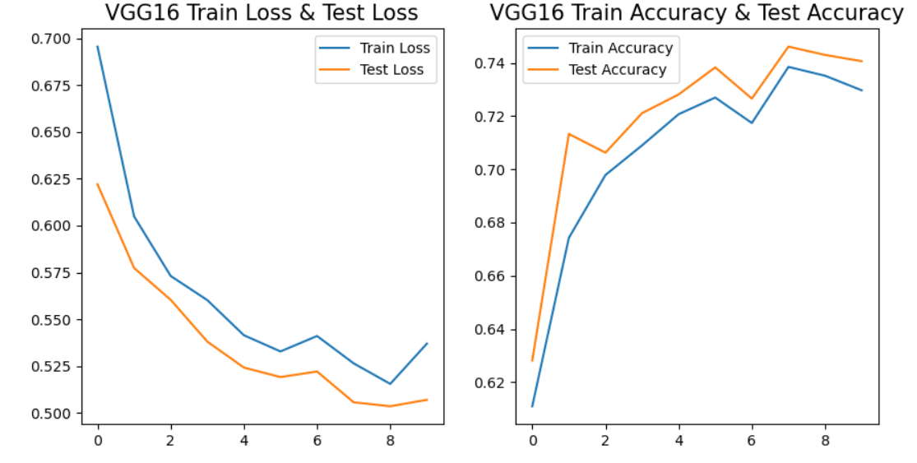
VGG16: Simple deep covolution
Notes:
Visual Geometry Group 16 layers
More correct trend
74% accuracy

Slide 8
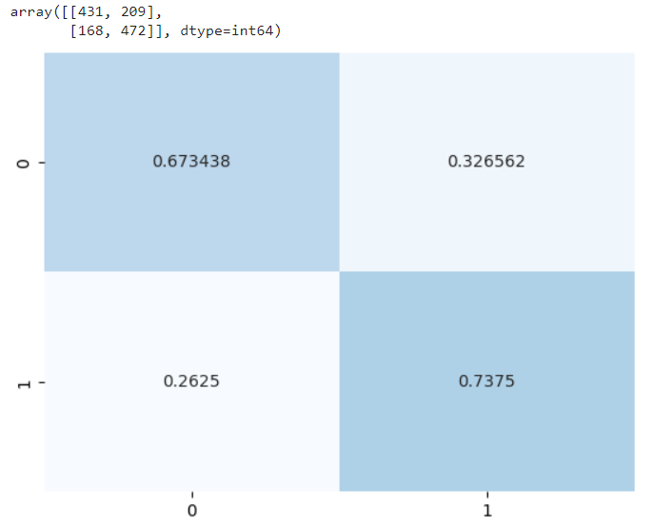
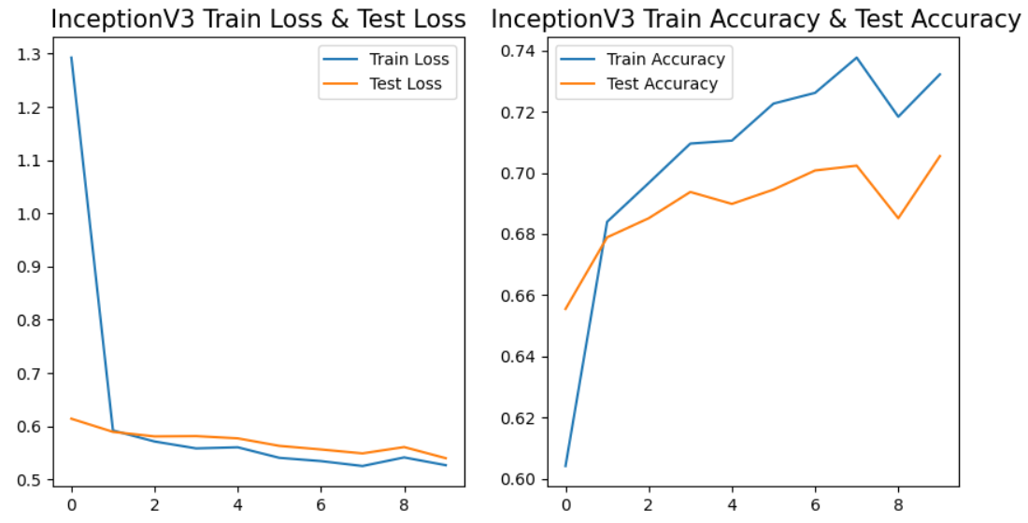
InceptionV3: different mini-filters
Notes:
Inception V3
Inception Modules: blocks that apply convolutions with different filters
More efficent e robust (different small filters rather than one large )

Slide 9
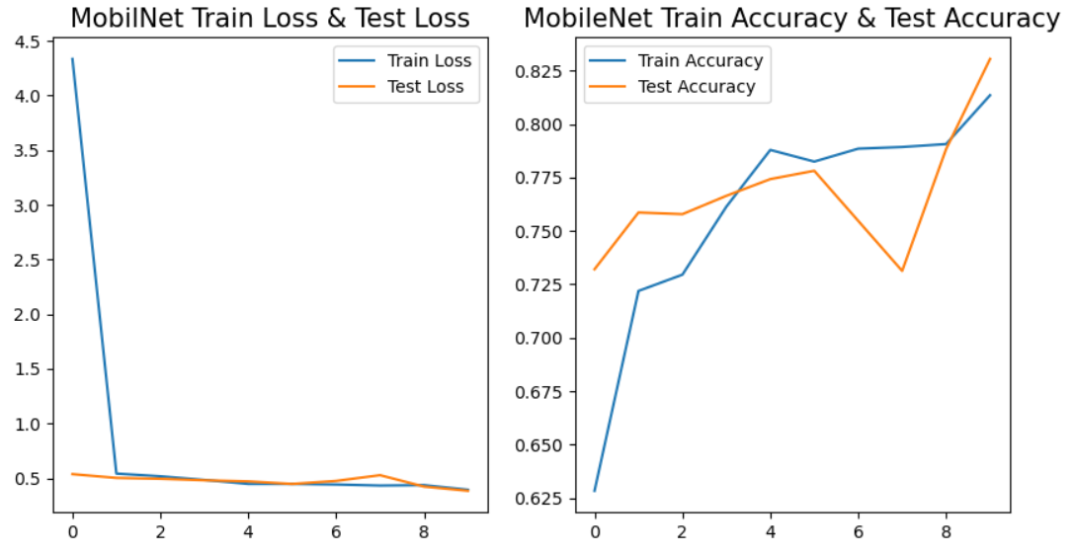
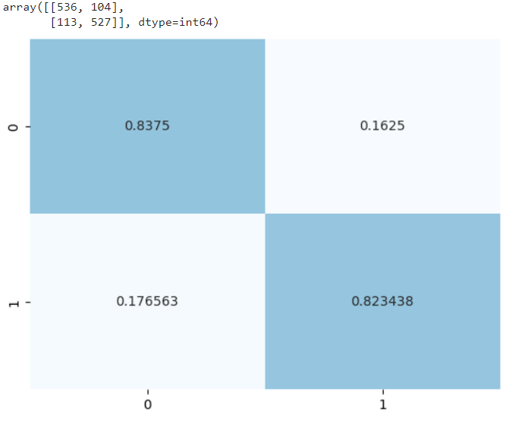
MobileNet: filter for each colour
Notes:
MobileNet
Depthwise convolution: one different for each color channel
Pointwise convolution: convolution that merge precedent results into one applying a 1x1 convolution

Slide 10
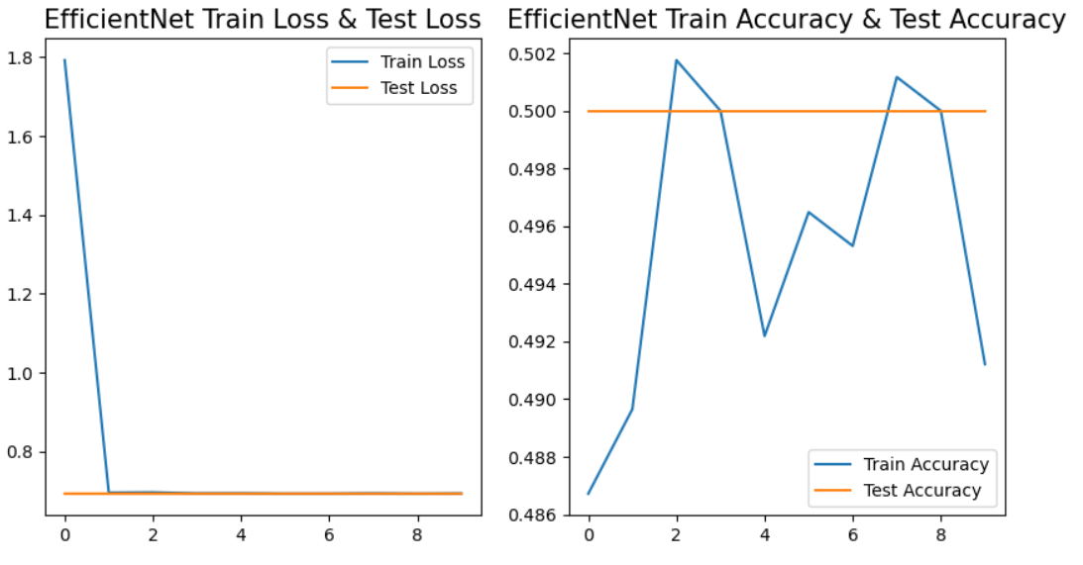
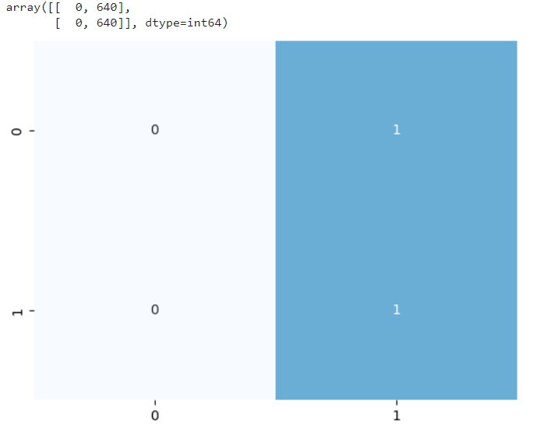
EfficientNet: Width, Depth & Resolution Scaling
Notes:
EfficentNet:
Compounding scale that uniformly scales
Width
Depth
Resolution
Completely wroong, classify all not sick, the opposite of the first model

Slide 11
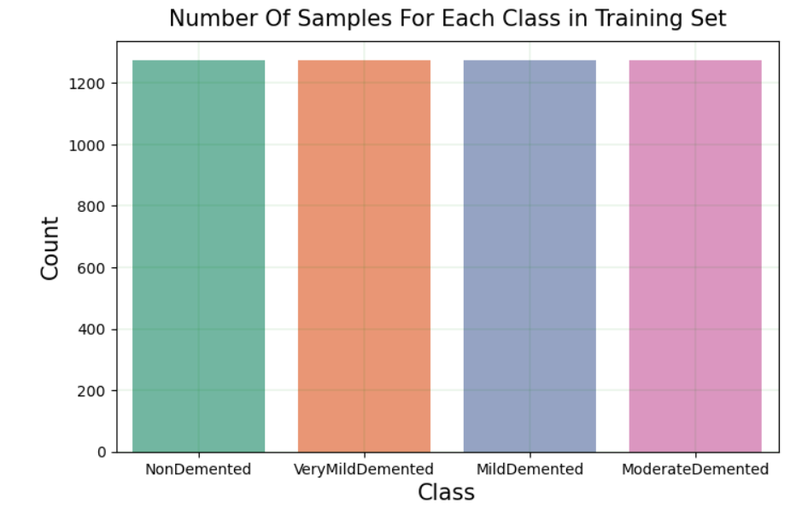
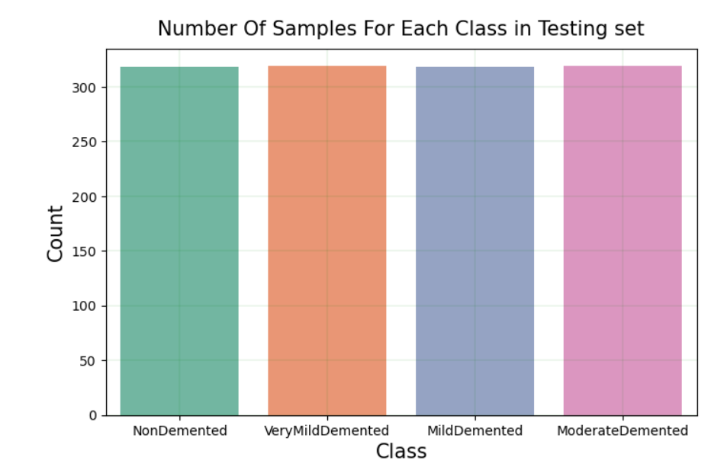
CNN with data augmentation
In order to balance the dataset we use the SMOTE function that duplicates the data in the categories that have few observations. Unfortunately, we need to reduce the data we obtained, or the computational cost is too high for us.
At this point we split the data in training and validation dataset with 80% data for training and 20% for validation.

Slide 12
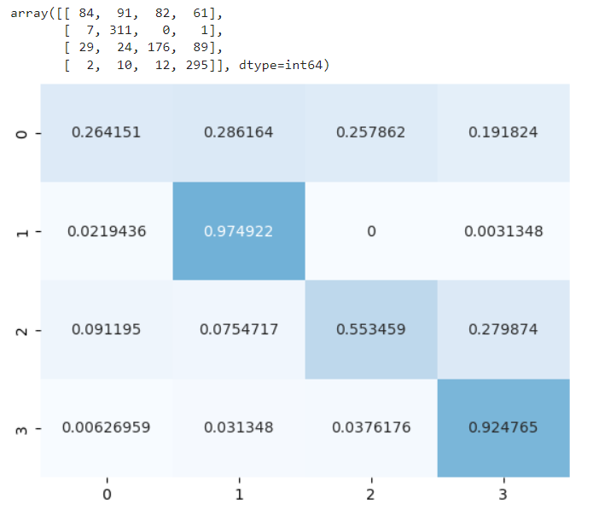
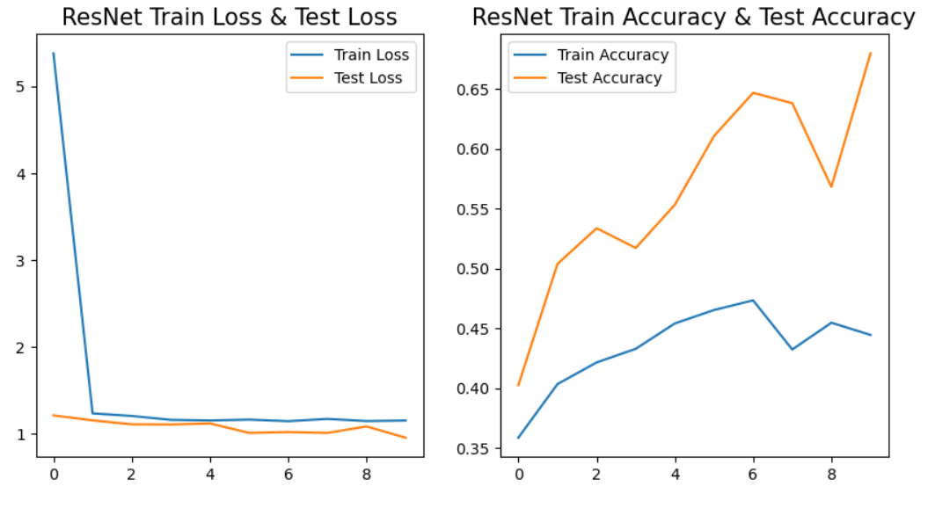
ResNet

Slide 13
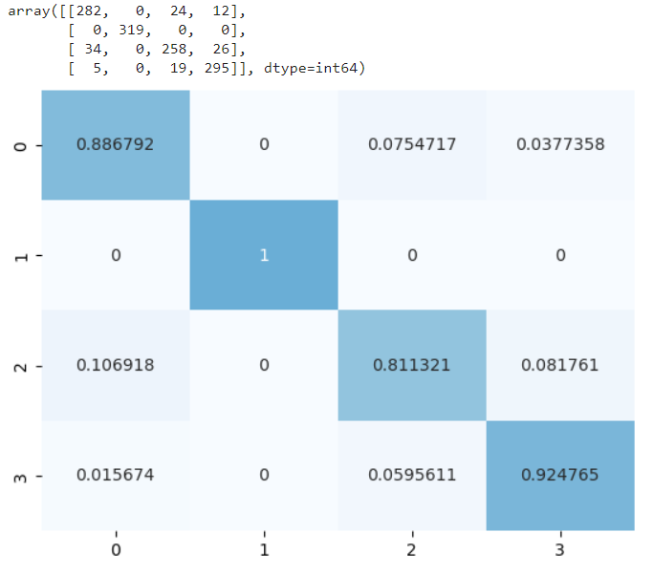
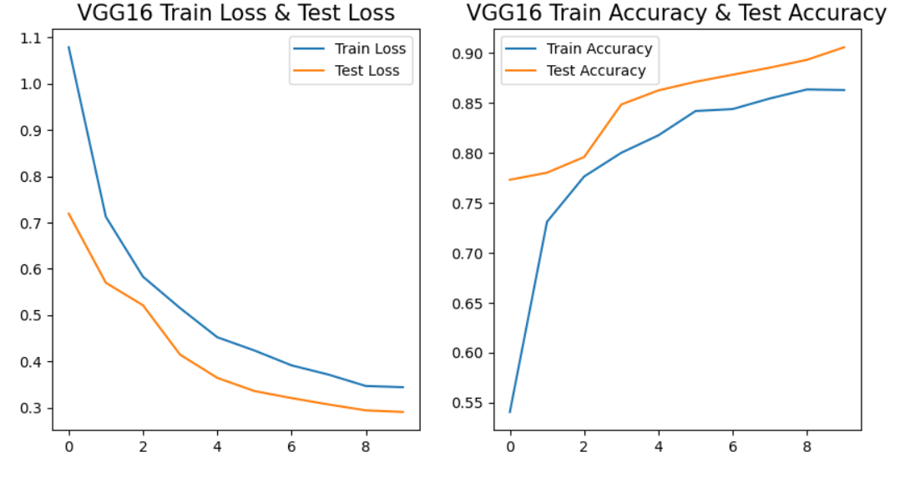
VGG16

Slide 14
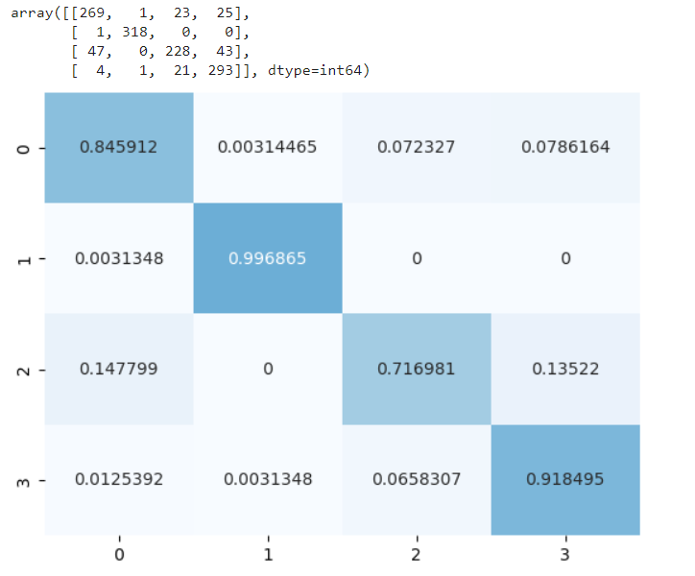
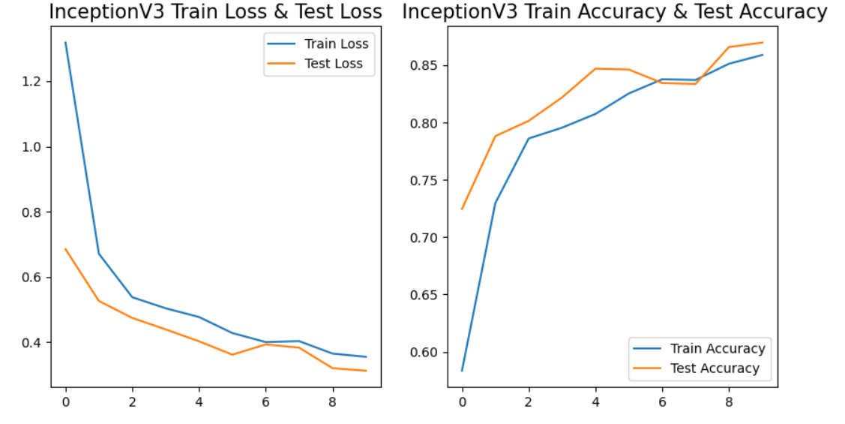
InceptionV3

Slide 15
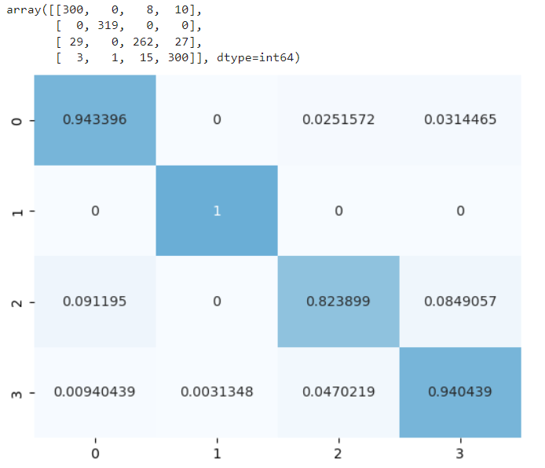
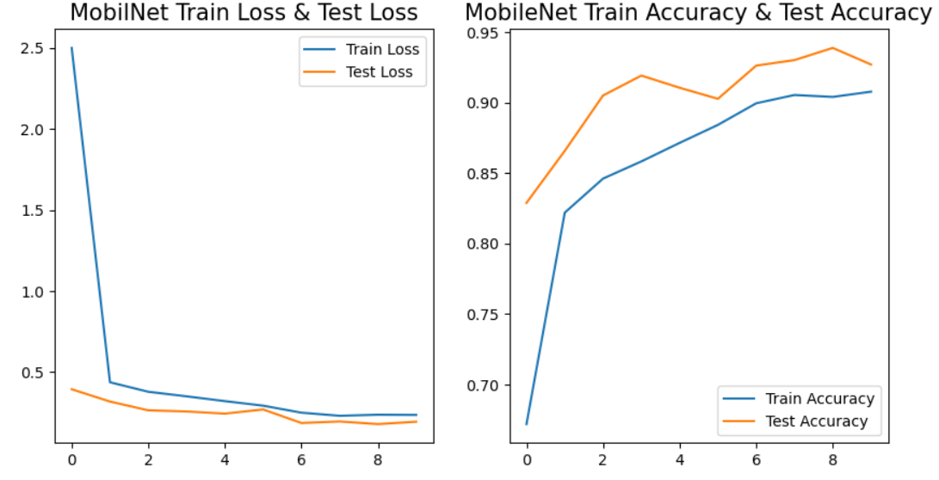
MobileNet

Slide 16
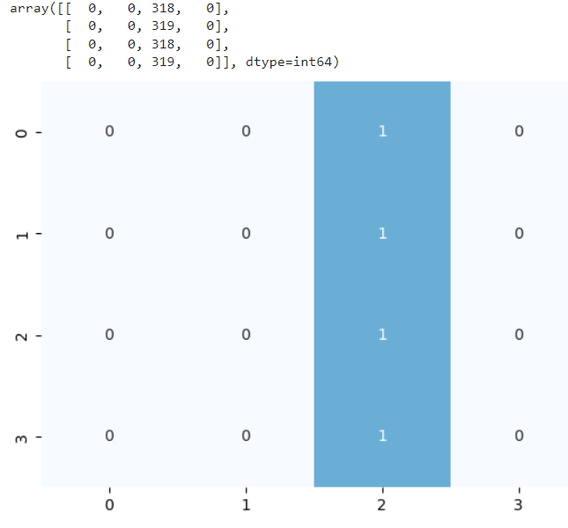
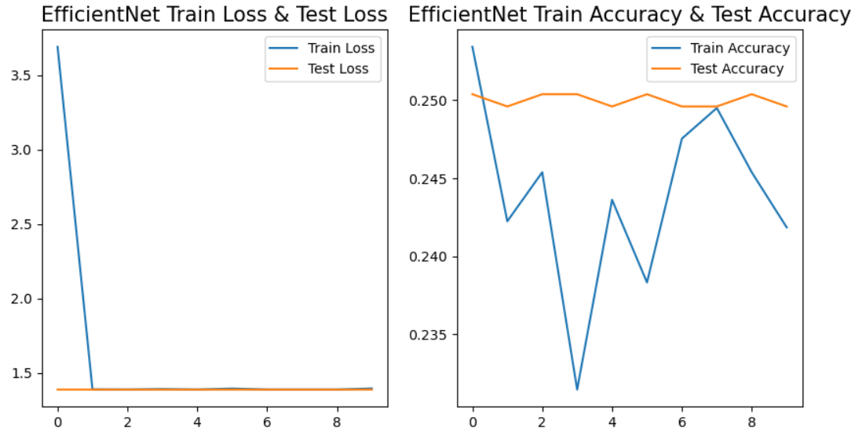
EfficientNet

Slide 17
Results
We noticed that the models that perform badly in the first part are the same that perform badly in the second.
The only difference is that the ones that perform nicely in the first part perform really well in the second.
So, the model that we prefer is the MobileNet with the technique of Data augmentation.

Slide 18
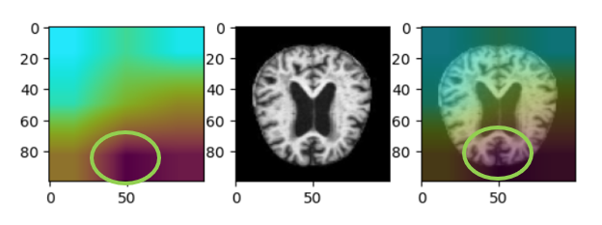
CAM interpretation
CAM (class activation map) is a method of explaining which part of the image is most used by the machine to make the prediction.
The main problem with this method is that it relies on the output of the last global average pooling layer, which we do not always have in our models.
For this we have to use the generalization of CAM, based on the gradient.

Slide 19
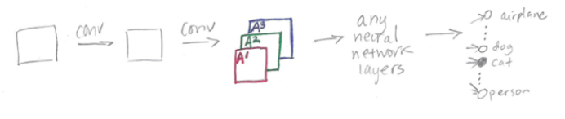
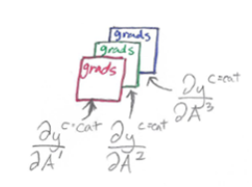
CAM interpretation
Step1:
Compute the gradient of the loss function for the final convolution layer with respect to each feature map (in our case 3, one for each coulour), considering a specific class C.
This will tell us how how final predictions changes with respect to changes in the last feature maps.

Slide 20
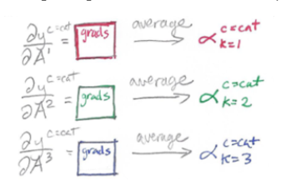

CAM interpretation
Step2:
Average the gradients for each feature map in order to express each of the tree feature map RGB as a single number instead of an array (these are called "alpha coefficients").
Step3:
CAM for the class is the weighted sum of feature map by its alpha coefficient

Slide 21
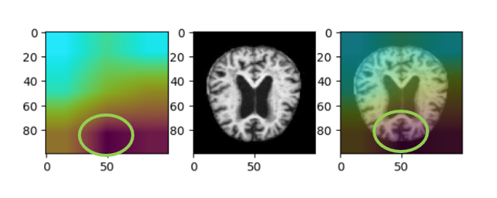
CAM interpretation
Step4:
Reshape the GradCAM to overlay it on the image
(The gradcam is smaller therefore much grainier)

