Slide 1

PROPOSAL · 2026
Apna Digital Zone
A cinematic new website + a booking & advertisement app
Same brand. Same photos. Same story. A completely new experience —
designed to win more weddings, more bookings, and more trust online.
Prepared for: Apna Digital Zone, Arrah, Bihar · Prepared by: Ashok Kumar

Slide 2
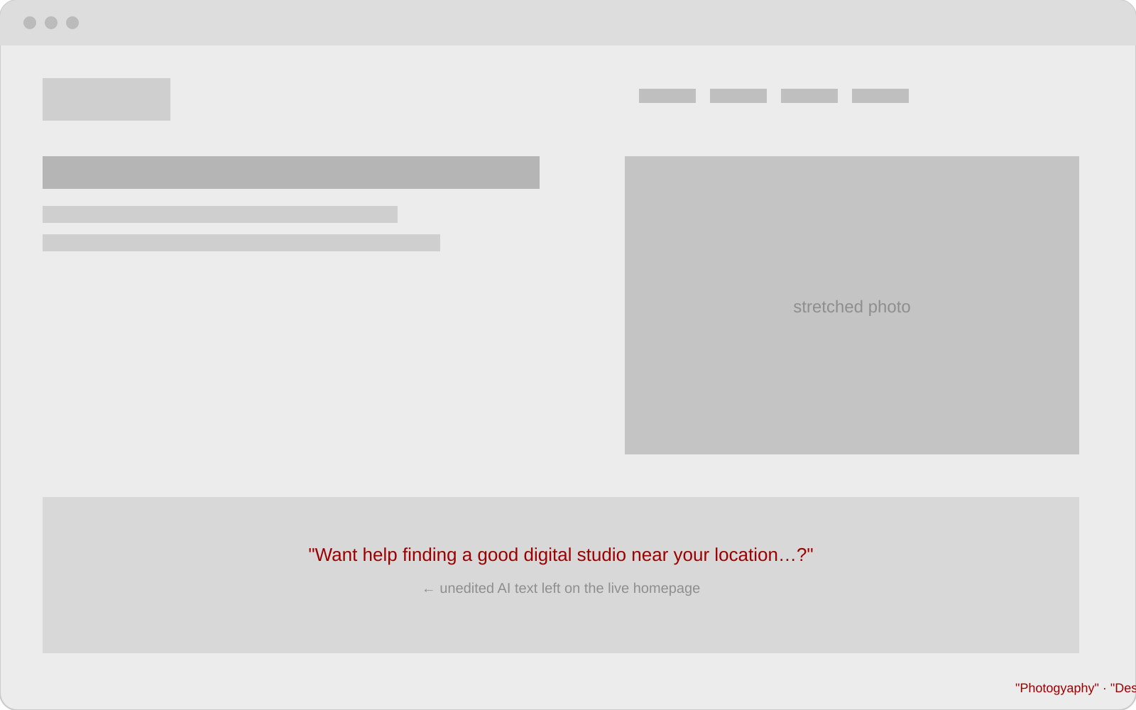
WHERE WE ARE TODAY
The current website is costing you customers
!
Unedited AI text is live on the homepage
The About section literally ends with "Want help finding a good digital studio…?" — a chatbot answer pasted onto the site.
!
Typos on every page
"Photogyaphy", "Desgined by", "cenimatic", "anniversery" — small errors that quietly destroy trust for a premium studio.
!
Gallery shows admin controls to visitors
"Admin Login / Upload 0%" buttons are visible to every customer. Broken Terms link on the same page.
Sketch of the current homepage — flat template, stretched photos, broken copy
!
No pricing, no reviews, no reasons to book
Visitors see no packages, no testimonials, no Google rating — so they call a competitor instead.

Slide 3
FULL AUDIT
Twelve fixes, three categories
CONTENT
DESIGN
TECHNICAL / SEO
Rewrite all copy — remove AI leftovers & typos
Add packages & transparent pricing
Add client testimonials + Google reviews
Add FAQ and a real studio story
Cinematic full-screen hero with your best shots
Filterable masonry gallery with lightbox
Dark + gold premium look, modern typography
Floating WhatsApp & call buttons on every page
Local SEO: "wedding photographer in Arrah, Bihar"
LocalBusiness schema + Google Maps + meta tags
One smart booking form replaces 12 pages
Compressed images = 3x faster loading

Slide 4
REFERENCE: INDIA’S TOP STUDIOS
What the best studios in India do differently
Shutterink · Delhi
The pattern
Rated among the top 20 wedding photographers for Indian weddings worldwide. Full-width hero films, minimal navigation.
Photos first, words second
One clear "Book Now" action everywhere
Social proof: reviews, ratings, film views
City-level SEO that wins Google searches
WhatsApp as the main enquiry channel
Going Bananas · Delhi
A decade-old studio. Photos dominate the homepage; text is minimal and emotional, not descriptive.
Focuz Studios · Chennai
Real-moment storytelling, uniform grid galleries, strong local SEO for their city.
WedMeGood / ShaadiSaga
Marketplaces where clients compare studios by portfolio, price and reviews — the standard your site is judged against.

Slide 5
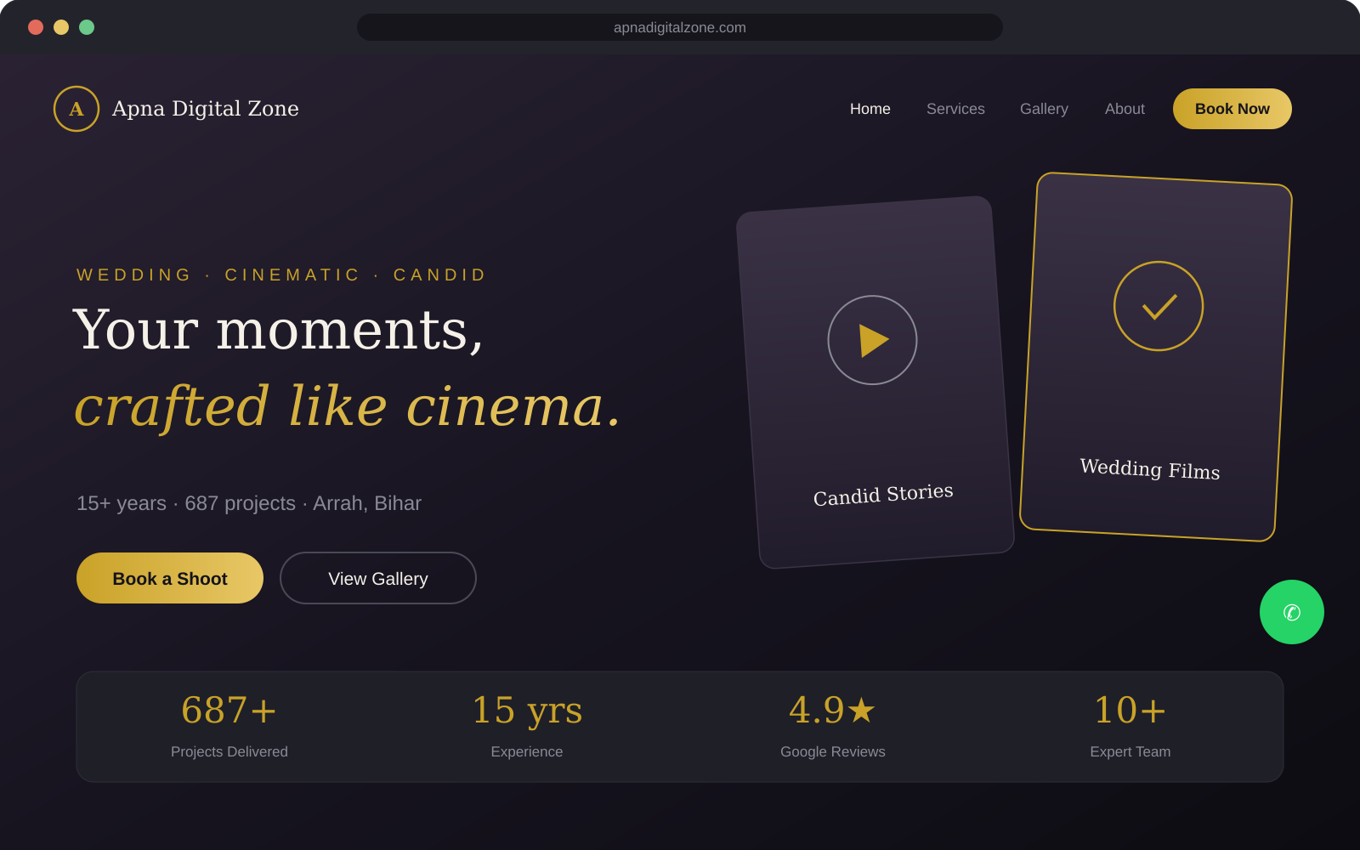
THE PROPOSAL — PART 1
Your website, reborn: dark, gold, cinematic
Concept mockup — built with your existing logo, photos, team and contact details

Slide 6
THE PROPOSAL — PART 1
Everything the new website includes
1
Cinematic hero
2
Smart gallery
3
Packages & pricing
Full-screen slideshow or wedding film teaser as the first thing visitors see.
Masonry grid, category filters, lightbox — your YouTube films styled beautifully inside it.
Clear cards for Wedding, Pre-wedding, Birthday, Drone — with "starting from" prices.
4
One booking flow
5
Trust section
6
Local SEO engine
A single multi-step form with date picker and WhatsApp confirmation replaces 12 pages.
Google reviews, testimonials, 687 projects, 15 years — shown with proof, not claims.
Meta tags, schema, Maps embed, fast loading — built to rank for "photographer in Arrah".

Slide 7
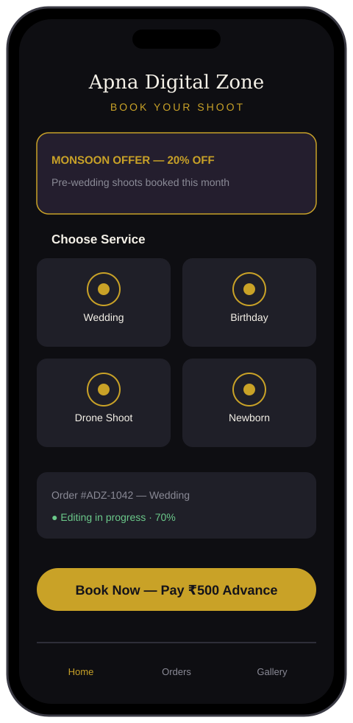
THE PROPOSAL — PART 2
The Apna Digital Zone app — for your customers
✓
Book in 60 seconds
Pick a service, pick dates, pay a small advance by UPI — booking confirmed instantly on WhatsApp.
✓
Live order tracking
Customers watch their order move: Booked → Shoot done → Editing → Album ready → Delivered.
✓
Offers & advertisements
Your banners and festival offers appear right on the home screen — with push notifications.
✓
Gallery & albums
Clients open their Flipix albums and your showcase films inside the app.
Delivered as an installable web app (PWA) — works on any Android phone, no Play Store fees.

Slide 8
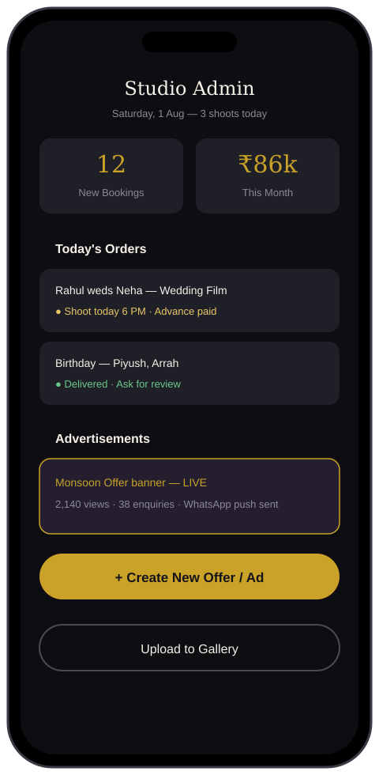
THE PROPOSAL — PART 2
The studio dashboard — for you
✓
All bookings in one place
New enquiries, today’s shoots, advances received — no more juggling calls and notebooks.
✓
One-tap status updates
Mark "editing done" and the customer is notified automatically. Fewer "kab milega?" calls.
✓
Advertisement manager
Create an offer, publish it to the app + website in one tap, see views and enquiries it brings.
✓
Business numbers
Monthly revenue, most-booked services, repeat customers — decisions backed by data.

Slide 9
HOW WE GET THERE
A simple three-phase plan
PHASE 1 · WEEK 1–2
PHASE 2 · WEEK 3–4
PHASE 3 · WEEK 5–6
New website live
Customer app
Studio dashboard
Redesigned site with your existing photos & logo, all copy rewritten, SEO done, one booking form, WhatsApp integration.
Installable booking app with UPI advance payment, order tracking and offer banners.
Admin panel for bookings, status updates, gallery uploads and the advertisement manager.
Every phase ships something you can show customers immediately — no waiting six weeks for results.

Slide 10
Why this pays for itself
More bookings
Higher-value clients
Found on Google
A booking form that works 24/7 with advance payment — customers commit on the spot instead of "calling later".
A premium website lets you confidently quote premium wedding packages.
Local SEO brings you every "photographer near me" search in Arrah & Bhojpur district.
Let’s build it.
Ashok Kumar · aiworkflows007@gmail.com
For: Apna Digital Zone · Mahadev Market, Arrah, Bihar · +91 93864 15795

